Slide 1
Development and Application of an
Automatic Potential Optimization Method
Lee-Ping Wang, Stanford Department of Chemistry
December 6, 2011
IBM Almaden Research Center

Slide 2
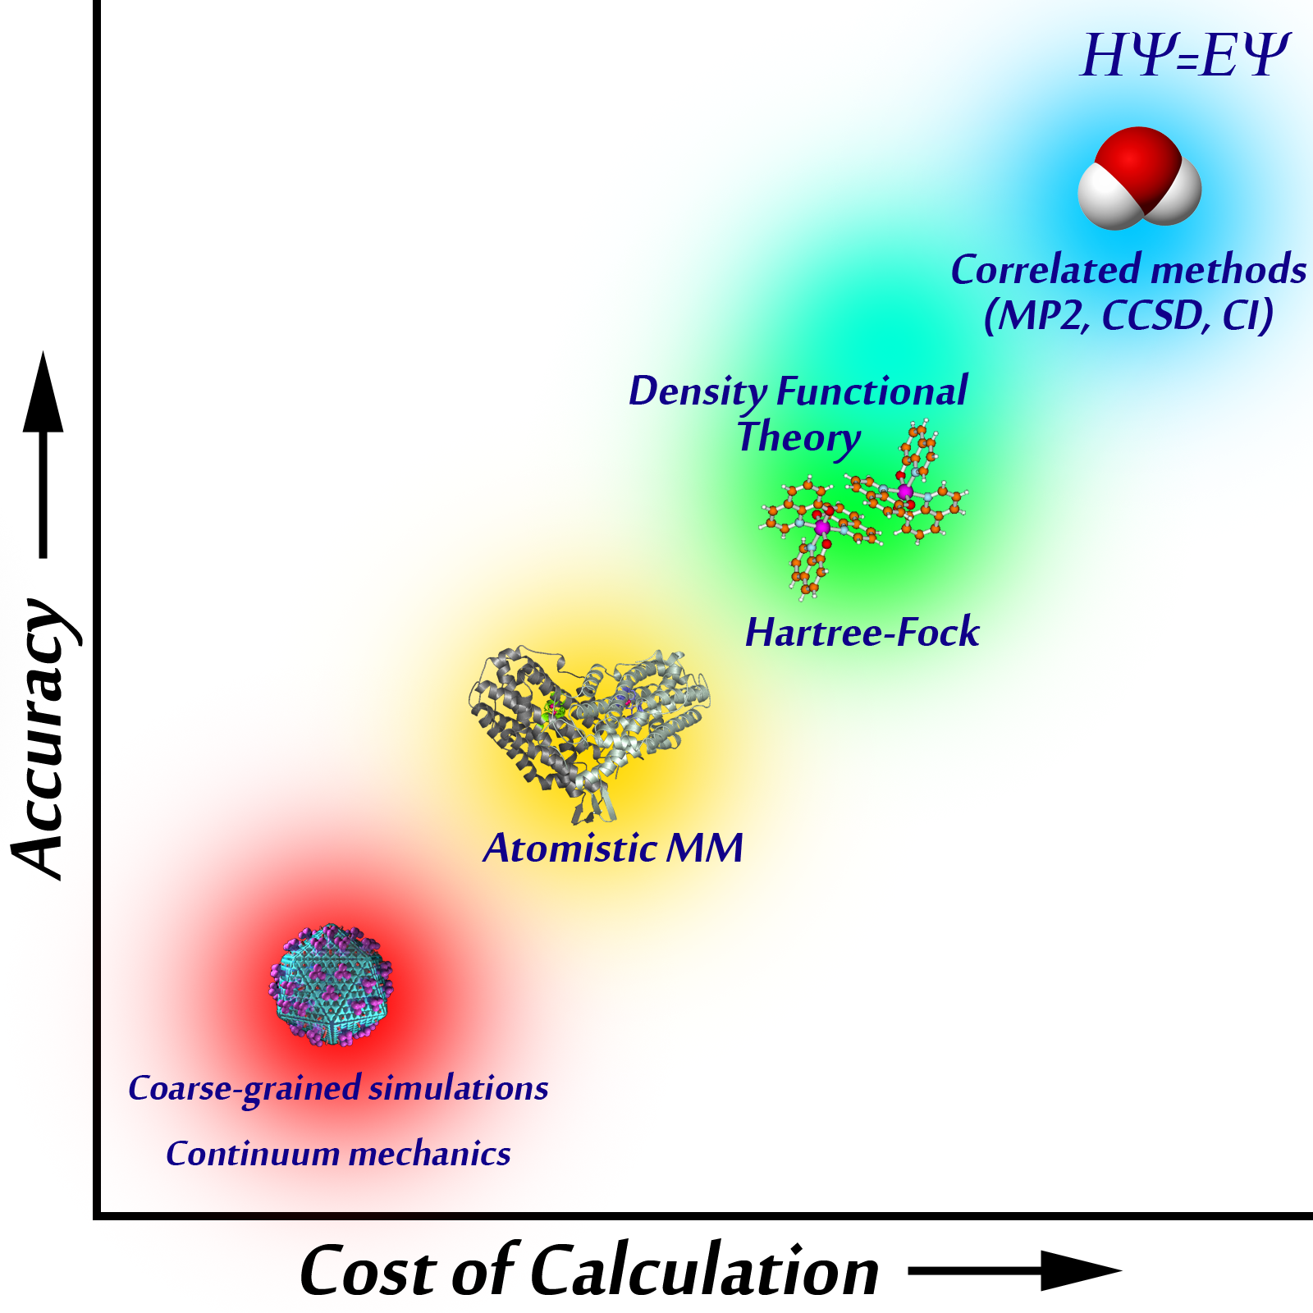
Introduction: Molecular Mechanics
Molecular Mechanics (MM) is a classical molecular simulation method
Within MM, the potential energy of atoms and molecules is described by an empirical function known as a force field

Slide 3
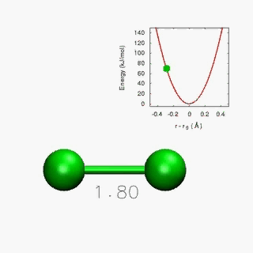
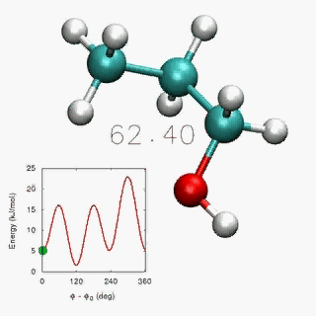
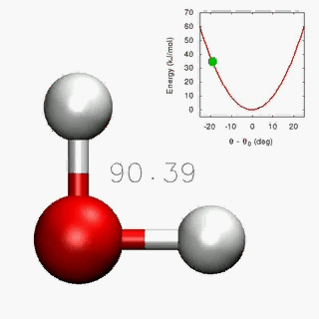
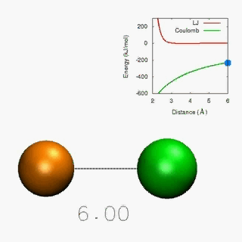
Introduction: Force Fields
Force fields are built from functional forms and empirical parameters
Interactions include bonded pairwise, 3-body, and 4-body interactions…
… as well as non-bonded pairwise interactions
Simulation accuracy depends critically on choice of parameters

Slide 4
Assumptions of Force Fields
Using a force field is equivalent to assuming accurate prior knowledge of the true potential energy surface.
Trends and Issues in force field development and usage:
Parameters fitted to reproduce experimentally measured bulk properties
  Poor microscopic interactions can still give correct bulk data
  No guarantee for reproducing properties outside of the fitting set
Large parameter libraries are used unmodified for wide classes of systems
  Inherent error in transferring parameters; approximates all functional groups across different systems as being identical
  New parameters added only when serious qualitative issues are found

Slide 5
Force Matching: The Concept
Accurate force fields can be obtained by carefully fitting to an accurate ab initio potential surface.
Overview of force matching method:
Match classical energies and forces to accurate reference calculations
Obtain geometries for fitting from sampling the configuration space
Optimize parameters by minimizing objective function χ²
We hope that:
  Accurate microscopic interactions should lead to correct bulk properties
  Gain the capability to automatically produce system-specific, nontransferable parameters
First introduced in 1994, but still not widespread, and not very automatic
Ercolessi F., and Adams JB. Europhys. Lett. 1994, 26, 583-588.
Izvekov S., and Voth GA. J. Chem. Phys. 2004, 120, 10896.

Slide 6
ForTune: Self-Consistent Parameterization
Initial
Parameters:
Start Here
Run MM dynamics for sampling
Extract
Snapshots
{r_{s}}
Converged?
Optimized
Parameters
QM Calculations on Snapshots
ts
Update Parameters k
Reference Data Q(r_{s})
Compute MM data M(r_{s})
New
Parameters
k_{n+1}
Compute χ² and Derivatives
Minimize χ²

Slide 7
ForTune: Minimize χ² by Newton-Raphson
The objective function χ² is made from MM quantities M minus reference values Q
Newton-Raphson minimization requires analytic derivatives in parameter space
First and second derivatives of MM energy and force added to custom GROMACS for many interaction types

Slide 8
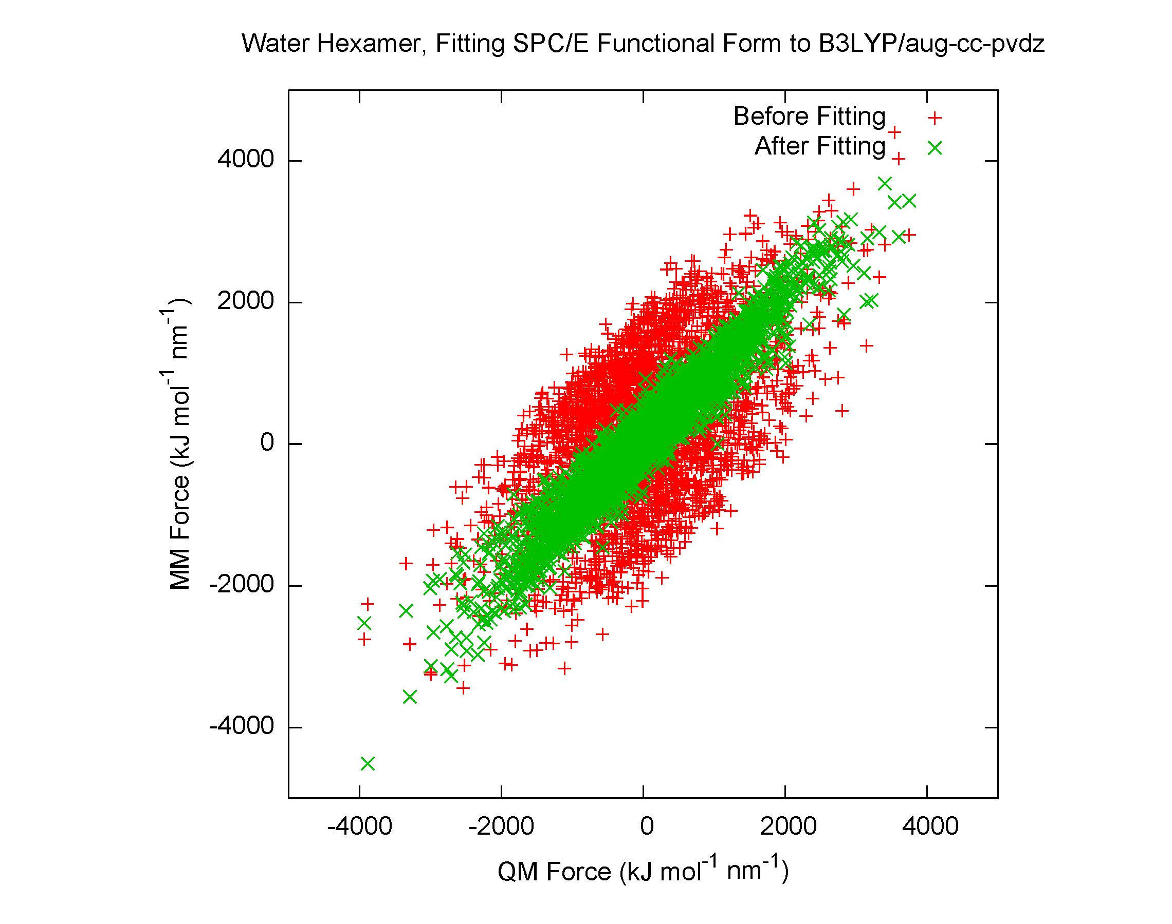
ForTune: Usage
[ defaults ]
1 2 yes 0.5 0.5
[ atomtypes ]
H 1.0080 0.0000 A 0.00000e+00 0.00000e+00
O 5.9950 0.0000 A 3.16557e-01 6.50194e-01 ; PARM 4 5
[ bondtypes ]
H O 1 0.100000 3.450000e+05 ; PARM 3 4
[ angletypes ]
H O H 1 109.470000 383.000000 ; PARM 4 5
[ moleculetype ]
SOL 3
[ atoms ]
1 O 1 SOL O1 1 -0.8476 15.9950 ; PARM 6
2 H 1 SOL H2 2 0.4238 1.0080 ; PARM 6
3 H 1 SOL H3 3 0.4238 1.0080 ; RPT 6 COULH2 /RPT
[ bonds ]
1 2 1
1 3 1
[ angles ]
2 1 3 1
Force field parameters are defined in the parameter file (.itp)
Tagging the .itp file triggers computation of derivatives
Python script modifies parameters, calls GROMACS for derivatives, and determines optimization steps using Newton-Raphson
Next-generation force field gives improved fit; used to rerun dynamics
--- WELCOME TO ForTune (Lee-Ping's Force Optimizer v9.1)! --- =D
Starting Point: Energy Error(kJ) = 44.35910 Force Error = 63.5% Objective Function = 7.7199e-01
Computing optimal FF parameters using trust-radius Newton Raphson algorithm
Step# Variance(X2) Step Size Direction Max. FErr EErr(kJ) FErr(%) Obj.Func
0 0.00e+00 1.14e-02 V.SH O1 73.77% 32.42 28.02 7.2644e-01
1 1.01e-01 2.71e-02 B.KHO H2 32.37% 11.53 26.60 5.2409e-01
2 1.07e-01 1.00e-01 B.KHO O1 23.16% 6.40 12.19 4.7994e-01
3 1.06e-01 2.00e-01 B.KHO O1 24.52% 8.54 15.08 4.5832e-01
4 1.02e-01 2.86e-01 B.KHO O1 27.43% 8.80 21.23 4.5389e-01
5 9.90e-02 7.09e-02 B.KHO O1 28.66% 8.50 18.15 4.3843e-01

Slide 9
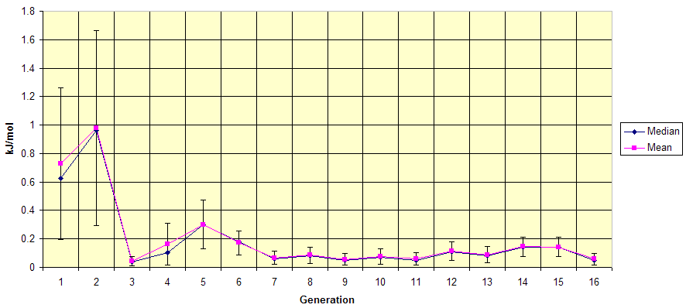
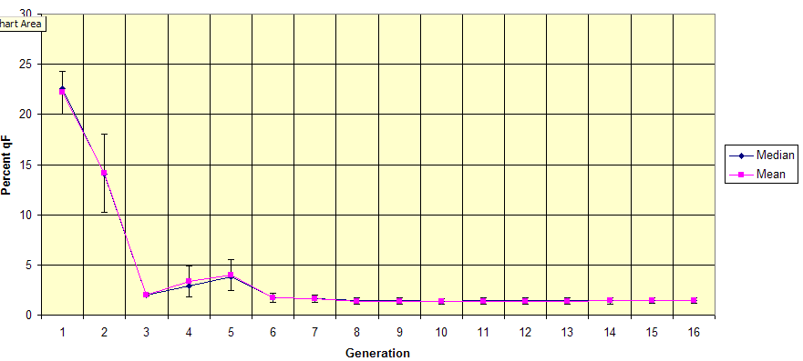
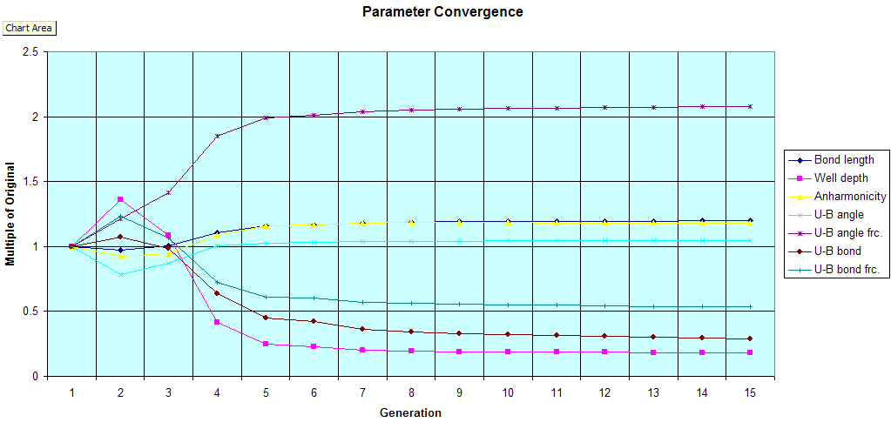
ForTune: Example
Energy Error
Force Error
Parameter Convergence
Sixteen cycles of force matching on methane monomer
Seven parameters in FF:
Morse bonds, Urey-Bradley angles
Very low energy and force errors
(ΔE < 0.1 kJ mol⁻¹, ΔF < 2%)
Parameters converged

Slide 10
Force Matching: Challenges
Problem: Incorrect functional form
Symptom: poor quality of fit
Problem: Too many parameters (overfitting), or too few (“borrowing” some interactions to fit others)
Symptom: unreasonable choice of functional form
Problem: Inaccurate reference data
Symptom: disagreement with experimental results
Problem: Poor sampling of configuration space
Symptom: parameters don’t converge

Slide 11
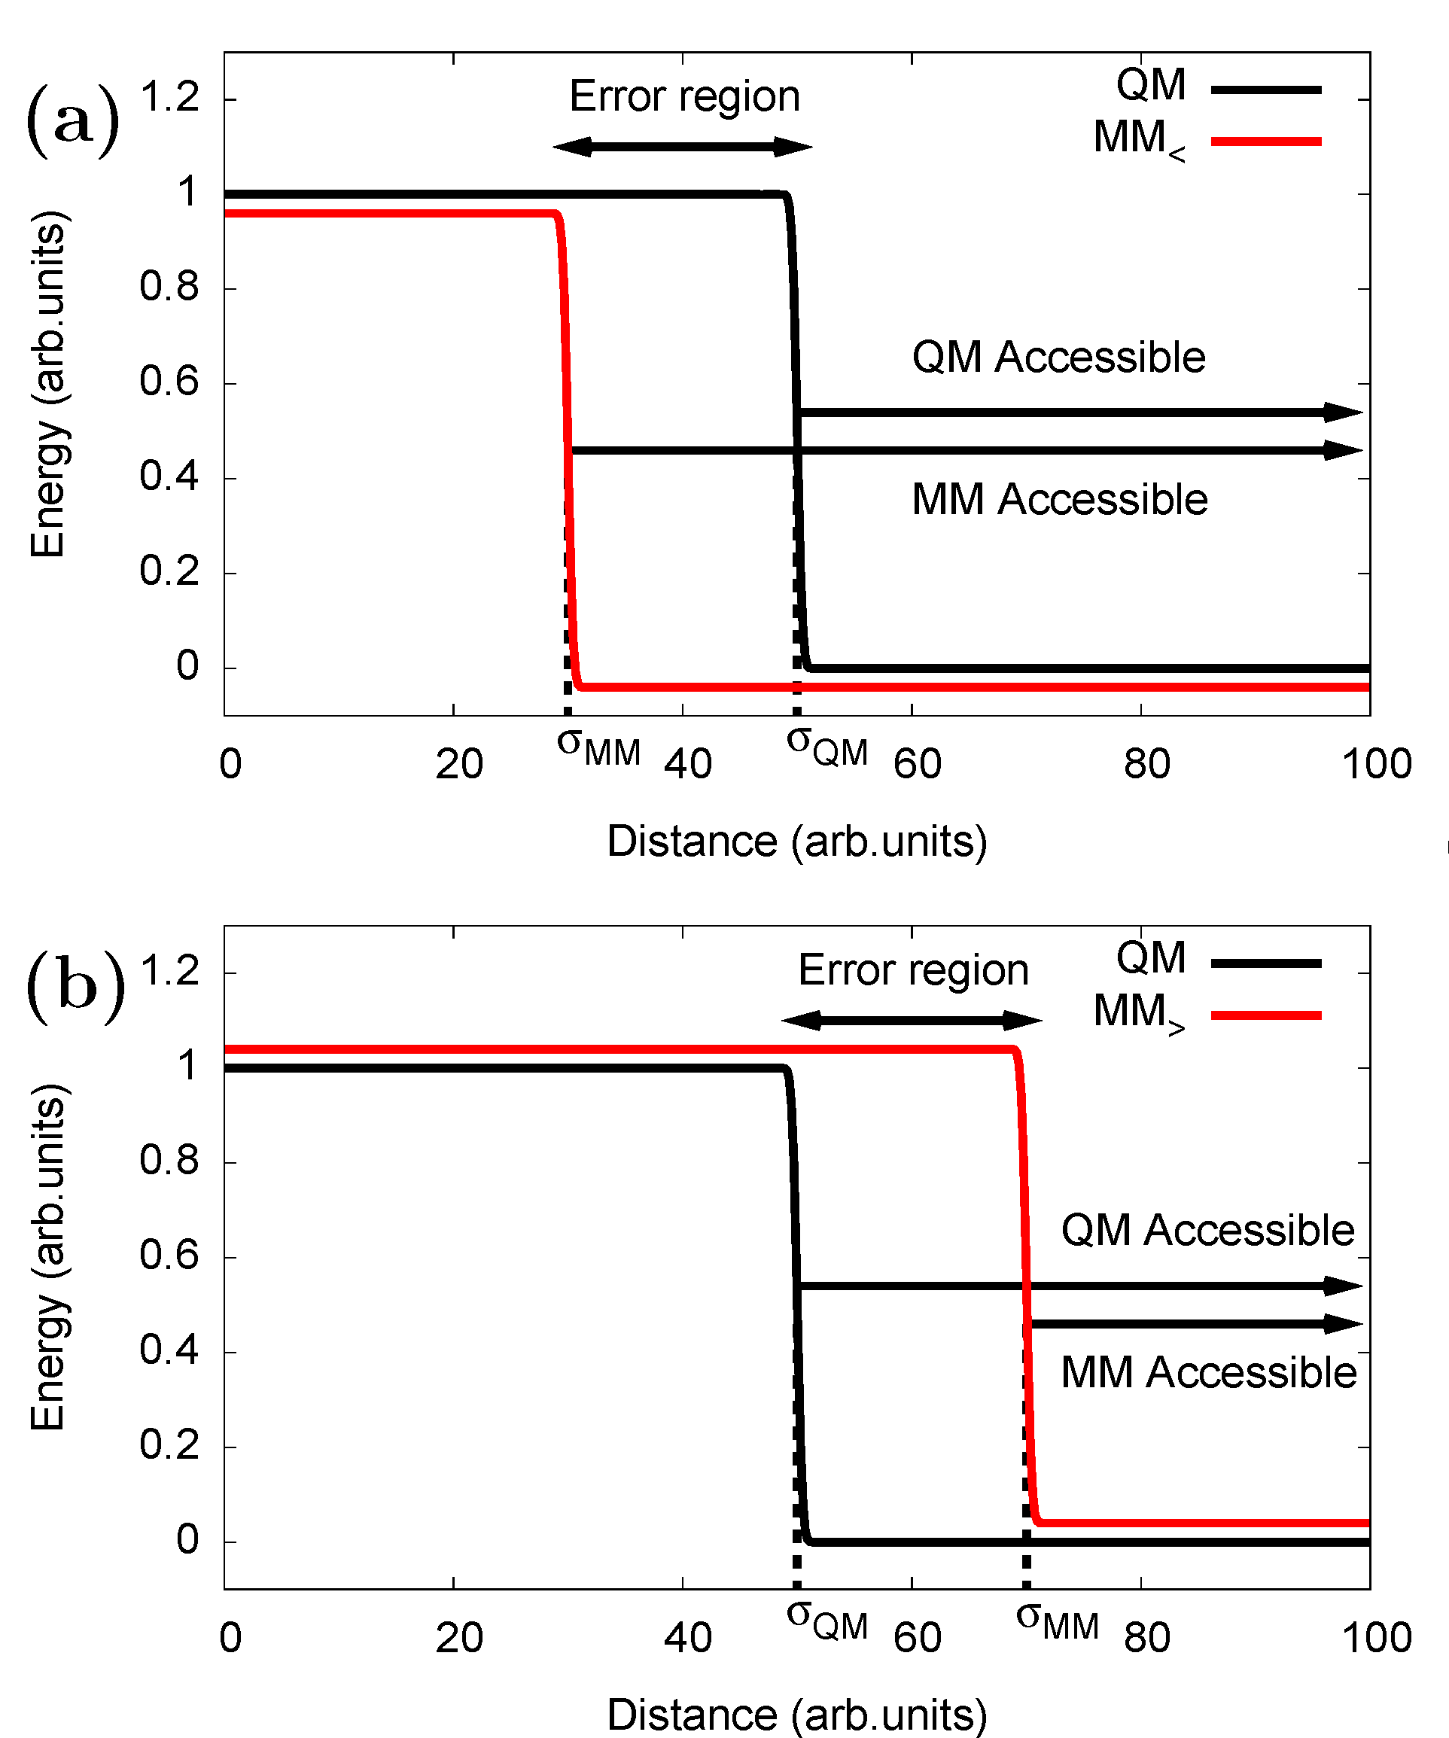
ForTune: Sampling – Hybrid Ensemble
Consider fitting an infinite hard-wall potential (kT→0)
If MM initially underestimates the wall position (above), the “error region” is only seen by the MM ensemble
In the case of an overestimate (below), the error region is only accessible by the QM ensemble
Conclusion: No single potential surface provides good sampling for force matching

Slide 12
ForTune: Sampling – Hybrid Ensemble
Solution: Create a hybrid ensemble by linearly combining Boltzmann weights
Sampling from different ensembles can be approximated by reweighting the configurations from MM
Hybrid ensemble gives optimal matching in the hard-wall case
L. P. Wang and T. Van Voorhis, J. Chem. Phys. (2010), 133, 231101.

Slide 13
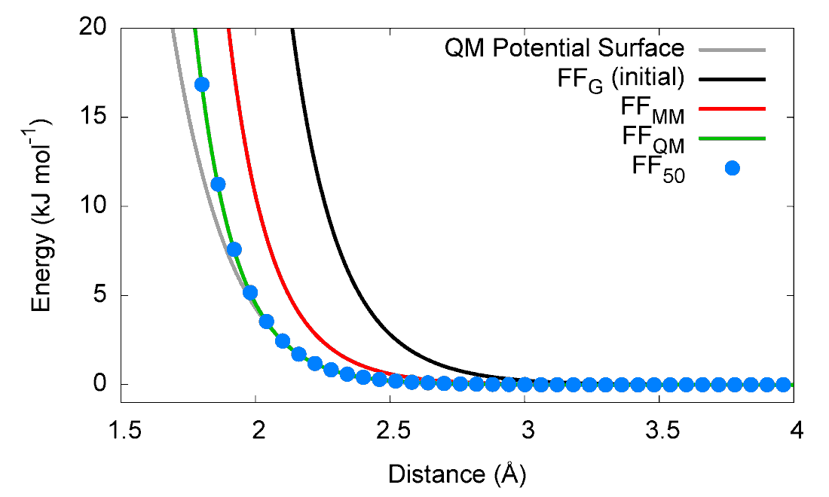
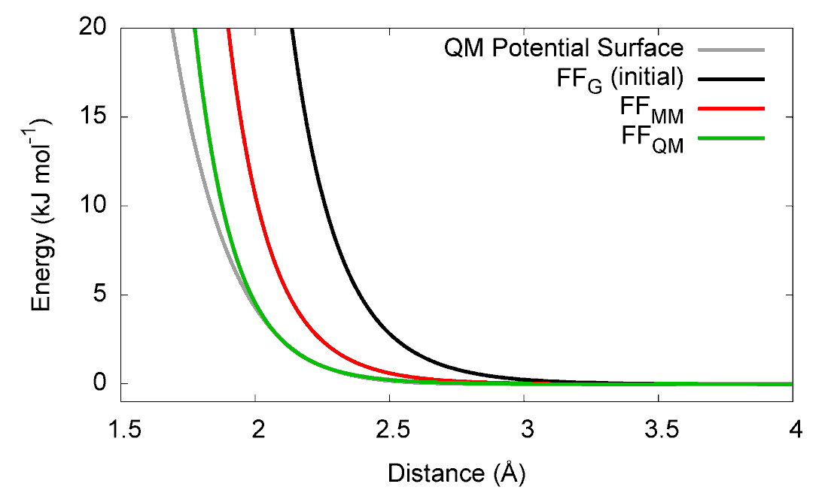
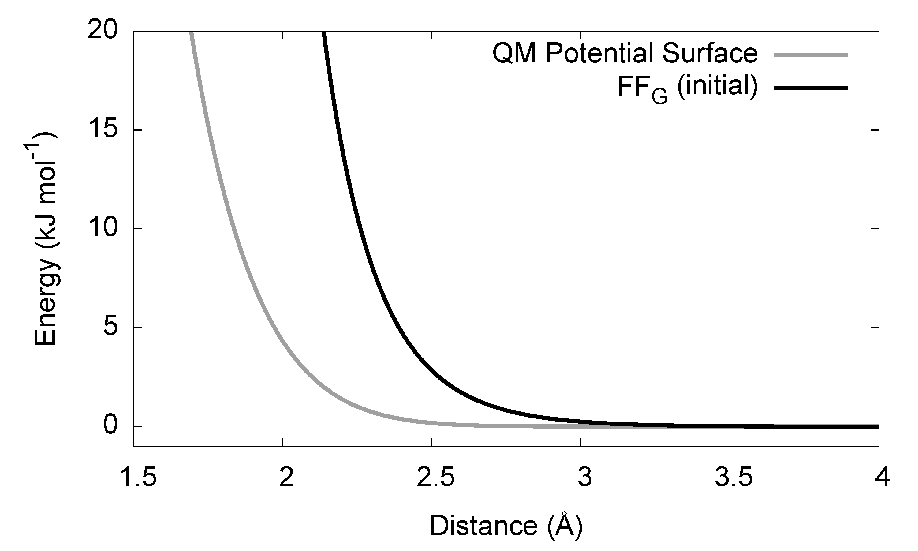
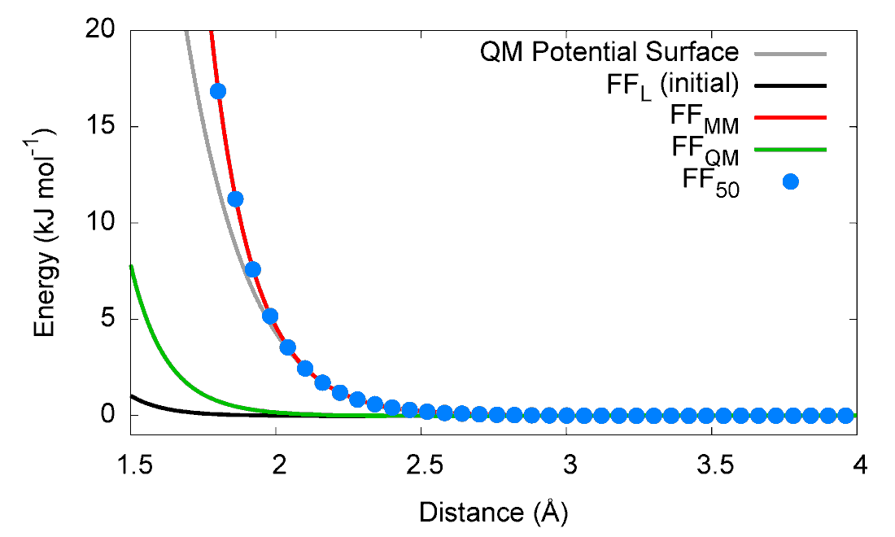
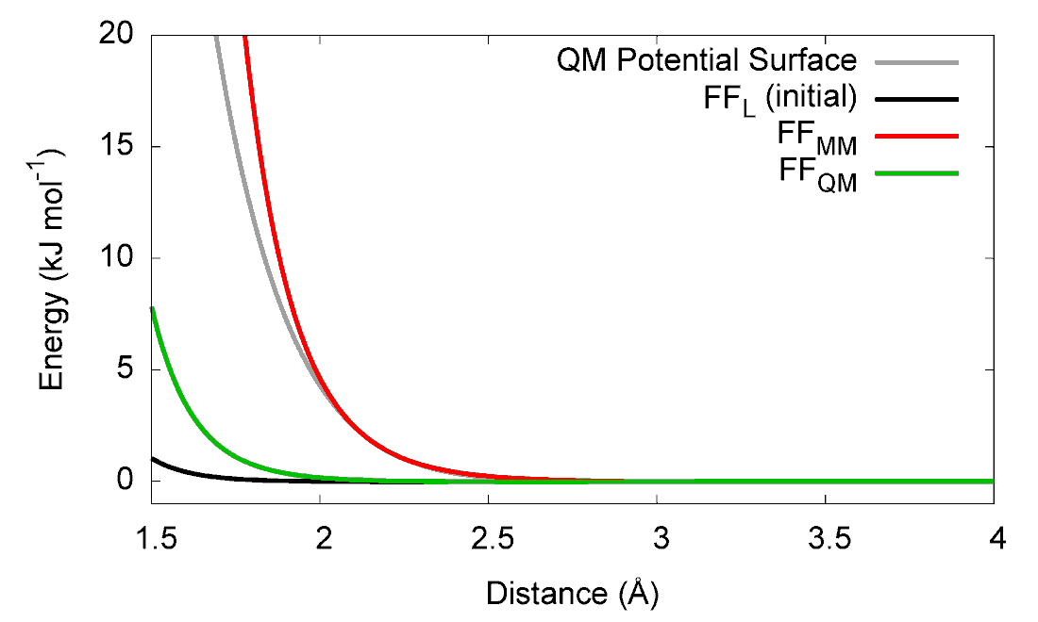
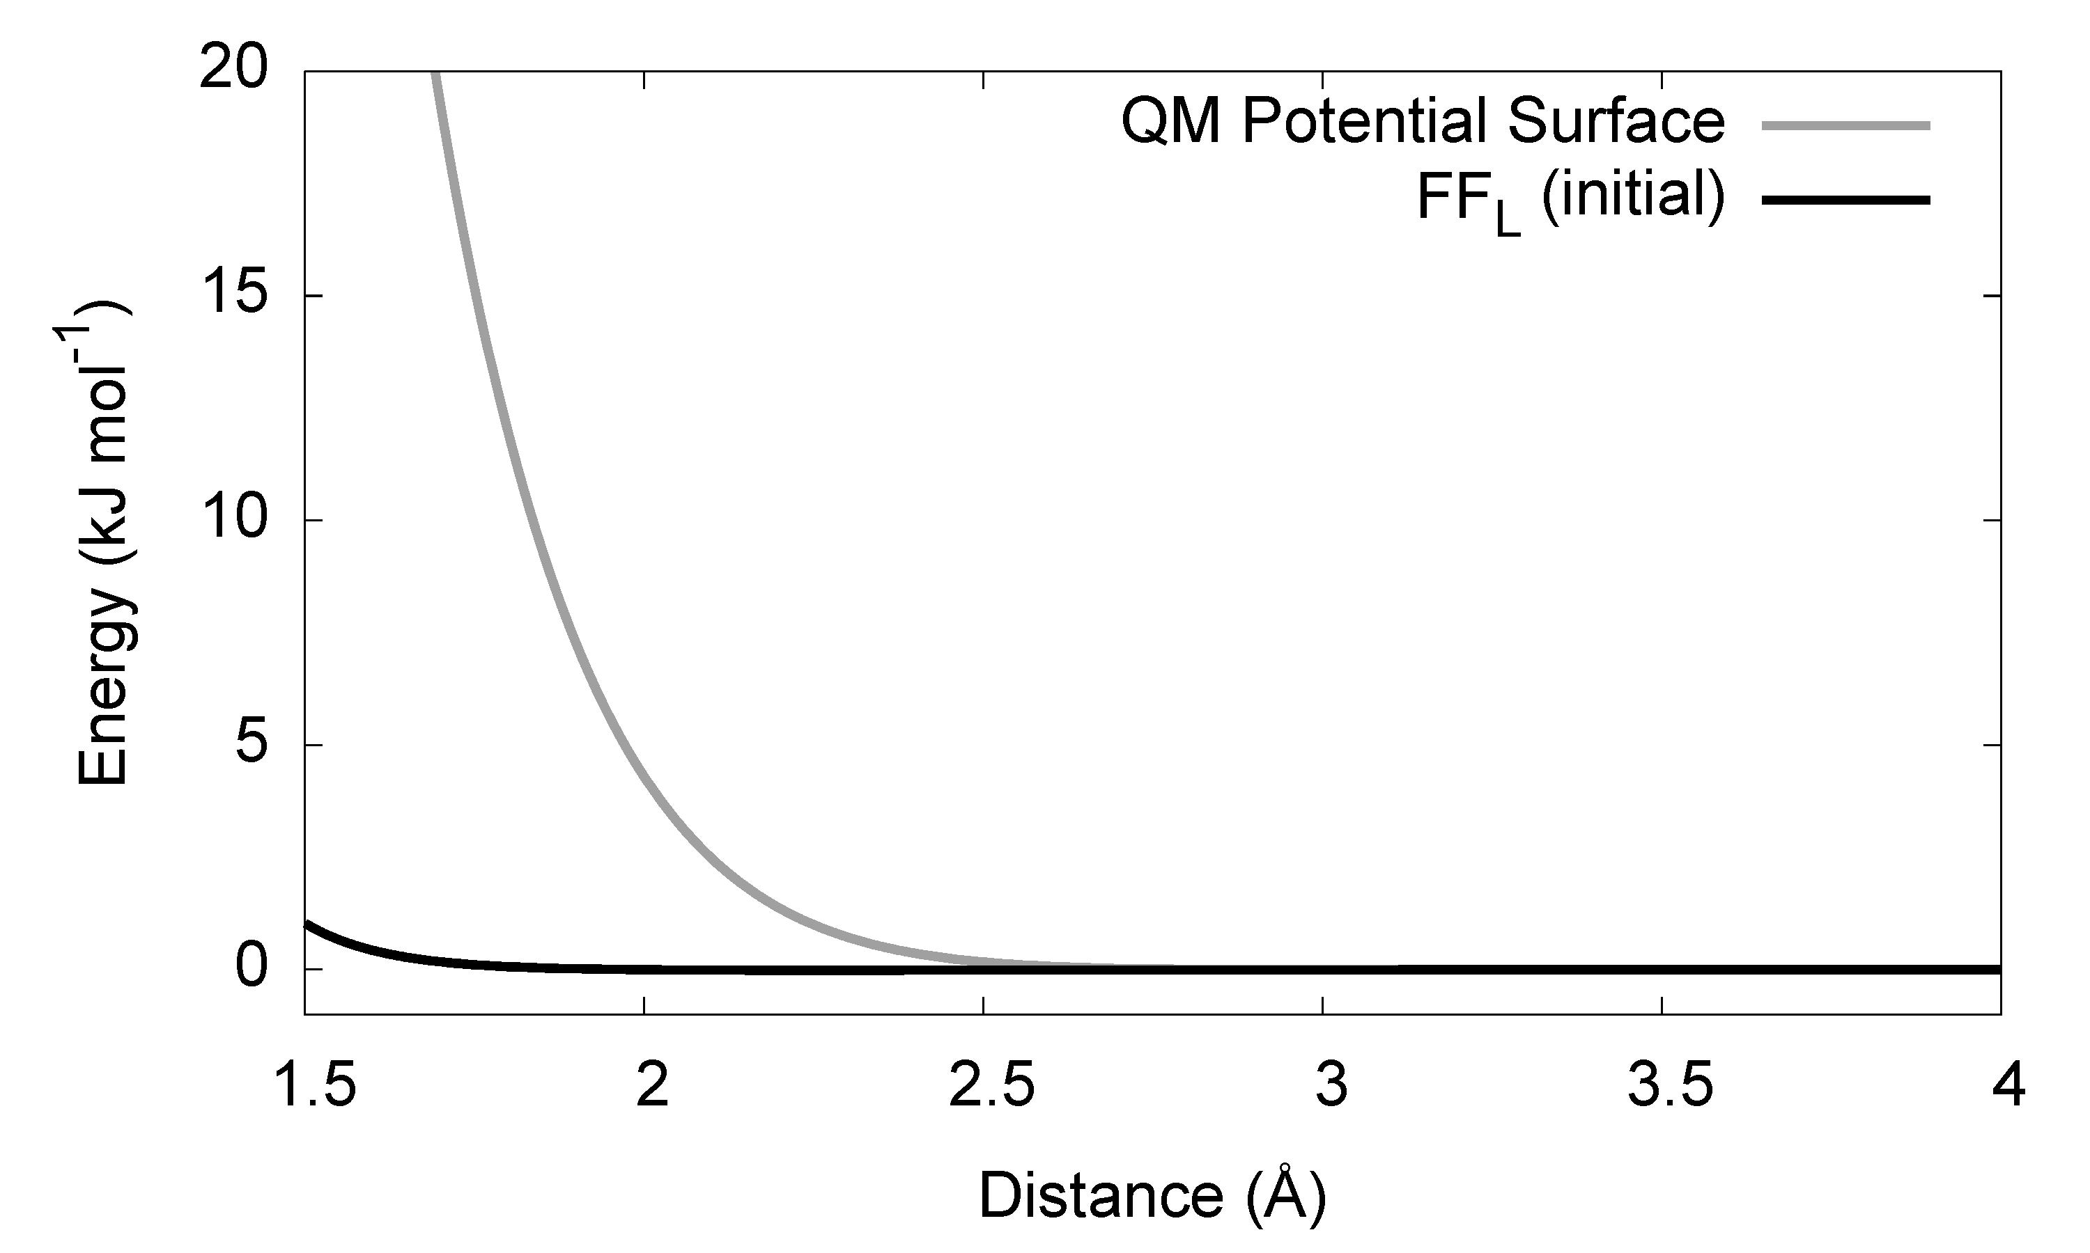
ForTune: Sampling – Hybrid Ensemble
Proof of concept example: He₂ (almost purely repulsive)
Only one MM parameter (LJ σ), starting at two initial values
The MM and QM ensembles reach the correct answer in one out of two cases
The hybrid ensemble reaches the correct answer in both cases

Slide 14
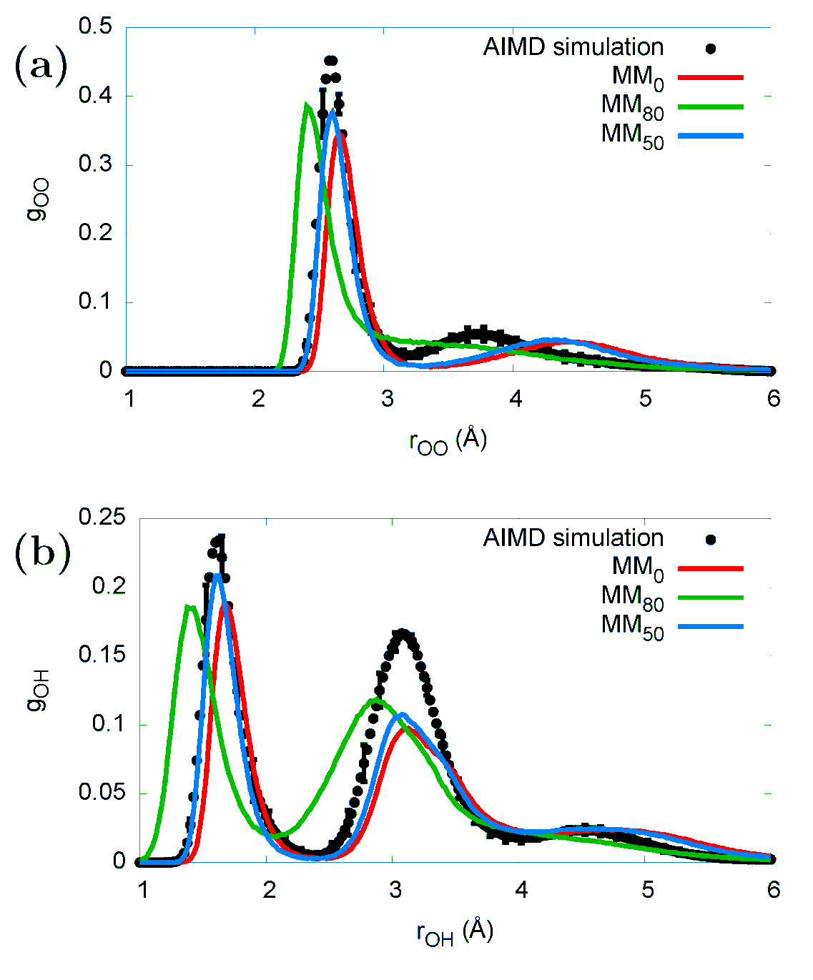
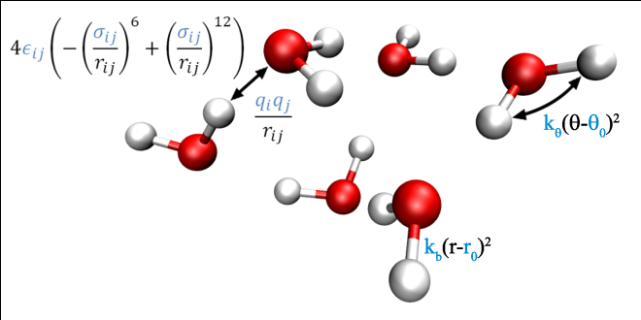
ForTune: Sampling – Hybrid Ensemble
The water hexamer; slightly more complicated, harder to disentangle parameteres with average properties
Three ensembles used: All MM, 50% QM, 80% QM
50% QM ensemble predicts most accurate peak distances and peak heights

Slide 15
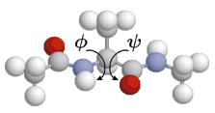
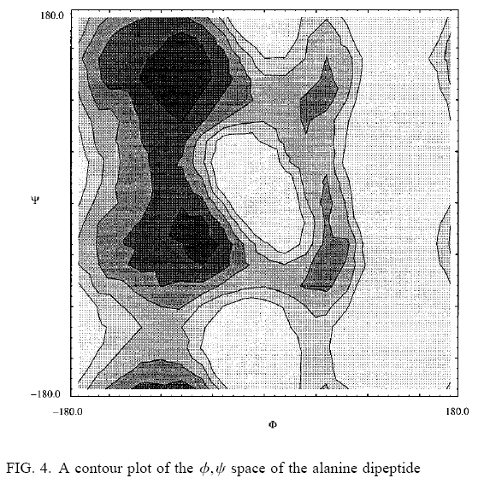
ForTune: Sampling – WHAM
We wish to reuse the reference data from all previous cycles
Each cycle of the potential corresponds to a different sampling
Weighted Histogram Analysis Method (WHAM) uses several different simulations to provide a single free energy profile
We don’t need free energy profiles but WHAM can provide a single consistent set of Boltzmann weights

Slide 16

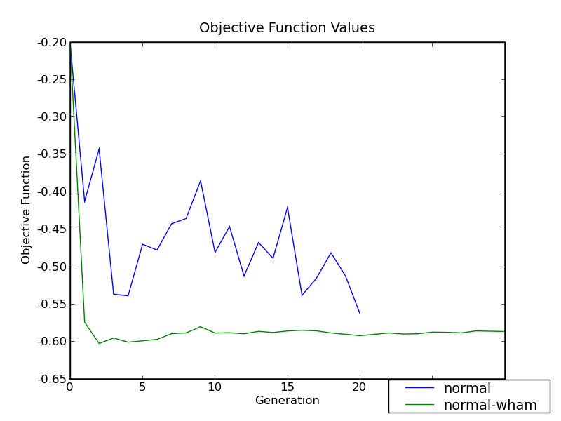
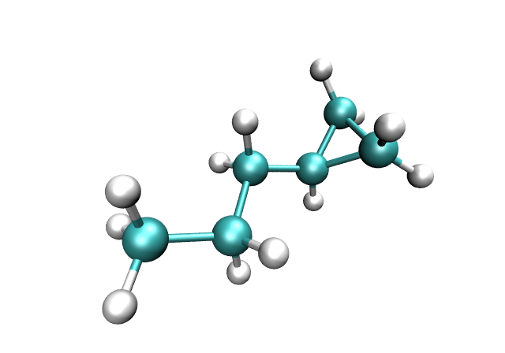
ForTune: Sampling – WHAM
In WHAM, the thermodynamic weights are determined self-consistently
With history information included, fluctuations in χ² are suppressed

Slide 17
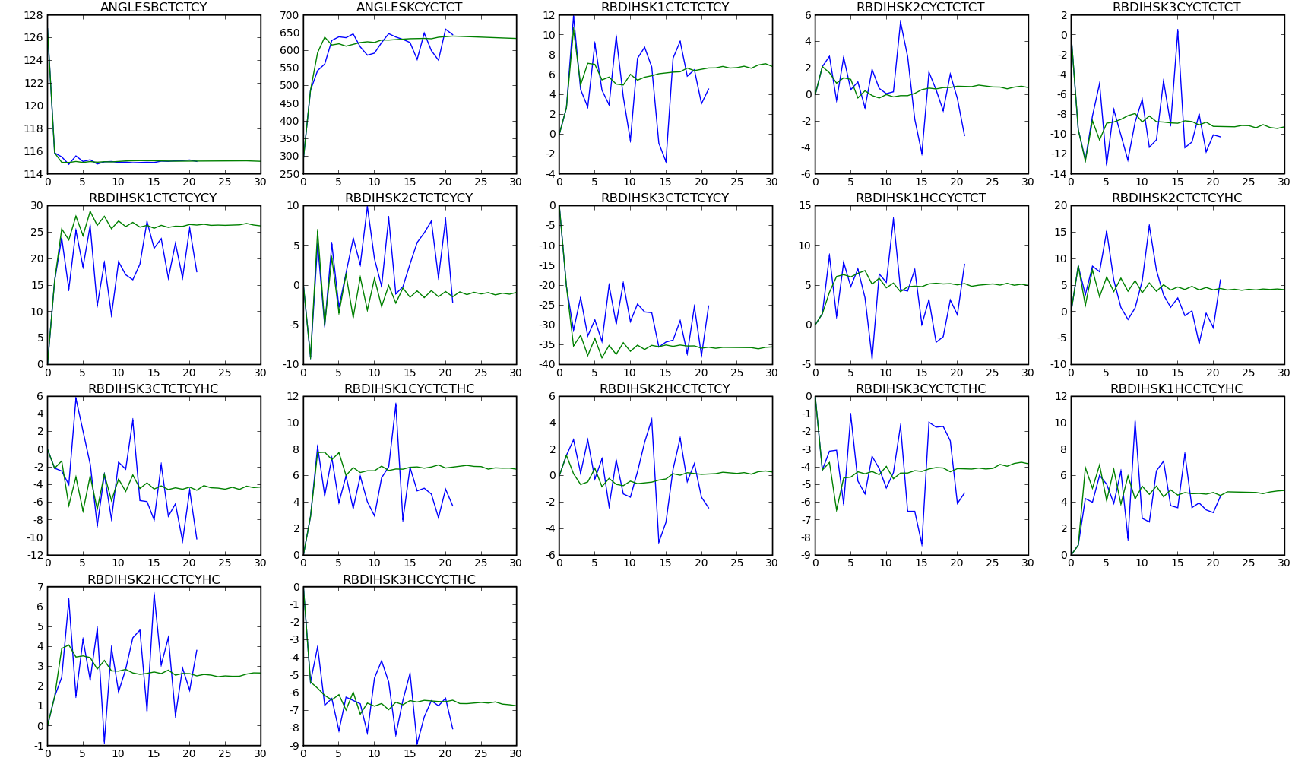
ForTune: Sampling – WHAM
Above: ForTune+WHAM (green) suppresses parameter fluctuations for molecule on right

Slide 18
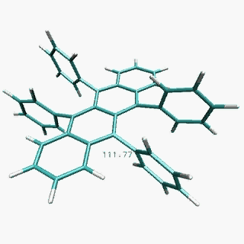
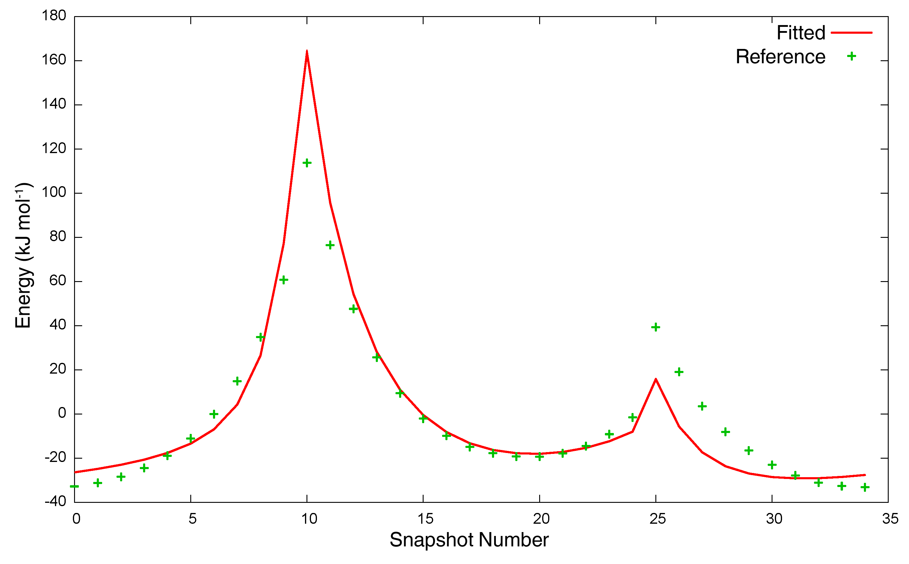
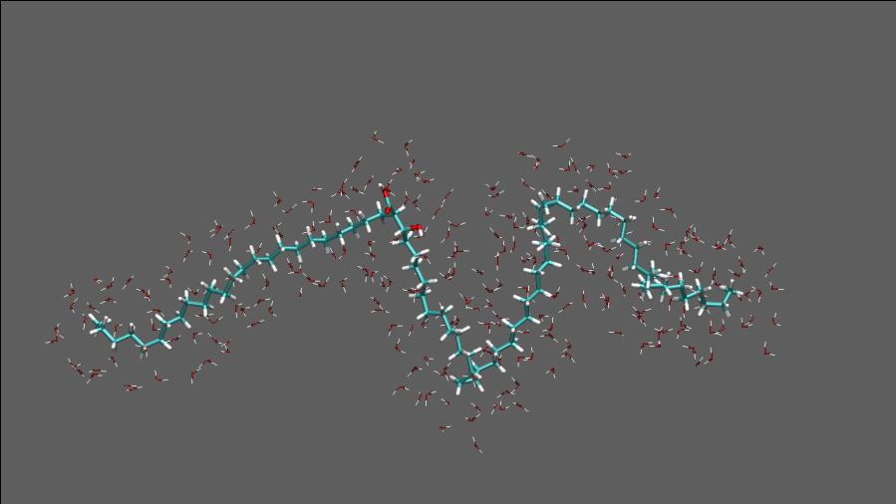
Applications: Patching MM simulations
Existing parameter libraries can be incomplete (e.g. OPLS-AA missing dihedral parameter in rubrene, an organic semiconductor material)
Dihedral angle manually parameterized; force field reproduces crystal structure
Propyl cyclopropane parameters used for mycolic acid with kinks from cyclopropane rings

Slide 19
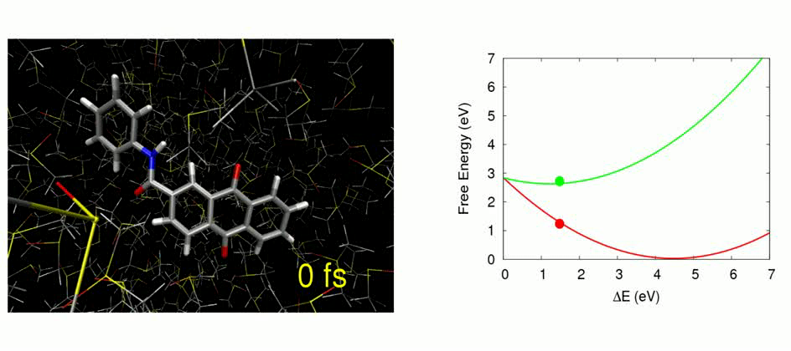
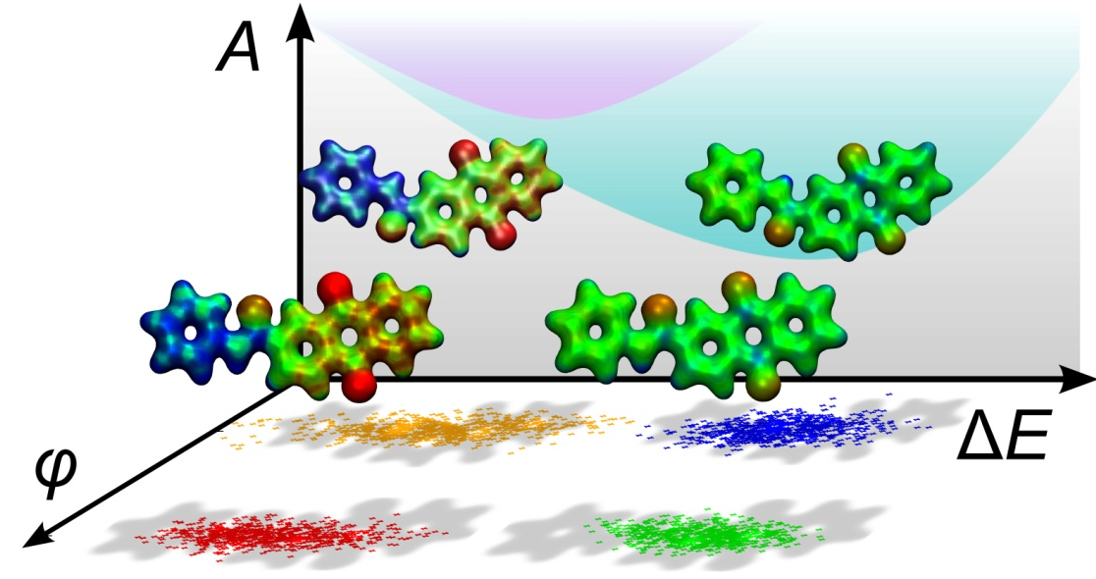
Applications: Multiple electronic states
Force fields created for the ground and CT excited states of the FAAQ molecule
Polarizable QM/MM simulations were seeded from MM simulations
QM/MM sampling of excitation energies and couplings give predictions of CT free energies, recombination rates
Images courtesy of T. Kowalczyk, MIT.
T. Kowalczyk, L. P. Wang and T. Van Voorhis, J. Phys. Chem. B, ASAP.

Slide 20
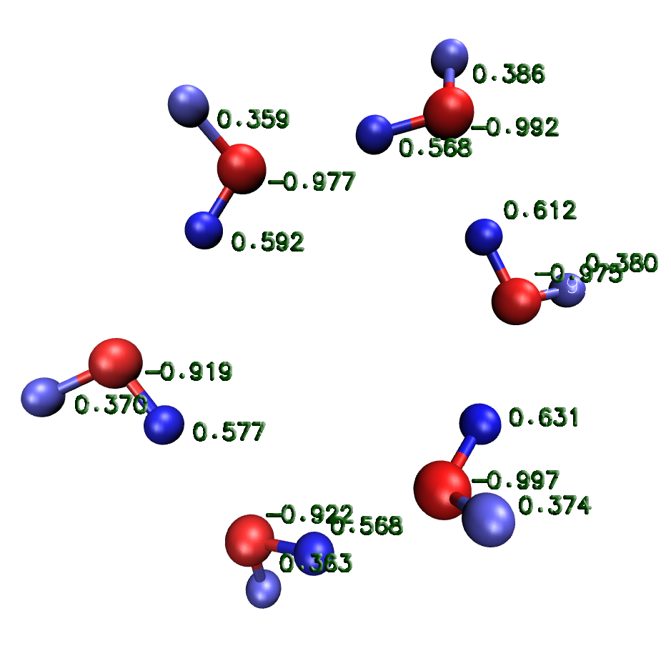
Applications: Fluctuating charge water model
Electronic polarizability is missing from additive force fields
Compensated by increasing atomic point charges
Several treatments of polarizability: Drude particle (charge on spring), inducible dipoles, fluctuating charge
Polarizability is a frontier for force fields in general and automatic parameterization in particular

Slide 21
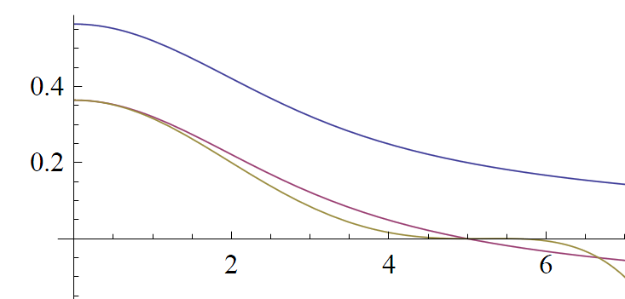
Electrostatics: QTPIE
QTPIE (Chen and Martinez, CPL 2007) is a fluctuating-charge force field
At each time step, charges determined by solving a system of N linear equations
QTPIE (and other fluctuating charge models) implemented into custom GROMACS 4.0
Periodic boundary conditions using smooth cutoffs
J_{ij}(R_{ij})
Blue: Full damped Coulomb interaction
Purple: Cutoff at R=5 by constant shift
Gold: Smoothed-force cutoff at R=5
R_{ij}

Slide 22
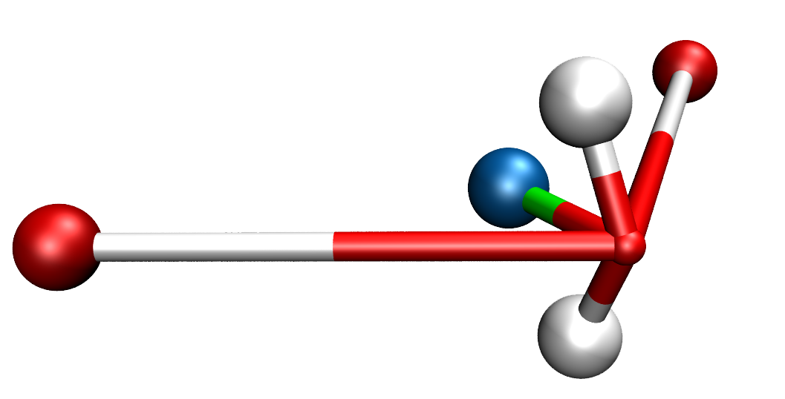
Six-site polarizable water model
Functional form contains 28 adjustable parameters
(3 bonded, 4 angle, 9 electrostatic, 9 VdW, 3 virtual-site)
Configurations from running MD on small clusters (6, 9, 12, 15)
Reference method: MP2, aug-cc-pVTZ
Five fluctuating-charge sites
H
O
H
L. P. Wang, J. Chen and T. Van Voorhis, in prep.

Slide 23
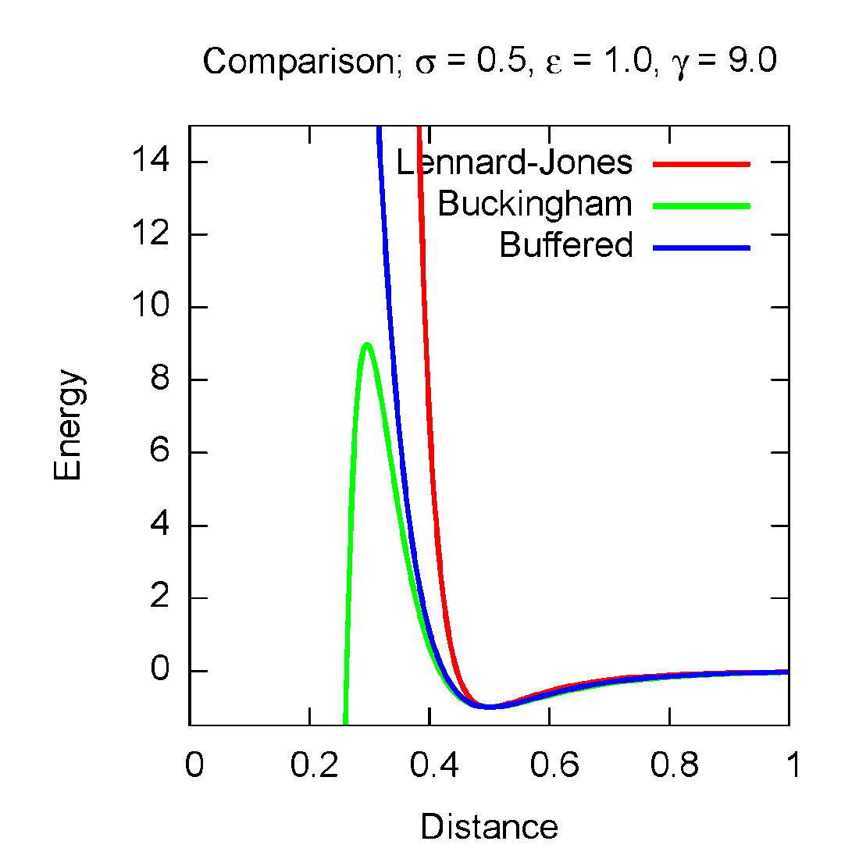
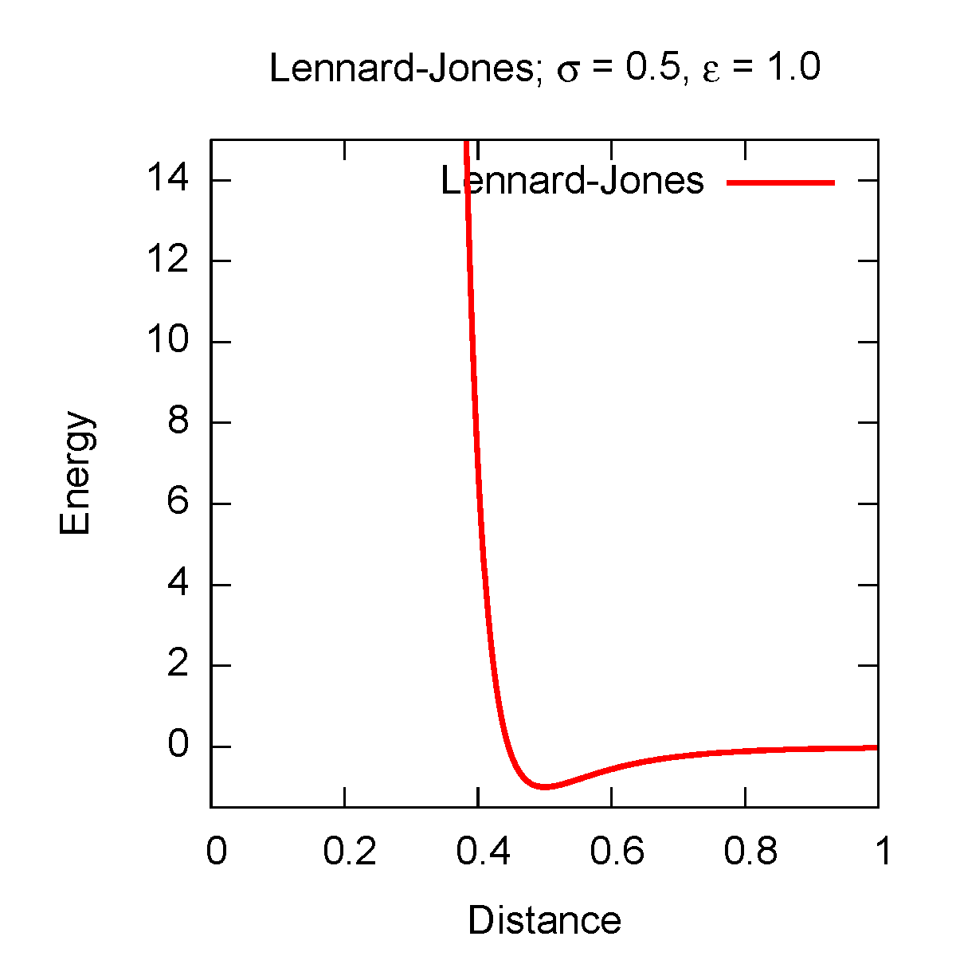
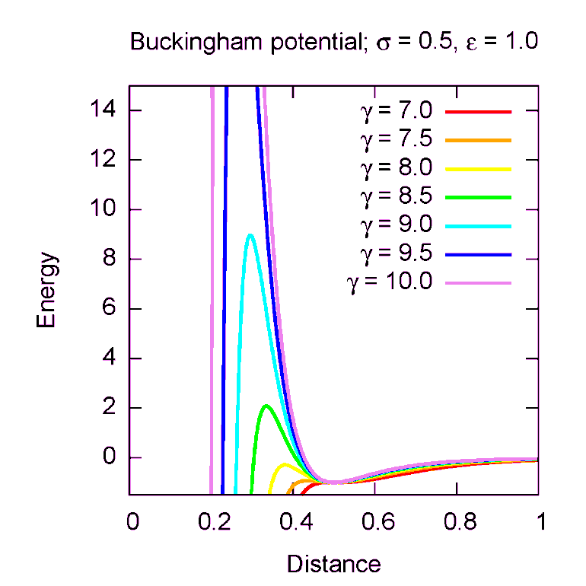
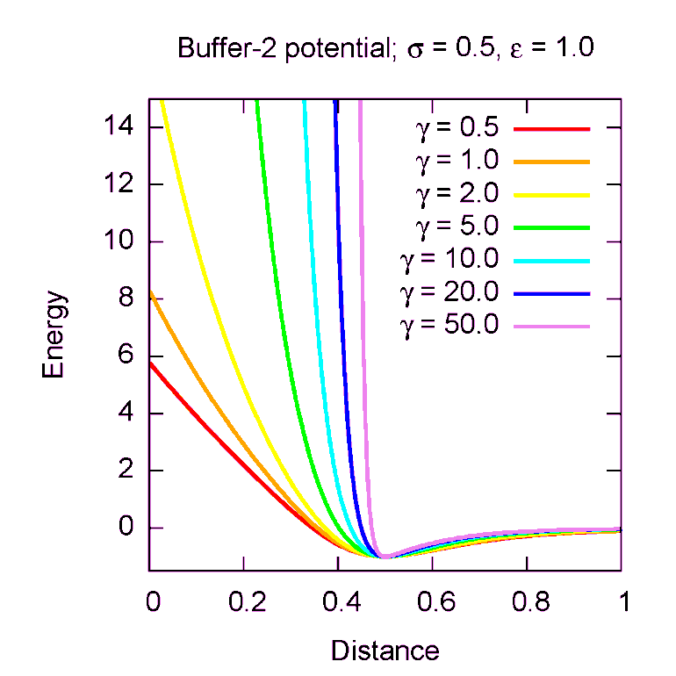
Buffered van der Waals potential
The widely used Lennard-Jones (12-6) interaction is too sharply repulsive
Buckingham potential (exp-6) provides a more physical repulsion
Potential is problematic due to singularity at r=0
Buffered Buckingham potential eliminates the singularity
Highly tunable repulsion, no extra parameters

Slide 24
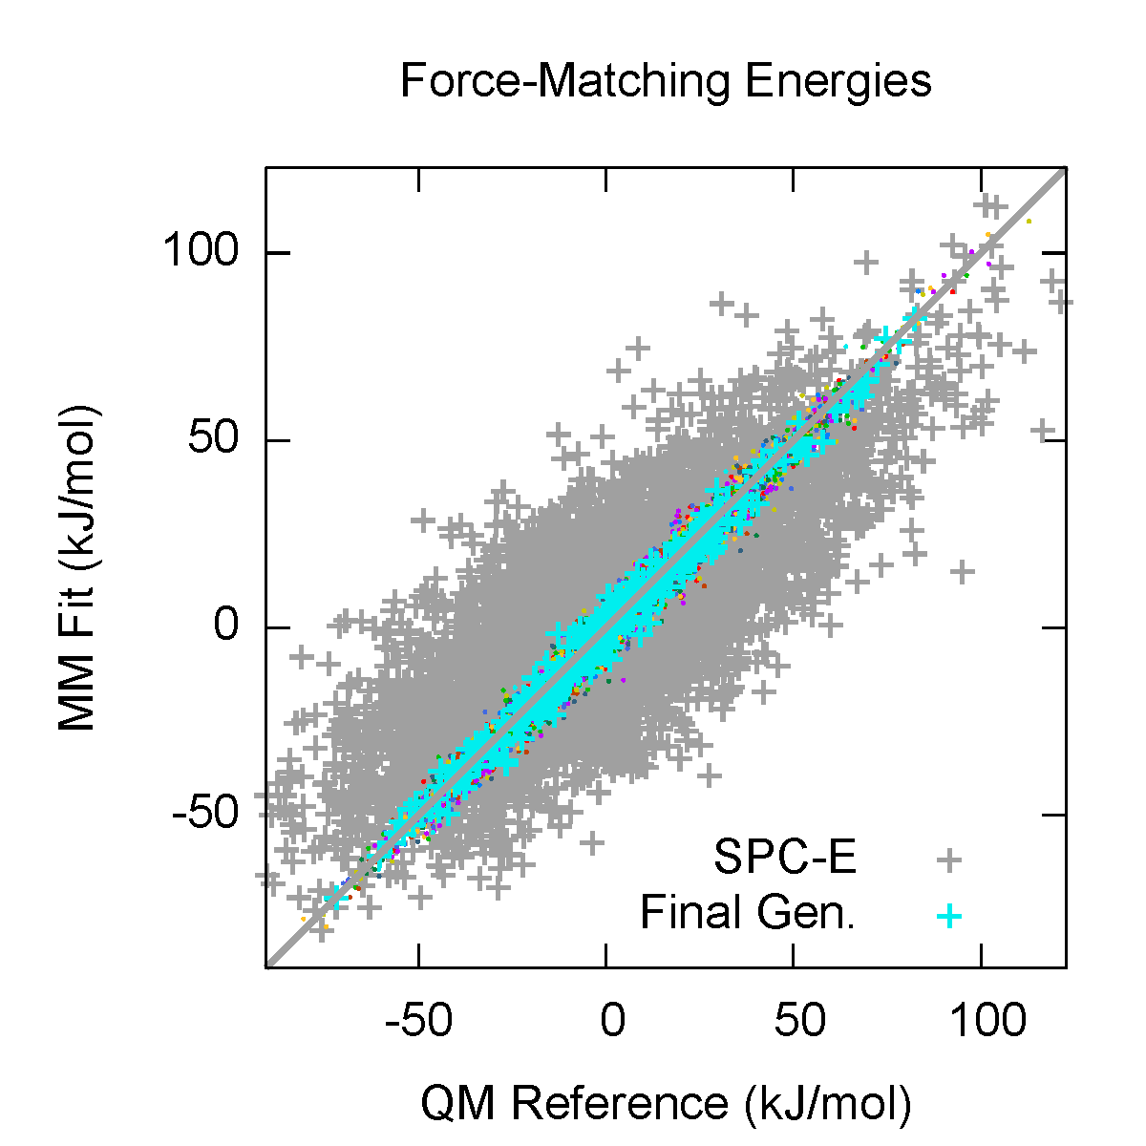
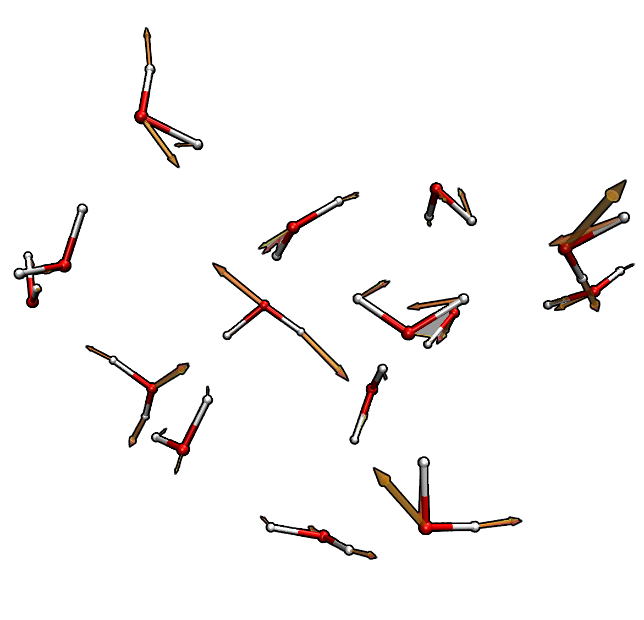
Results: Atomistic energies and forces
17 total cycles of force matching, 5,100 configurations
Energies of water clusters matched to within 1 kcal/mol
Atomistic forces are correct to within 10%
Visually, forces are nearly identical

Slide 25
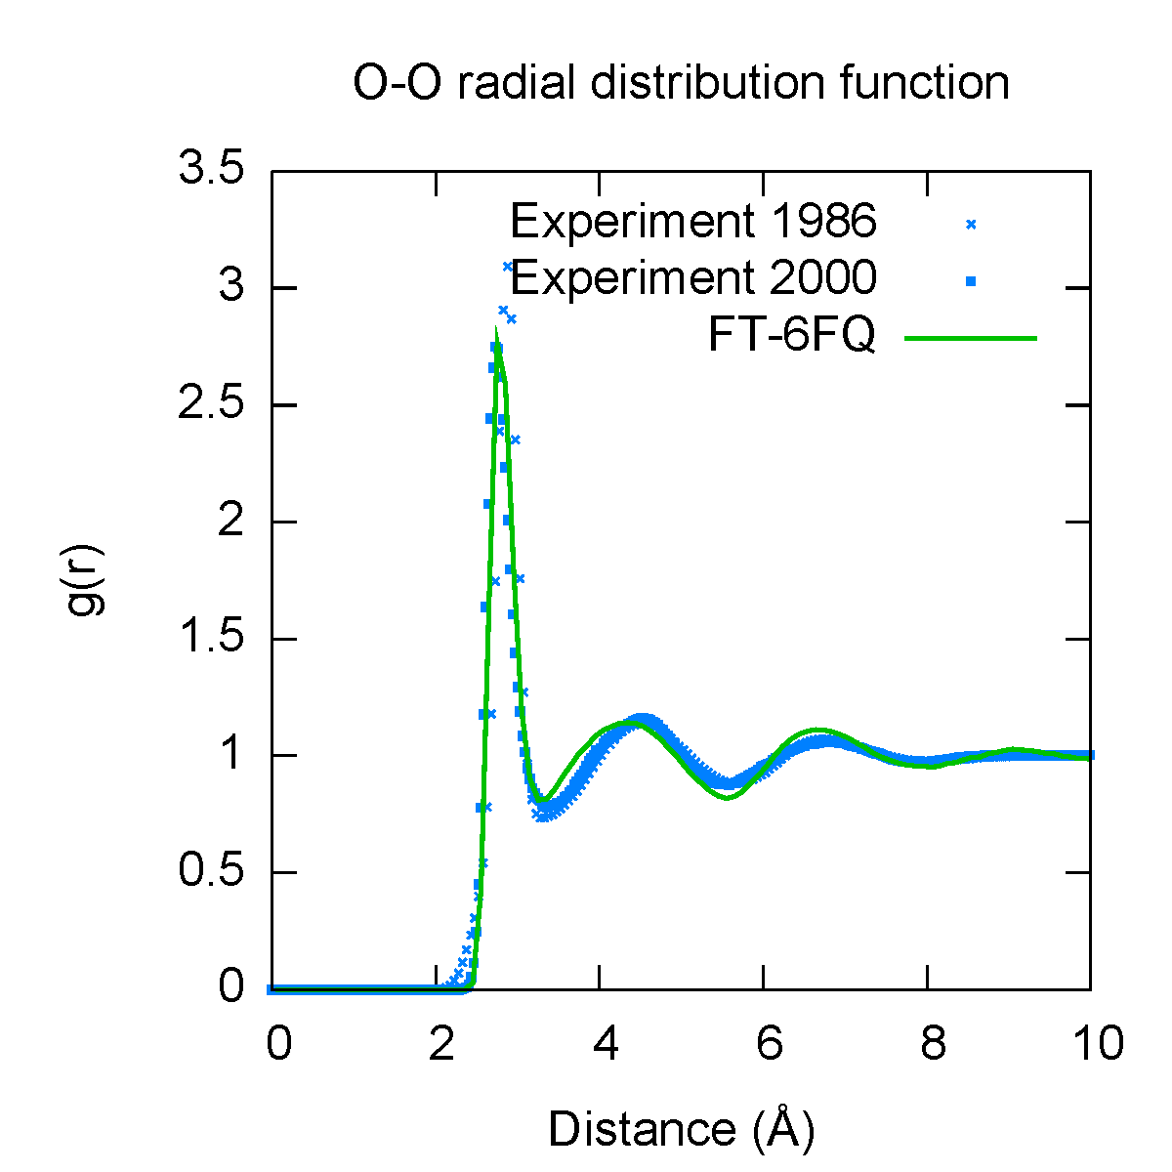
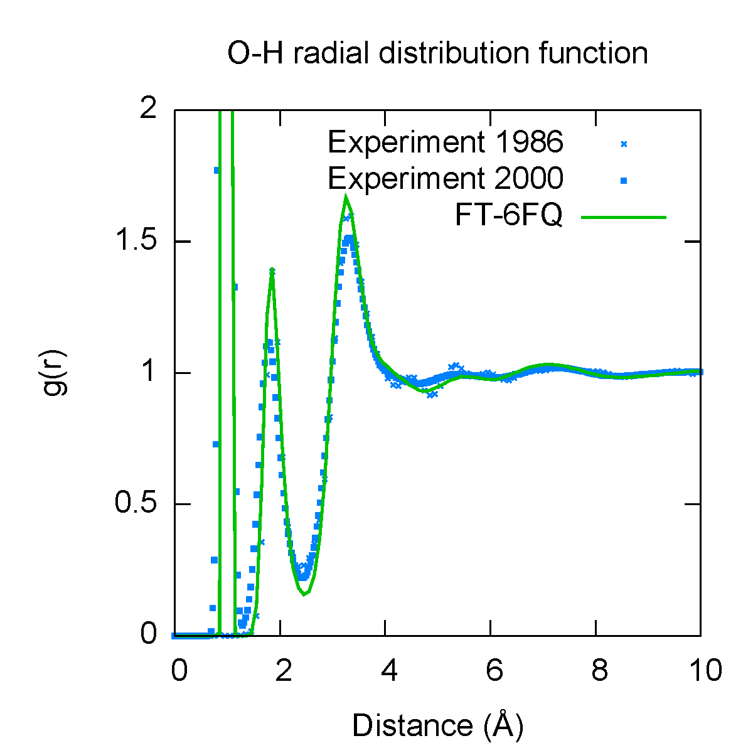
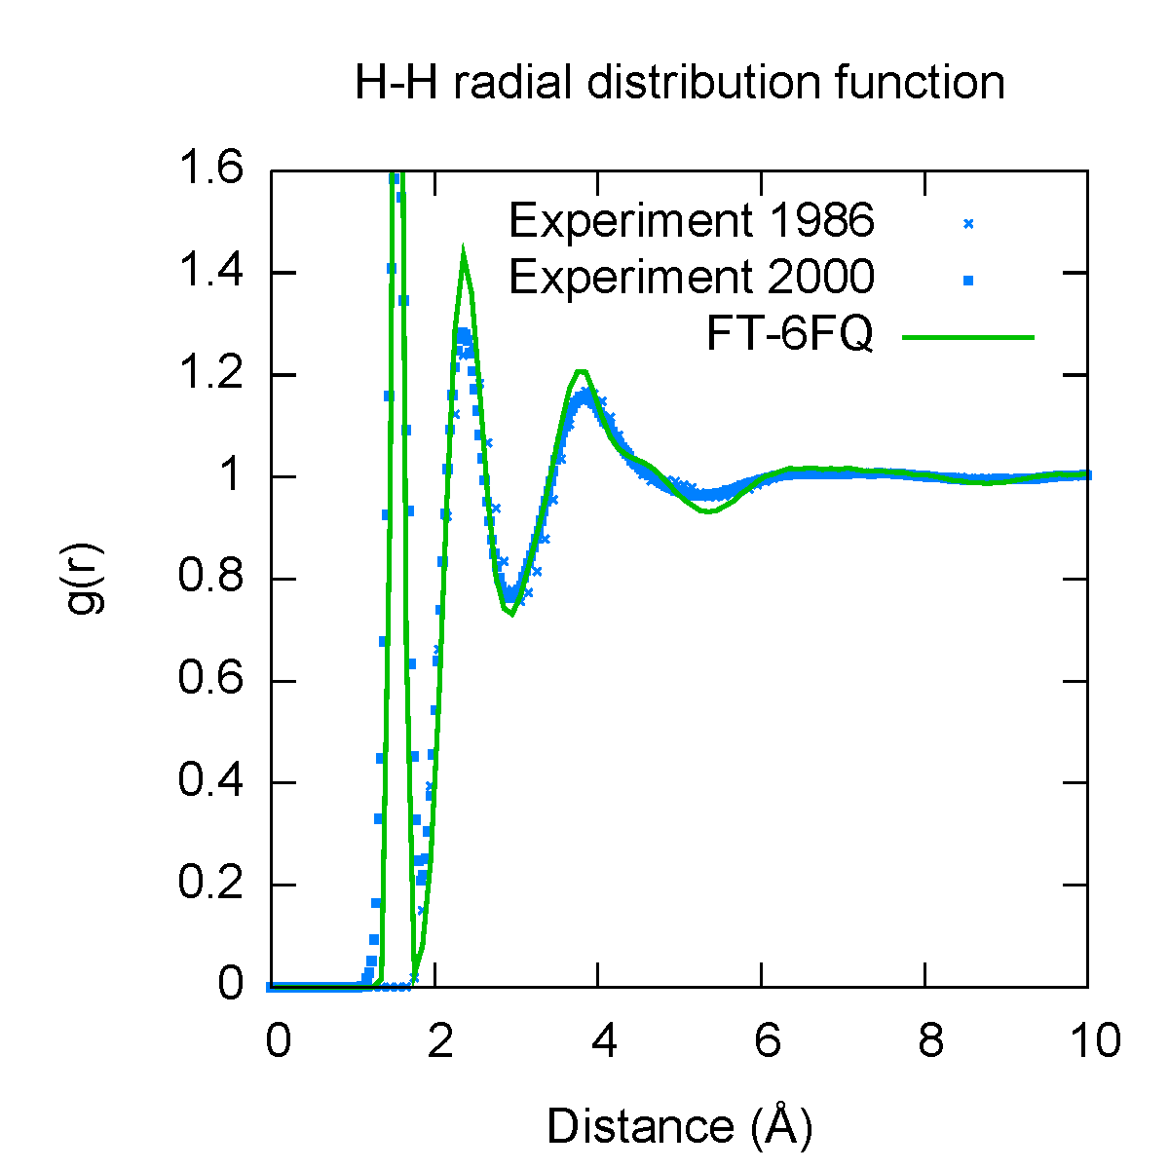
Results: Bulk properties
Property | Calculated | Experiment
Density (kg m⁻³) | 1040 ± 10 | 1000
Dielectric constant | 85 | 78.4
Diffusion constant (10⁻⁵ cm² s-1) | 1.5 | 2.3
Density maximum (ºC) | <6ºC | 4ºC
Solution phase dipole moment (D) | 2.6 | 2.3 – 2.9
Bulk properties are an important test of the water model; these quantities were not fitted
Pair distribution functions have good agreement with experiment; some over-structuring present
Basically accurate density and dielectric constant, diffusion constant underestimated by ~40%

Slide 26
Recent progress: Major rewriting of code
Force
Field
Parameter Rescaling and Duplication
Objective Function
Optimizer
Optimization
Algorithm
Statistical
Regularization
Complete rewrite of code; much more modular, extensible
Supports multiple fitting simulations in objective function
Python redistributable package soon on “SimTK” website
Multiple fitting simulations (energy/force matching, experimental measurements)
Software (GROMACS, OpenMM, TINKER)
ts

Slide 27
Future Plans
Many interesting problems involve closing the gap between two different models.
Long Term:
Improving solute / solvent model compatibility
Correcting low-level QM methods and QM-MM Hamiltonian
Exploring contributions to objective function
(experimental properties, energy decomposition)
Biological applications (protein / ligand binding, enzyme catalysis)
Short Term:
Decide on a tangible and useful application
Create distributable software package with test cases
Write and test several “fitting simulation” modules

Slide 28


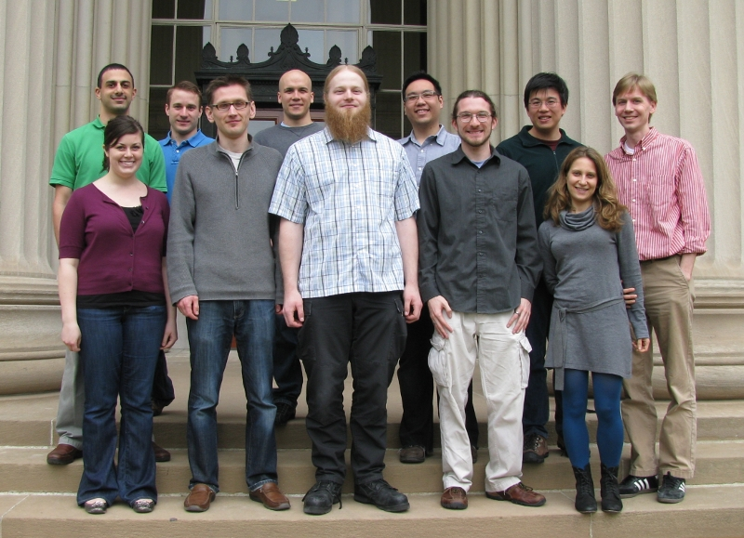
Acknowledgements
Troy Van Voorhis (MIT)
Vijay Pande (Stanford)
Todd Martinez (Stanford)
VV Group Members
  Jiahao Chen (collaborator)
  Tim Kowalczyk (collaborator)
NIH “Simbios” Postdoctoral Fellowship
You!

