Slide 1
Systematic force field optimization for more accurate molecular simulations
Lee-Ping Wang
Stanford Department of Chemistry
OpenMM Workshop, Stanford University
September 7, 2012

Slide 2
Preface: Getting basic help
Find out what data and member functions are available using the help() and dir() commands.
$ python # Open a Python prompt.
> from simtk.openmm.app import * # Import SimTK OpenMM libraries.
> from simtk.openmm import *
> from simtk.unit import *
> MyPDB = PDBFile(‘input.pdb’) # Create a PDB Object.
> help(MyPDB) # Read the documentation for the PDB Class.
| writeFile(topology, positions, file=<open file '<stdout>', mode 'w'>, modelIndex=None)
| Write a PDB file containing a single model.
|
| Parameters:
| - topology (Topology) The Topology defining the model to write
| - positions (list) The list of atomic positions to write
| - file (file=stdout) A file to write to
> dir(MyPDB) # Get a list of all data attributes and member functions.
# Note: Attributes with __underscores__ are “private” variables.
['__class__', '__delattr__', '__dict__', '__doc__', '__format__', '__getattribute__', '__hash__', '__init__', '__module__', '__new__', '__reduce__', '__reduce_ex__', '__repr__', '__setattr__', '__sizeof__', '__str__', '__subclasshook__', '__weakref__', '_atomNameReplacements', '_loadNameReplacementTables', '_numpyPositions', '_parseResidueAtoms', '_residueNameReplacements', 'getPositions', 'getTopology', 'positions', 'topology', 'writeFile', 'writeFooter', 'writeHeader', 'writeModel']
> MyPDB.topology # Now we know that a PDB object contains a Topology object.
<simtk.openmm.app.topology.Topology object at 0x2d26e50>

Slide 3
Diagram of classes in OpenMM
Positions
API Layer
Class
App Layer
Class
App Layer
Class from
File
https://simtk.org/home/mdseriessep2012
“OpenMM Class Diagram” in Downloads
Velocities
Energy
Box Vectors
Forces
Integrator
required for
Simulation
contains
Reporters
Reporters
Reporters
Forces
Forces
Forces
get or set variables
required for
creates
contains
required for
creates w/ Topology
Context
State
ForceField
System
creates
Topology
sets positions
contains
converts to/from XML
creates
contains
sets positions
Platform
XmlSerializer
contains
AmberPrmtopFile
PDBFile
AmberInpcrdFile

Slide 4
Outline
Introduction
  Force fields in molecular mechanics
  The ingredients of a force field
    Functional form
    Reference data
    Optimization method
ForceBalance program for force field optimization
  Overview of program
  Application: Polarizable water model
  Results and discussion
  Basic program usage

Slide 5
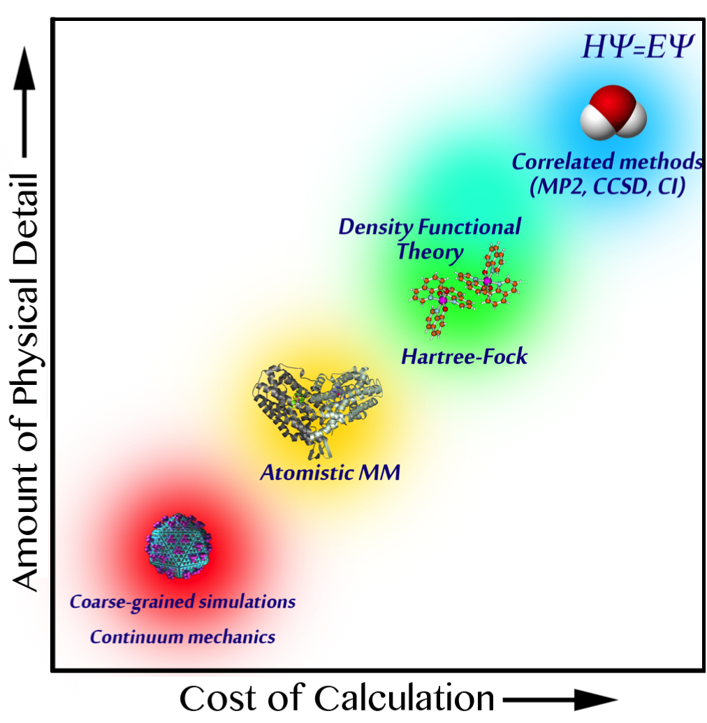
Introduction: A wide range of simulation domains
Single-point, 2-3 atoms
Computer simulations of atoms and molecules span a vast range of detail
More detailed theories can describe complex phenomena and offer higher accuracy
Less detailed theories allow for simulation of larger systems / longer timescales
In molecular mechanics simulation, the potential energy of molecules is represented using an empirical force field
100 fs, 10 atoms: photochemistry
10 ps, 100 atoms: chemical reactions
10 μs, thousands of atoms:
protein folding,
drug binding
1 ms+, 1 million atoms: dynamics of large proteins, cell membranes, viruses

Slide 6
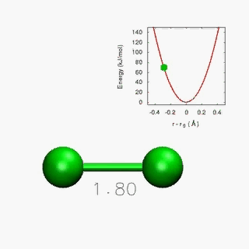
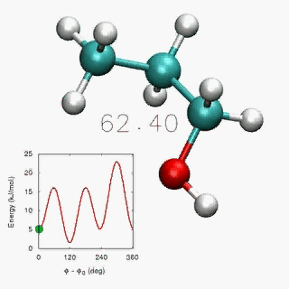
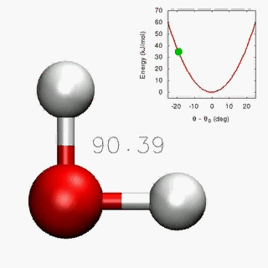
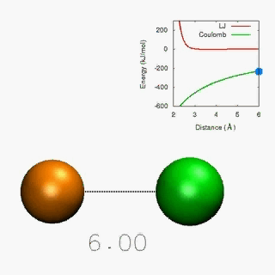
Introduction: Force Fields
Force fields are built from functional forms and empirical parameters
Interactions include bonded pairwise, 3-body, and 4-body interactions…
… as well as non-bonded pairwise interactions
Simulation accuracy depends critically on choice of parameters

Slide 7
Introduction: Force Fields
The common paradigm for running simulations is to choose a force field from a large literature selection.
PROTEINS:
AMBER
“Assisted Model Building with Energy Refinement”
Main series: ff94, ff96, ff99, ff03, ff10
Dihedral modifications: ff99sb, ff99sb-ildn, ff99sb-nmr, ff99-phi
GAFF (Generalized AMBER force field)
OPLS
“Optimized Potential for Liquid Simulation”
OPLS-UA (united atom), OPLS-AA (all atom)
OPLS-AA/L (revised torsions)
OPLS-2001, OPLS-/2005 (improved solvation free energies)
CHARMM
“Chemistry at Harvard Molecular Mechanics”
CHARMM19 (united atom), CHARMM27 (all atom)
CHARMM36 (carbohydrates)
CMAP (two-dimensional dihedral corrections)
CGenFF (General CHARMM force field)
AMOEBA
“Atomic Multipole Optimized Energetics
for Biomolecular Applications”
Contains polarizable point dipoles
WATER:
TIP3P, TIP4P, TIP5P
“Transferable Intermolecular Potential”
AMBER, OPLS, and CHARMM are “paired” with TIP3P
TIP3P water melts at -146 ºC and boils at -90 ºC
SPC, SPC/E, SPC/Fw
“Simple Point Charge”
Same functional form as TIP3P, different parameters
TIP4P/Ew, TIP4P/Ice, TIP4P/2005
Reparameterization of TIP4P model
Improved fits to experimental properties of water
Various polarizable models
SWM4-DP, SWM4-NDP (contains Drude particle)
AMOEBA (contains polarizable point dipoles)
DPP, DPP2 (distributed point polarizable model)
TTM2-F, TTM2-R, TTM3-F (Thole type model)
TIP4P-FQ, SPC-FQ (Fluctuating charge model)
There are too many to choose from…
Can we create a force field that is best for our research project?

Slide 8
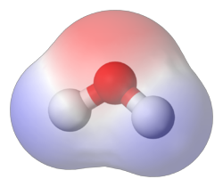
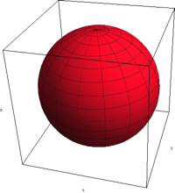
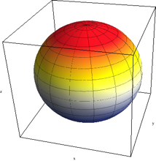
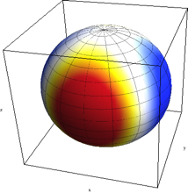
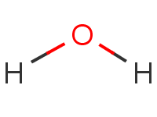
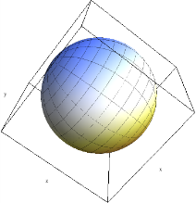
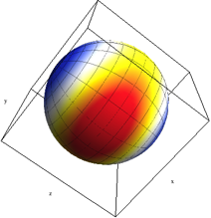
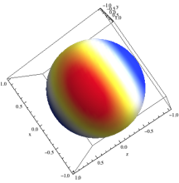
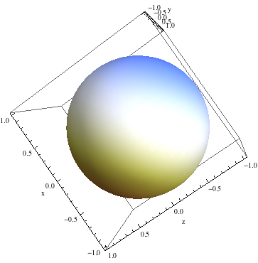
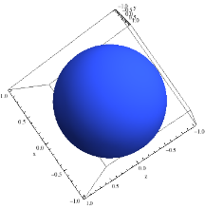
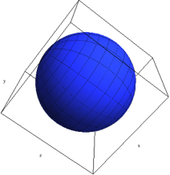
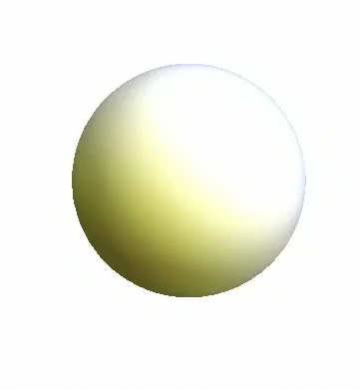
Creating a force field: Functional form
Step 1: Choose a functional form to represent the
potential energy surface, or design your own.
AMBER fixed-charge force field:
Point charge on each atom
AMOEBA polarizable force field:
Point charge, dipole, and quadrupole on each atom
Polarizable point dipole on each atom with short-range damping

Slide 9
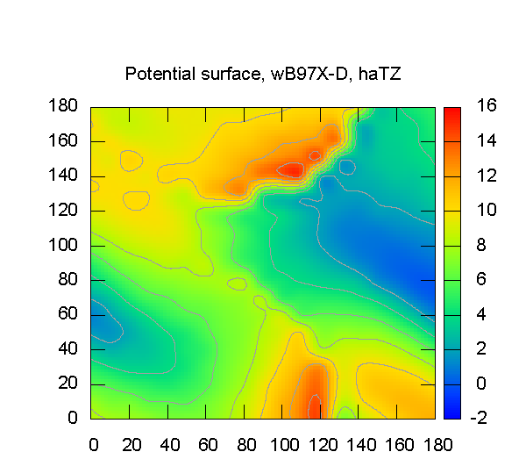
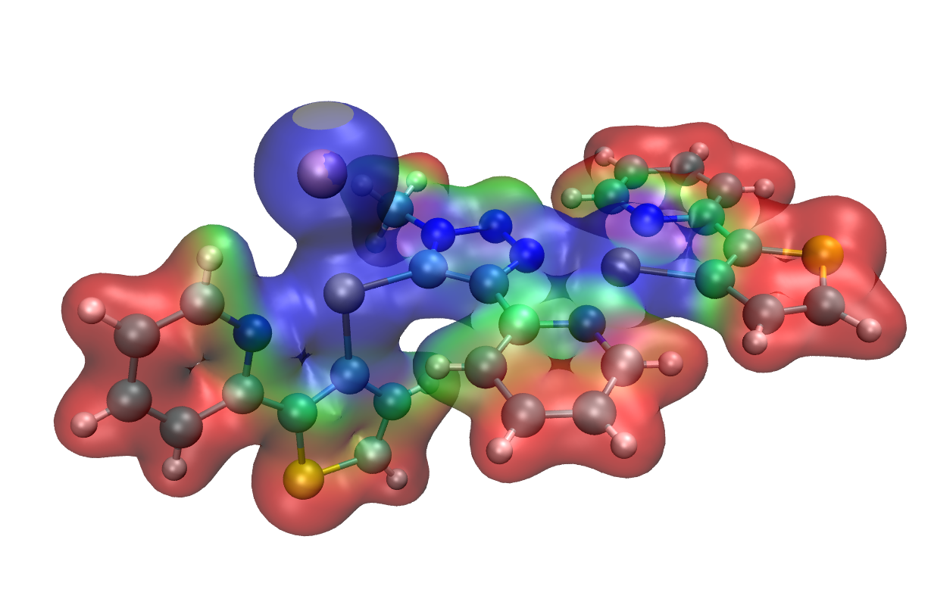
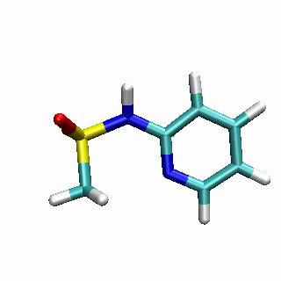
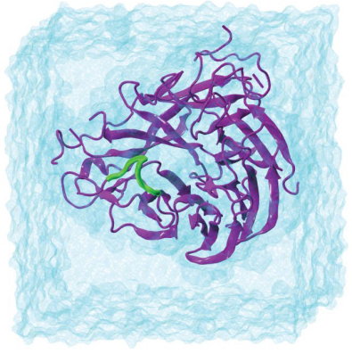
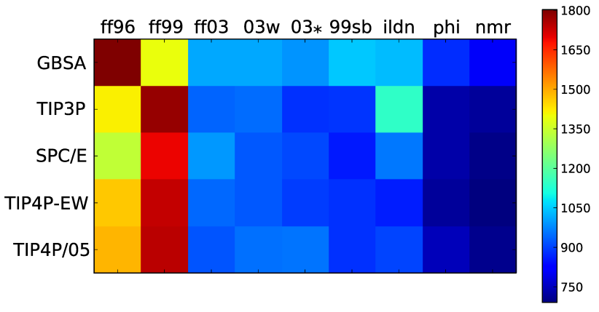
Creating a force field: Reference data
Step 2: Create a reference data set from theoretical calculations or experimental measurements.
Electrostatic potential on a molecular surface (red = positive, blue = negative)
Energy scan across 2 dihedral angles
Simulated vs. experimental NMR chemical shifts for proteins (red = bad, blue = good)

Slide 10
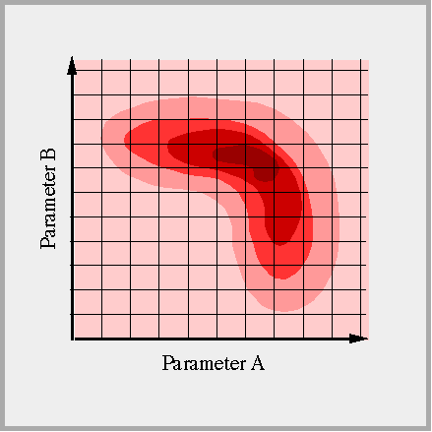
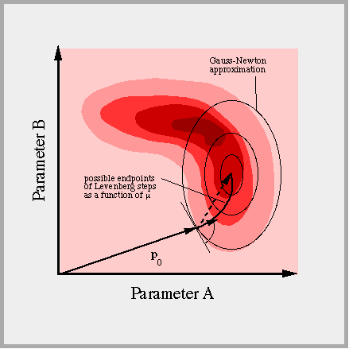
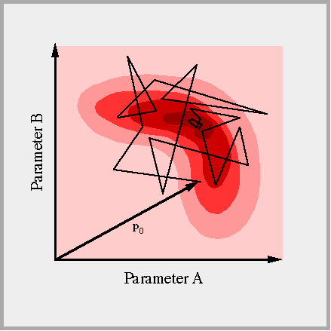
Creating a force field: Optimization method
Step 3: Construct an objective function and
apply an optimization method to minimize it.
The objective function measures the disagreement between the reference data and corresponding simulation result.
An optimization algorithm searches for parameters that minimize the objective function.
Grid Scan
Newton-Raphson
Simulated Annealing

Slide 11
Outline
Introduction
  Force fields in molecular mechanics
  The ingredients of a force field
    Functional form
    Reference data
    Optimization method
ForceBalance program for force field optimization
  Overview of program
  Application: Polarizable water model
  Results and discussion
  Basic program usage

Slide 12
Introducing ForceBalance
ForceBalance is free software for creating force fields.
Functional forms
Base
Class
AMBER
Force
Field
AMOEBA
File Parsing,
Parameter Rescaling and Constraints
Derived
Class
Written in Python
Direct interface with OpenMM
Highly flexible and easily extensible
Freely available at simtk.org with installation instructions and user’s manual
AM1, PM3
Restartable
Feature
Objective
Function
Optimizer
Bayesian
Regularization
ForceBalance
平 “ping” means
peace or balance
Energies and Forces
Simplex, Powell
Drivers:
OpenMM,
GROMACS,
TINKER,
AMBER
Electrostatic Potential
BFGS, Newton-Raphson
Experimental Properties
Simulated Annealing
Data and Simulations
Optimization Methods
http://simtk.org/home/forcebalance

Slide 13
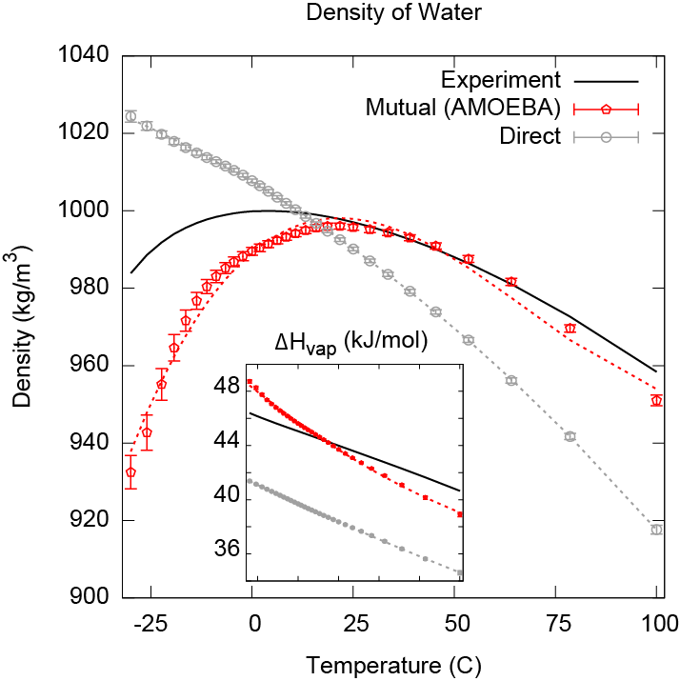
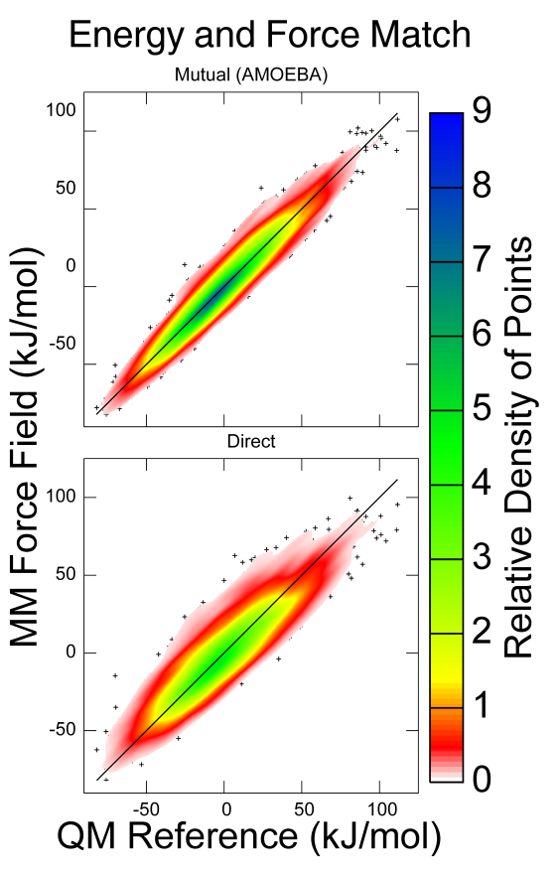
Polarizable water - motivation
We applied ForceBalance to parameterize a
variation on the AMOEBA water model.
The AMOEBA force field contains mutually induced dipoles
Direct induced dipoles are cheaper (5x faster) but the physics of the model are different
19 total tunable parameters

Slide 14
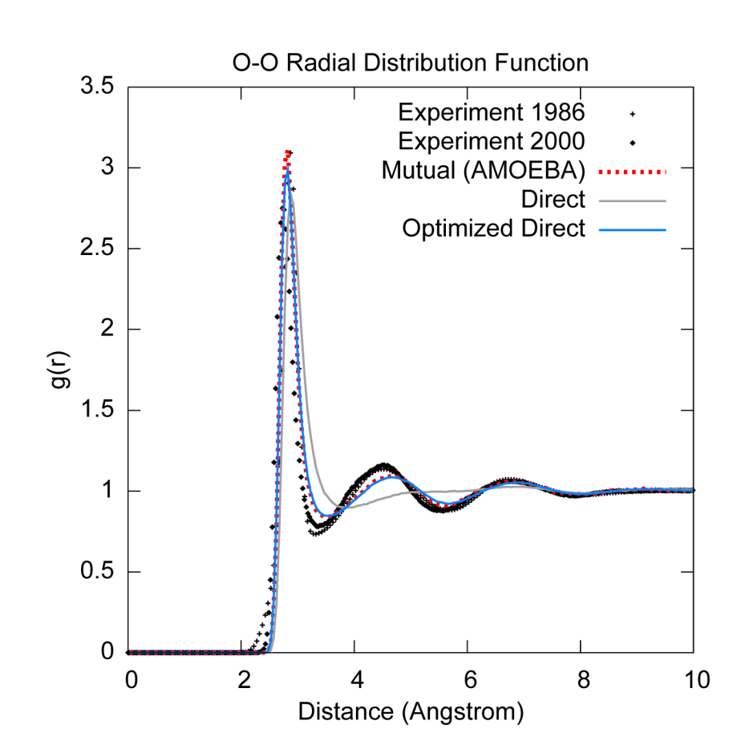
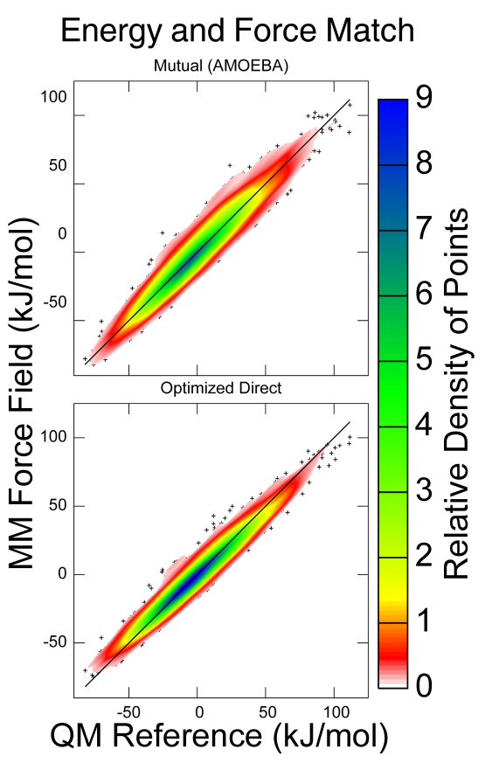
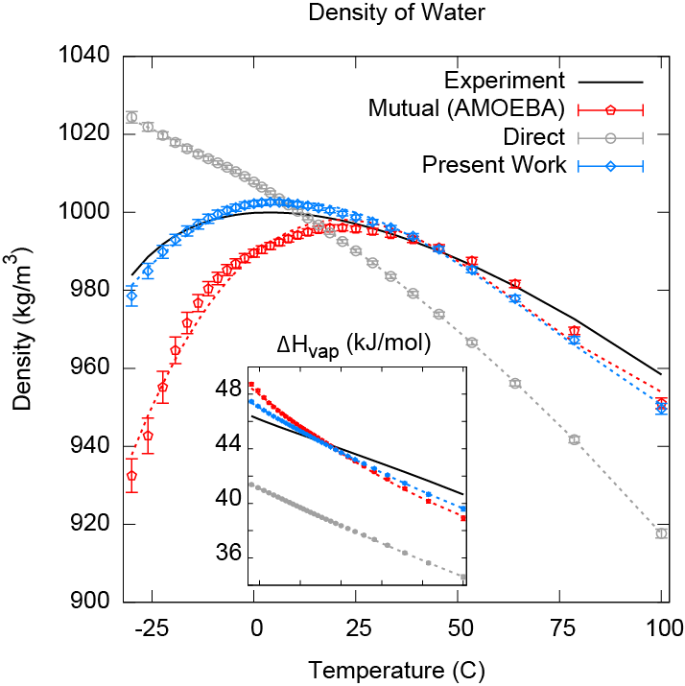
Polarizable water - results
Our optimized model exceeds the accuracy of AMOEBA for several properties of water.
We used a large set of experimental and theoretical data:
Energies and forces for 12,000 geometries from QM theory
Gas-phase cluster binding energies from QM theory
Experimental monomer geometry, vibrational modes, and multipole moments
Experimental density and
heat of vaporization curves
Fitted properties exceed accuracy of original AMOEBA
Other properties were also predicted accurately
Property | AMOEBA | This work | Experiment
Density (kg m⁻³) | 1000 ± 1 | 999 ± 1 | 997
ΔH_{vap} (kJ mol⁻¹) | 43.8 ± 0.1 | 43.8 ± 0.1 | 44.0
Dielectric constant | 81 ± 10 | 81 ± 5 | 78.4
Diffusion constant (10⁻⁵ cm² s⁻¹) | 2.0 ± 0.1 | 2.3 ± 0.1 | 2.3
Density maximum (ºC) | 15 - 25 | 0 - 10 | 4

Slide 15
Interface to OpenMM
ForceBalance interfaces with OpenMM
by importing it as a Python module.
Create
Systems
Execute
Simulations
Save
Simulation
Data
OpenMM
Interface
Write
Force Field
File
Build
Objective
Function
Start
Update
Parameters
Finish
Parameters
Converged?

Slide 16
Force field parameter files
The parameters to be optimized are
specified by labeling the XML file.
Simply add a “parameterize” attribute to the XML element containing parameters to be optimized.
At each optimization step, ForceBalance writes new parameter files containing updated parameter values.
Several other force field formats are supported (GROMACS .itp, AMBER .mol2 and .frcmod, TINKER .prm
Parameters can either be independent variables or arbitrary functions of other parameters (advanced functionality).
Example of labeled force field XML file
<AmoebaHarmonicBondForce>
<Bond class1="73" class2="74" length="0.09572" k="232986.04" parameterize="length, k" />
</AmoebaHarmonicBondForce>
<AmoebaHarmonicAngleForce>
<Angle class1="74" class2="73" class3="74" k="0.06207" angle1="108.50" parameterize="angle1, k" />
</AmoebaHarmonicAngleForce>

Slide 17
ForceBalance input file
The optimization is completely specified
using the input file.
Generate a documented input file with all available options with MakeInputFile.py
Set up directories containing reference data and simulation settings
Run the optimization using ForceBalance.py
Optimizations can be restarted by pasting sections of output back into input
Example of ForceBalance input file
$options
jobtype newton
tinkerpath /home/leeping/opt/tinker-6.1.01-intel/bin/
forcefield amoebawater.xml water.prm
trust0 0.1 # Levenberg-Marquardt trust radius
$end
$simulation
name LiquidCluster-12
simtype AbInitio_OpenMM
$end

Slide 18
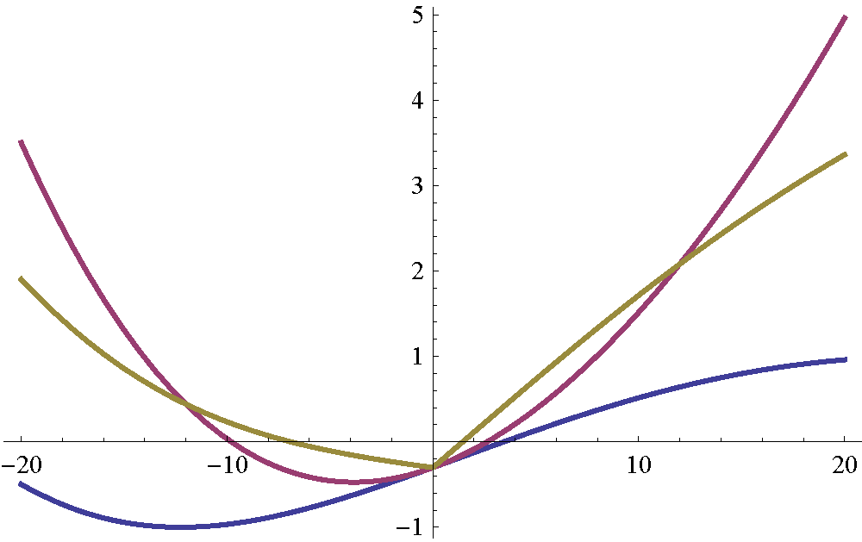
Bayesian regularization
Optimizations with hundreds of parameters are made possible through strict regularization.
We address overfitting issues by applying a Bayesian prior.
The prior affects the optimization by penalizing large parameter movements.
Different types of priors (Gaussian, Laplacian) have various impacts on the optimization behavior
Gaussian prior (L2 regularized):
Large movements penalized
Objective
Function
Laplacian prior (L1 regularized):
Some parameters don’t change
No regularization:
Prone to overfitting
Parameter

Slide 19
Conclusion
We hope that ForceBalance will systematize and democratize the discipline of force field development.
Systematic optimization methods:
Optimize parameters using theoretical and experimental data simultaneously
Parameterization calculations are reproducible and systematically improvable
Rigorously prevent overfitting using strict regularization methods
Give everybody the infrastructure for making good force fields:
Improve simulation accuracy for uncommon (non-mainstream) molecules, where force field development efforts are relatively sparse
All-inclusive: New interfaces with simulation software are easy to write
Reduce the headache of force field development and let’s focus on the science
http://simtk.org/home/forcebalance

