Slide 1
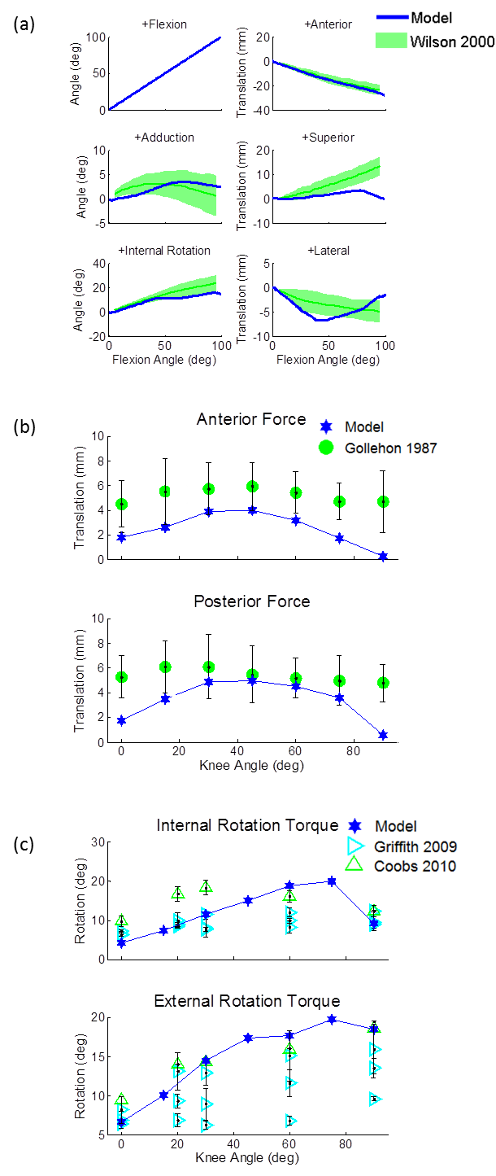
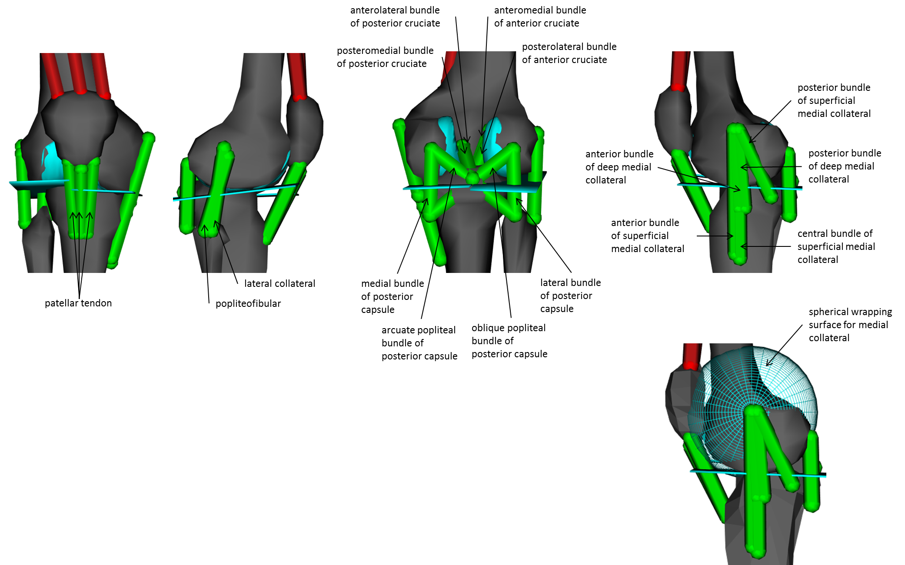
Development of an Open-Source, Discrete Element Knee Model
Anne Schmitz
Gannon University, Erie, PA
INTRODUCTION
Osteoarthritis, the most common form of arthritis, occurs more in the knee than any other joint [1].
Therefore, knee models are valuable tools that can be used to study normal joint function, simulate potential strategies to prevent injury, and assess the effect of treatment programs.
These models range in complexity from a hinge joint [2,3] to a complex continuum representation using finite element analysis [4].
Discrete element models offer a balance between simplified and finite element models by providing soft tissue loads at a low computational cost.
Uses of these models include the estimation of immeasurable forces (i.e. muscle forces and soft tissue loads) and the performance of ‘what-if’ studies.
For example, a discrete element model of the knee, which included cartilage loads and spring representations for ligaments, has been used to predict hamstring and quadriceps forces that could be used to restore normal joint function in a knee without an anterior cruciate ligament [5].
However, there is not an open-source, discrete element knee model available in the literature.
Therefore, the goal of this work was to develop a discrete element model of the knee that is open-source.
RESULTS AND DISCUSSION
Passive motion and stiffness properties of the model mostly agreed with the range presented in the literature (Figure 2).
This provides a comprehensive description of the passive behavior of the model and highlights its physiological relevance.
However, there are some exceptions to note.
When the model was flexed, the tibia did not translate as much superiorly as the literature suggests. This may be largely governed by the contact geometry.
Also, anterior translation of the model under an applied anterior force was on the low side of the literature range. However, further loosening of the ligaments to increase this translation caused intercondylar lift-off during the passive flexion motion.
This model has many applications:
investigate the sensitivity of passive motion and stiffness to ligament properties and placements
investigate the effect of scaling on passive behavior
used to create a surrogate model
used in a cosimulation or serial (e.g. [16]) approach to predict soft tissue loading during movement
METHODS
The right femur and tibia of a generic musculoskeletal model (i.e. gait2392 model [6]) were scaled for a 77.5 kg female in the open-source software OpenSim [7].
A six degree-of-freedom (dof) tibiofemoral joint and one dof patellofemoral joint were created that included tibiofemoral contact, ligaments, and vastii muscles (Figure 1).
The patellofemoral joint was modeled as a one dof joint where the patella moved in a constrained path about the distal femur subject to vastii and patellar tendon forces.
Contact was modeled between the femur and tibia using an elastic foundation model [8].
The geometry of the distal femur articular cartilage was based on an open-source finite element knee model [9].
The tibial plateaus were modeled as two planes: the lateral plateau sloped 7 degrees posteriorly and 2 degrees laterally while the medial plateau sloped 2 degrees posteriorly and medially [5,10].
Eighteen ligament bundles were included in the model: anterior cruciate ligament (ACL, 2), posterior cruciate ligament (PCL, 2), medial collateral ligament (MCL, 5), lateral collateral ligament (LCL, 1), poplitofibular ligament (PFL, 1), posterior capsule (4), and patellar tendon (3).
The origins and insertions were based on the literature and modeled as nonlinear elastic springs with properties adapted from the literature [5,11].
The properties were minimally tuned to match the model behavior to literature measures of passive motion, anterior-posterior stiffness, and axial rotational stiffness.
The developed model is available from https://simtk.org/home/kneemodel and can be freely downloaded and recreated using OpenSim.
To validate the model, its passive behavior was compared to cadaveric literature.
First, the model was passively flexed while the other five dof were compared with [12].
Next, an anterior and posterior force of 100N was applied to the tibia with the amount of anterior-posterior translation measured [13].
Then, an axial rotation torque of 5Nm was applied to the tibia with the resulting rotation measured [14,15].
Figure 2: (a) Passive motion of the tibiofemoral joint compared to [12]. (b) Anterior-posterior translation of the tibia resulting from application of 100N. Results compared to [13]. (c) Axial rotation of the tibia with 5Nm torque applied. Results compared to [14,15].
CONCLUSIONS
A discrete element knee model has been presented.
Through a comparison with the literature, the model has shown physiologically reasonable passive behavior.
A novel element of the model is that it is open-source.
This enables more researchers to add to the refinement of the model as well as providing modeling as an accessible tool to a wider audience.
REFERENCES
Oliveria, S. A., et al. Arth and Rheu 38, 1134-1141, 2005.
Asano, T., et al. J Arthro 20, 1060-1067, 2005.
Reinbolt, J. A., et al. J Biomech 38, 621-626, 2005.
Dhaher, Y. Y., et al. J Biomech 43, 3118-3125, 2010.
Shelburne, K. B., et al. Med Sci Sports Exerc 37, 642-648, 2005.
Delp, S. L., et al. IEEE Trans on BME 37, 757-767, 1990.
Delp, S. L., et al. IEEE Trans BME (in press), 2007.
Sherman, M. A., et al. Procedia IUTAM 2, 241-261, 2011.
Sibole, S., et al. Proc of 34th Annual Meeting of the American Society of Biomechanics, Providence, RI, 2010.
Garg, A., et al. J Biomech 23, 45-53, 55-58, 1990.
Shin, C. S., et al. J Biomech 40, 1145-1152, 2007.
Wilson, D., et al. J Biomech 33, 465-473, 2000.
Gollehon, D. L., et al. J Bone Joint Surg Am 69, 233-242, 1987.
Griffith, C. J., et al. Am J Sports Med 37, 1762-1770, 2009.
Coobs, B. R., et al. Am J Sports Med 38, 339-347, 2010.
Shelburne, K. B., et al. J Biomech 37, 797-805, 2004.
Figure 1: Discrete element knee model created in OpenSim

