Slide 1
1: Young’s Modulus and prestretch tests for all ligaments
For all ligaments: Prestretch 0.8 to 1.05 in steps of 0.01 Young’s modulus literature + and – 60: ACL: 63 – 183 in steps of 20 literature = 123 PCL: 108 – 228 in steps of 20 literature = 168 MCL: 164 – 284 in steps of 20 literature = 224 LCL: 220 – 340 in steps of 20 literature = 280 Simulations: All ligaments: 0.5 rad flexion (FE) ACL: AP in the anterior direction (tib relative to fem) → 5 mm PCL: AP in the posterior direction (tib relative to fem) → 5 mm MCL: VV into valgus (-VV) → 3° (0.05235 rad) LCL: VV into varus (+VV) → 3° (0.05235 rad)
Prestretch applied between step 0.1 and 0.2, full simulation until 1.0

Slide 2
ACL - AP simulations
Tibia moving anterior with respect to the femur 5mm

Slide 3
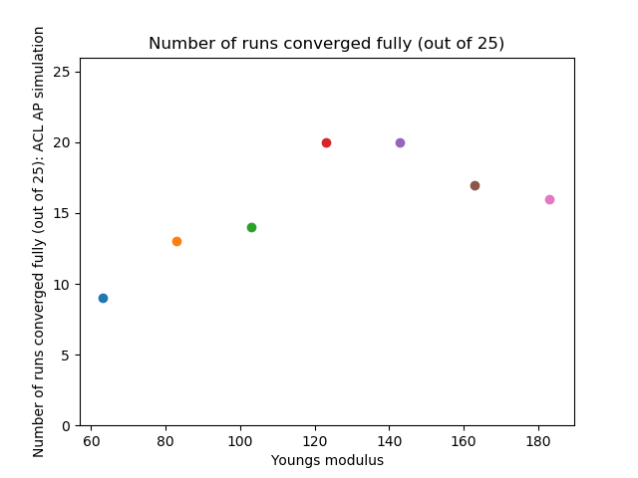
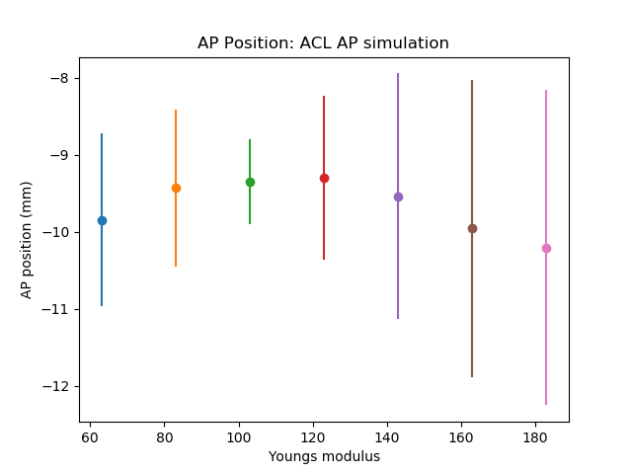
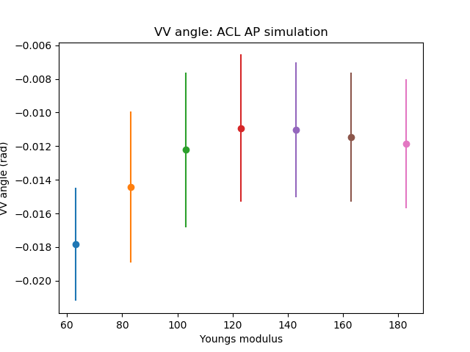
ACL – AP simulations: Young’s modulus

Slide 4
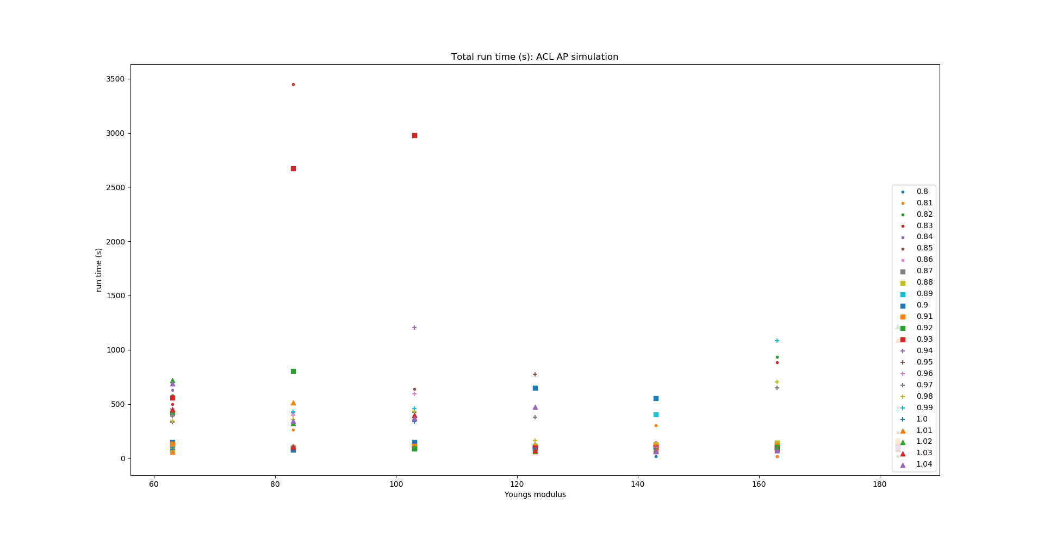
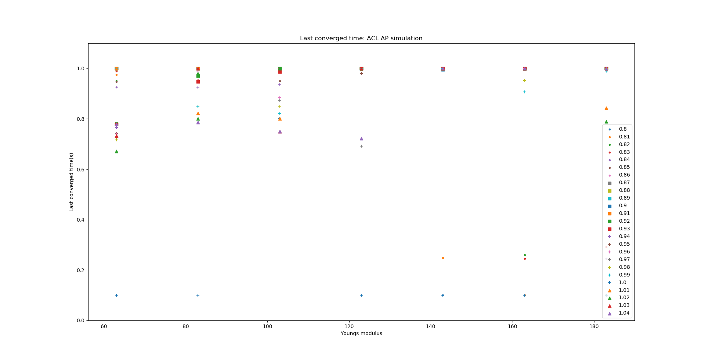
ACL – AP simulations: Young’s modulus

Slide 5
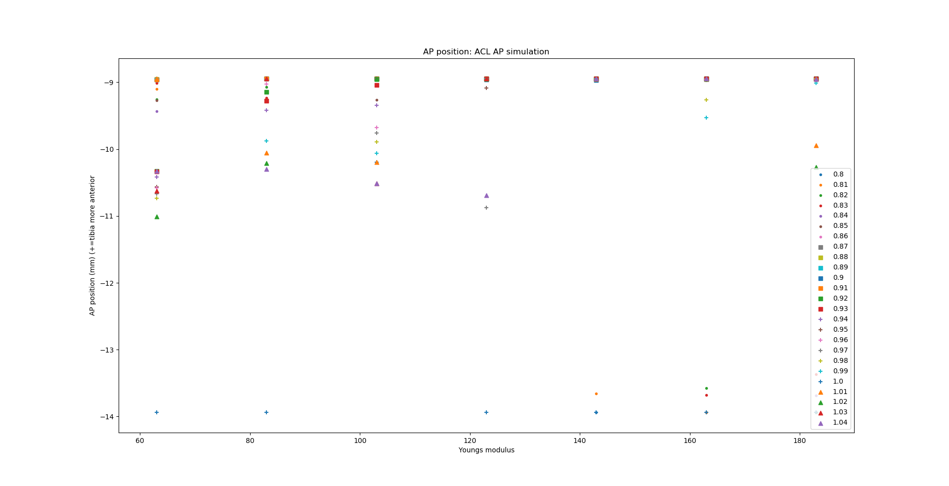
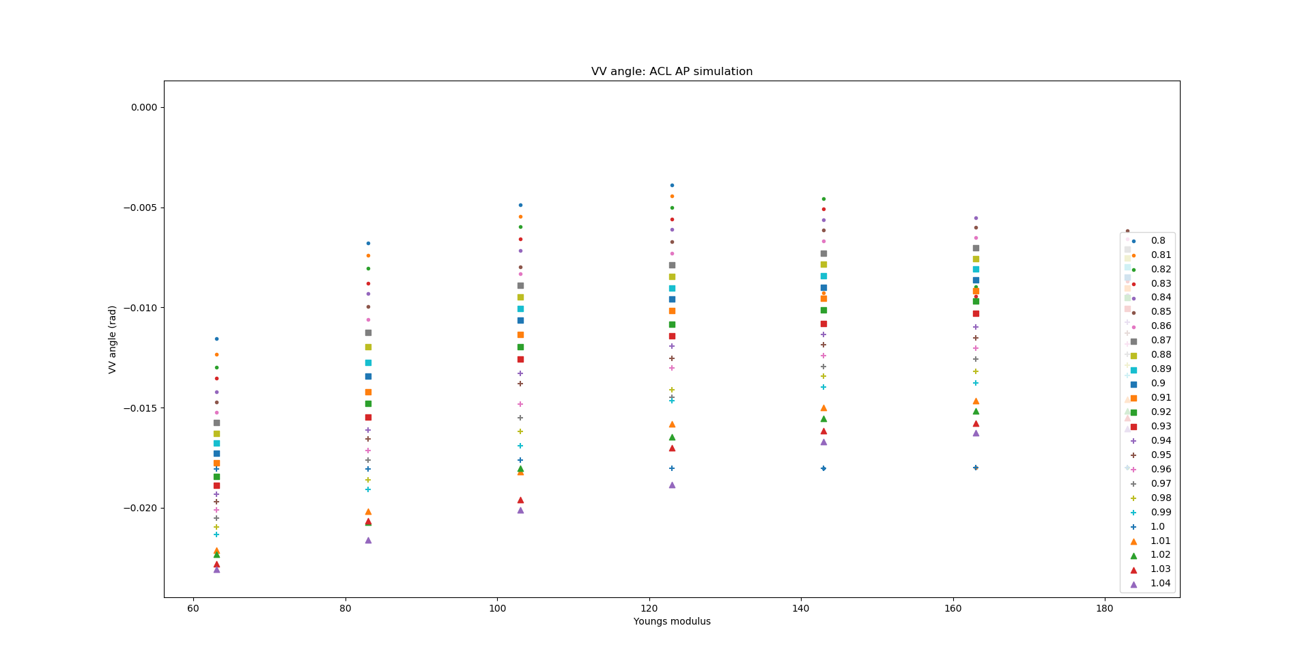
ACL – AP simulations: Young’s modulus

Slide 6
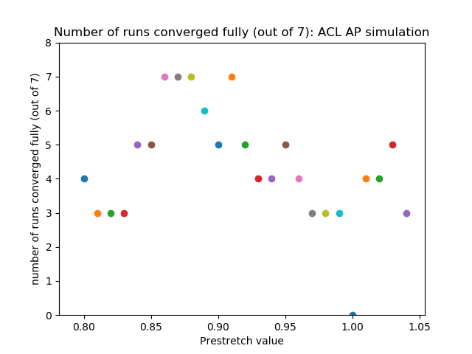
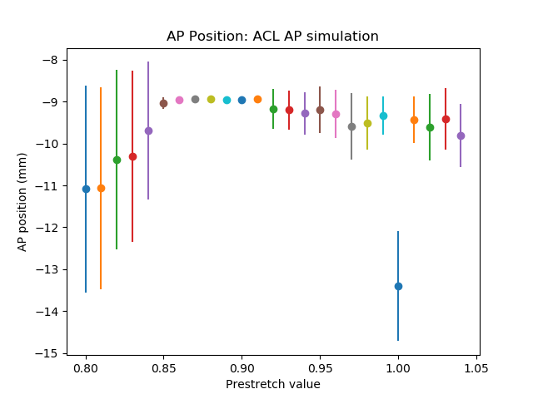
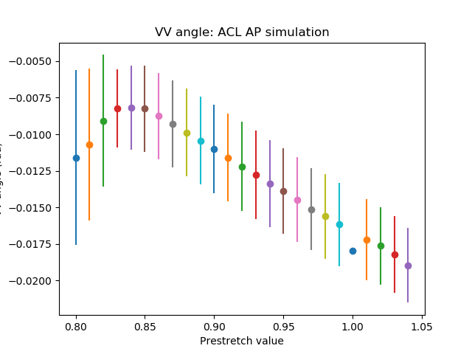
ACL – AP simulations: Prestretch value

Slide 7
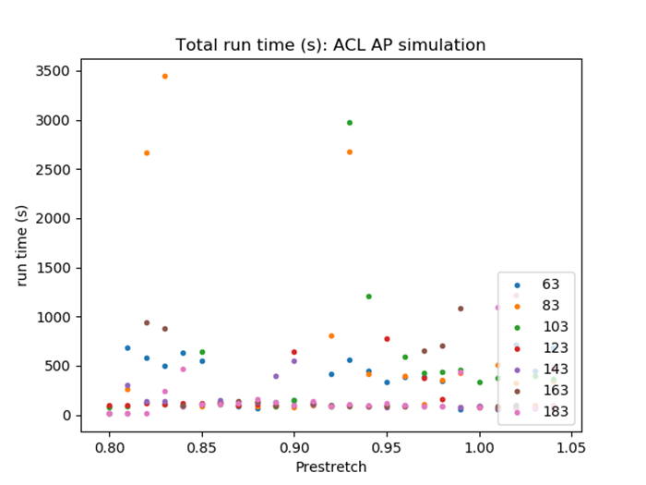
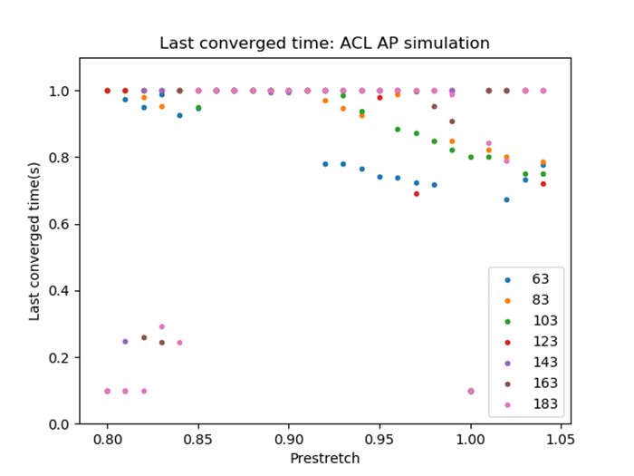
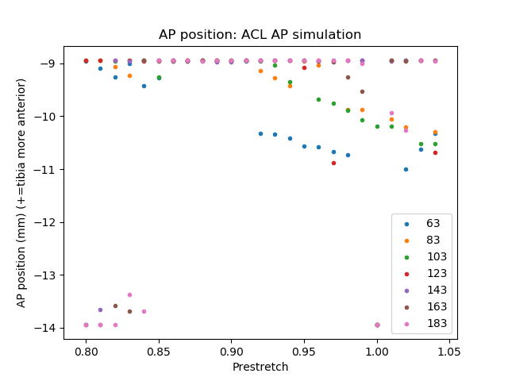
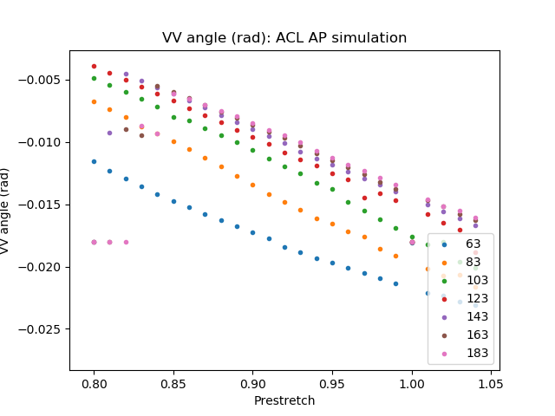
ACL – AP simulations: Prestretch value

Slide 8
ACL - FE simulations
0.5 rad flexion rotation

Slide 9
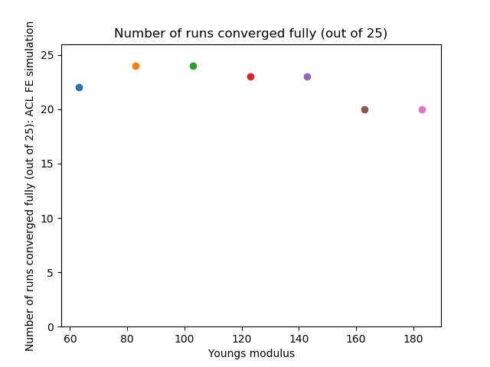
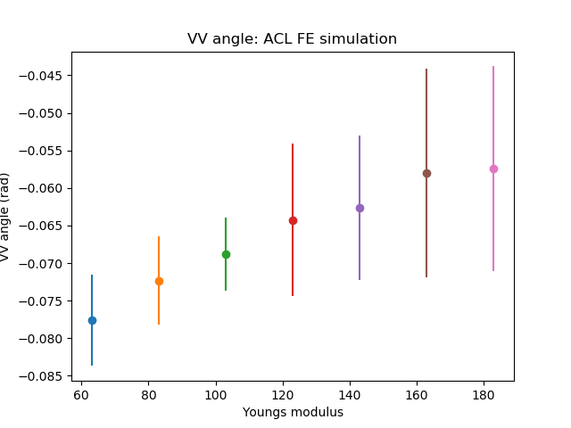
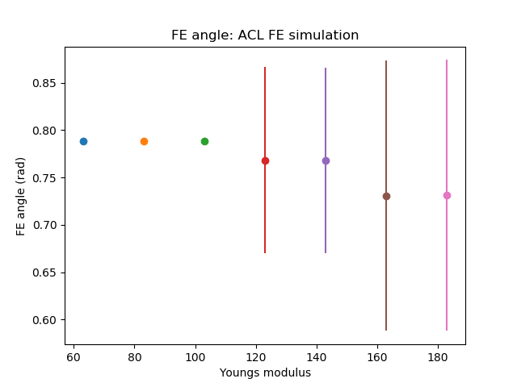
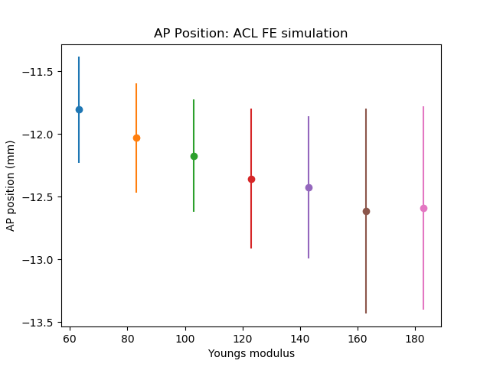
ACL – FE simulations: Young’s modulus

Slide 10
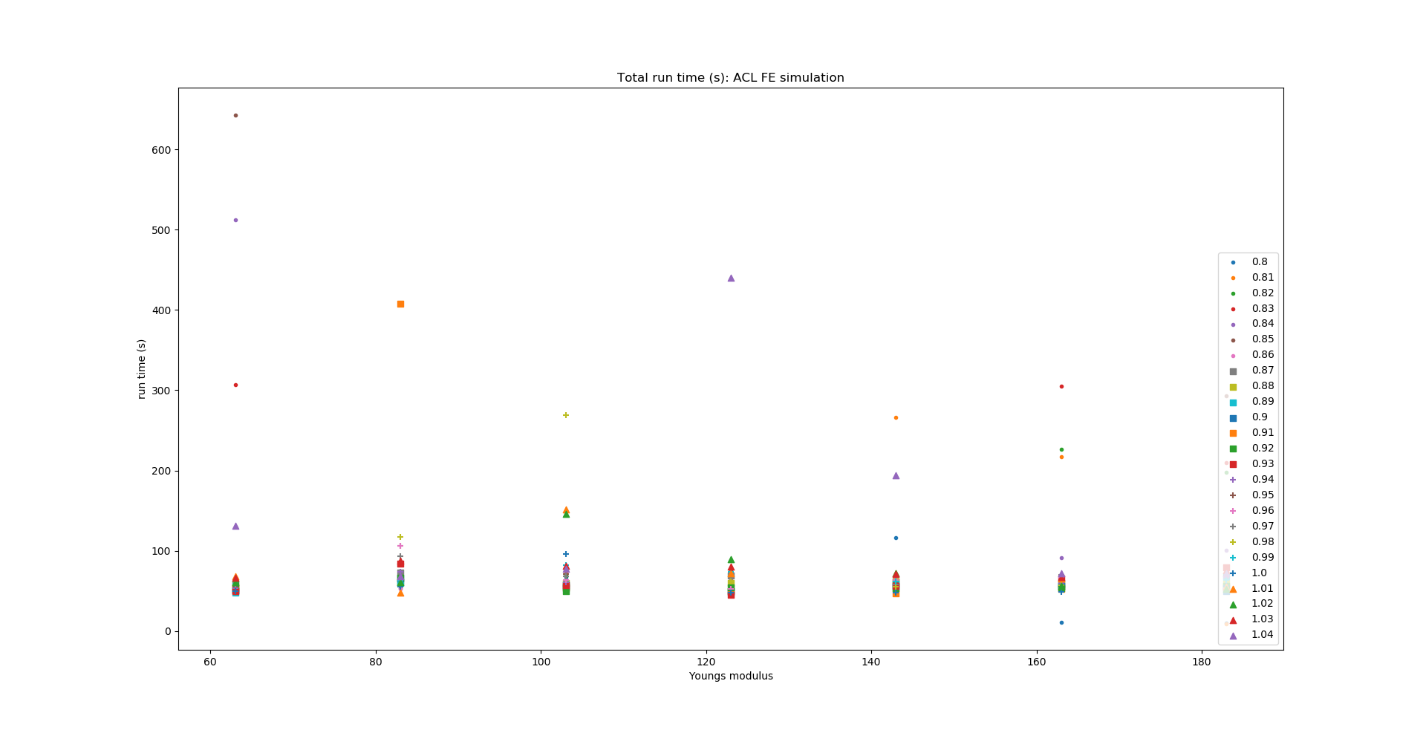
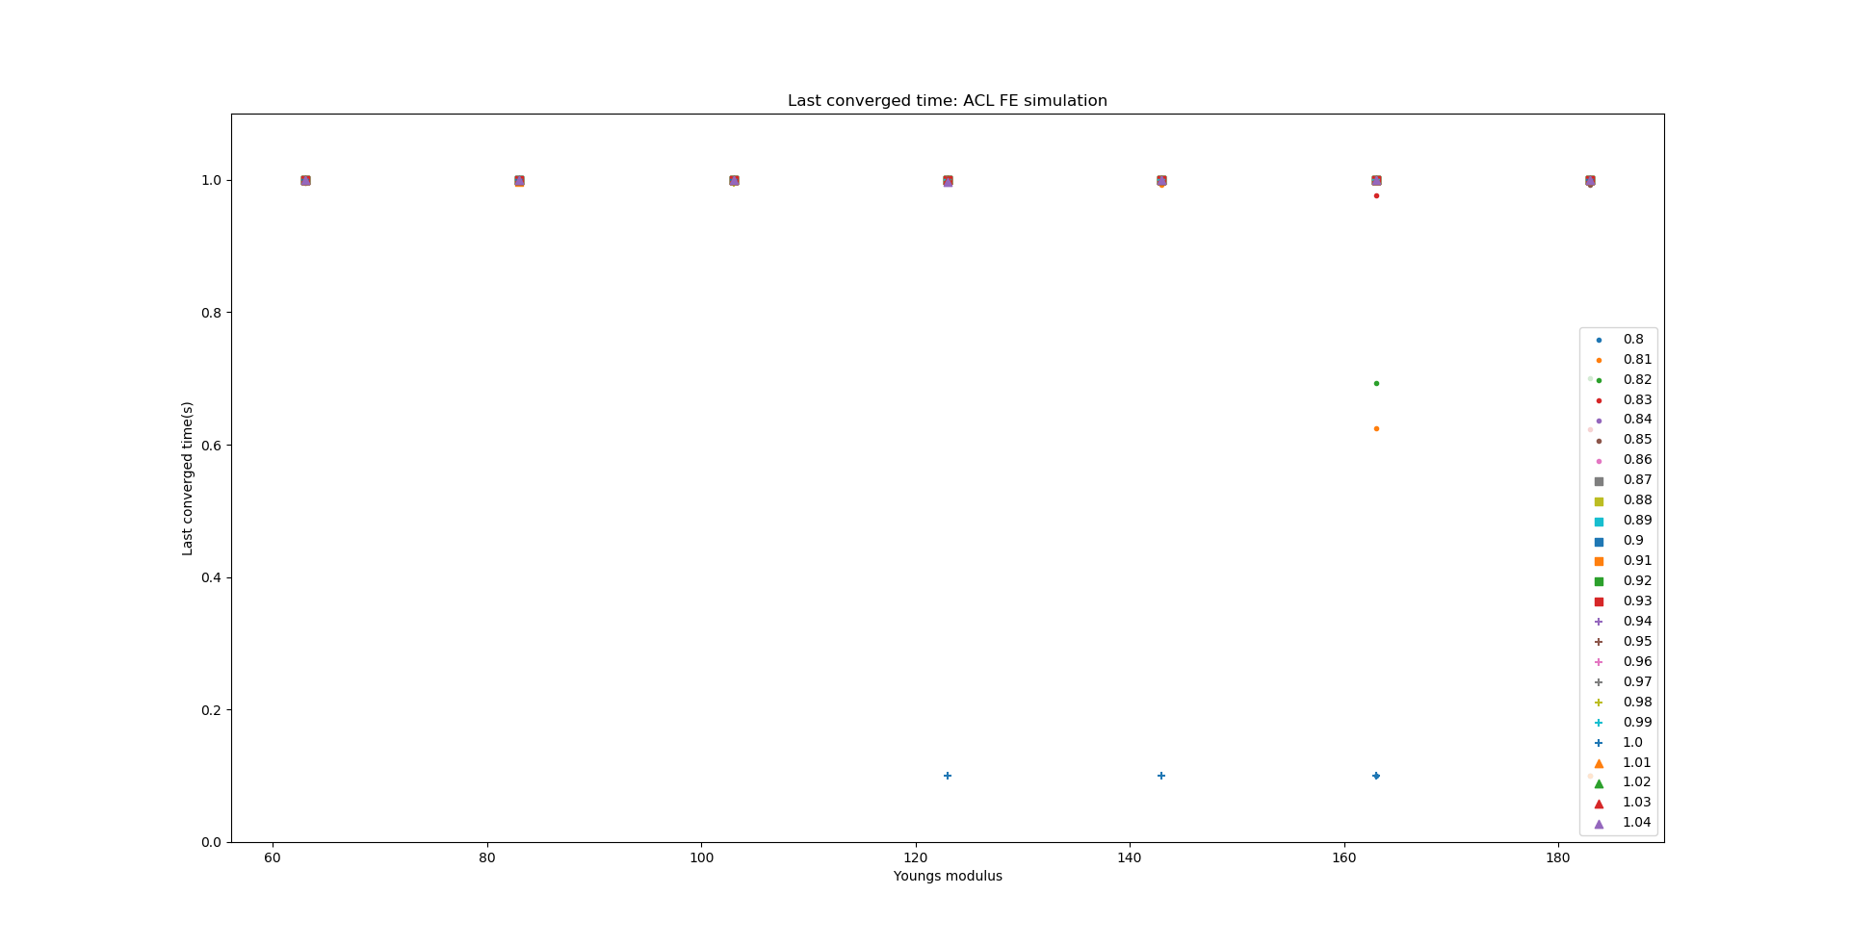
ACL – FE simulations: Young’s modulus

Slide 11
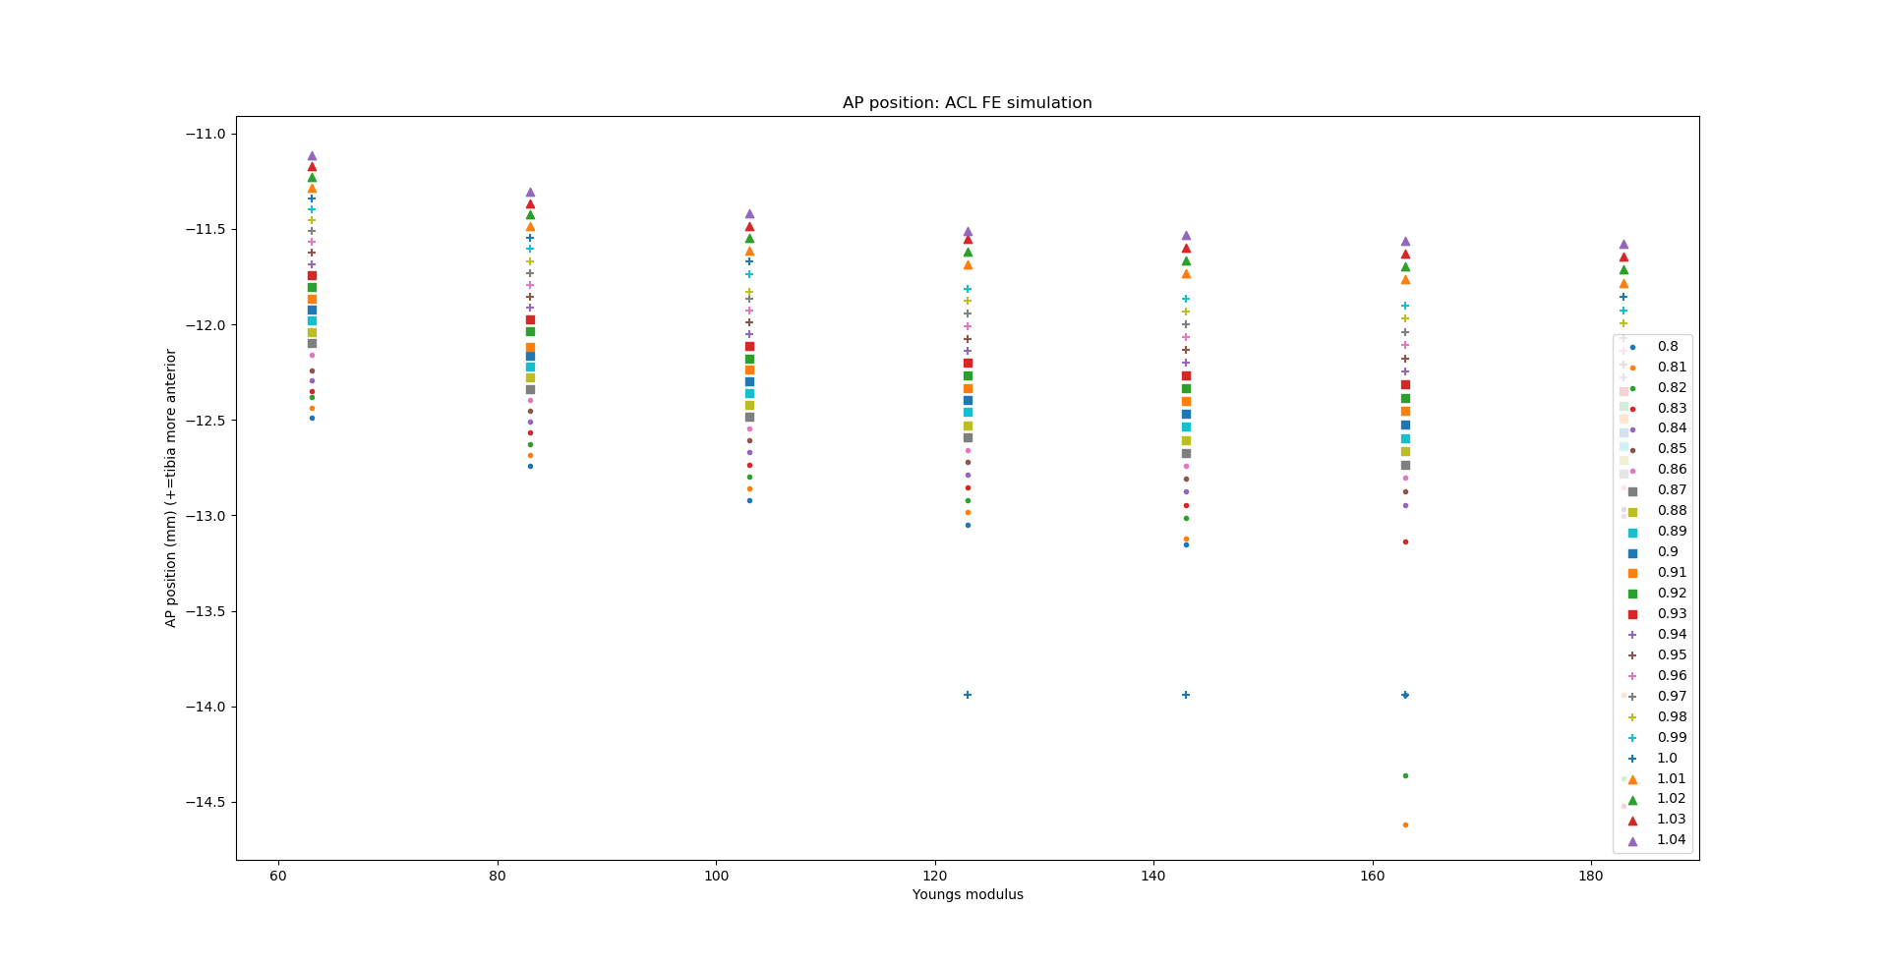
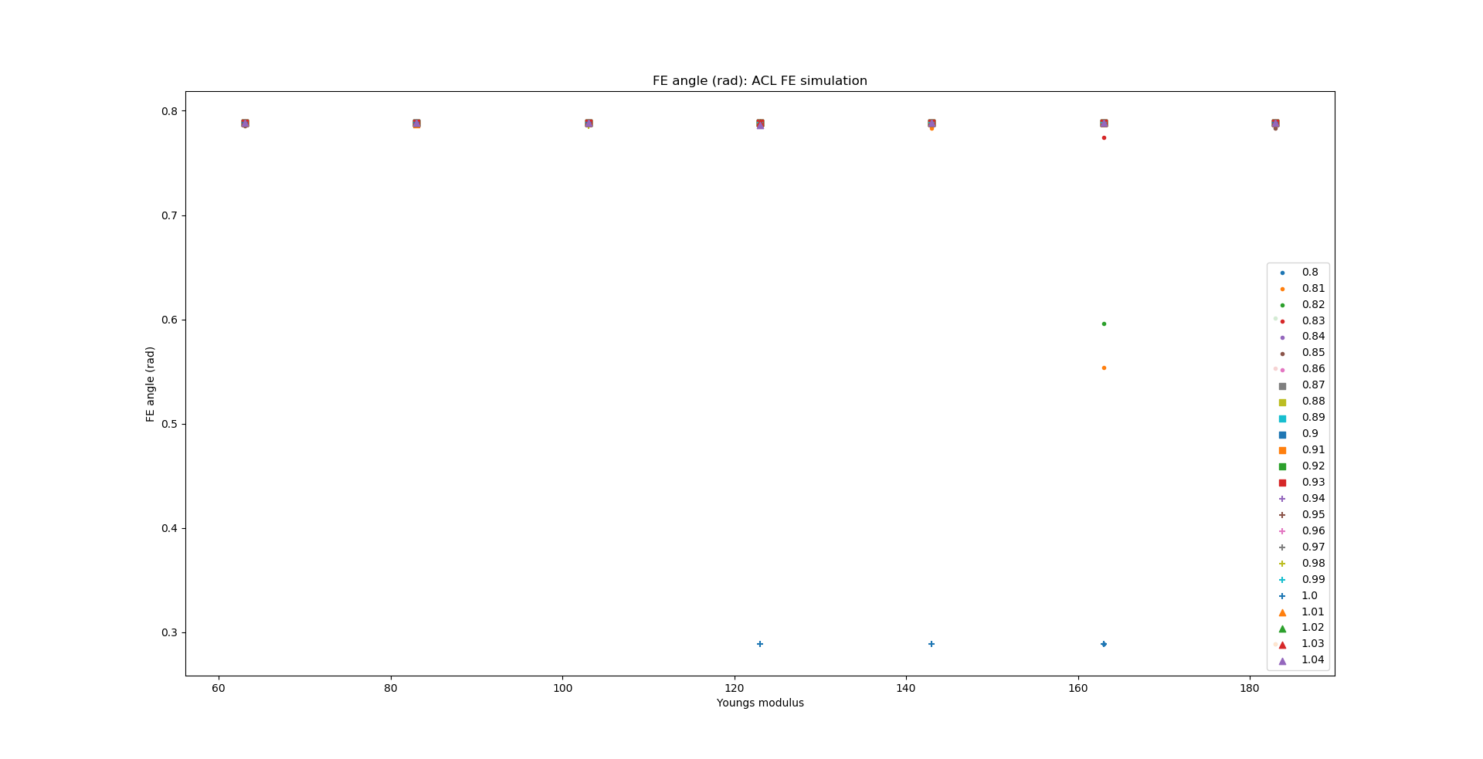
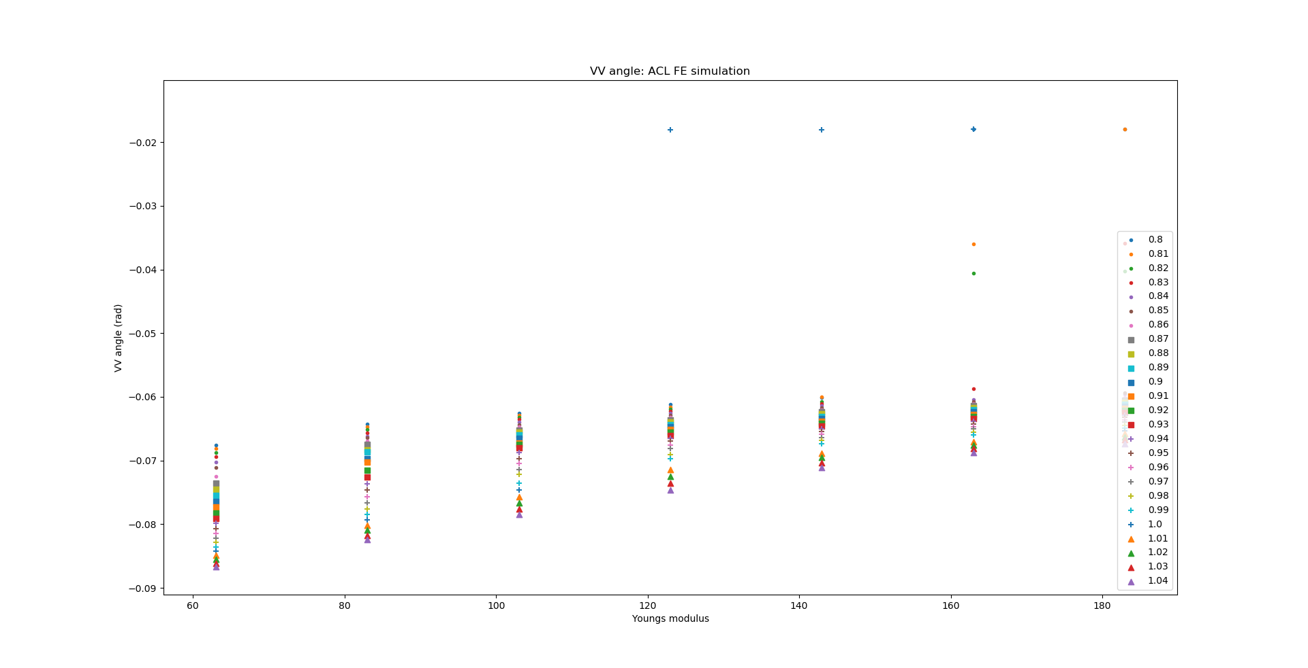
ACL – FE simulations: Young’s modulus

Slide 12
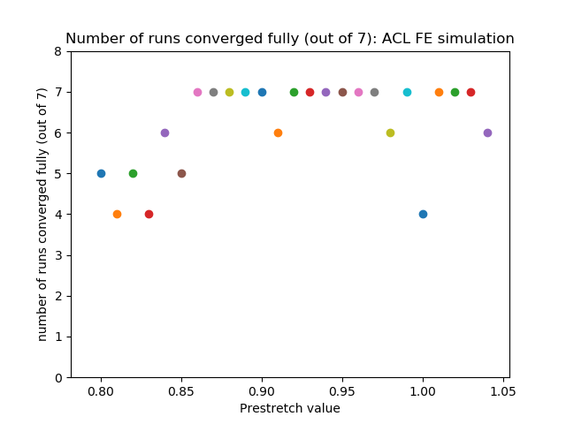
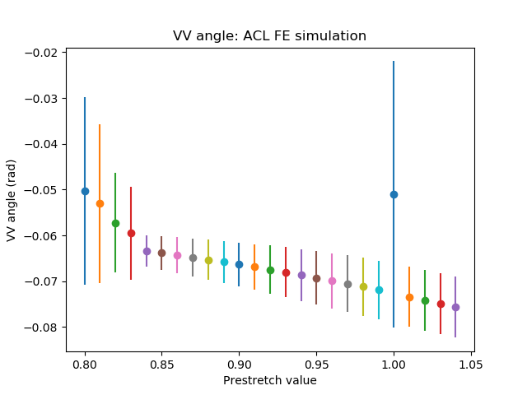
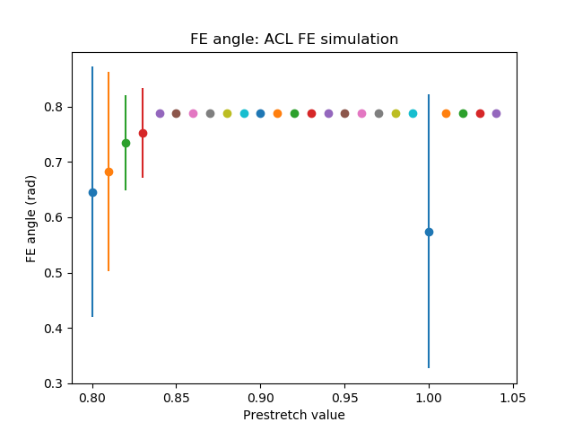
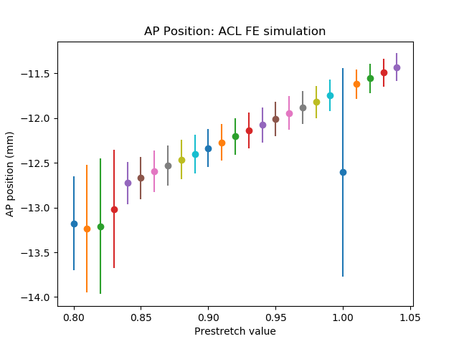
ACL – FE simulations: Prestretch value

Slide 13
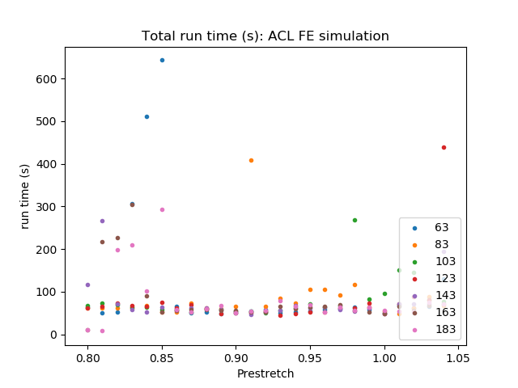
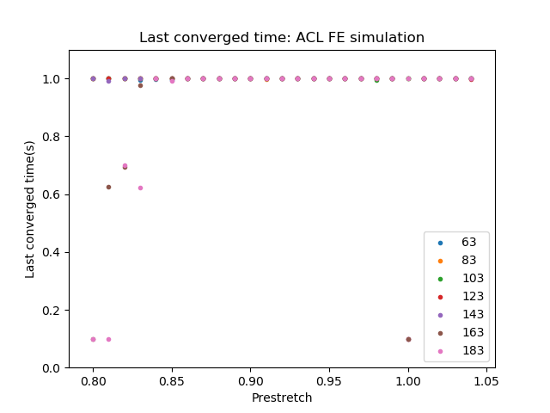
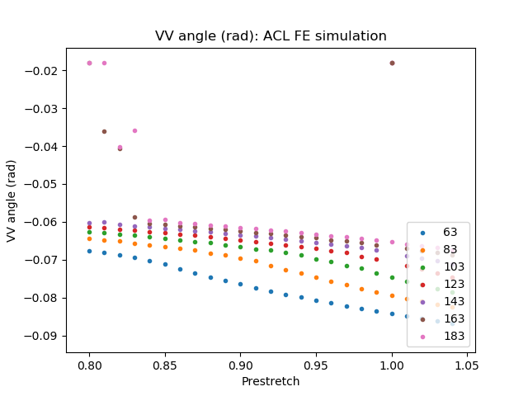
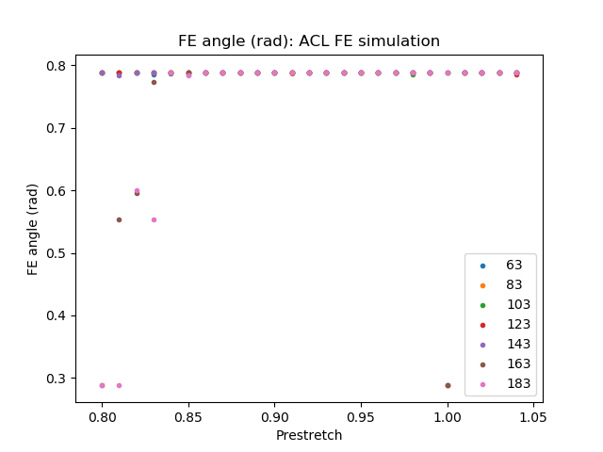
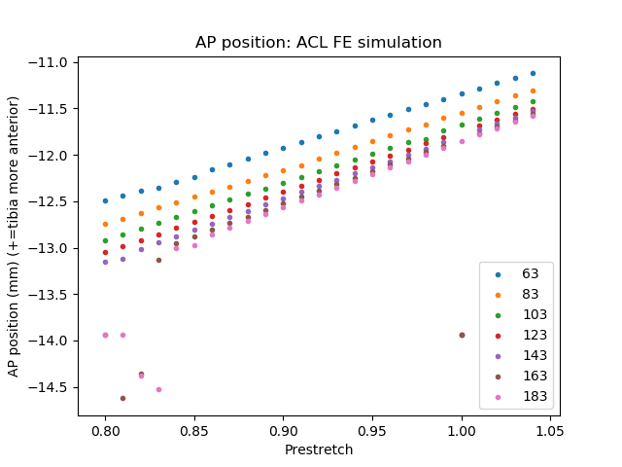
ACL – FE simulations: Prestretch value

Slide 14
PCL - AP simulations
Tibia moving posterior with respect to the femur 5mm

Slide 15
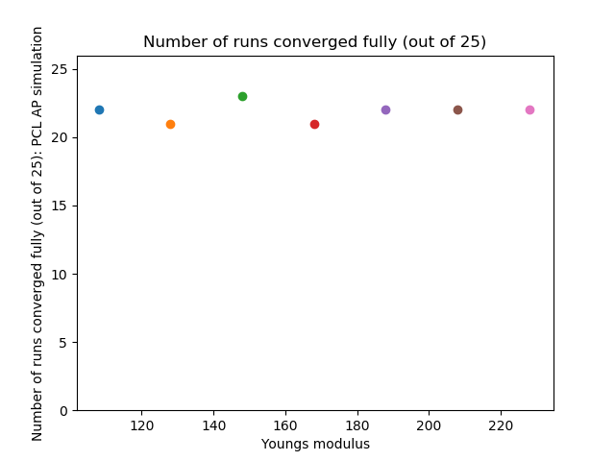
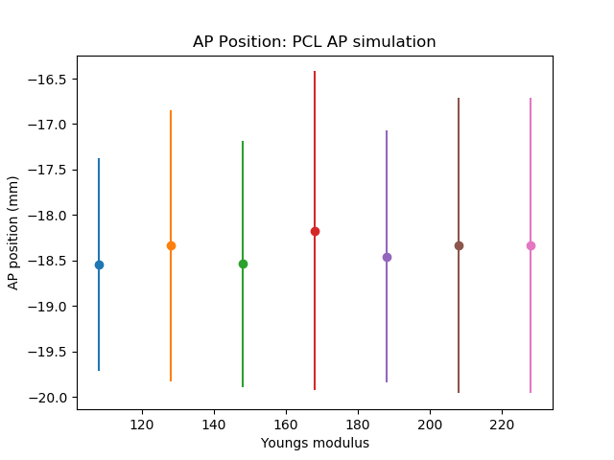
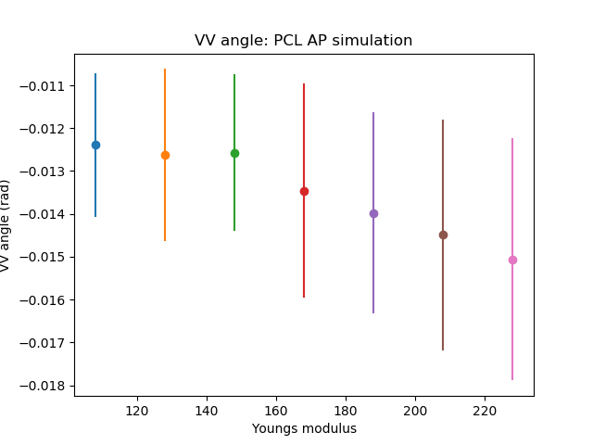
PCL - AP simulations: Young’s modulus

Slide 16
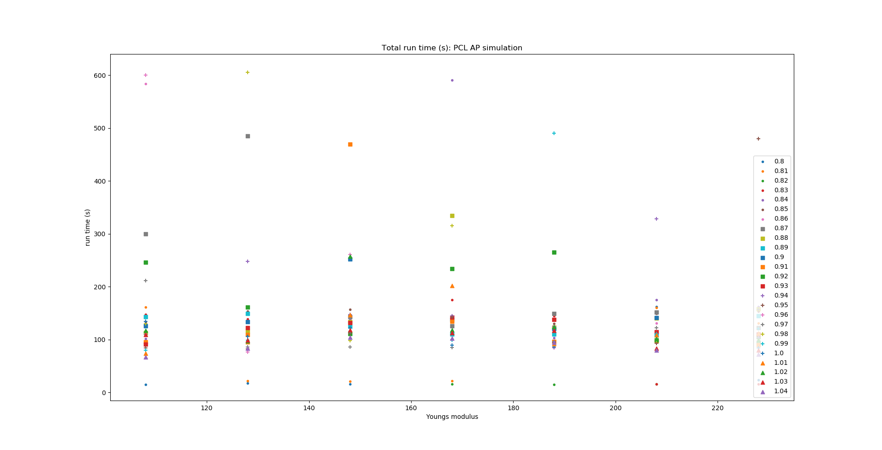
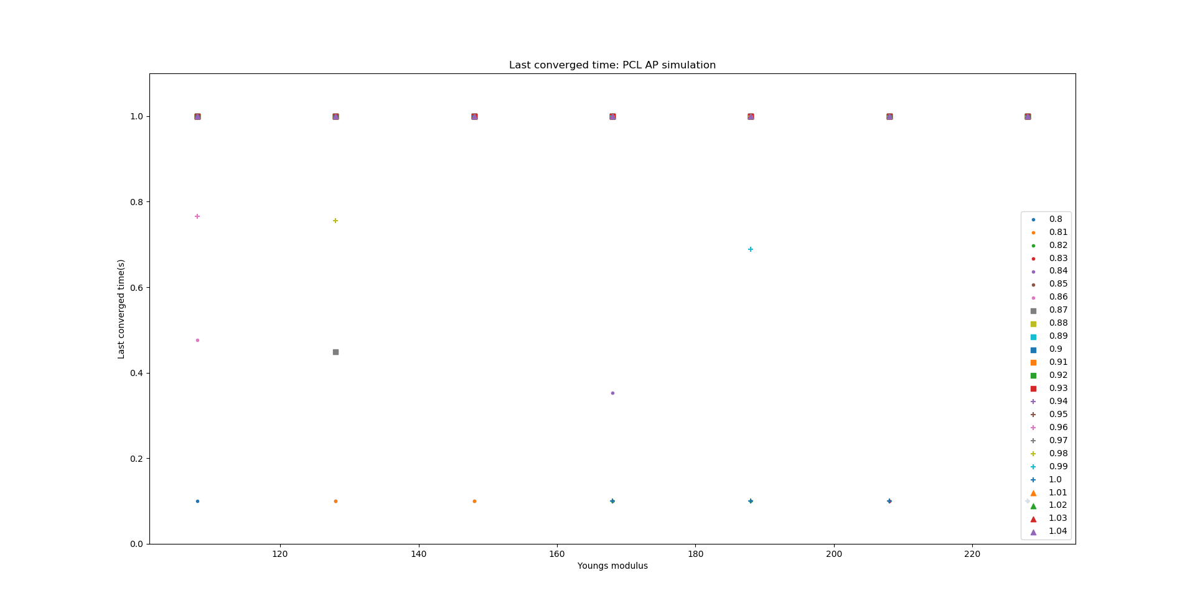
PCL - AP simulations: Young’s modulus

Slide 17
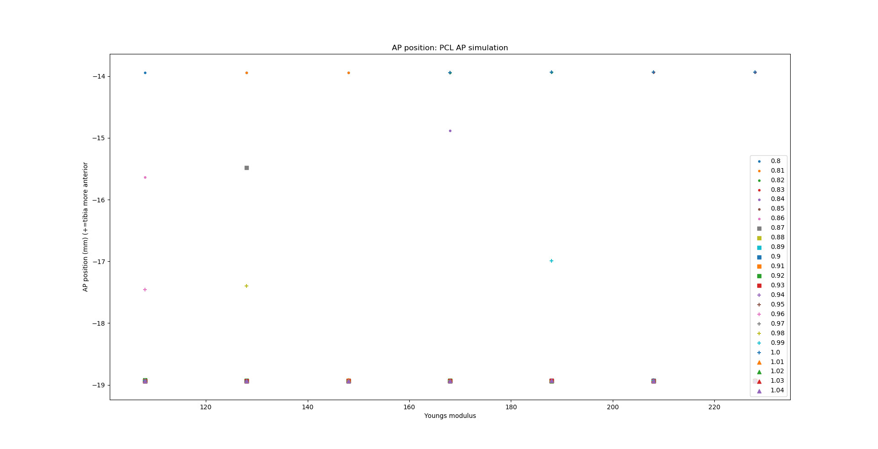
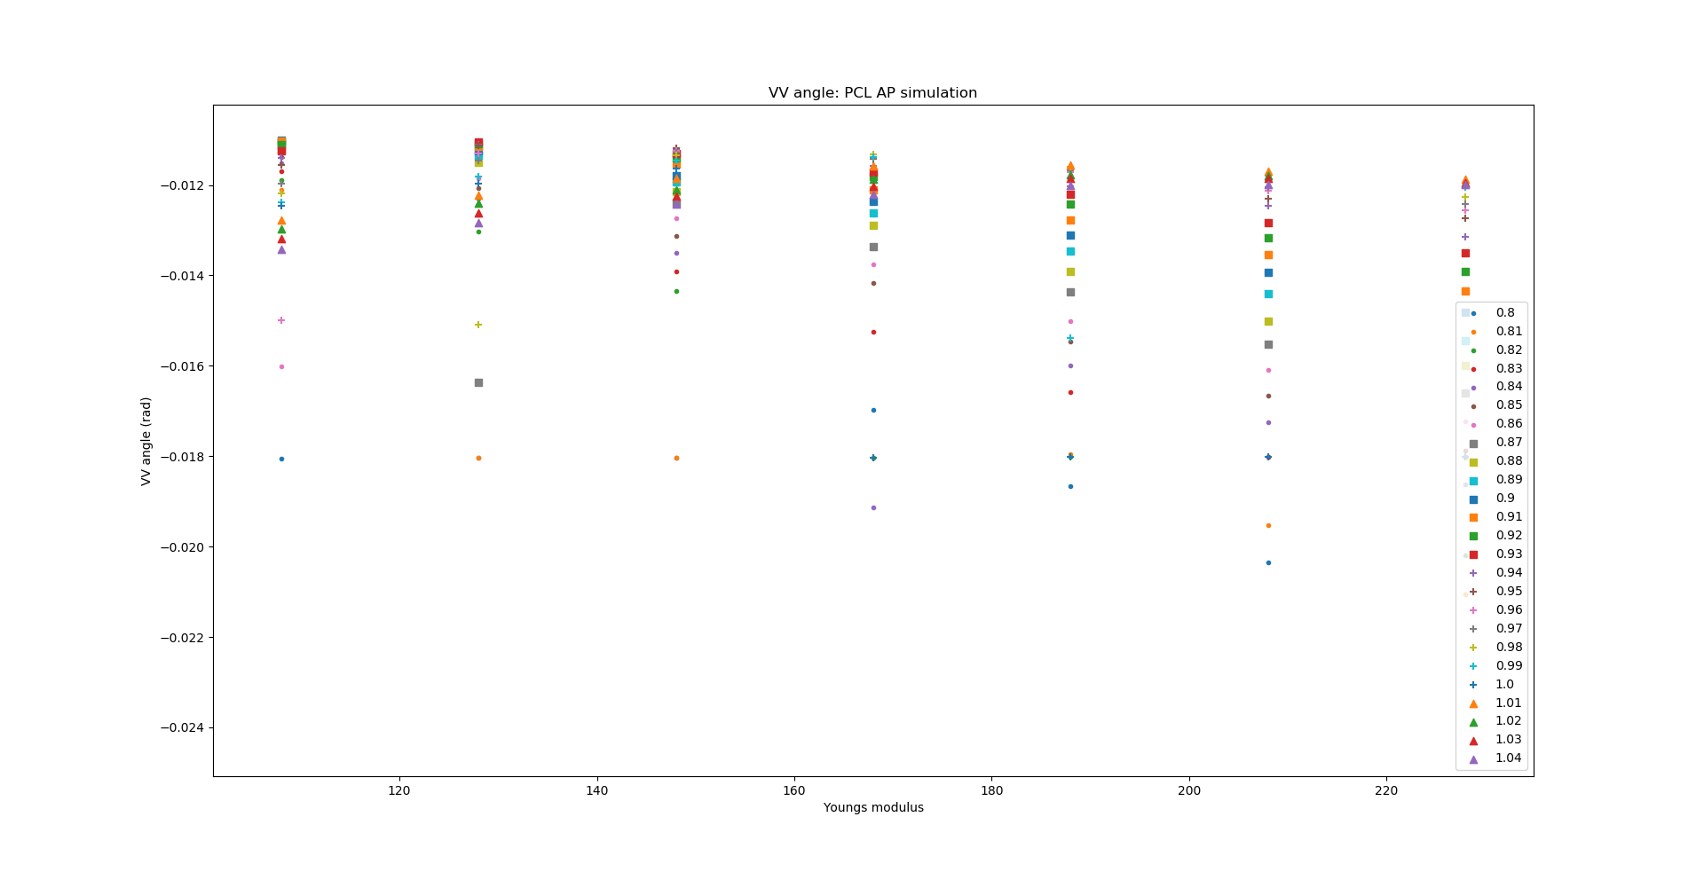
PCL - AP simulations: Young’s modulus

Slide 18
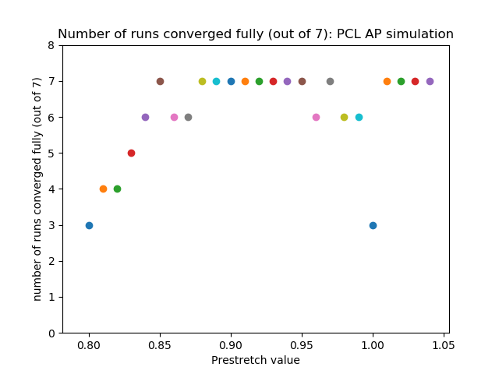
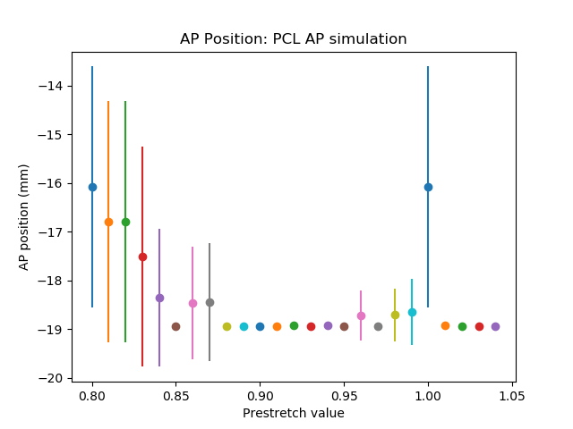
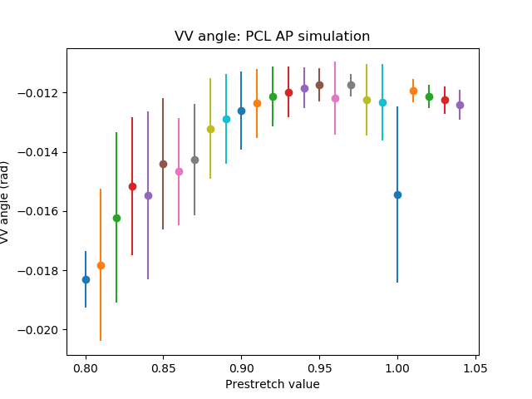
PCL - AP simulations: Prestretch value

Slide 19
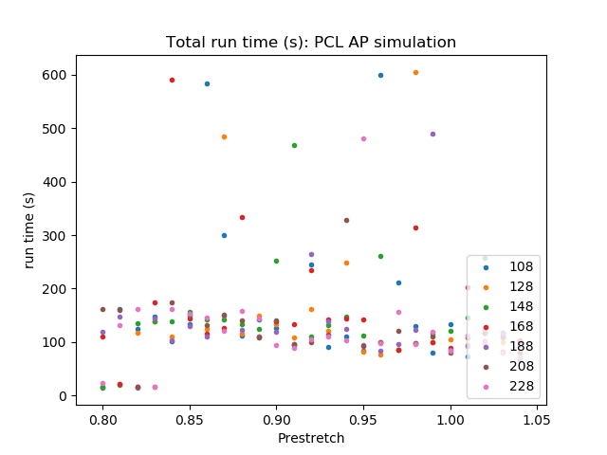
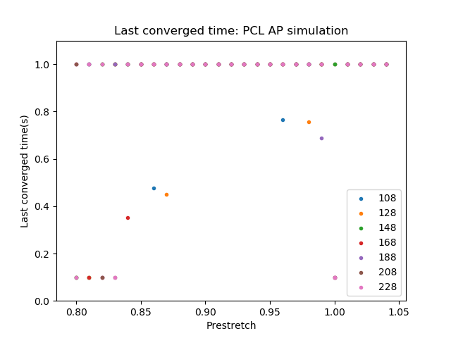
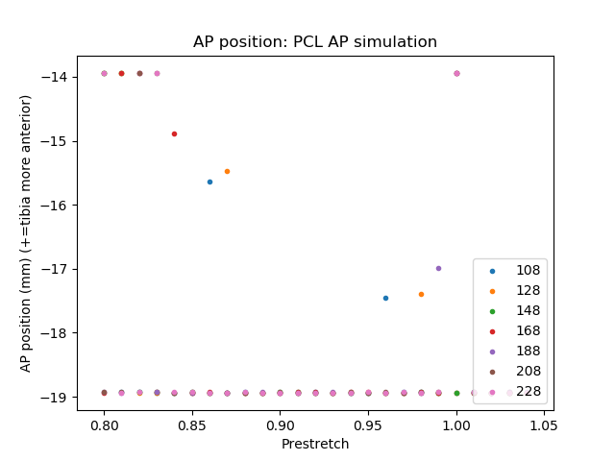
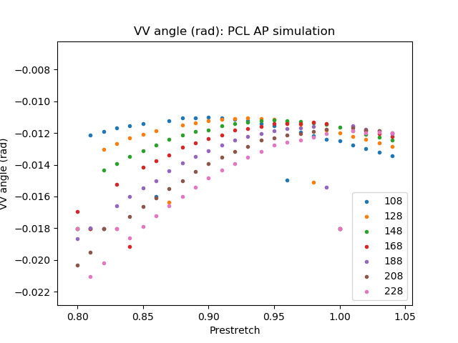
PCL - AP simulations: Prestretch value

Slide 20
PCL - FE simulations
0.5 rad flexion rotation

Slide 21
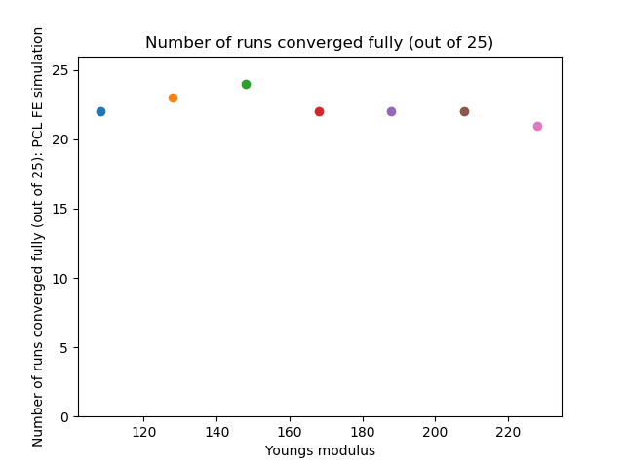
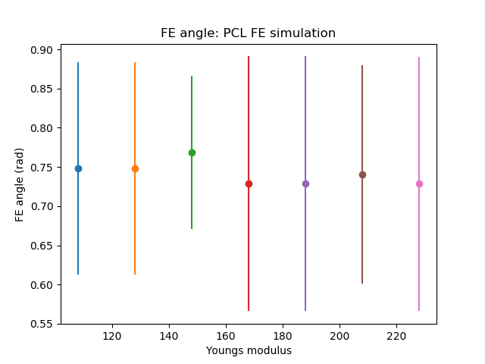
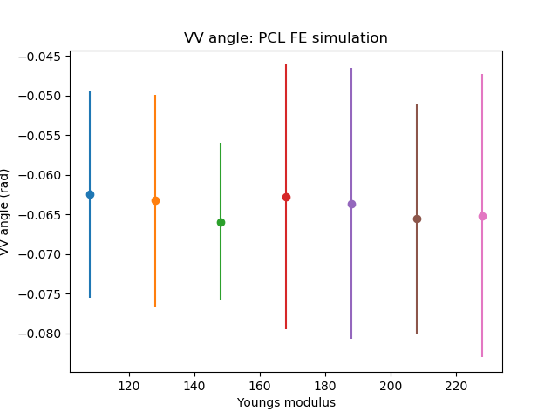
PCL - FE simulations: Young’s modulus

Slide 22
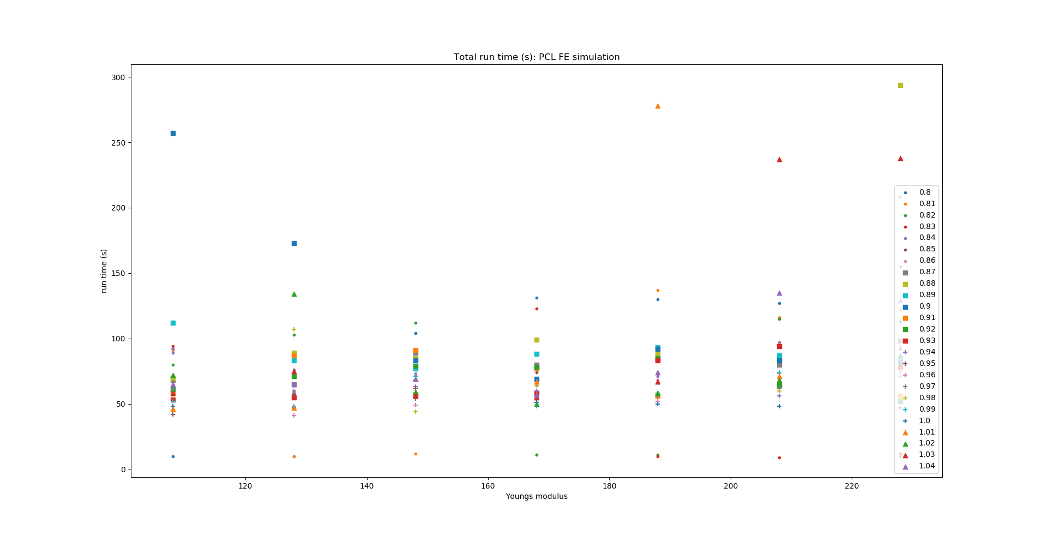
PCL - FE simulations: Young’s modulus

Slide 23
PCL - FE simulations: Young’s modulus

Slide 24
PCL - FE simulations: Prestretch value

Slide 25
PCL - FE simulations: Prestretch value

Slide 26
MCL - VV simulations
Rotation in the valgus direction 3 degrees: 0.05235 rad

Slide 27
MCL - VV simulations: Young’s modulus

Slide 28
MCL - VV simulations: Young’s modulus

Slide 29
MCL - VV simulations: Young’s modulus

Slide 30
MCL - VV simulations: Prestretch value

Slide 31
MCL - VV simulations: Prestretch value

Slide 32
MCL - FE simulations
0.5 rad flexion rotation

Slide 33
MCL - FE simulations: Young’s modulus

Slide 34
MCL - FE simulations: Young’s modulus

Slide 35
MCL - FE simulations: Young’s modulus

Slide 36
MCL - FE simulations: Prestretch value

Slide 37
MCL - FE simulations: Prestretch value

Slide 38
LCL - VV simulations
Rotation in the varus direction 3 degrees: 0.05235 rad

Slide 39
LCL - VV simulations: Young’s modulus

Slide 40
LCL - VV simulations: Young’s modulus

Slide 41
LCL - VV simulations: Young’s modulus

Slide 42
LCL - VV simulations: Prestretch value

Slide 43
LCL - VV simulations: Prestretch value

Slide 44
LCL - FE simulations
0.5 rad flexion rotation

Slide 45
LCL - FE simulations: Young’s modulus

Slide 46
LCL - FE simulations: Young’s modulus

Slide 47
LCL - FE simulations: Young’s modulus

Slide 48
LCL - FE simulations: Prestretch value

Slide 49
LCL - FE simulations: Prestretch value

