Slide 1
2. Check prestretch range for force driven simulations
Try prescribed forces/moments: ACL & PCL: 1. AP -50N 2. AP +50N 3. AP -100N 4. AP +100N
MCL & LCL: 1. VV -500N/mm 2. VV +500N/mm 3. VV -1000 N/mm 4. VV +1000 N/mm ACL, PCL, MCL & LCL: 1. IE -500N/mm 2. IE +500N/mm 3. IE -1000 N/mm 4. IE +1000 N/mm For prestretch range 0.8 – 1.04 for each ligament separately
Prestretch applied between step 0.1 and 0.2, full simulation until 1.0

Slide 2
ACL - AP simulation

Slide 3
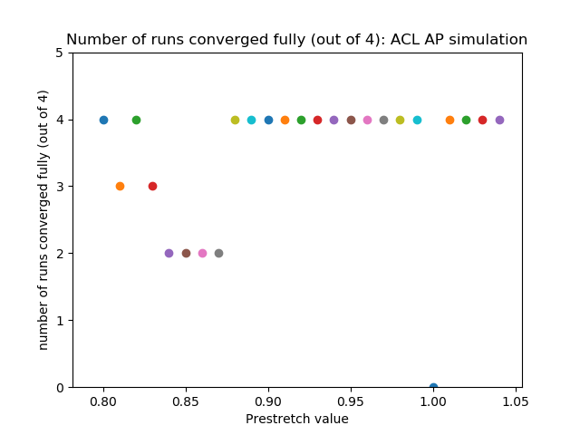
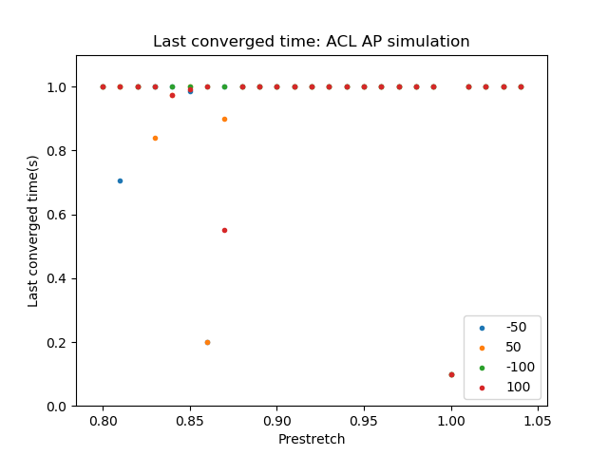
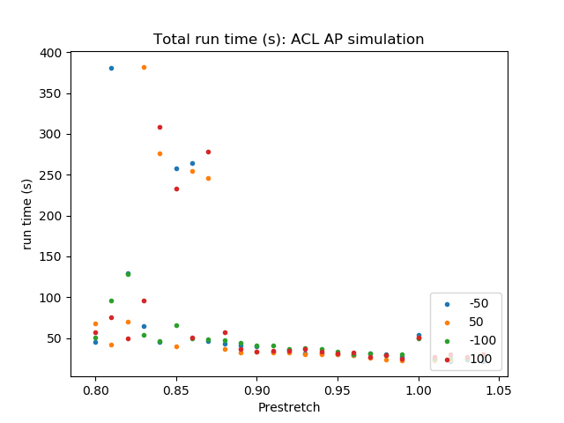
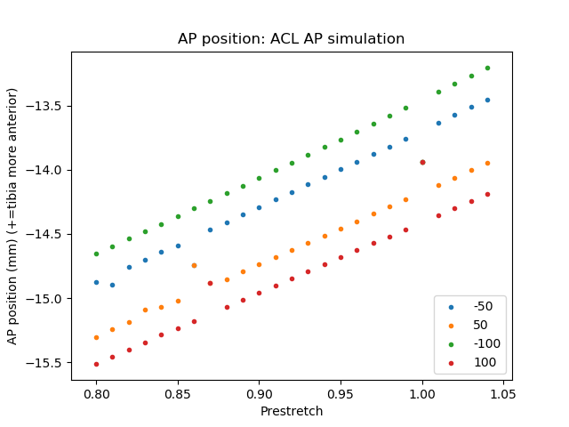
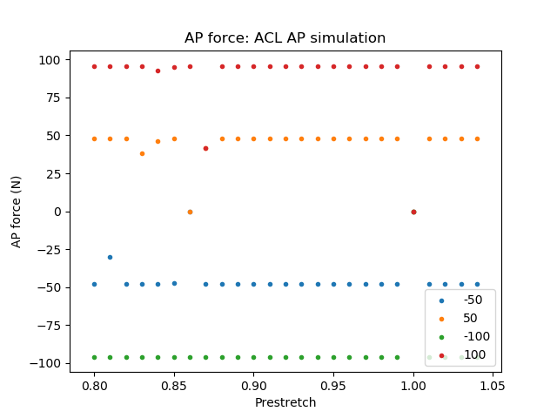
ACL - AP simulation

Slide 4
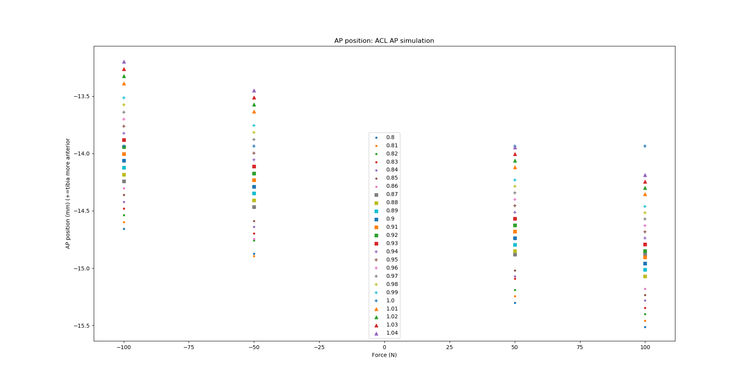
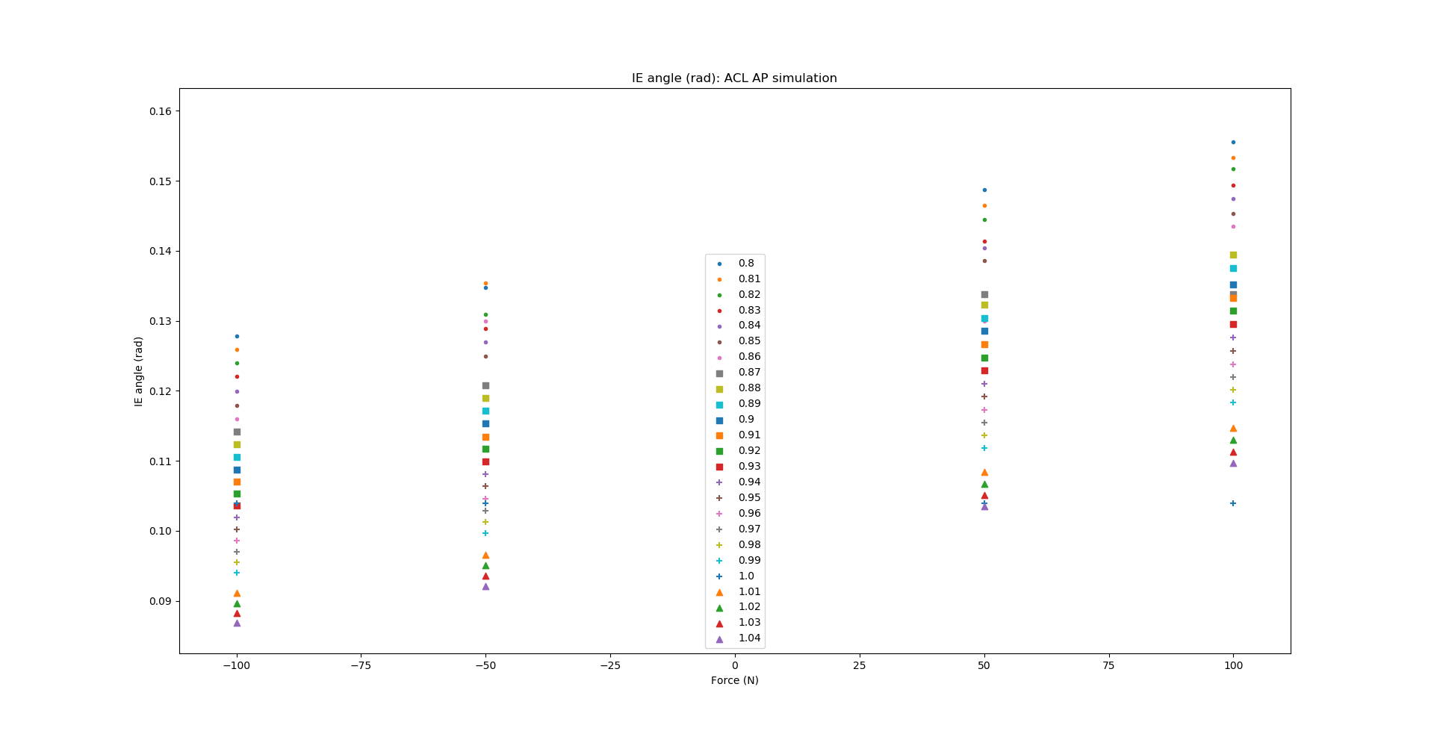
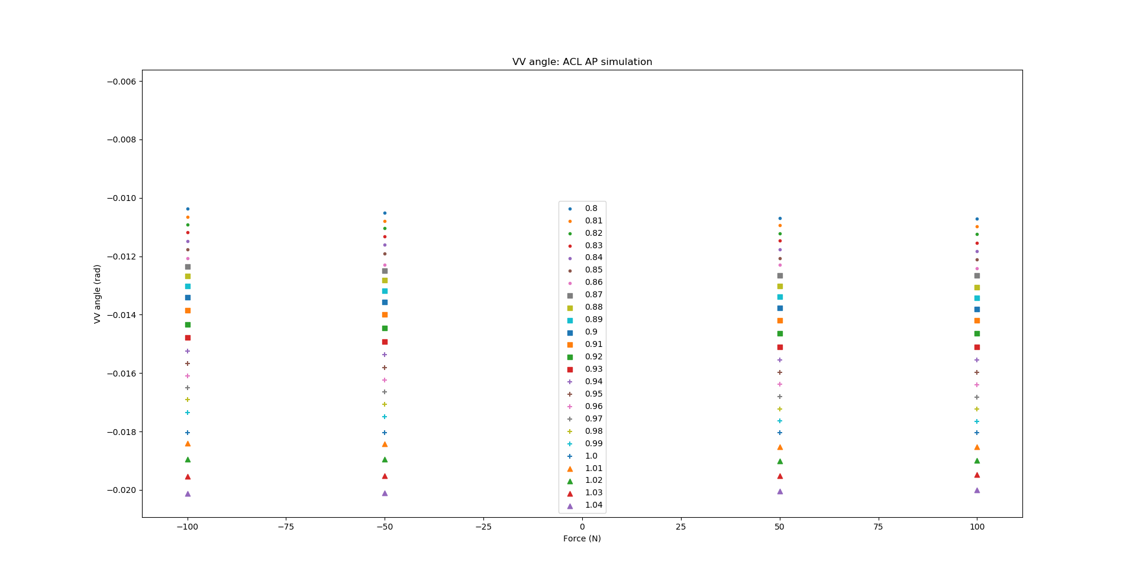
ACL - AP simulation

Slide 5
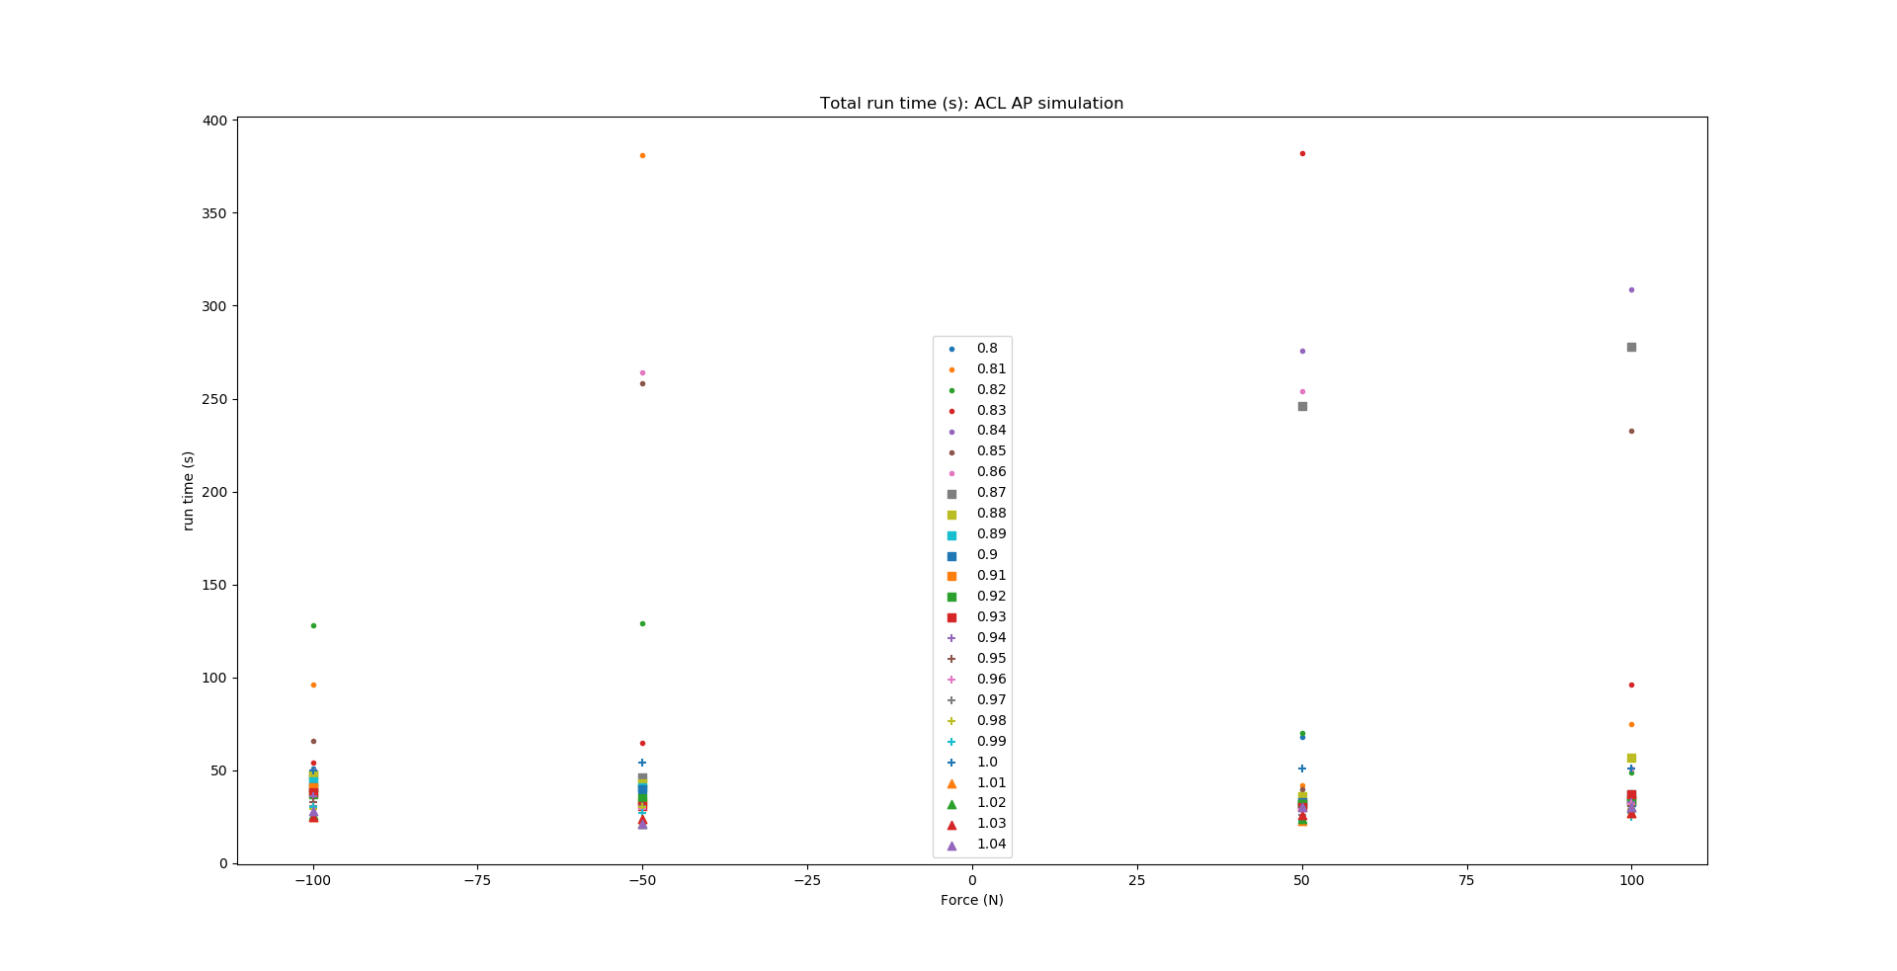
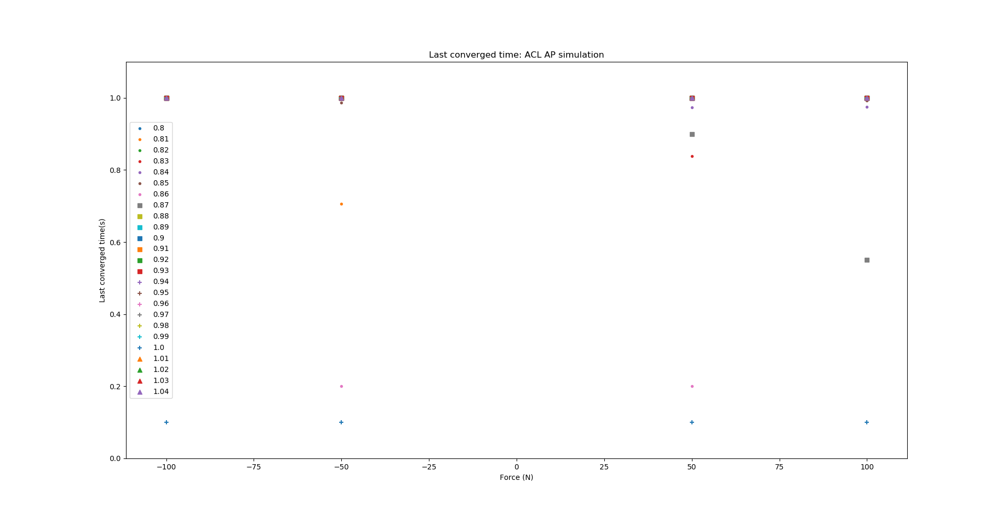
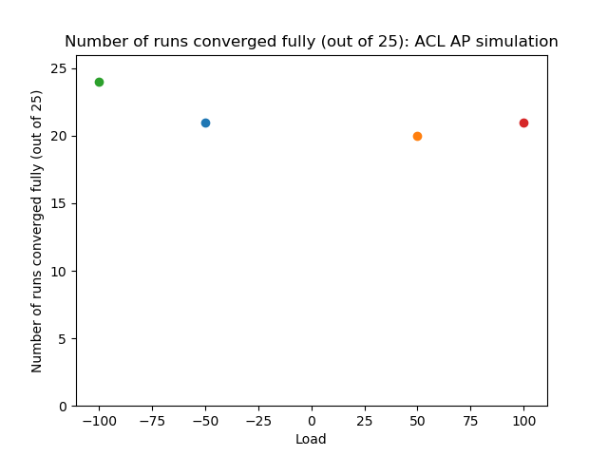
ACL - AP simulation

Slide 6
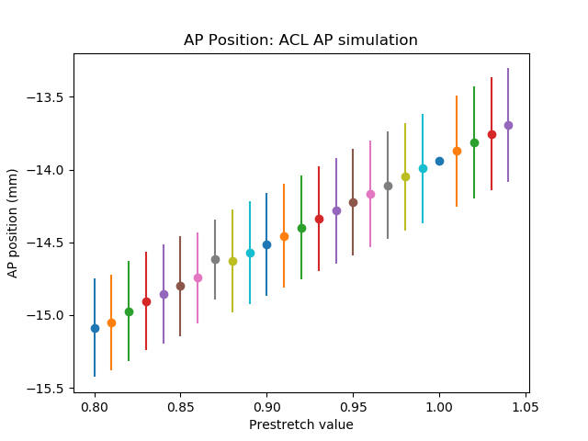
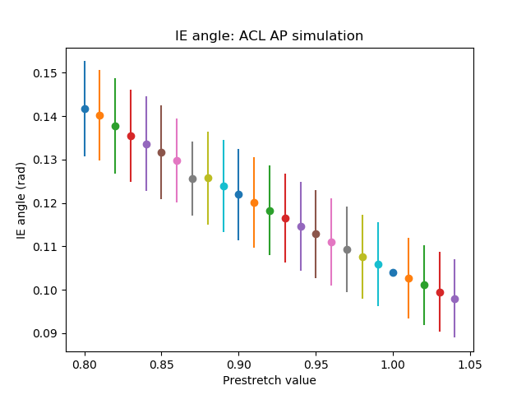
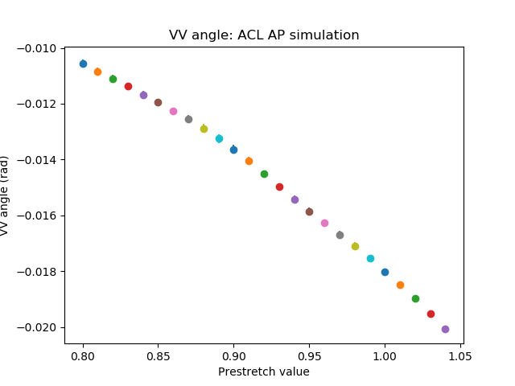
ACL - AP simulation

Slide 7
ACL - IE simulation

Slide 8
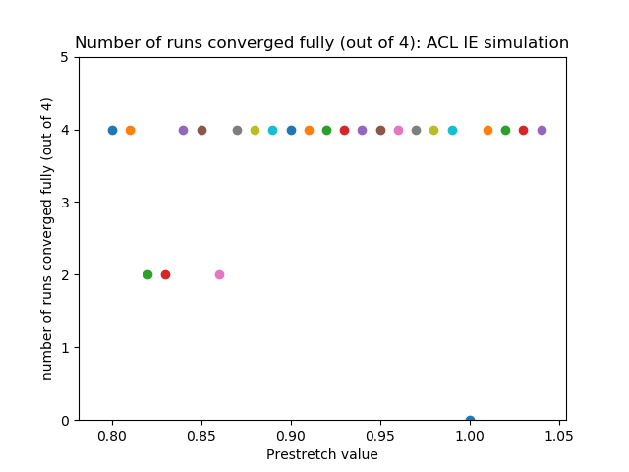
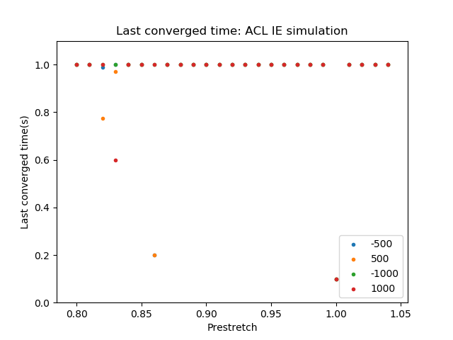
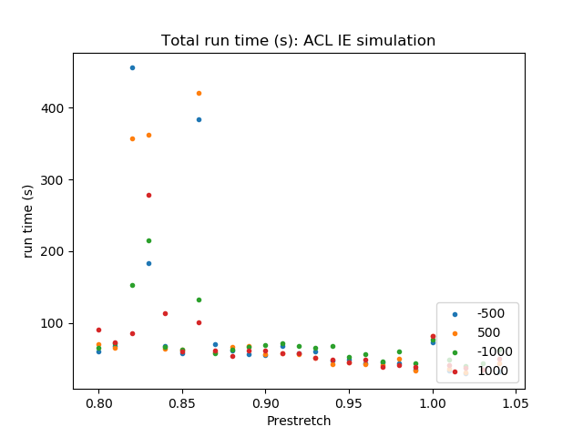
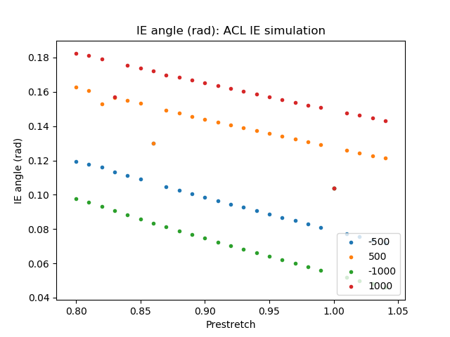
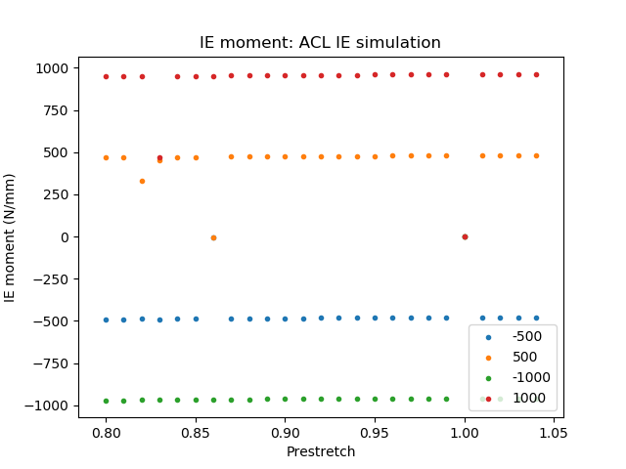
ACL - IE simulation

Slide 9
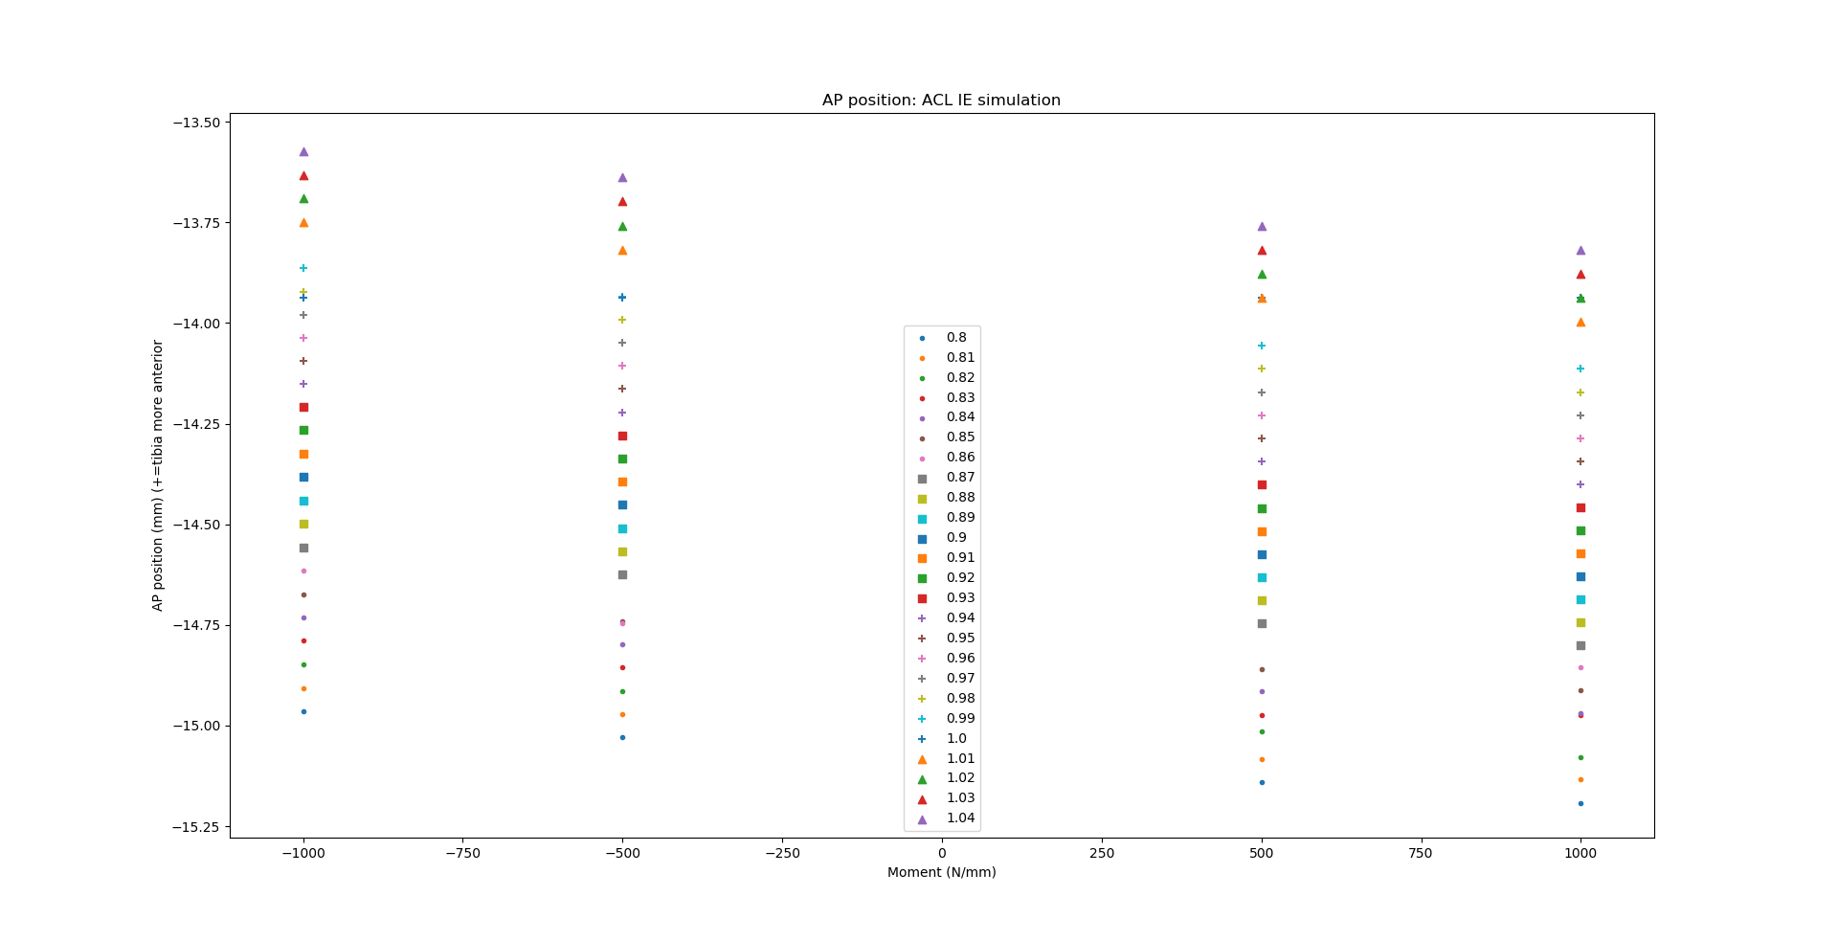
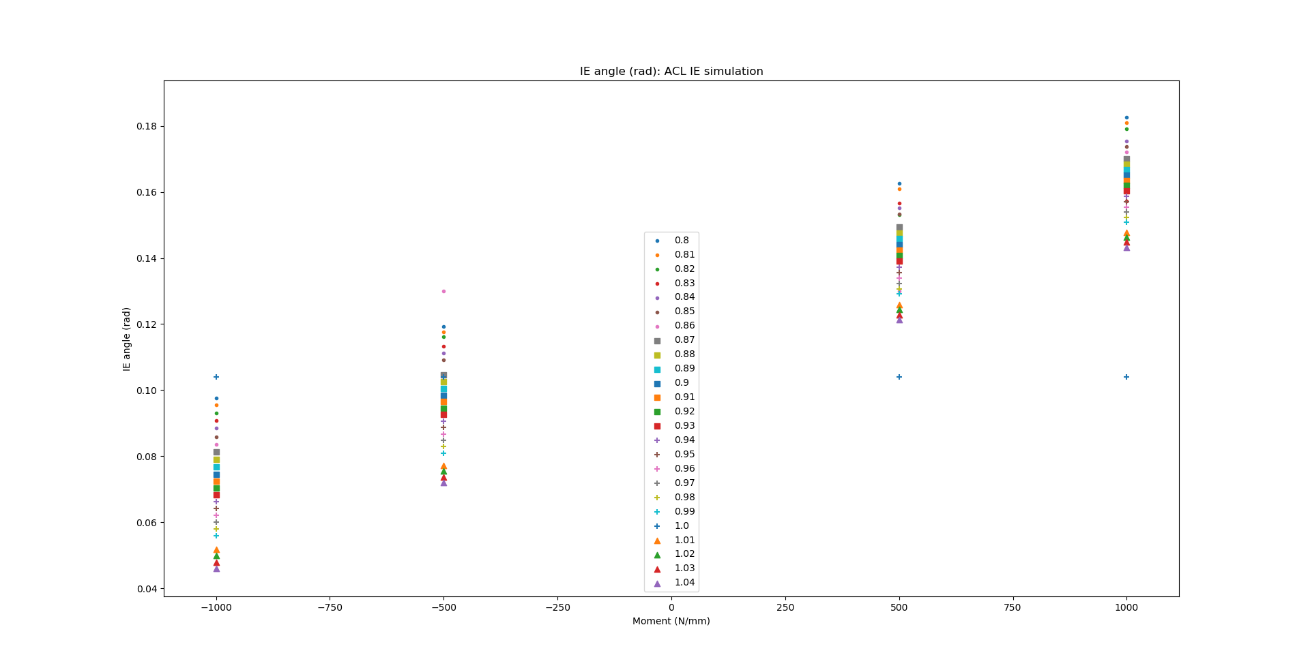
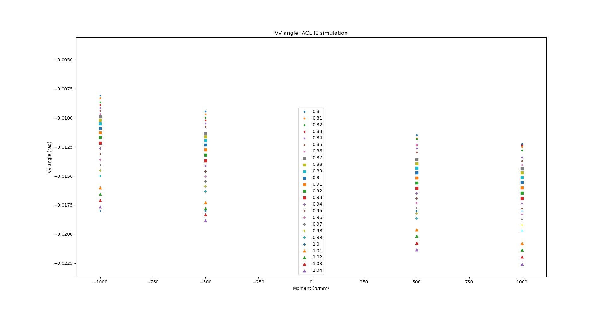
ACL - IE simulation

Slide 10
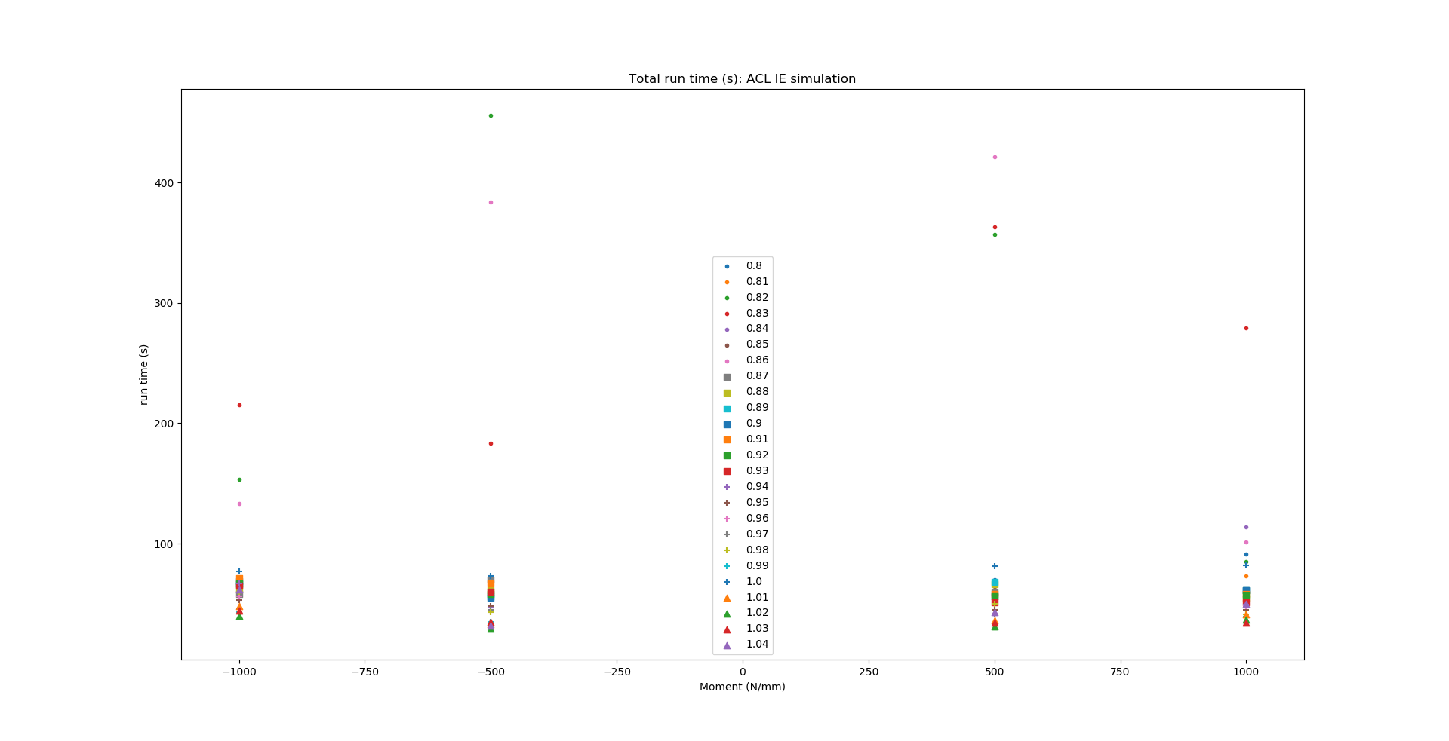
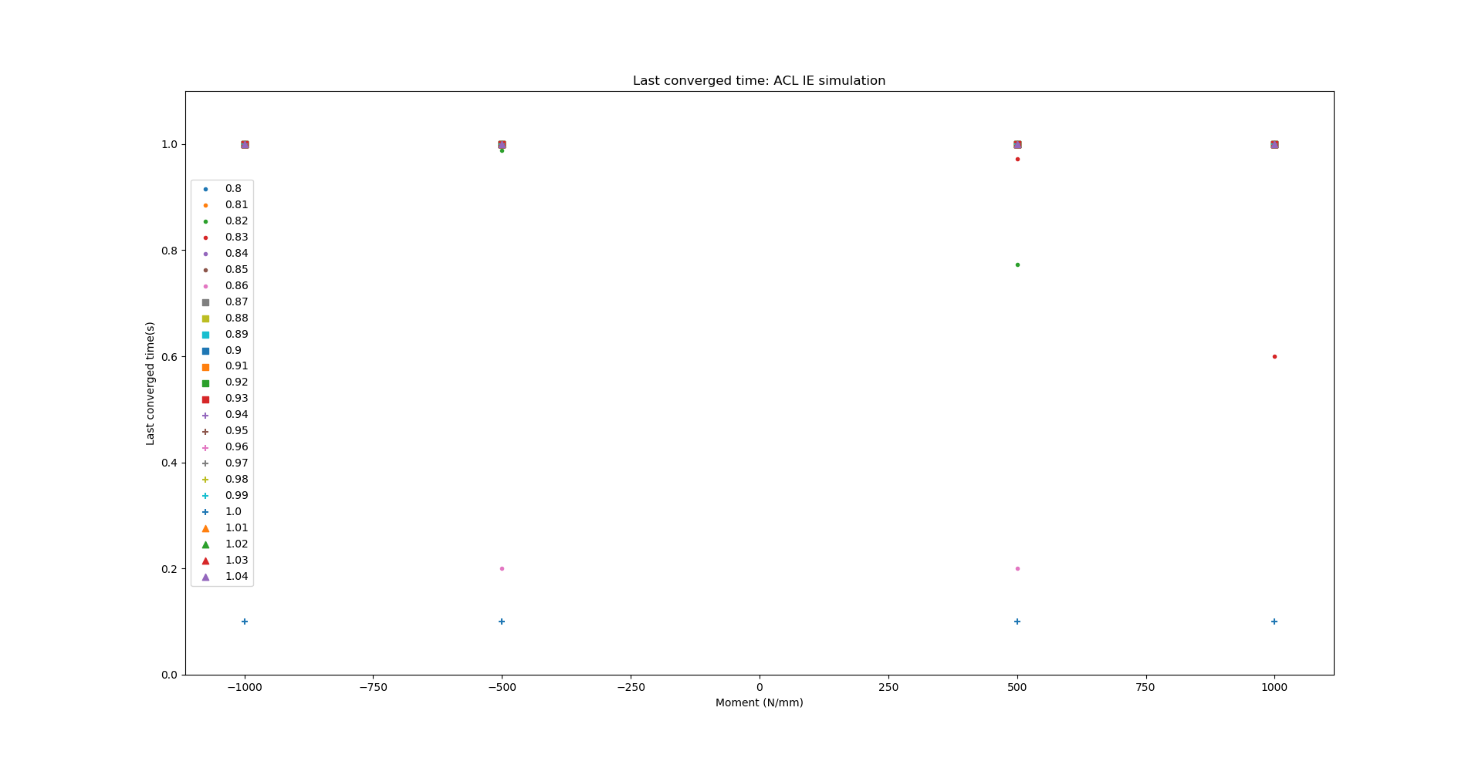
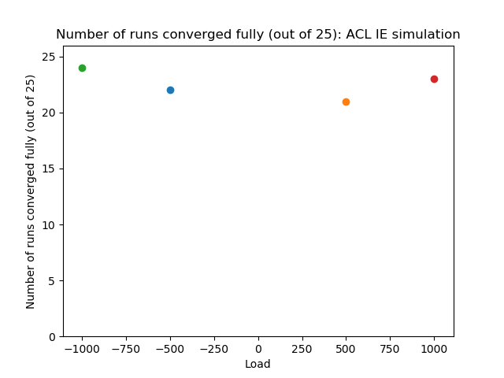
ACL - IE simulation

Slide 11
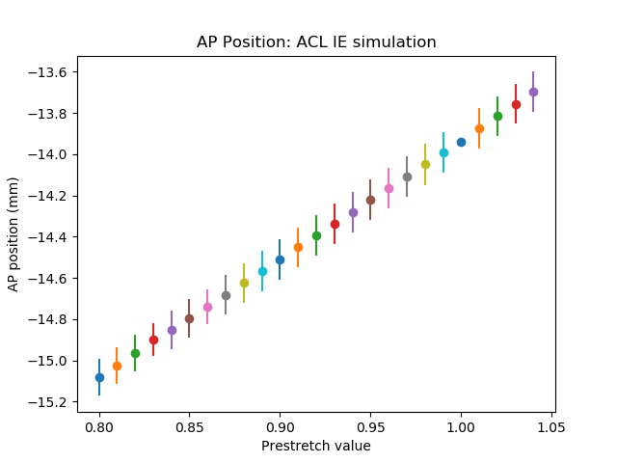
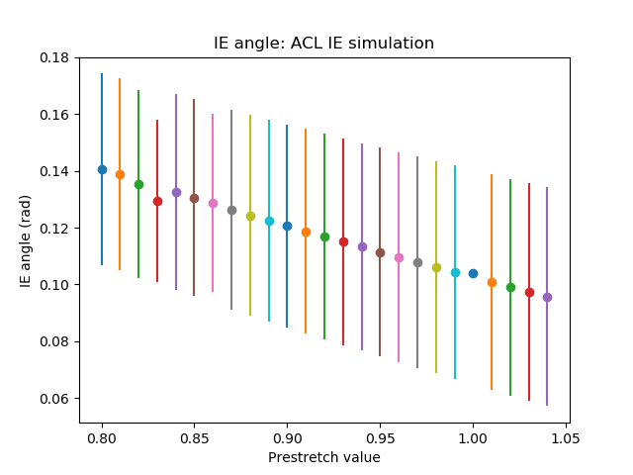
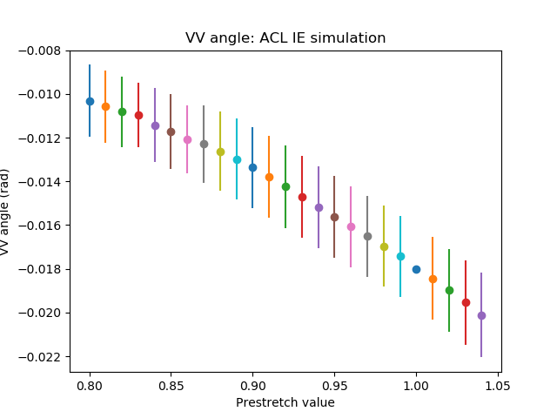
ACL - IE simulation

Slide 12
PCL - AP simulation

Slide 13
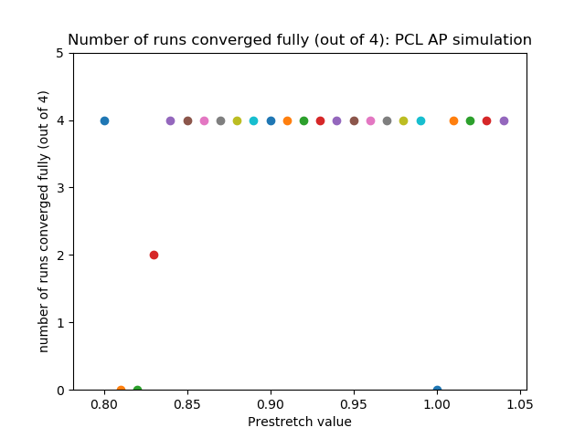
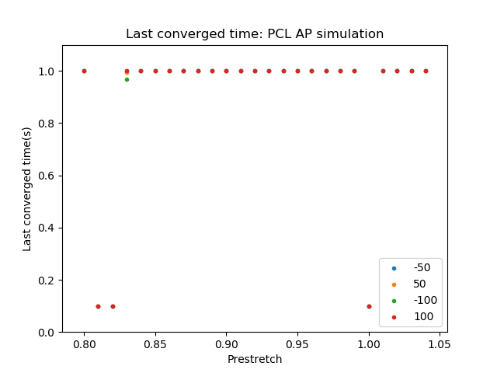
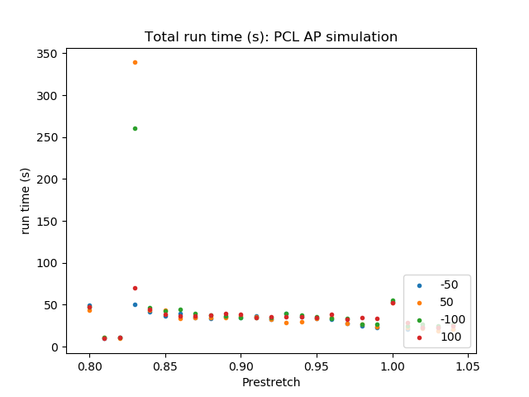
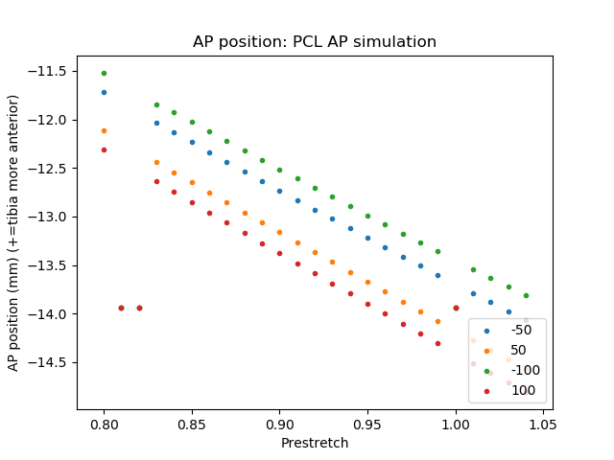
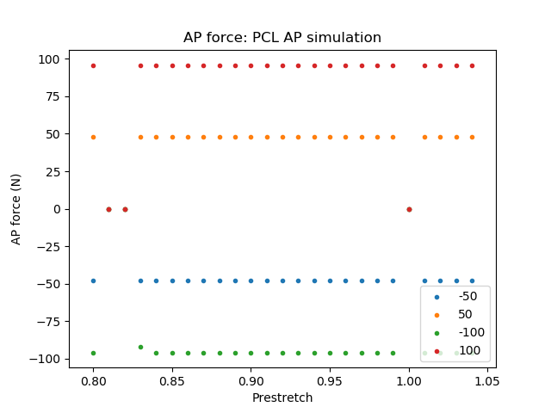
PCL – AP simulation

Slide 14
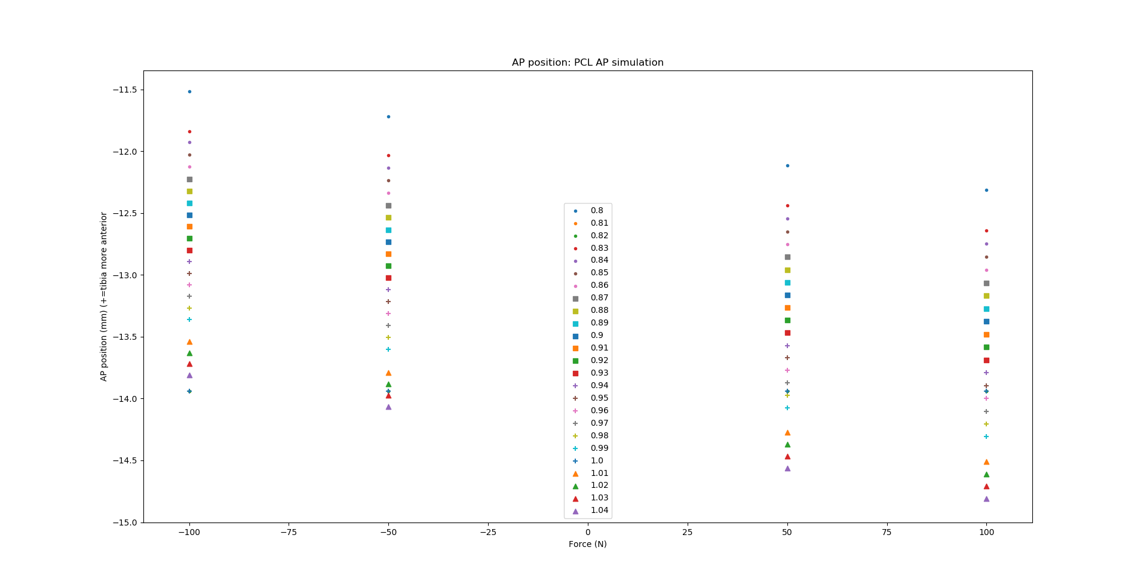
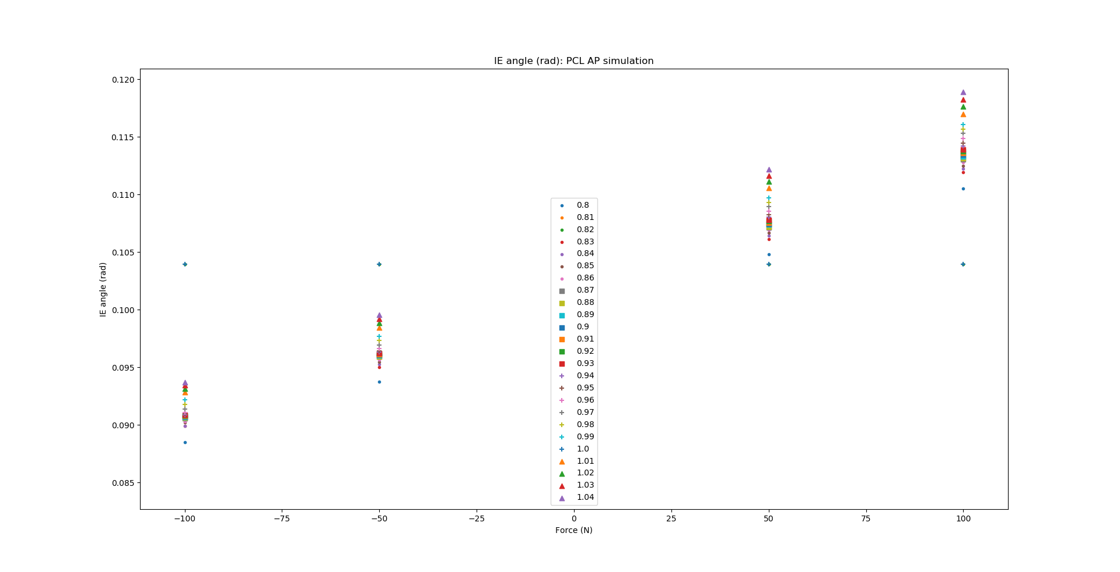
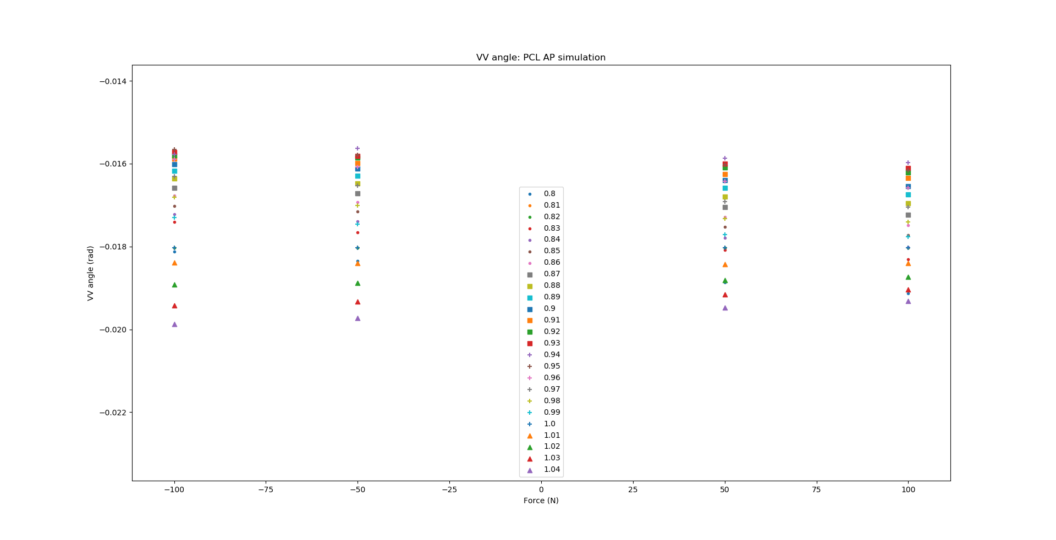
PCL – AP simulation

Slide 15
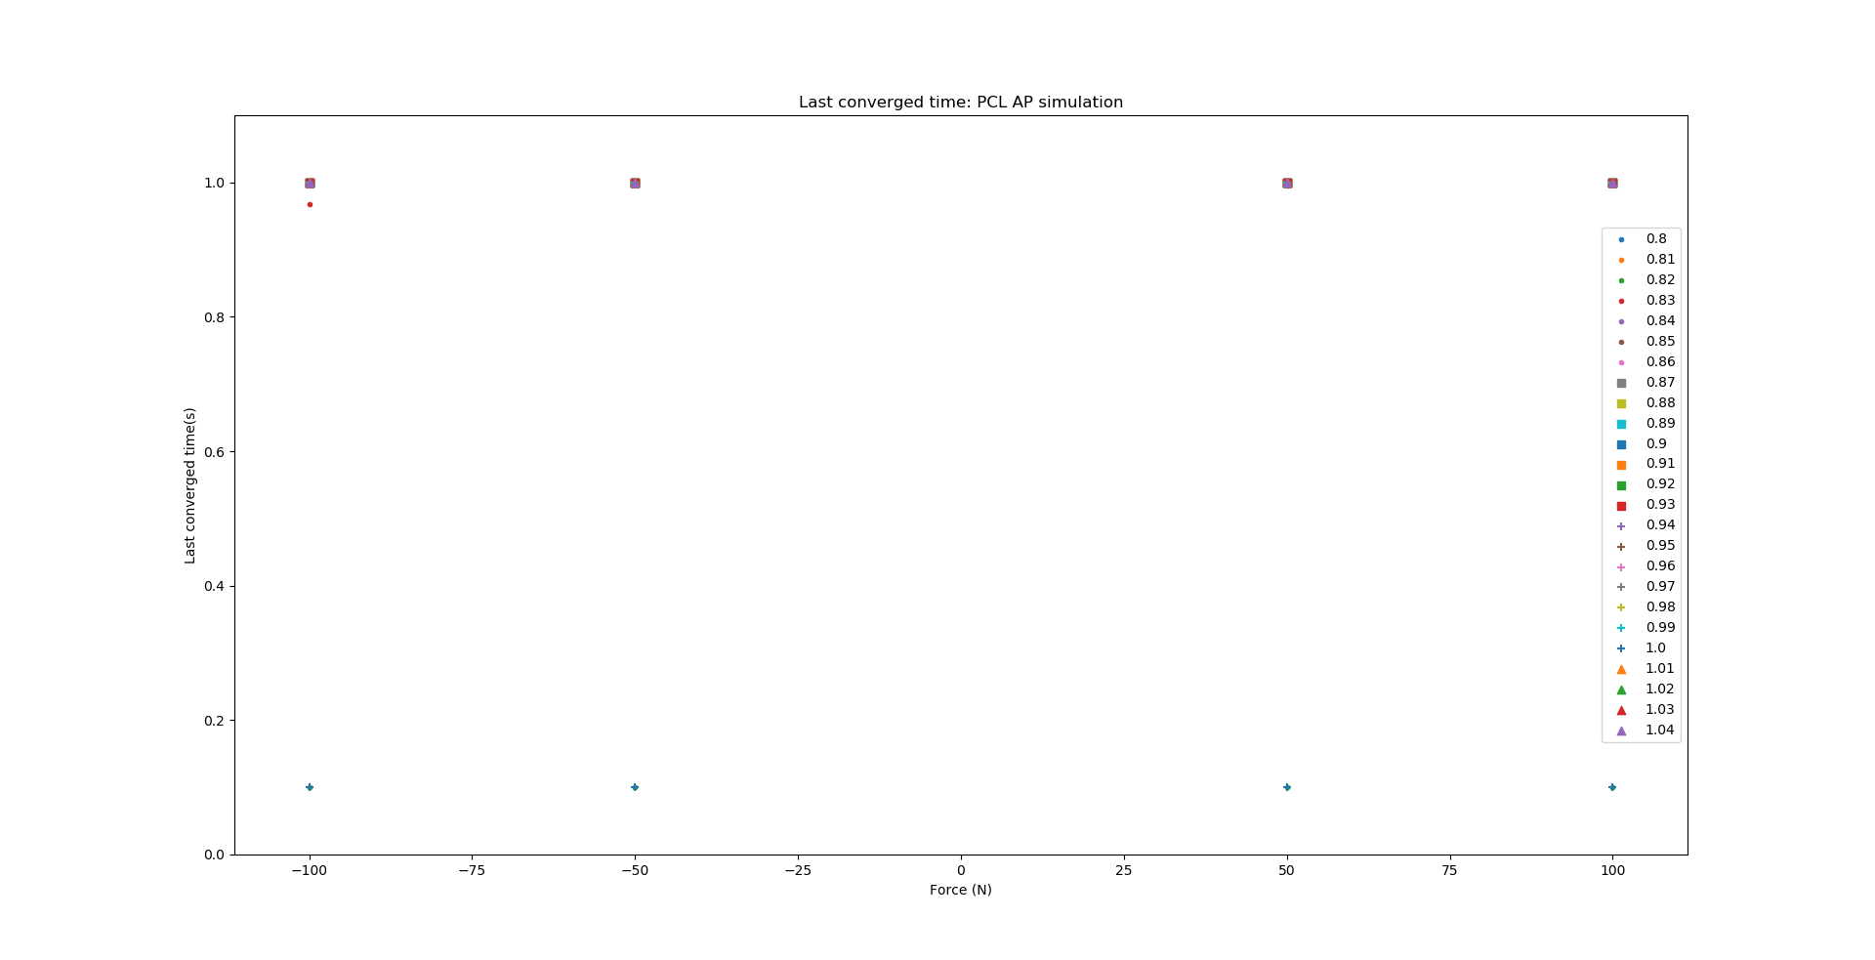
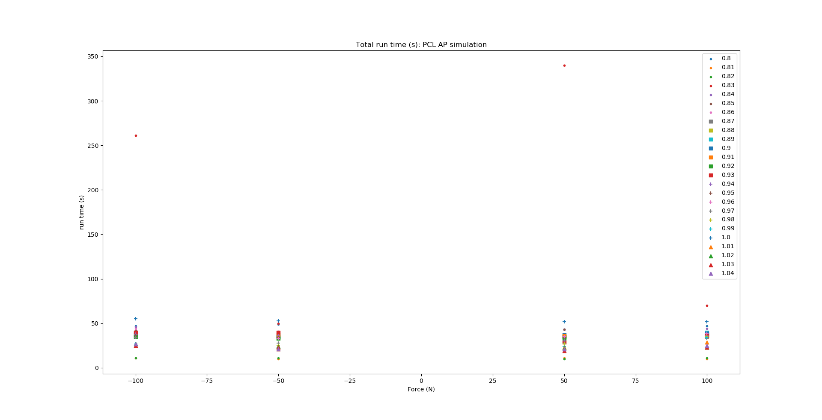
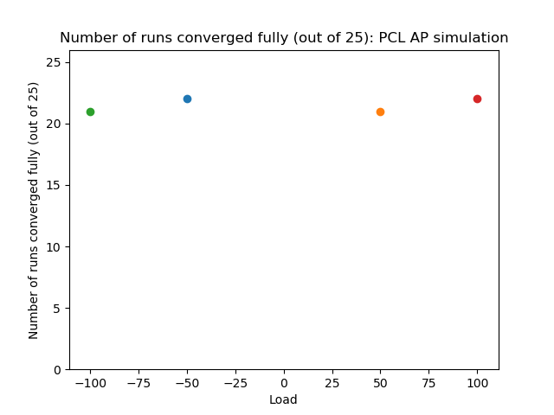
PCL – AP simulation

Slide 16
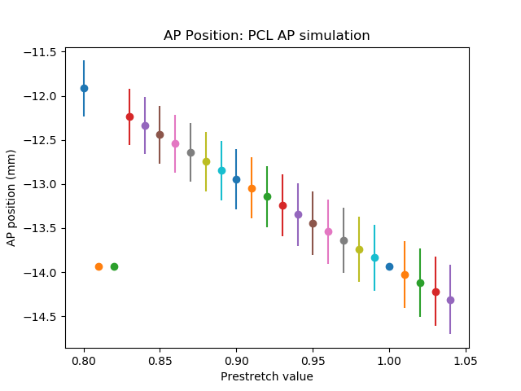
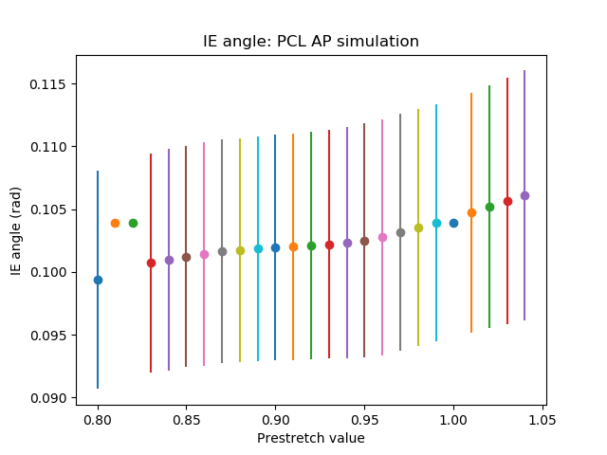
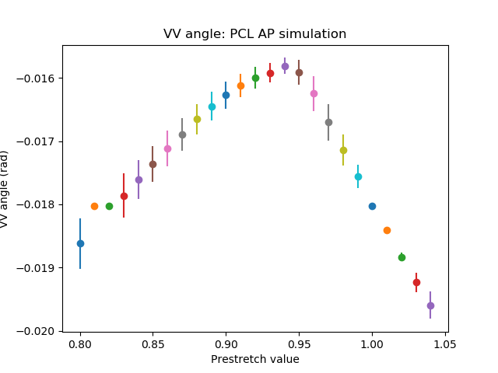
PCL – AP simulation

Slide 17
PCL - IE simulation

Slide 18
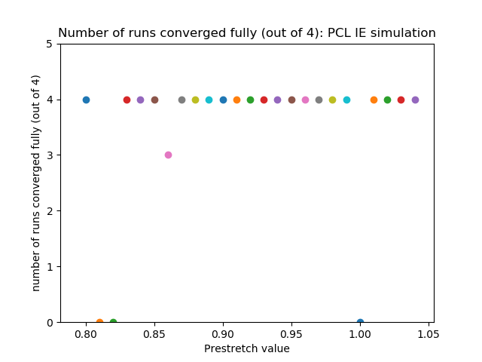
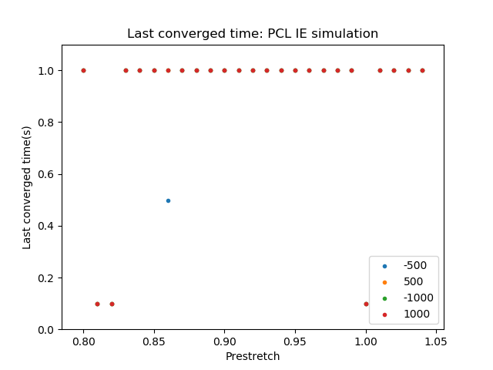
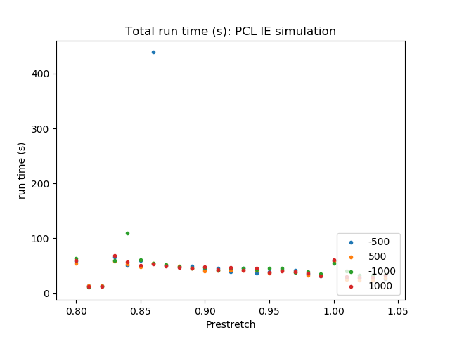
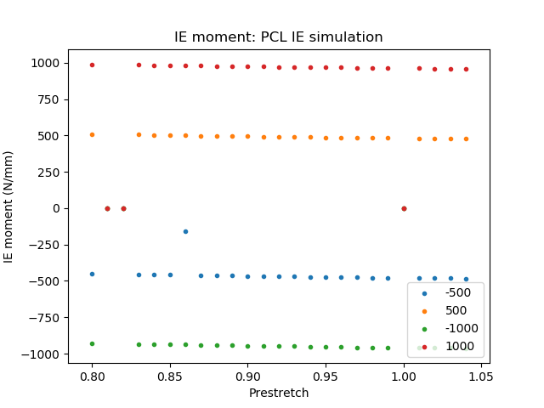
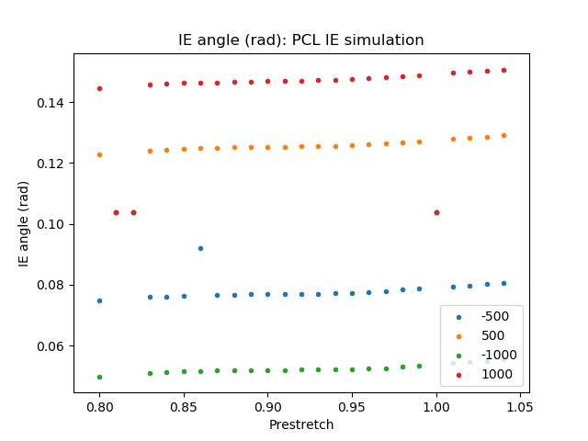
PCL – IE simulation

Slide 19
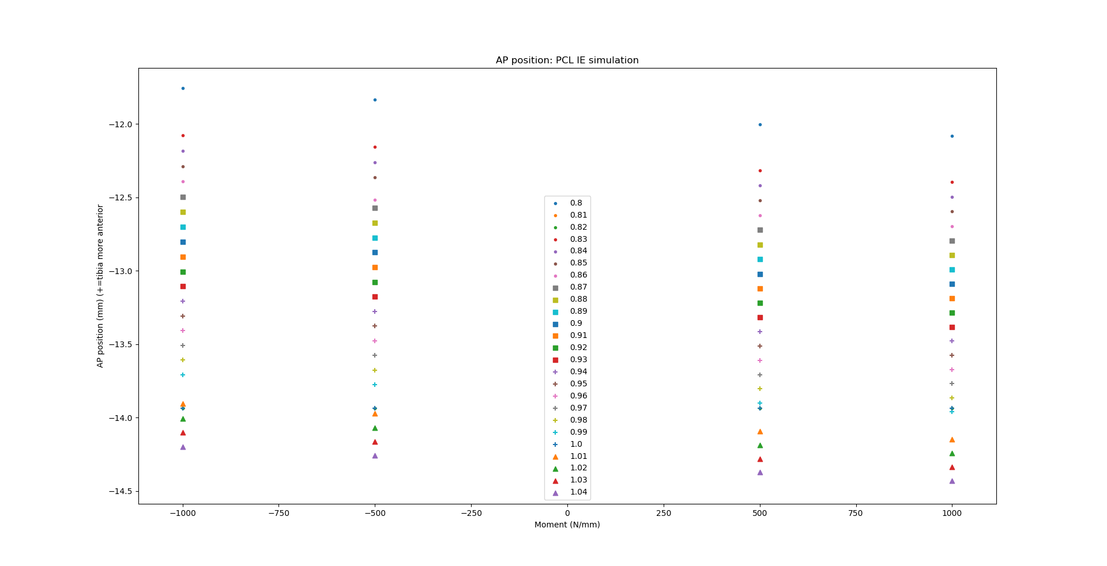
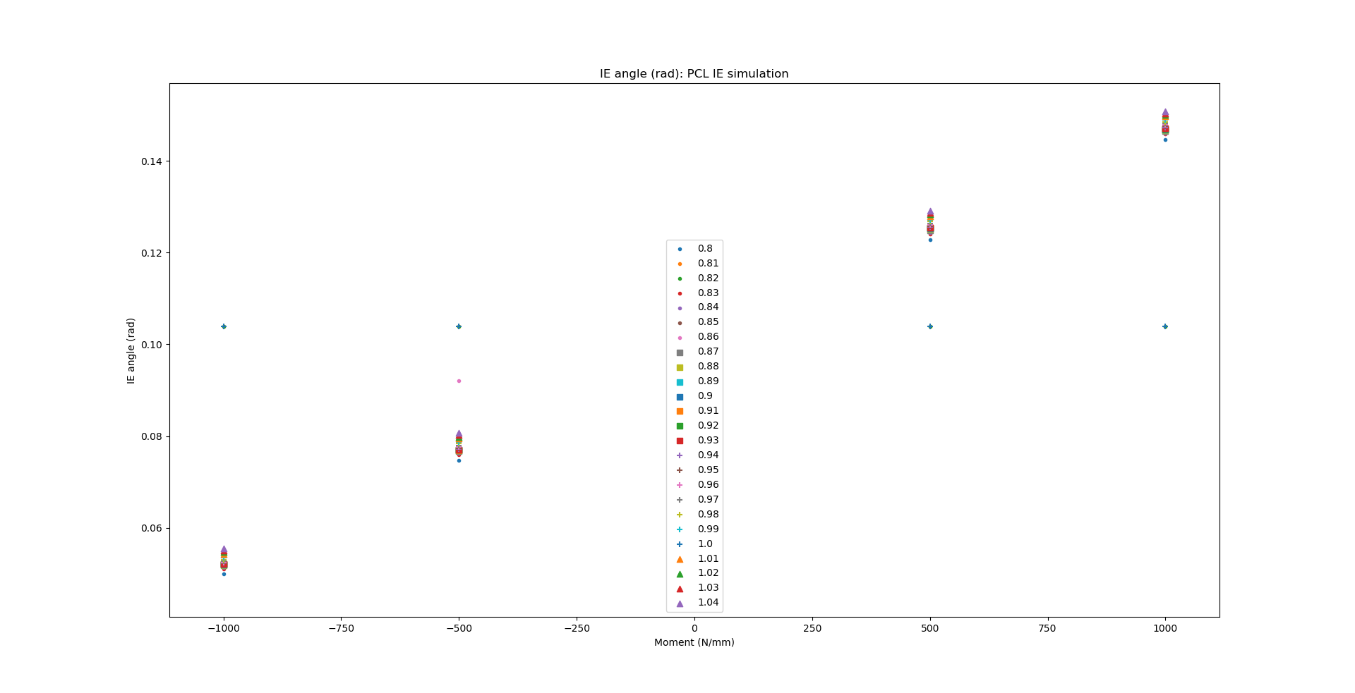
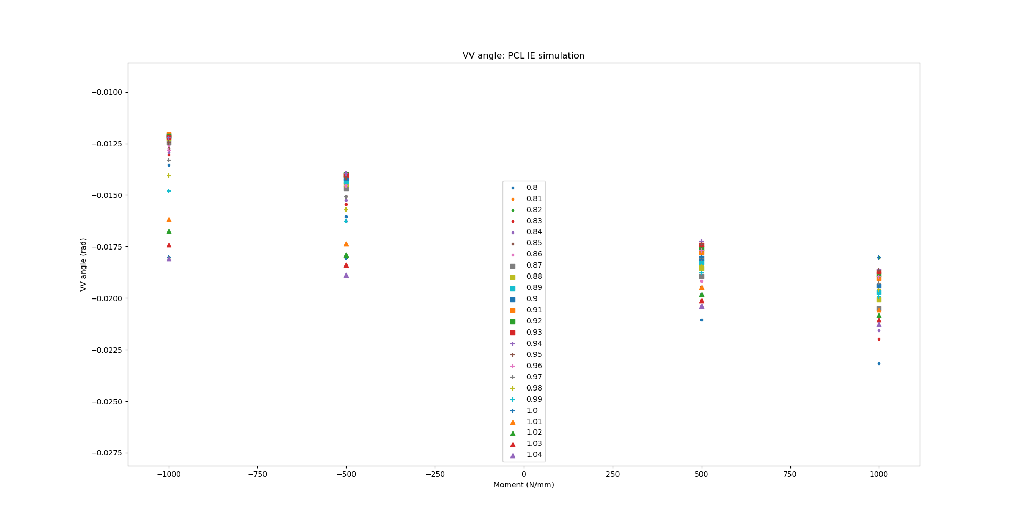
PCL – IE simulation

Slide 20
PCL – IE simulation

Slide 21
PCL – IE simulation

Slide 22
MCL - VV simulation

Slide 23
MCL - VV simulation

Slide 24
MCL - VV simulation

Slide 25
MCL - VV simulation

Slide 26
MCL - VV simulation

Slide 27
MCL – IE simulation

Slide 28
MCL - IE simulation

Slide 29
MCL - IE simulation

Slide 30
MCL - IE simulation

Slide 31
MCL - IE simulation

Slide 32
LCL – VV simulation

Slide 33
LCL - VV simulation

Slide 34
LCL - VV simulation

Slide 35
LCL - VV simulation

Slide 36
LCL - VV simulation

Slide 37
LCL – IE simulation

Slide 38
LCL - IE simulation

Slide 39
LCL - IE simulation

Slide 40
LCL - IE simulation

Slide 41
LCL - IE simulation

