Slide 1
Population Modeling by Examples
Population Modeling Working Group
popmodwkgrpimag-news@simtk.org
SpringSim 2015
April 12 - 15, 2015
Alexandria, VA, USA

Slide 2
Background
The Inter Agency Modeling and Analysis Group (IMAG) hosts a population modeling working group
There was increased interest in the topic in 2014 MSM/IMAG meeting at the NIH
We defined Population modeling as:
  “Modeling a collection of entities with different levels of heterogeneity“
We created a mailing list and asked people to join and share their research
Here are some examples:
Notes:
You may add notes to help the presenter focus on some points, yet focus on slide

Slide 3
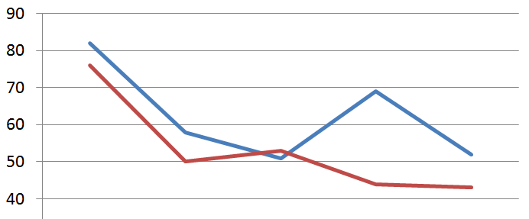
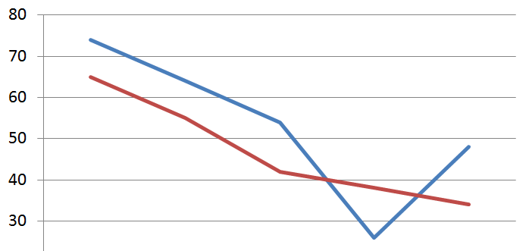
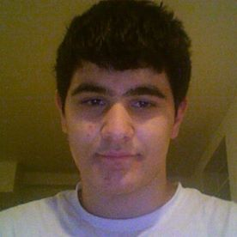
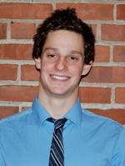
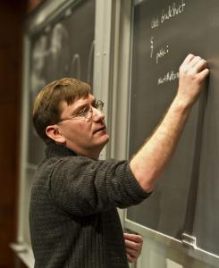

Systems Epidemiology – Tufts
Percents of infants in a simulated population (N=1,000) born at the GA indicated who had bacteria (PLACBUG) and inflammation in the placenta (PLACINF). Simulated data (blue) compared to published values (red) from ~1080 placentas from the ELGAN study.
Gestational Age (week) |  | 23 | 24 | 25 | 26 | 27
Simulation
% Placbug
Published
?
% Placinf
Durgham, Fried, Hescott & Dammann, in preparation
Notes:
You may add notes to help the presenter focus on some points, yet focus on slide

Slide 4
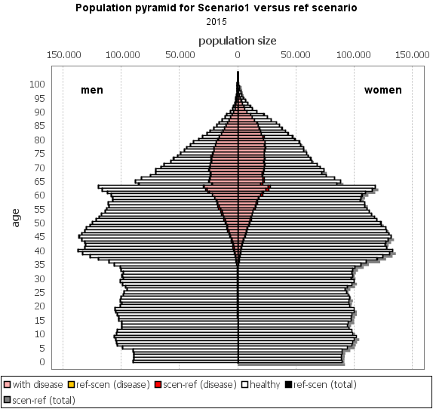
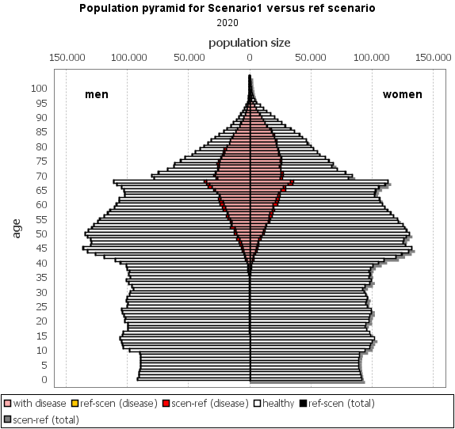
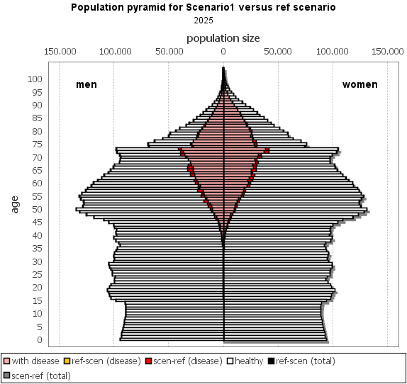
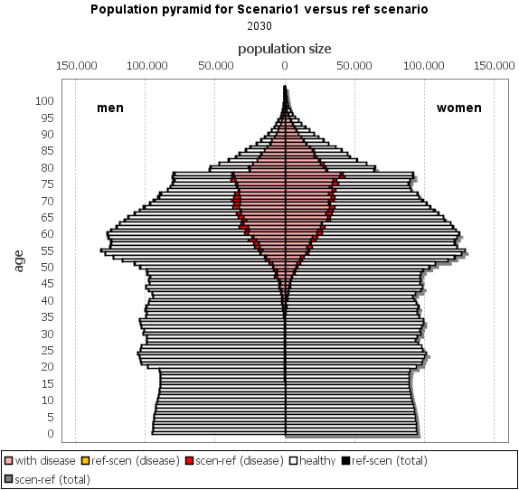
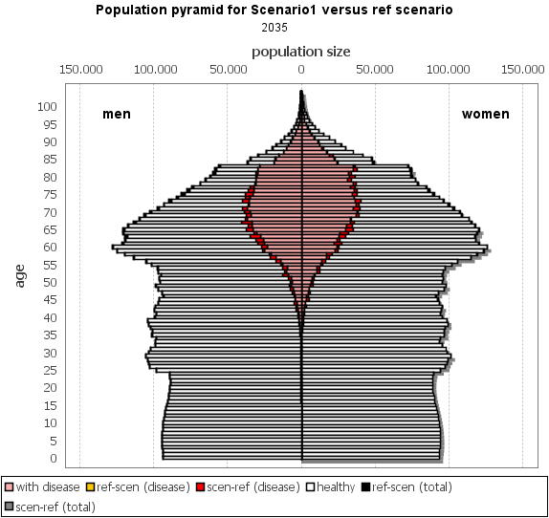
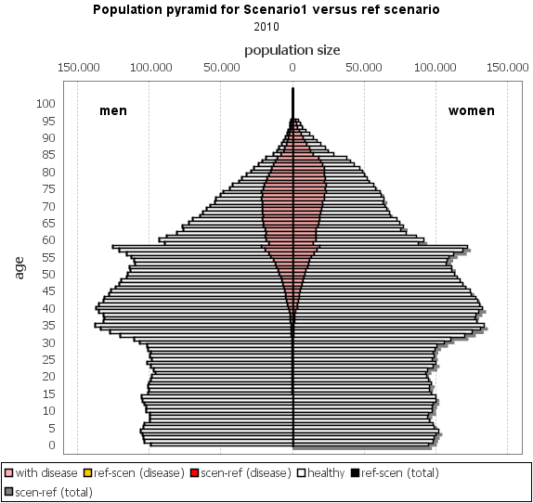


Modeling in Support of Public Health Policy - RIVM
Simulate human population, add your own national or regional data
Link lifestyle to diseases and health outcomes
E.g. effect of overweight policy, what if UK weights in NL?
Contact: Hendriek.Boshuizen@rivm.nl Talitha.Feenstra@rivm.nl www.dynamo-hia.eu
Notes:
RIVM=Dutch National Institute for Public Health and the Environment. Joint work with Erasmus University Rotterdam.
Several population models both general and disease specific to support public policy in The Netherlands. Dynamo-hia chosen since it is international and available to everyone to use on their own data.
Show the animation which is an example of a scenario analysis. In this scenario, Dutch prevalence of obesity was replaced by UK (higher) prevalence of obesity. Reflected by the red areas with more disability at higher ages over time.
You may add notes to help the presenter focus on some points, yet focus on slide

Slide 5
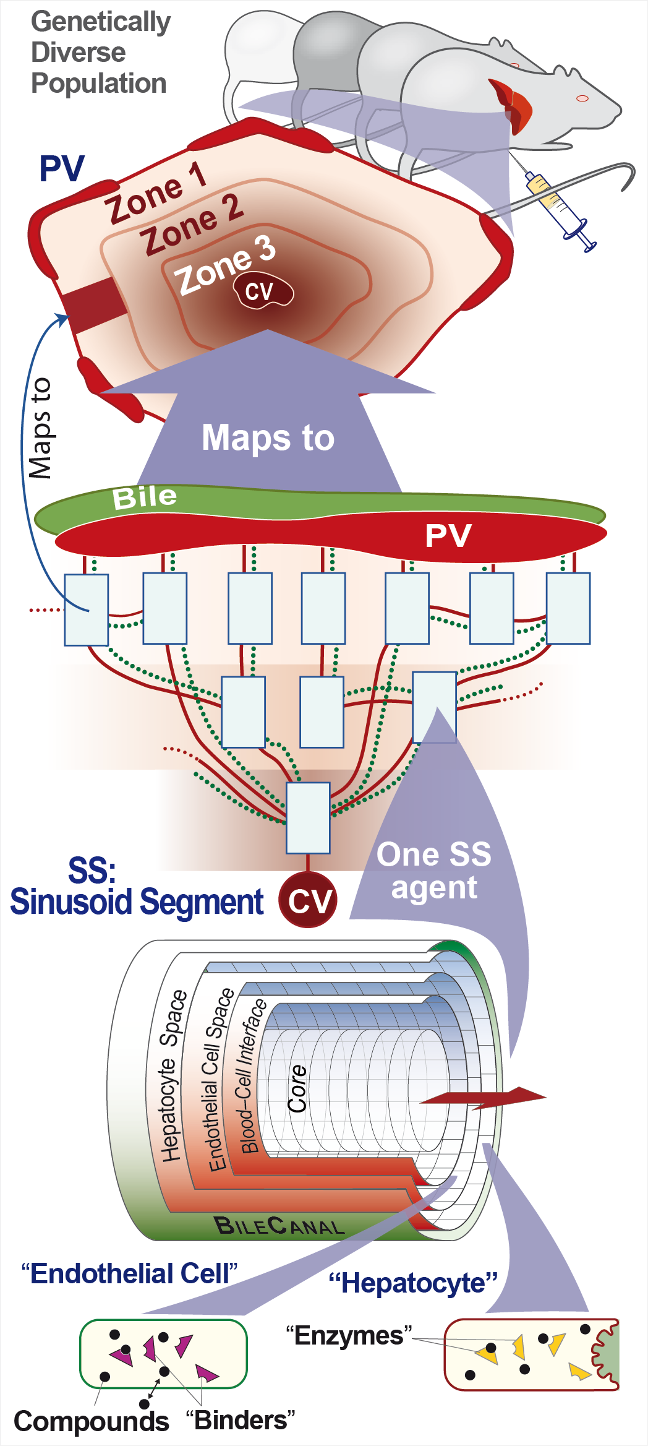
Explaining Mechanisms of
Drug Induced Liver Injury
C. Anthony Hunt, BioE, UCSF
Represent & explain intra- &
inter-individual mechanistic
variability in DILI
Methods are agent-oriented
Components & spaces are
concrete, biomimetic & nested
Mechanistic events are networked
within & across scales
Notes:
You may add notes to help the presenter focus on some points, yet focus on slide

Slide 6
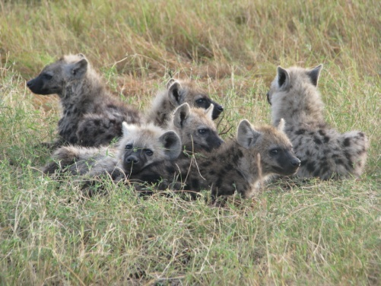
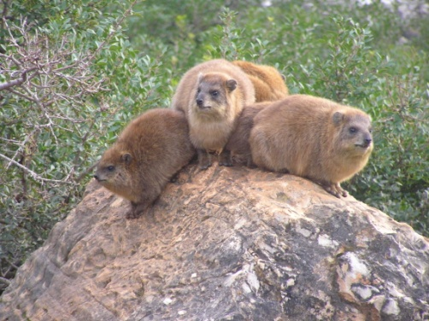
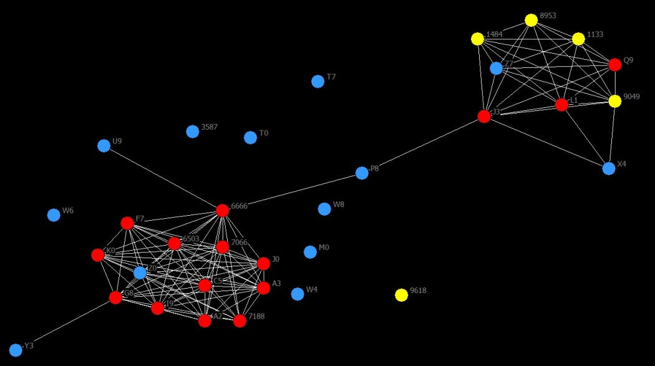
Social Networks of Wild Mammals
Amiyaal Ilany (Biology, University of Pennsylvania)
Studying spotted hyenas and rock hyraxes
Exploring network dynamics using Stochastic Agent-Based Models
Finding that the social structure constraints its future dynamics and affects survival and mating patterns
Notes:
The circles in the bottom right timage are individual animals, with lines representing social relationships (based on spatial proximity). The colors are for males (blue), females (red), and juveniles (yellow), so the networks shows nicely the social structure of the species, in this case the rock hyrax.

Slide 7
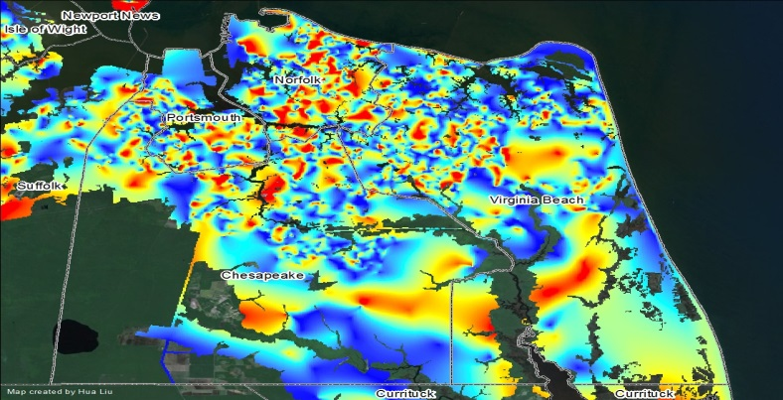
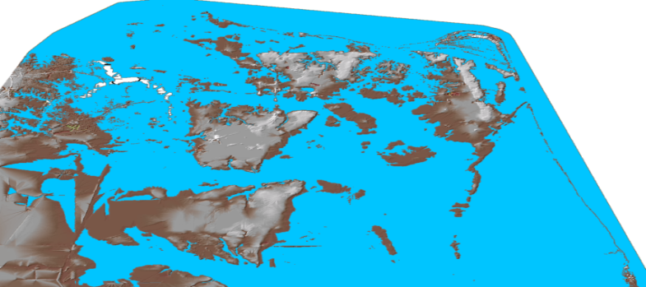
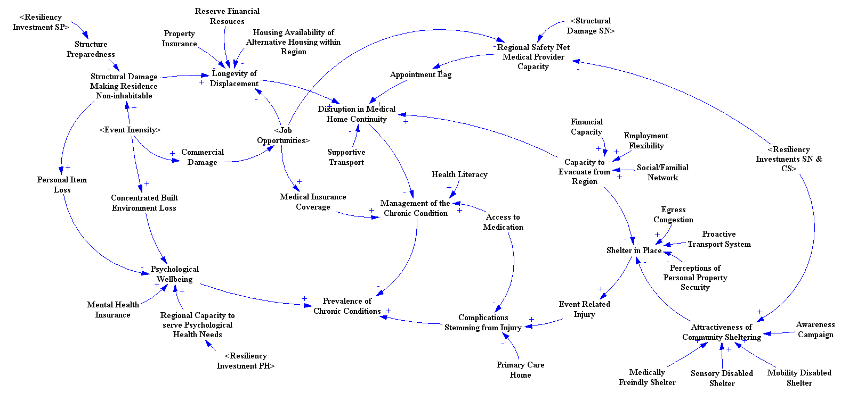
Modeling Community Vulnerability and Medically Fragile Populations for
Natural Disaster Preparedness
Joshua G Behr & Rafael Diaz
VA Modeling, Analysis, & Simulation Center
Measure & map 17 dimensions of household vulnerability.
Simulate storm scenarios, such as Super Storm Sandy, crossing the region, and measure damage and displaced persons.
The merging of these two data streams informs our system dynamics models.
Models produce short, medium, and long term forecasts of housing needs and demand for services, especially among medically fragile populations.
Models allow for testing planning and policy interventions and measuring ROI under different preparedness scenarios.
Notes:
Top Visual:
We conceptually defined over a dozen dimensions of household vulnerability. This is a map illustrating the spatial variation of vulnerable households in Norfolk and Virginia Beach, part of the Hampton Roads region. These data are derived from our interview of more than 7,000 households following Hurricane Irene.
Middle Visual:
Superstorm Sandy came up the east coast. We bent the path of Sandy so it crossed directly over Hampton Roads. We modeled the flooding and wind damage using FEMA's HazUS software. We dubbed this scenario "Sandtrina' (Sandy and Katrina combined). This map illustrates the storm surge and inundation from that modeling.
Bottom Visual:
This is System Dynamics causal loop diagram illustrating factors driving the transition times of displaced vulnerable populations, especially medically fragile populations, through the states of immediate, intermediate, and long-range housing recovery.
KEY POINT: THIS SD MODEL LEVERAGES THE INTERSECTION OF TWO DATA STREAMS -- THE HOUSEHOLD VULNERABILITY DATA FROM OUR SURVEY AND THE DISPLACED PERSONS DATA FROM OUR HAZUS MODELING -- TO MAKE FORECASTS ABOUT HOUSING RECOVERY.

Slide 8
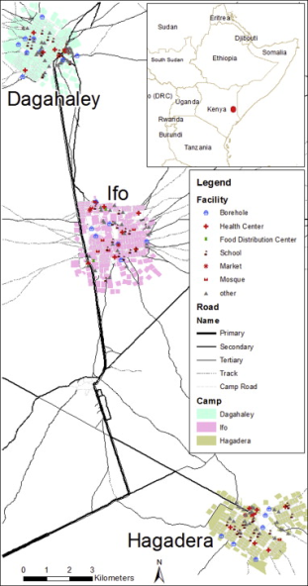
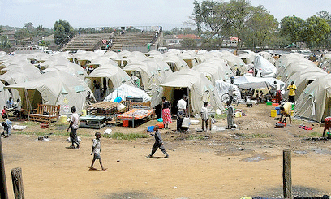
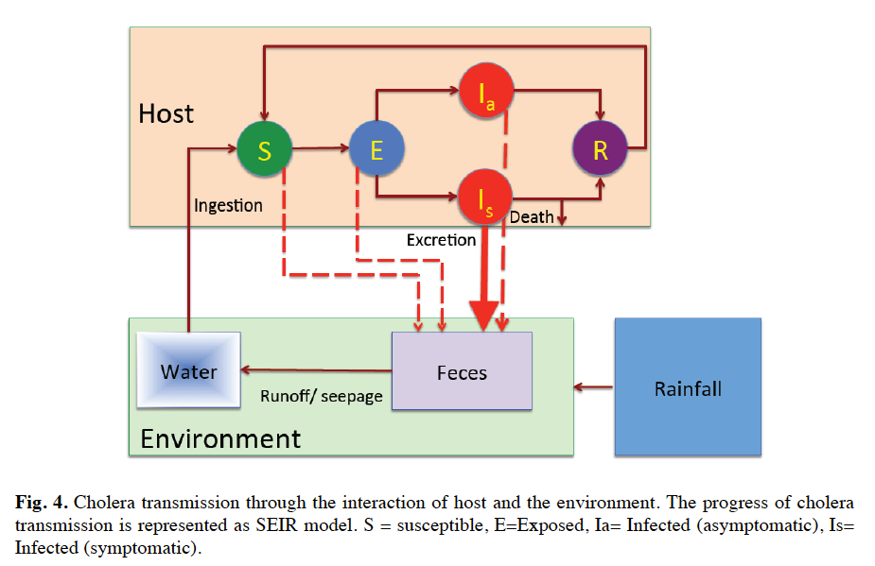
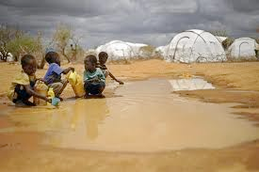
Agent Based Modeling of the Spread of Cholera
Atesmachew Hailegiorgis and Andrew Crooks, George Mason University
Explores the dynamics of cholera outbreaks in Dadaab refugee camps
The model integrates geographical data with agents' daily activities within a refugee camp.
Click here to see the YouTube Video
Results show cholera infections are impacted by agents' movement and source of contamination.
Notes:
Video URL: https://www.youtube.com/watch?feature=player_embedded&v=3GCminsqQgM
Or http://css.gmu.edu/cholera/Cholera/Home.html

Slide 9
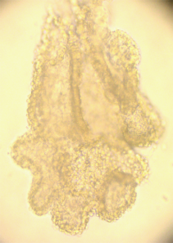
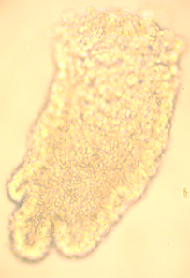
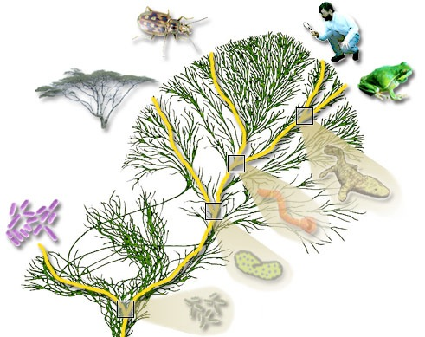
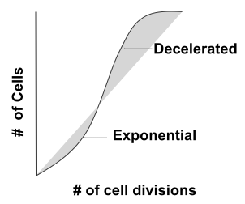
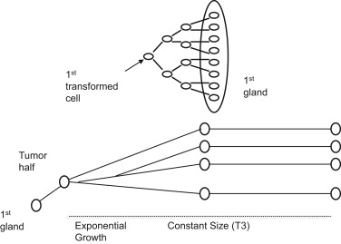
Ancestral inference in tumors
University of Southern California
Zhao J, Siegmund KD, Shibata D, Marjoram P. "Ancestral inference in tumors: How much can we know?." Journal of theoretical biology 359 (2014): 136-145.
cancer gland
fragments
(2,000 to
10,000 cells)
Same concept as phylogenetic inference
left tumor side
right tumor side
first
transformed cell
Sample population of tumor cells from both tumor sides
Build model for tumor growth
Use patterns of relatedness between populations of cells to infer deep history of tumor ancestry (e.g. what happens just after a tumor has formed and is growing rapidly; how many stem cells does the tumor have).
Notes:
Top left image: We build ancestral models for tumors, which are collections (or populations) of cells, using the same intuition used to build phylogenetic trees from collections of samples from different species.
Top right image: We sample cells from different regions of the tumor (multiple cells from each of the left and right side) and then try to understand the ancestry of those cells over the lifetime of the tumor - this helps us understand how the tumor grew, and potentially how it might best be treated.
Bottom left image: Our analysis is model-based - we use a model that reflects both changes to the overall size of the population of cells that forms the tumor as well as the specifics of how cell and gland copying lead to those changes in overall population size.

Slide 10
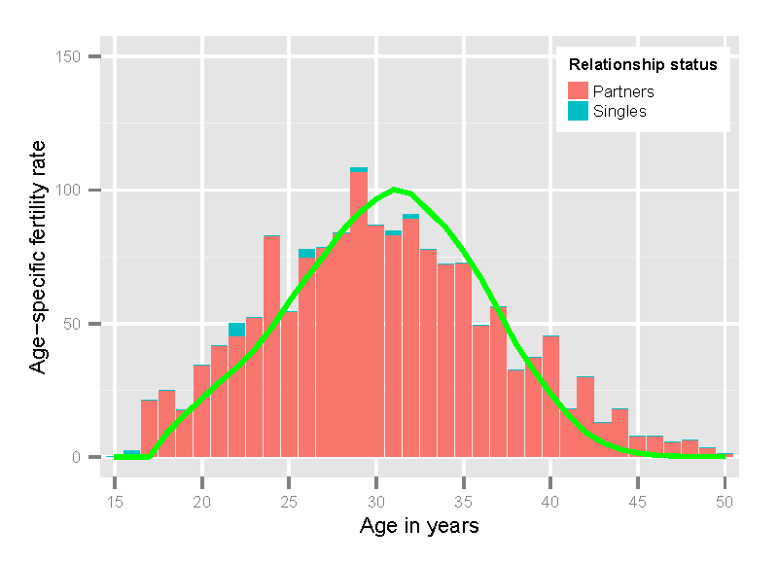
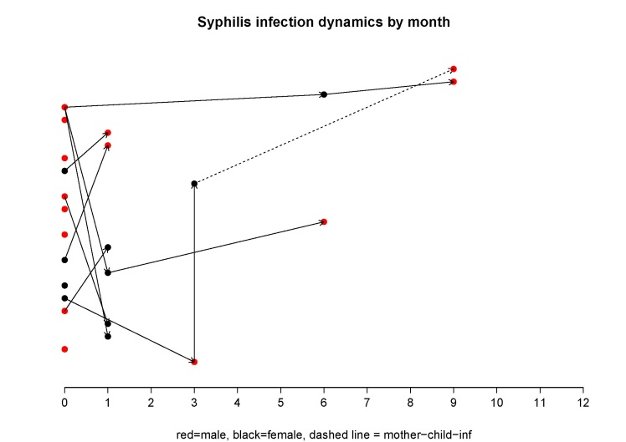
The SILAS model
Sexual Infections as Large-scale Agent-based Simulation
Stefan Scholz, University of Bielefeld, Germany
Agent-based model in FLAME
Simulates sexual behavior of humans for the analysis of STI-spreads
Age-, sex-, sexual orientation- and relationship-status-specific, social, sexual and contraceptual behavior
Behavior estimated via GLMs from panel datasets
Pregnancy as internal result of sexual contacts to simulate perinatal infections
Notes:
The top image shows fertility rates per age. In the bottom image on the y-axis the dots are ordered by their ID and on the x-axis is the time. So at time point zero you see all agents which are "created" with syphilis. The dots are connected to the other dots if agents infect each other. Red dots are males, black dots are females and a dotted line indicates a mother-child infection. The aim of the figure is to make the infections paths visible.

Slide 11
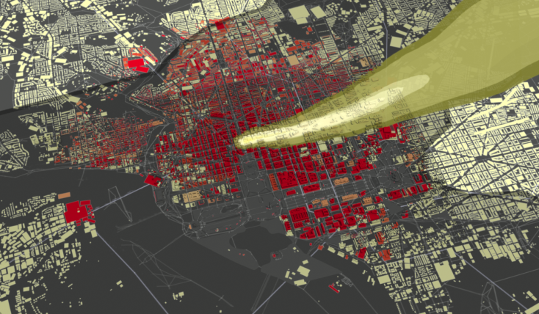
A Large-Scale Simulation of a Behaving Human Population in the Aftermath of a Hypothetical Nuclear Detonation
Christopher L. Barrett, Madhav V. Marathe, Stephen G. Eubank, Samarth Swarup, et al.
Network Dynamics and Simulation Science Lab, Virginia Bioinformatics Institute, Virginia Tech
Models interactions between individuals and infrastructures in the aftermath of a large human-initiated crisis.
Model includes the population (with demographics and family structure), physical locations, and multiple infrastructures (transportation, cell phone communication, health, and power).
Multiple human behaviors are modeled, including household reconstitution, shelter-seeking, healthcare-seeking, evacuation, panic, and aid&assist.
Scenario: A 10kT IND is detonated at ground level
Location: 16th and K Street, Washington D.C., USA
Day and Time: Tuesday, 11:15 a.m.
The figure above shows the building damage and the expected path of the fallout cloud.
1
2
The figure on the left shows a four-cell experiment investigating the effects of early (partial) restoration of communication on health outcomes. We suppose that emergency broadcasts are sent over the cell phone network, advising people to shelter in place. The probability that people will actually do so upon receiving the broadcasts is one of the parameters in the experiment.
If communication if not restored, it doesn’t matter how likely people are to shelter upon receiving broadcasts, because the right people don’t get the broadcasts.
Restoring communication helps even if people have a low probability of following advice to shelter. This is due to secondary benefits like helping people determine their families are safe.
Communication restoration (an engineering intervention) combined with a high probability of sheltering (attainable through advance education/training of people) leads to a large health benefit.
No communication restoration, Pr(Sheltering|EBR) = 0.1 | Partial comm restoration, Pr(Sheltering|EBR) = 0.1
No communication restoration, Pr(Sheltering|EBR) = 0.9 | Partial comm restoration, Pr(Sheltering|EBR) = 0.9
3
4
EBR: Emergency Broadcast Received
Papers at AAMAS ‘13, WSC ‘13, BDSE ‘13, SBP ‘13, and more

Slide 12
Computer Implemented, Markov Mental Health Simulation Model
Steve Leff, Harvard Medical & Human Services Research Institute
Service Utilization, Expenditures, Revenues
Applications:
Mental Health System Planning
Mental Health System Resource Allocation
Mental Health System Performance Measurement

Slide 13
The Reference Model for Disease Progression
Jacob Barhak
Built from literature references and hence the name: The Reference Model
Compares equations to populations from multiple studies /clinical trials
A League / Consumers Report for disease models
Current version deals with diabetic populations
A
B
Process CHD
Pop 3
D
C
No CHD
MI
Survive MI
CHD Death
Pop 2
Pop 1
E
F
Process Stroke
Death
No Stroke
H
G
Stroke
Survive Stroke
Stroke Death
Eq EH | E | E | E | E | …
Eq AD | A | B | C | D | …
Pop 1 | 4 | 6 | 2 | 1 | …
Pop 2 | 2 | 4 | 6 | 1 | …
Pop 3 | 2 | 3 | 9 | 2 | …
… | … | … | … | … | …
Process Competing Mortality
Alive
Other Death
Fitness Matrix

Slide 14
INSPYRED Evolutionary Computation
Aaron Garrett - Jacksonville State University
Candidates
Generator
Evaluator
3.1
7.5
4.2
5.2
Selector
+
=
Generations / Epocs
→
Variators
Repeat
Parents
Crossover
Mutation
Terminator
Best Solution

Slide 15
Discrete Event Simulation (DES) to value service improvement
Patients with booked clinic date
Wait for intended time to next clinic
Queue for clinic visit
Referred to service
Wait for 1st clinic visit
Clinic visit
Discharge or dead
Wait for intended time to next clinic
Queue for clinic visit
Patients going onto waiting list
Service use ➔ Costs & Glaucoma stability ➔ QALYs & Service use ➔ …
Compare value of new technologies and service improvement
Prof Jon Karnon, University of Adelaide
Notes:
Funding decisions for new technologies consider their costs and benefits, usually measured as quality adjusted life years (QALYs)
Opportunities for service improvement are infrequently assessed, and tend to focus on improvements in throughput, for which it is difficult to assign a value.
This project used DES to represent hospital-based glaucoma services, allowing for the ongoing relationship between service use and costs, disease status, and QALYs. Scenario analyses identified service improvements that achieved QALY gains at low additional cost, when compared to funded new technologies.
This resulted in changes at the study hospital and highlights the potential value of service improvement.

Slide 16
Population modeling of environmentally transmitted and drug resistant pathogens
Cristina Lanzas
North Carolina State University
Study infectious diseases dynamics of enteric pathogens (e.g. Clostridium difficile in humans, Shiga-toxin Escherichia coli in cattle)
Methods: Compartmental, agent-based and network models.
Models include detailed exposure patterns, individual and spatial heterogeneity relevant to disease transmission.
http://www.cvm.ncsu.edu/dphp/personnel/lanzas.html
Notes:
You may add notes to help the presenter focus on some points, yet focus on slide

Slide 17
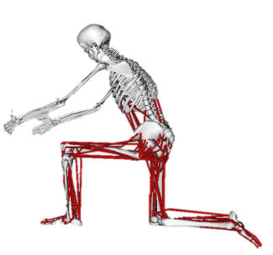

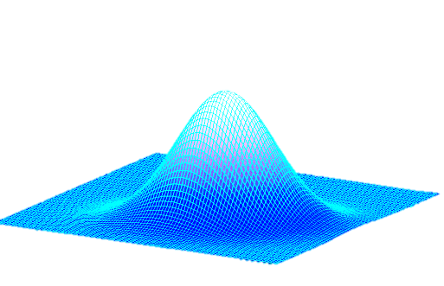
Assessment of Rehabilitation-Based Effects by Simulating Treatment Effects and Randomized Controlled Trials with Population of Musculoskeletal
Difficult to simulate treatment effects that inform evidence based medicine in orthopaedics
Recently created an open source Probabilistic Plug In for OpenSim to simulate uncertainty and population variability
Monte Carlo simulations and efficient estimation methods to analyze the effects of experimental error and parameter uncertainty within patient-specific simulations
Bradley Davidson, Casey Myers
Kevin Shelburne, Peter Laz

Slide 18
Discussion on the Mailing List
What constitutes population modeling?
  Is “cohort modeling” in “population modeling”?
    Active members tend to distance from traditional cohort modeling and prefer newer technologies
    Yet there is still a spectrum of opinions within the group
  Will modeling non human/animal entities such as cells or cell phones constitutes population modeling?
    This idea is in the current definition of the group

Slide 19


Join the Mailing List or
Read the Mailing List Archives
https://simtk.org/mailman/listinfo/popmodwkgrpimag-news
This presentation is indented for reuse by educators
Please feel free to use this material while acknowledging the authors of slides you use.
Mailing list is powered by simtk.org
Thanks to Joy Ku and the SimTk team

