Slide 1
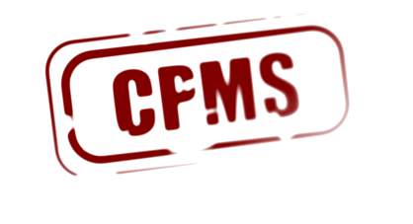










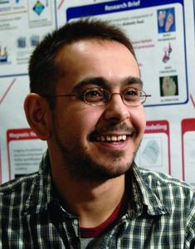
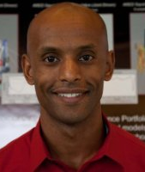

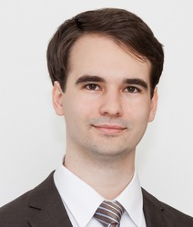
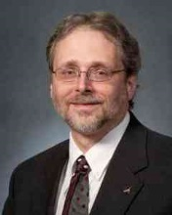
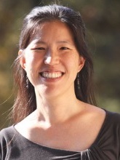
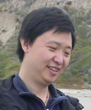
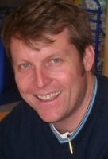
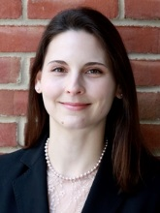
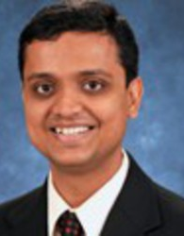
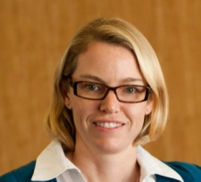
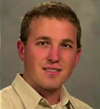
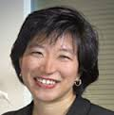
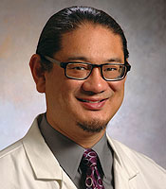
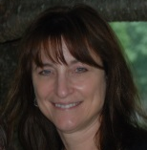
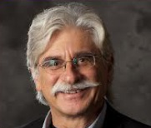
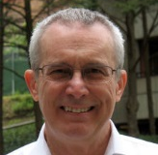
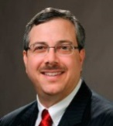
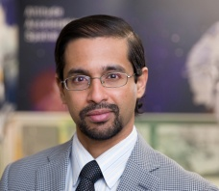
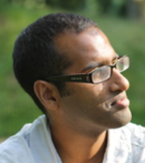
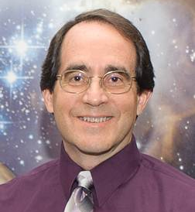
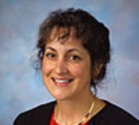
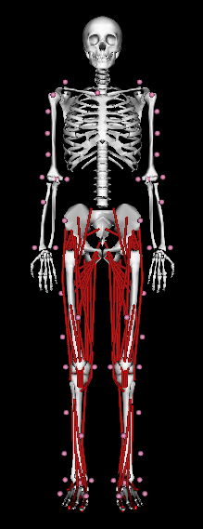
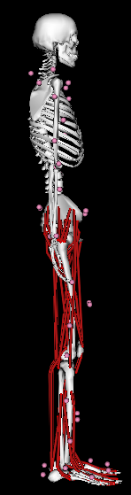
Guidelines for Credible Practice of Modeling and Simulation in Healthcare
L. Mulugeta, A. Erdemir, D.M. Eckmann, G.C.Y. Peng, R. Vadigepalli, G. An, C.A. Hunt, M.J. Steele, W.W. Lytton, T.M. Morrison, J.G. Myers, G.N. Pradhan, D.R. Lochner, M.E. Walton, M. Horner, and J.P. Ku
All listed authors are members of the Committee on Credible Practice of Modeling & Simulation in Healthcare
Committee on Credible Practice of
Modeling & Simulation in Healthcare
Web: https://simtk.org/home/cpms
e-mail: cpmsinhealthcare@gmail.com
INTRODUCTION
The role of computational modeling and simulation (M&S) in healthcare research and practice continues to expand [1-2]. However, the full potential of M&S for facilitating scientific discovery and clinical care can only be realized when M&S workflows and end-products are credible. The Committee on Credible Practice of Modeling & Simulation in Healthcare (the Committee) was established under the Interagency Modeling and Analysis Group (IMAG) and the Multiscale Modeling (MSM) Consortium [2] to establish Guidelines for Credible Practice of Modeling and Simulation in Healthcare. This informational poster primarily focuses on the Committee’s work to develop and adopt the credible practice guidelines, accompanied with a practical example on how to successfully implement this guidance to establish M&S credibility.
About the Committee
PRACTICAL Application EXAMPLE
Committee’s charge
Propose guidelines and procedures for credible practice
Adopt a consistent terminology
Demonstrate workflows for credible practice
Promote good practice
Primarily driven by research initiatives under the:
The M&S workflow used by Rajagopal et al. [8] to develop, evaluate and publish a full body musculoskeletal model illustrate the spirit behind the Committee’s Ten Simples of Credible Practice. Therefore, with permission from Rajagopal et al., we selected their work to demonstrate how the essential elements of the ten simple rules may be implemented.
DISCLAIMER: This example does not necessarily demonstrate the level of detail required to fully satisfy the Committee’s credibility guidelines. The granularity of how each rule is applied is solely dependent on the needs of each M&S project.
& Multiscale Modeling (MSM) Consortium
Multifaceted Approach
The Committee strives for balanced representation of interests and perspectives of different stakeholders, such as clinicians and experts in modeling, simulation, development and evaluation of medical products, and biomedical engineering.
R1 - Define context clearly
Develop an open-source, three-dimensional musculoskeletal model that:
Has high-fidelity representations of the lower limb musculature of healthy, young adult individuals
Is suitable for simulating normal gait – specifically for walking and jogging/running, but should be tested before use for activities that require high knee flexion such as sprinting and cycling
Is computationally fast enough for use in muscle-driven simulations.
Example research application: Investigating lower body joint load differences between heel-strike and midfoot-strike running techniques.
Committee Executive Members (Execute & Charge)
Integration of multiple disciplines
Engaging diverse organizations
Mathematics
Life sciences
Engineering
Computing
Medicine
…
Government
Academia
Hospitals
Industry
…
R2 - Use appropriate data
L. Mulugeta, M.Sc.
Co-Chair
InSilico Labs LLC
A. Drach, Ph.D.
U. of Texas
J. Myers, Ph.D.
NASA
J. Ku, Ph.D.
Stanford U.
L. Tian, Ph.D.
Stanford U.
Multidisciplinary
Cross-organizational
Data used to develop the model:
Motion capture data from 41 retro-reflective markers tracked at 100 Hz using an eight-camera motion capture system
Ground reaction forces and moments measured at 2000 Hz using over-ground force plates
Musculotendon parameters derived from previous anatomical measurements of 21 cadaver specimens and magnetic resonance images of 24 young healthy subjects
Expected variability in the data is provided in Supplemental Table I of Rajagopal et al. [8]
Data used to validate the model:
Experimental electromyography (EMG) data for the gluteus maximus, gluteus minimus, rectus femoris, vastus lateralis, biceps femoris long head, gastrocnemius lateralis, tibialis anterior, and soleus
A. Erdemir, Ph.D.
Co-Chair
Cleveland Clinic
W. Lytton, M.D.
Kings County Hosp.
Downstate Med. Cntr
M. Horner, Ph.D.
ANSYS, Inc.
T. Morrison, Ph.D.
FDA
R. Vadigepalli, Ph.D.
Thomas Jefferson U.
Communication Accountability
…
Reporting
Standards
Validation
Verification
Repeatability
…
Diagnosis
Clinical research
Disease pathway
Drug development
Therapeutics design
Advisory Council (Review & Advise)
Leverage Existing
Procedures
Wide-ranging
Applications
A. Marsden, Ph.D. Stanford U.
J. Bischoff, Ph.D.
Zimmer
G. Peng, Ph.D.
NIH
G. An, MD
U. of Chicago
D. Lochner
FDA
V. Marmarelis, Ph.D.
U. of Southern California
R3 - Evaluate within context
A. Hunt, Ph.D.
U. of California, SF
D. Eckmann, M.D., Ph.D.
University of Pennsylvania
G. Pradhan, Ph.D.
Mayo Clinic
P. Pathmanathan, Ph.D.
FDA
M. Steele, Ph.D.
NASA
M. Walton, Ph.D.
Wyle
Inclusive of a variety of procedures
Application across many areas
Tested model fidelity criteria by:
Qualitative comparison of musculoskeletal geometry of the model to experimental data
Quantitative and qualitative verification of simulated muscle-generated joint moments to inverse dynamics joint moments
Qualitative validation of simulated muscle activity to EMG data
However, comprehensive testing and sensitivity analysis is still needed.
Tested computational speed by comparing the speed of the Full Body Model to generate a single gait cycle simulation relative to other frequently used musculoskeletal models.
Developing The Guidelines
Based on a survey of Committee members, the Committee has drafted its perspectives on “The Ten Simple Rules of Credible Practice of M&S in Healthcare” (Table 1) [4].
R4 - List limitations explicitly
Rule | Description
R1 - Define context clearly | Develop and document the subject, purpose, and intended use(s) of the model or simulation.
R2 - Use appropriate data | Employ relevant and traceable information in the development or operation of a model or simulation.
R3 - Evaluate within context | Verification, validation, uncertainty quantification, and sensitivity analysis of the model or simulation are accomplished with respect to the reality of interest and intended use(s) of the model or simulation.
R4 - List limitations explicitly | Restrictions, constraints, or qualifications for or on the use of the model or simulation are available for consideration by the users or customers of a model or simulation.
R5 - Use version control | Implement a system to trace the time history of M&S activities including delineation of contributors’ efforts.
R6 - Document adequately | Maintain up-to-date informative records of all M&S activities, including simulation code, model mark-up, scope and intended use of M&S activities, as well as users’ and developers' guides.
R7 - Disseminate broadly | Publish all components of M&S activities, including simulation software, models, simulation scenarios and results.
R8 - Get independent reviews | Have the M&S activity reviewed by nonpartisan third-party users and developers.
R9 - Test competing implementations | Use contrasting M&S execution strategies to check the conclusions of the different execution strategies against each other.
R10 -Conform to standards | Adopt and promote generally applicable and discipline specific operating procedures, guidelines, and regulations accepted as best practices.
Table 1: The Committee’s “Ten Simple Rules of Credible Practice of M&S in Healthcare” [4-6].
Model does not contain representations of all lower limb muscles or representations of ligaments or other soft tissues
Chosen musculotendon parameters represent an average individual based on experimental data from literature, and these data contain variability not captured in the model
It is assumed that as a muscle-tendon unit changes length, all fibers in the muscle change length equally
Model tested within defined ranges of motion: 40° plantarflexion to 30° dorsiflexion; 0° to 120° knee flexion; 30° hip extension to 120° hip flexion; 50° hip abduction to 30° hip adduction; and 40°hip external rotation to 40° hip internal hip rotation
Users should always test within kinematic space the model will be used – particularly for movement with higher knee flexion angles
R5 - Use version control
Full Body Model [8]
R8 - Get independent reviews
All versions of the model, associated data, and documentation are managed using the subversion repository provided by SimTK. [9]
Prior to making the model publically available, the model was submitted for independent review in conjunction with publication review of their manuscript. During the initial submission of the manuscript and model:
All four reviewers were able to reproduce the results reported in the manuscript
Reviewers noted a need for more streamlined and documented process to re-run simulations
Several data discrepancies were identified in the initial submission of the manuscript and model
With resubmission of the manuscript and model, Rajagopal et al. made several enhancements that improved the usability of the model and alleviated data discrepancies. [10]
R6 - Document adequately
All associated documentation (e.g. readme file) and publications are freely available for download from the SimTK project site. [9]
R7 -Disseminate broadly
The Committee also surveyed the broader research community to ensure a balanced representation of the interests and perspectives of global stakeholders in healthcare M&S.
The preliminary results show that both the Committee and the broader community agree that the four rules highlighted in Table 1 are necessary for credible practice of M&S in healthcare. [5-6]
This has had an early impact in the field by informing the IMAG U01 funding program [7]
Analysis of the global survey data and consolidation with the Committee’s perspective is still in progress.
The model, data used to create the simulations, documentation, and publications are freely available for download from the SimTK project site. The user community is also encouraged to make refinements and share them. [8-9]
R9- Test competing implementations
Simulation computation time of the model was compared to two other commonly used OpenSim models: the Delp model modified to include arms, and the Arnold model
Model’s fidelity to simulate normal gait was not compared with these two commonly used models or any other model.
Synergistic Initiatives in Progress
Glossary of Terms - Develop consistent terminology among stakeholders | Promoting Good Practice - Promote good practice through webinars, presentations and professional engagements
Demonstrate Workflows - Document different strategies to achieve credible practice throughout the entire M&S life-cycle
R10 - Conform to standards
Model testing conformed to published guidelines for best practices “Best practices for verification and validation of musculoskeletal models and simulations of human movement” [11]
Human subject testing was carried out with Institutional Review Board approval
Data collection, processing, and reporting methods conformed to practices generally accepted by the biomechanics community.
References:
Forward Work
G.C. Peng, IEEE Trans. Biomed. Eng., 58:3440-2, 2011.
U.S. Food and Drug Administration, Advancing Regulatory Science at FDA, A Strategic Plan, August 2011.
L. Mulugeta and A. Erdemir, ASME 2013 Frontiers in Medical Devices, Washington, DC, 2013, 10.1115/FMD2013-16080.
A. Erdemir, et al., 2015 Frontiers in Medical Devices, Washington, DC, 2015.
L. Mulugeta et al., 38th Annual International Conference of the IEEE Engineering in Medicine and Biology Society, 16-20 August 2016, Orlando, FL.
T.M. Morrison, et al., Virtual Physiological Human Conference 2016, 26-28 September 2016, Amsterdam, Netherlands.
Predictive Multiscale Models for Biomedical, Biological, Behavioral, Environmental and Clinical Research, PAR-15-085 (NIH U01), http://grants.nih.gov/grants/guide/pa-files/PAR-15-085.html, May 22, 2016.
A. Rajagopal et al. IEEE Trans. Biomed. Eng., 63(10 ): 2068-2079, 2016.;
Full Body Model SimTK Project Site, https://simtk.org/projects/full_body.
A. Erdemir et al., IEEE Trans. Biomed. Eng., 63(10): 2080-2085, 2016.;
J.L. Hicks et al., J. Biomech. Eng., 137(2):020905, 2014.
We anticipate the guidance provided by the Committee will evolve with the further penetration of M&S into healthcare.
The Committee will continue to provide support to the IMAG/MSM community through its efforts to develop consistent terminology, illustrative workflows, and resources for promoting credible practice of modeling and simulation in healthcare.
Projected outcomes of the glossary initiative are a peer-reviewed manuscript and contribution to the Medical Dictionary maintained by the National Library of Medicine.
The result of the other two synergistic initiatives will augment the guideline and a proposed Model Certification Process.
Acknowledgments: The authors would like to acknowledge the Interagency Modeling and Analysis Group and the Multiscale Modeling Consortium, who enabled activities of the Committee.

