Slide 1
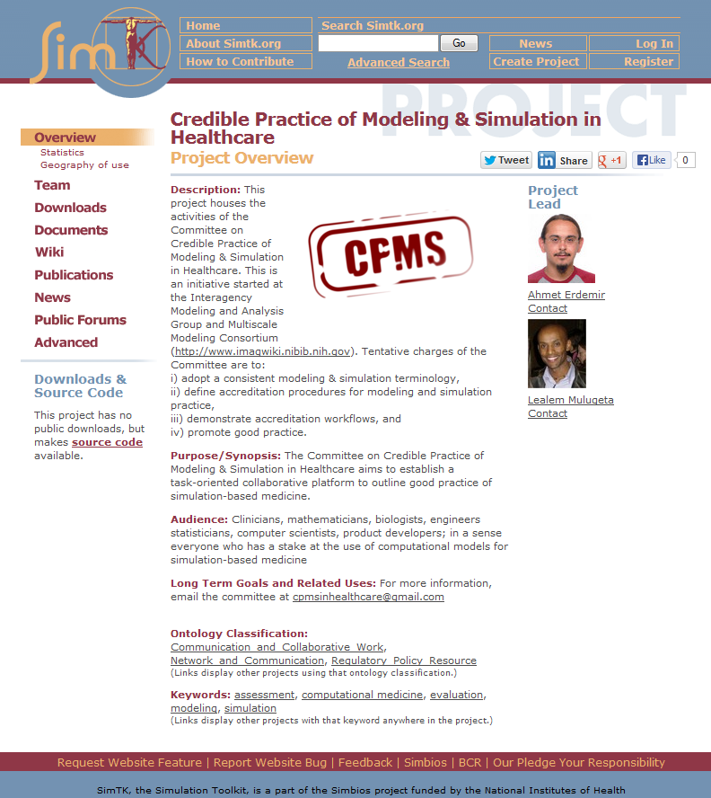
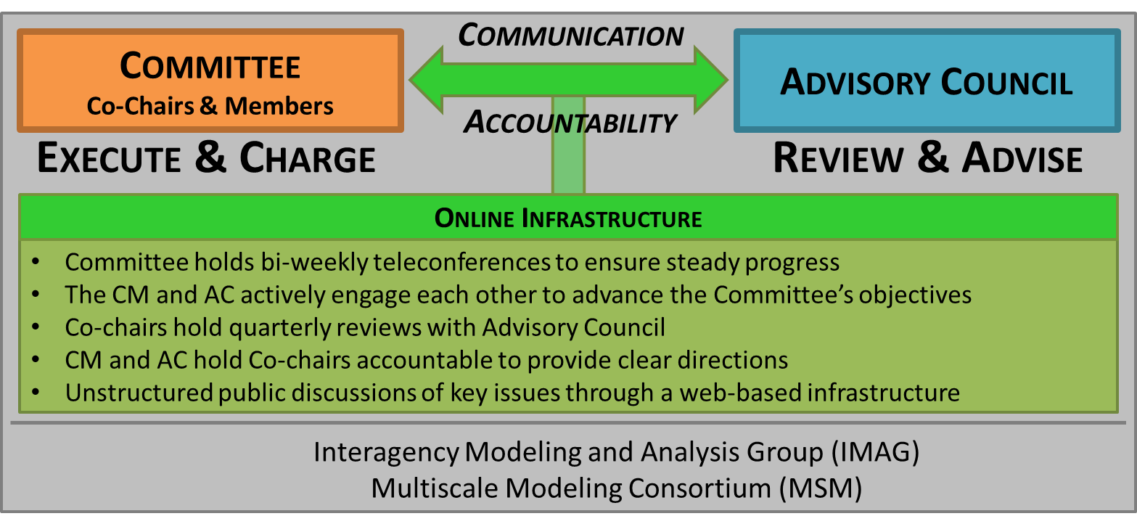
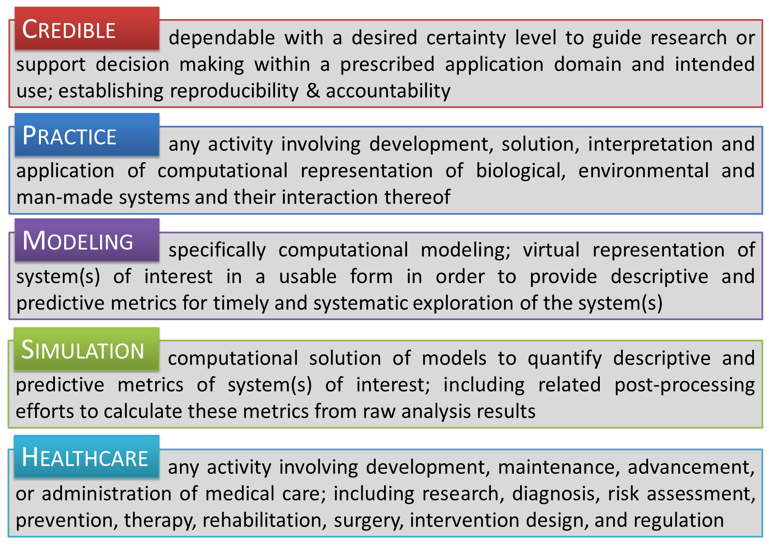
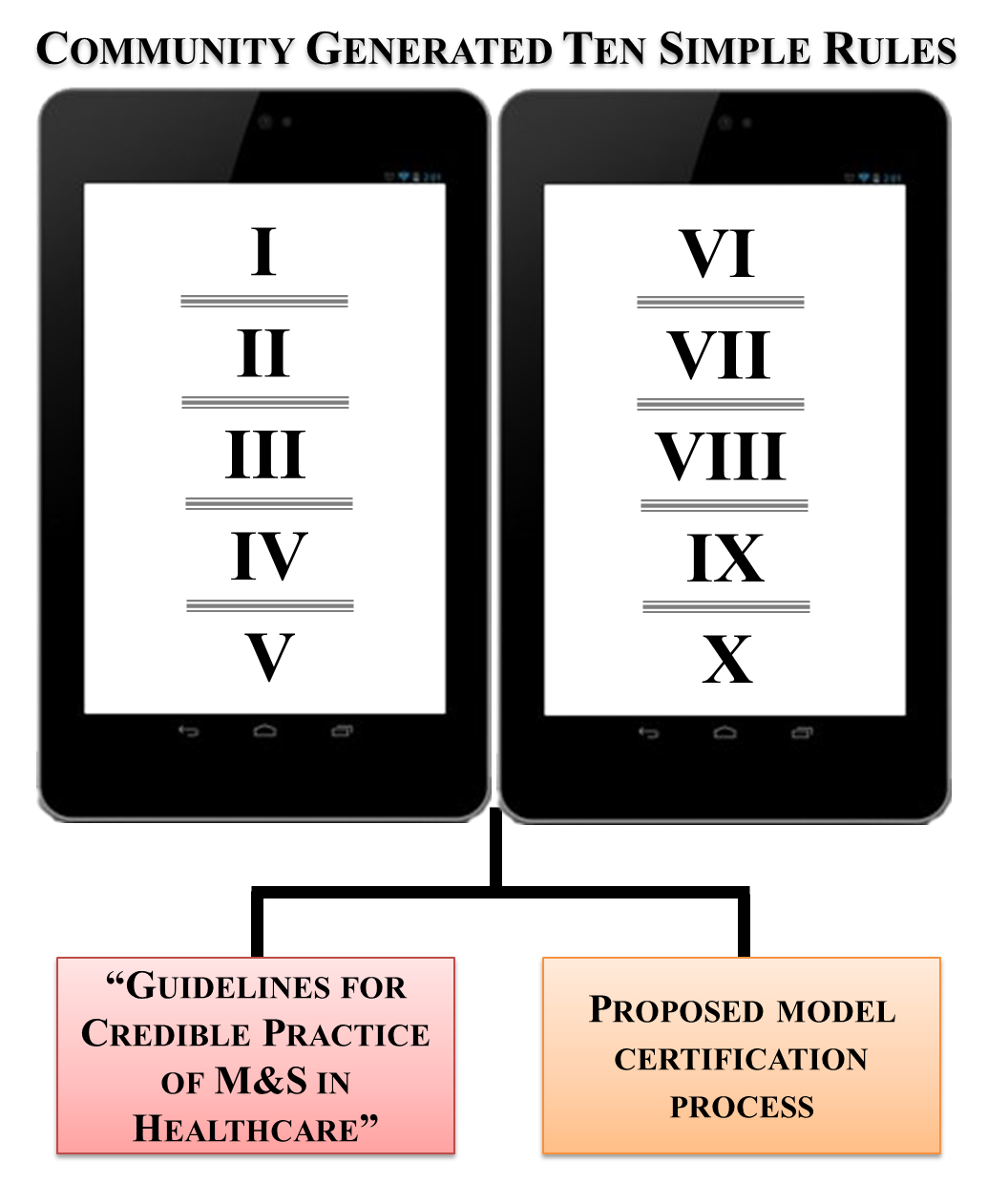
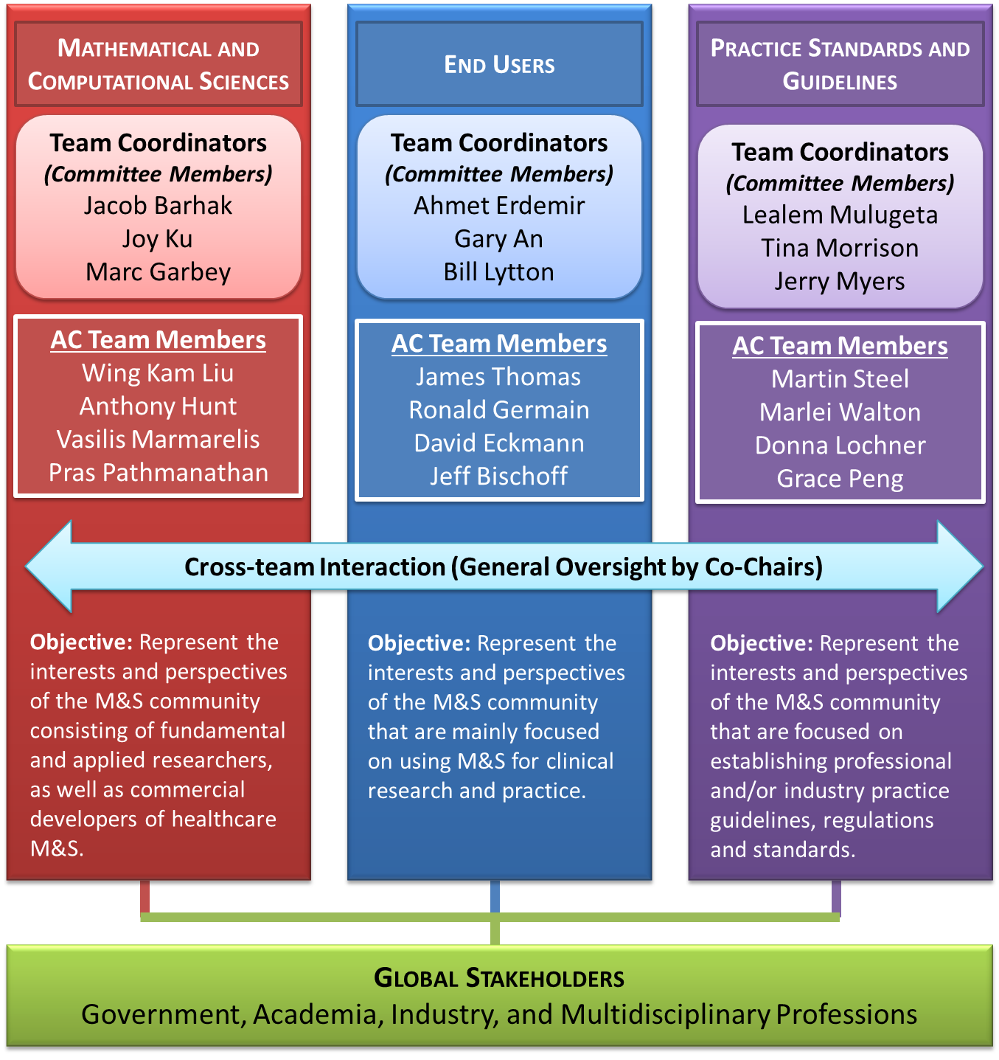
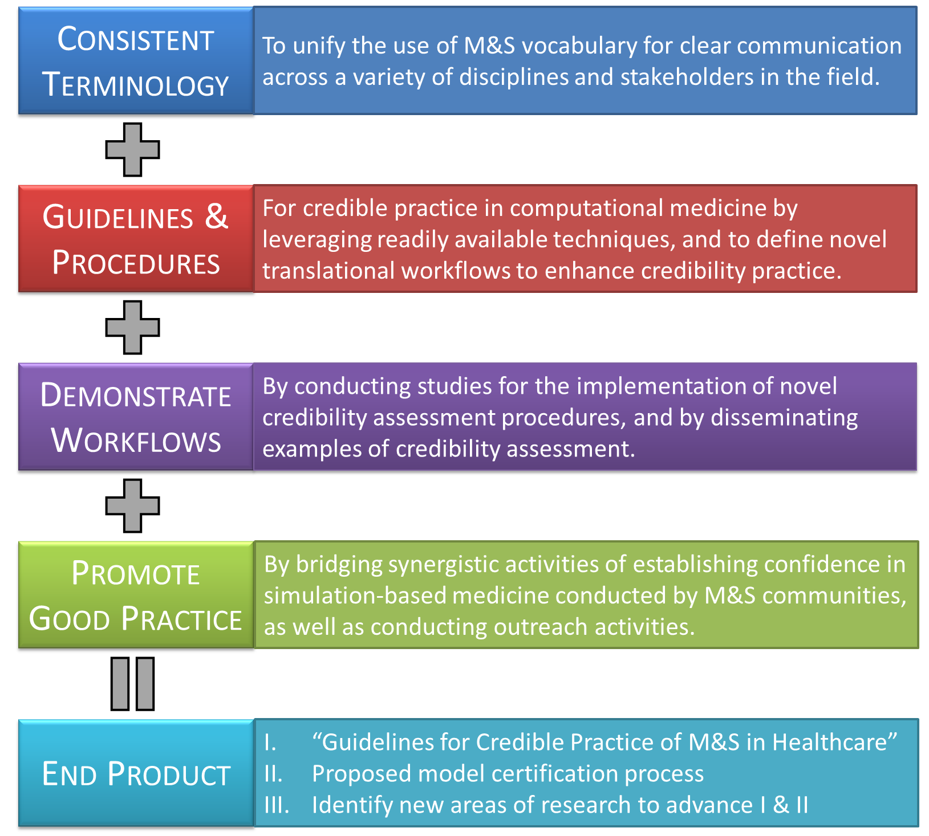
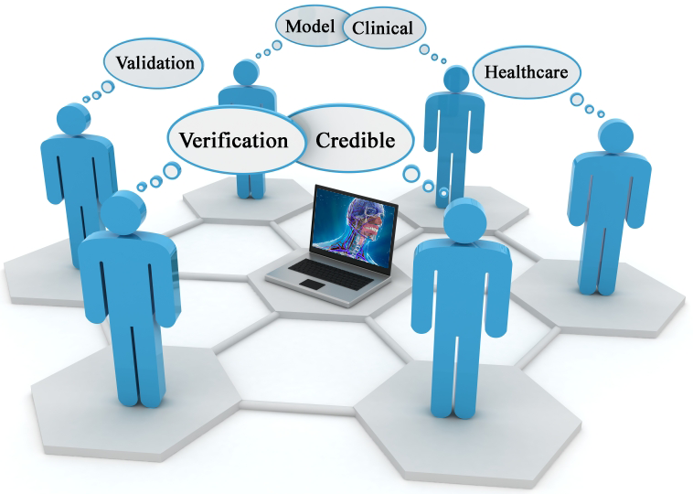











Committee on Credible Practice of Modeling & Simulation in Healthcare
Lealem Mulugeta¹ and Ahmet Erdemir²
Division of Space Life Sciences, Universities Space Research Association, Houston, TX
Computational Biomodeling (CoBi) Core, Cleveland Clinic, Cleveland, OH
Introduction
Committee Organization
Infrastructure
Computational modeling and simulation (M&S) methods have substantial potential to support clinical research and decision support. Consequently, substantial investment is being made by government agencies and industry to advance research and development activities in simulation-based medicine and notable discoveries are being made [1]. However, the mechanisms or processes necessary to appropriately translate these research activities and discoveries in computational methods to clinical research and practice are lacking. Moreover, there is substantial research diversity in the field such that subject matter experts within and across mathematical and biological disciplines tend to have their own interpretation of credible practice in M&S [2-4]. This can result in misuse and distrust of the tools among medical practitioners, ultimately leading to their under-utilization across all aspects of medicine. To help fill this gap, the “Committee on Credible Practice of Modeling & Simulation in Healthcare” (see Figure 1 for definitions) was established under the Interagency Modeling and Analysis Group (IMAG) and the Multiscale Modeling (MSM) Consortium. The IMAG and MSM are organized by the National Institutes of Health (NIH) in collaboration with other government agencies and academic researchers to promote the advancement of computational medicine [5]. The objectives of Committee on Credible Practice of Modeling & Simulation in Healthcare (hereafter the Committee) are to establish guidelines and identify new areas of research for the development and implementation of credible computational models and simulations for healthcare research and intervention. The Committee’s charge are summarized in Figure 2.
To realize the objectives, the Committee was organized in two groups; one to carry-out day-to-day operations and active tasks to realize the charges of the committee, the other to review and provide feedback on the activities (Figure 3). The former group, the Executive Committee, consists of ten Committee Members (CM) including two co-chairs, who are held accountable for carrying out the charge of the Committee. The latter group, the Advisory Council (AC), has been put in place to assist the Executive Committee with document reviews and providing guidance on various subject matters.
Given the multifaceted interest and multidisciplinary nature of computational medicine, the Committee seeks a balanced representation of the different stakeholders by including representatives from government, academia, and industry from very diverse disciplinary backgrounds. With this in mind, the Committee has been divided into three teams that represent the fundamental areas that are significant to our primary aim (Figure 4). Using this approach, we can bridge synergistic activities in simulation-based medicine throughout the M&S communities.
The Committee conducts all of it’s operations publicly via the online infrastructure of Simbios, NIH Center for Biomedical Computing at Stanford [6,7]. The Committee website (Figure 5) includes version control system to keep materials relevant to the activities; public forums for discussions; a wiki platform for developing content relevant to the committee’s end deliverables; tools to conduct surveys; and various sections for downloads and documents for outreach. The activities are supported by web conferencing tools to allow online meetings among members.
Figure 5: The Committee website hosted on SimTK.org - https://simtk.org/home/cpms.
Planned Activities
Figure 3: Operational organization of the Committee on Credible Practice of Modeling & Simulation in Healthcare.
The Committee’s vision is to produce a guidance document on establishing credible practice of M&S in healthcare and to draft a proposal for model certification process in the next two years. To achieve this, the Committee is focusing on three main activities:
Ten Simple Rules of Credible Practice: The Committee is currently working to generate a list of ten key elements or “ten simple rules” of credible practice. Using the three team structure shown in Figure 4, the Committee is gathering input from all stakeholders and conducting a survey of computational models to develop a better understanding of the needs and successes of different types and applications of M&S in healthcare. The Committee will use the established "Ten Simple Rules of Credible Practice" as the foundation to develop a "Guidelines for Credible Practice of Modeling and Simulation in Healthcare," the Committee's primary deliverable for the first two-year term (Figure 6).
Figure 6: Community generated credible practice rules, guidelines and accreditation methods.
Figure 1: Definitions relevant to the activities of the Committee on Credible Practice of Modeling & Simulation in Healthcare.
A Common Language Across Disciplines: A glossary of terms is currently being generated on the Committee’s website [7] in an attempt to unify the use of M&S vocabulary to ensure clear communication across a variety of disciplines and stakeholders in the field.
Public Engagement: The success of the Committee and wide acceptance of the guidelines depends on adoption by all stakeholders. Consequently, we seek to engage and encourage the global stakeholder community to actively contribute to these efforts via the online forum and Wiki [7].
Figure 4: Functional team structure for executing the Committee’s goals.
Collaborating Organizations
References
& Multiscale Modeling (MSM) Consortium
[1] Peng GC, IEEE Trans Biomed Eng, 58:3440-2, 2011.
[2] Kopec, JA et al., BMC Public Health, 10:710, 2010.
[3] Waltemath, D et al., BMC Syst Biol, 5:198, 2011.
[4] Erdemir, A et al., J Biomech, 45:625-33, 2012.[5]
[5] IMAG Wiki, http://www.imagwiki.nibib.nih.gov/, accessed on April 27, 2013.
[6] Delp, SL et al., J Am Med Inform Assoc, 19:186-9, 2012.
[7] Credible Practice of Modeling & Simulation in Healthcare. Committee website. https://simtk.org/home/cpms. Accessed July 21, 2013
Acknowledgements
Figure 2: Overview of the Committee’s charge
The authors and the Committee acknowledge the feedback from IMAG and MSM members during the development and deployment of the Committee.

