Slide 1
Credibility of Computational Methods in Healthcare: A Comparison of Community-based Standards and Guidelines
https://simtk.org/home/cpms
M. Horner^{1,2}, L. Mulugeta^{1,2}, A. Erdemir¹, G. An¹, D.M. Eckmann¹, J.E. Bischoff^{1,2}, C.A. Hunt¹, J. Ku¹,
D. Lochner¹, W.W. Lytton¹, V. Marmarelis¹, J.G. Myers¹, G. Peng¹, M.J. Steele¹ and M. Walton¹
IMAG/MSM Committee on Credible Practice of M&S in Healthcare
ASME V&V40: Verification and Validation in Computational Modeling of Medical Devices
ASME Verification and Validation Symposium
Las Vegas, Nevada May 18-20, 2016
Notes:
While there are lessons to be learned from each group, this information could help to identify which community guideline or other material would be appropriate for a given V&V activity.

Slide 2
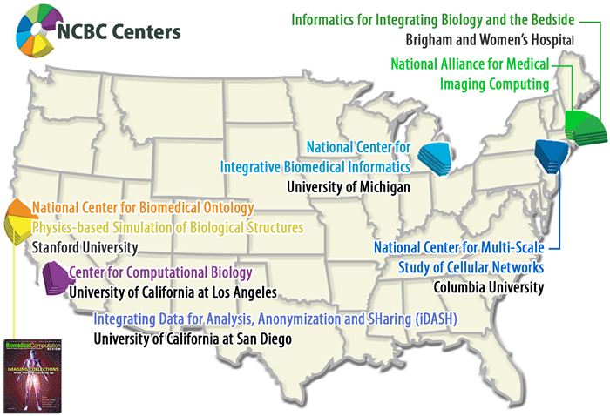
Background
Computational modeling and simulation (M&S) methods have substantial potential to support research, clinical decisions and education in healthcare
Government agencies and industry are making substantial investments on R&D activities in simulation-based medicine and notable discoveries are being made
adapted from NCBC website (2014)
Notes:
Impetus for forming the group was that in 2011/2012, the IMAG/MSM consortium observed that the models being developed within the MSM consortium were not being translated to the clinic. Reasons for this include:
There was no unified standard/guideline for establishing the credibility of the model
The researcher may not have been working directly with a clinician to collect model inputs, feedback, etc.
A variety of US government agencies are investing in biomedical/clinical research. As an example, this slide shows a map of the National Centers for Biomedical Computing, which is a collection of government research centers funded by the NIH whose mission is to create innovative software programs and other tools that will enable the biomedical community to integrate, analyze, model, simulate, and share data on human health and disease. But we can’t just hope that the software or the models make it to the clinic. Thus, a need for a standard/guideline on how to translate a model to the clinic becomes clear.

Slide 3

The Challenge
Am I applying credible practice?
Common practice guidelines do not exist to ensure that appropriate credibility processes are followed
Adapted from http://beaver1003.com
Notes:
So we need to make researchers aware of the challenge and potential solutions to translating computational models to clinical practice.

Slide 4
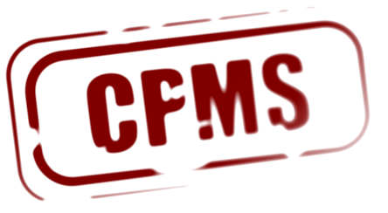











Solution Pathway
To bridge this gap, the
Committee on Credible Practice of
Modeling & Simulation in Healthcare
was established under
& Multiscale Modeling (MSM) Consortium
Primary focus: Computational M&S for clinical research and decision-making
Notes:
The CPMS group was established in early 2013 under the auspices of IMAG and the MSM Consortium to develop and disseminate a unified credible practice guidelines across all areas biomedical applications.
IMAG = Interagency Modeling and Analysis Group. Formed in 2003, it is an interagency group because the 10 diff’t government agencies shown in the box are members that can potentially fund trans-agency research that has the potential for broad impact in the research community.
MSM = Multiscale Modeling Consortium. IMAG realized very early on that single-scale models would have limited in their impact. Therefore, the MSM was formed in 2006 to grow the field of multiscale modeling in biomedical, biological and behavioral systems, which necessarily requires multidisciplinary scientific collaboration among multiscale modelers. Examples might be connecting research on LDL transport in the CV system to plaque growth or simulating the biological response to a drug.
Membership: You have to work for a gov’t agency to be a member of IMAG, which any researcher can be a member of MSM. Members of MSM are funded by IMAG projects or are an interested party as follows:
Consortium members, who are funded/active consortium members that are part of a working group.
Interested parties: interested in research, events, etc. funded by iMAG/MSM. Interested parties are typically affiliated with one or more working groups.

Slide 5
What Makes the Committee Unique?
Integration of multiple disciplines
Engaging diverse organizations
Mathematics
Life sciences
Engineering
Computing
Medicine
…
Government
Academia
Hospitals
Industry
…
Multidisciplinary
Cross-organizational
…
Reporting
Standards
Validation
Verification
Repeatability
…
Diagnosis
Clinical research
Disease pathway
Drug development
Therapeutics design
Leverage Existing
Procedures
Wide-ranging
Applications
Inclusive of a variety of procedures
Application across many areas
Notes:
We recognize that CM&S for healthcare is a multi-disciplinary pursuit with a wide range of applications, especially in government where fundamental research on human physiology, disease pathways, and other areas is emphasized.
Also, we are not trying to re-invent the wheel, but Take advantage of existing procedures and standards sources, e.g. ASME V&V standards, NASA guidelines, etc.
The end goal is to come up with a sufficiently flexible guideline such that researchers across a wide array of disciplines and applications can translate their results to the clinic.

Slide 6
Committee Implementation Strategy
None of us are experts in everything.
We need to learn from each other.
Credible practice of modeling and simulation in healthcare requires ongoing inclusive communications to establish adaptive workflows that can be utilized broadly.
Notes:
The CPMS group could have been implemented in many forms.
Many standards tend to be developed by focus groups or a selected group of “experts”, which may or may not be fully representative of the global stakeholder community.
Recognizing that:
Our stakeholders are international and come from any backgrounds: engineer, clinician, molecular biologist, etc. So we had to structure the group in a way that allowed for participation across many diverse disciplines.
We decided to align the structure and operation of the committee to fit this multi-faceted paradigm (may not be the best wording, but I think you get the point)

Slide 7
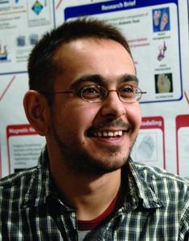
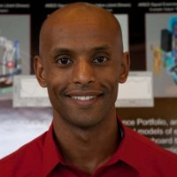

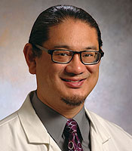
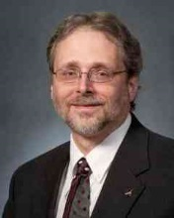
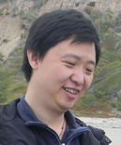
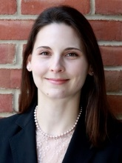
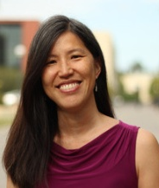
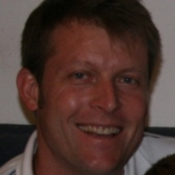

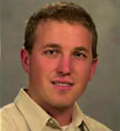
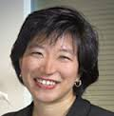
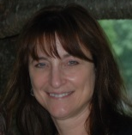
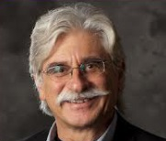
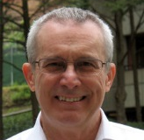
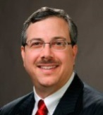
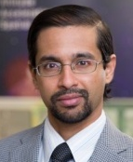

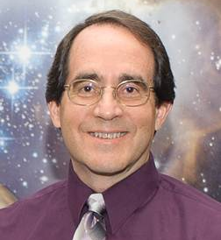
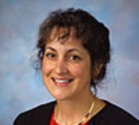
Committee Implementation Strategy
Committee Executive Members (Execute & Charge)
A. Erdemir, Ph.D.
Co-Chair
Cleveland Clinic
L. Mulugeta, M.Sc.
Co-Chair
InSilico Labs, LLC
W. Lytton, M.D.
Kings County Hosp.
Downstate Med. Cntr
G. An, MD
U. of Chicago
J. Myers, Ph.D.
NASA
L. Tian, Ph.D.
Stanford U.
T. Morrison, Ph.D.
FDA
J. Ku, Ph.D.
Stanford U.
M. Horner, Ph.D. ANSYS, Inc.
Communication Accountability
Advisory Council (Review & Advise)
Al. Marsden, Ph.D.
Stanford U.
J. Bischoff, Ph.D.
Zimmer
G. Peng, Ph.D.
NIH
D. Lochner
FDA
V. Marmarelis, Ph.D.
U. of Southern California
A. Hunt, Ph.D.
U. of California, SF
D. Eckmann, M.D., Ph.D.
University of Pennsylvania
G. Pradhan, Ph.D.
Mayo Clinic
P. Pathmanathan, Ph.D.
FDA
M. Steele, Ph.D.
NASA
M. Walton, Ph.D.
Wyle
Interagency Modeling and Analysis Group (IMAG) & Multiscale Modeling Consortium (MSM)
For full credentials of the CPMS members: http://wiki.simtk.org/cpms/CPMS_Members
Notes:
Our strategy is to recruit people representing the different disciplines and interest in healthcare. Membership of EC and AC represents the multi-disciplinary nature of our group.
The Executive Committee develops a roadmap for the committee. The Executive Committee then “executes” the charge of the Committee and the Advisory Council reviews and advises the executive Committee on the progress made toward the execution of the charges (e.g. TSR Survey Design process). The majority of the AC members are highly experienced and have significant vision/experience to impart to the team members.
We are currently looking to fill one seat in the EC and the AC, so please let me know if you are interested in participating.
(Note that IMAG/MSM is shown at the bottom to emphasize that we are part of a larger group.)
LEALEM: I don’t see a strong industry presence. Would a focus on surgical planning or other areas affect this or is it still too early to expect industry to see the value?

Slide 8
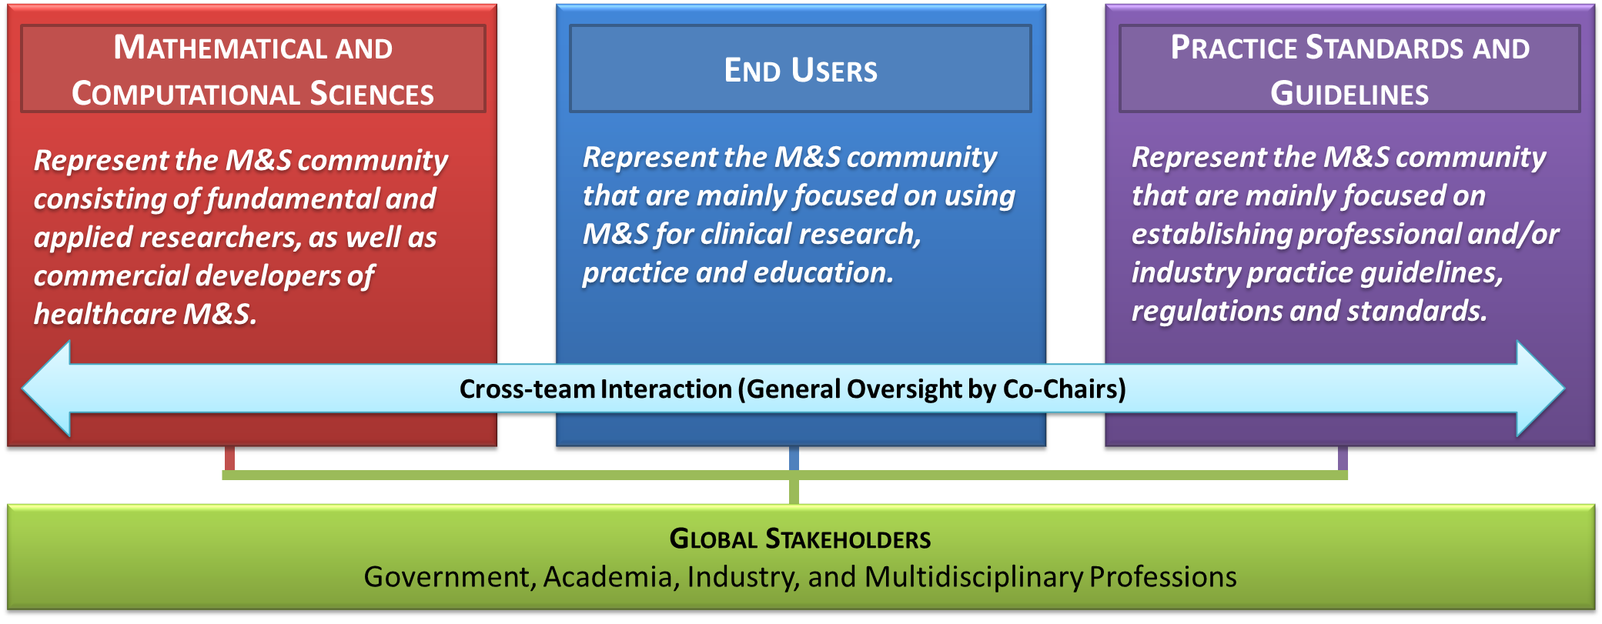
Committee Implementation Strategy
Use team-based structure to:
Establish a balanced representation of the interests and perspectives of the different stakeholders
Bridge synergistic activities in simulation-based medicine throughout the M&S communities
Notes:
The above functional team structure was adopted for executing the various goals of the Committee. Effectively, this is breaking down the community into three “Task Teams”:
Those who are focused on modeling
Those who just want to use the software
And regulators: The goal of the “Regulators” group is to provide the perspectives of the governing/professional bodies that normally create standards and guidelines. This way, we can ensure the Committee develops a guideline that aligns with what would be expected of a standard or guideline developed by government or professional bodies like FDA, DoD or ASME. At the same time, we are having the developers and users to provide their perspectives on what should be included in the guideline.
This structure was identified as the result of an internal survey and shows that we are carefully considering that we are trying to solve multi-faceted problems and there need to structure ourselves accordingly.
Team coordinators lead the individual teams to ensure the perspectives of the three broad stakeholder communities are communicated effectively, and the Co-chairs also work with the team coordinators to incorporate the perspectives into the execution of the Committee’s charge.

Slide 9
Functional Team Structure
Mathematical and Computational Sciences
Team Coordinators
(Exec. Comm. Members)
Adv. Comm. Members
End Users
Team Coordinators
(Exec. Committee Members)
Adv. Comm. Members
Practice Standards and Guidelines
Team Coordinators
(Exec. Committee Members)
Adv. Comm. Members
Objective: Represent the interests and perspectives of the M&S community, consisting of fundamental and applied researchers, as well as commercial developers of healthcare M&S.
Objective: Represent the interests and perspectives of the M&S community that are mainly focused on using M&S for clinical research and practice.
Objective: Represent the interests and perspectives of the M&S community that are focused on establishing professional and/or industry practice guidelines, regulations, and standards.
Cross-team interaction (General Oversight by Co-Chairs)
GLOBAL STAKEHOLDERS
Government, Academia, Industry, and Multidisciplinary Professions
Notes:
The above functional team structure was adopted for executing the various goals of the Committee. Effectively, this is breaking down the community into three “Task Teams”:
Those who are focused on modeling
Those who just want to use the software
And regulators: The goal of the “Regulators” group is to provide the perspectives of the governing/professional bodies that normally create standards and guidelines. This way, we can ensure the Committee develops a guideline that aligns with what would be expected of a standard or guideline developed by government or professional bodies like FDA, DoD or ASME. At the same time, we are having the developers and users to provide their perspectives on what should be included in the guideline.
This structure was identified as the result of an internal survey and shows that we are carefully considering that we are trying to solve multi-faceted problems and there need to structure ourselves accordingly.
Team coordinators lead the individual teams to ensure the perspectives of the three broad stakeholder communities are communicated effectively, and the Co-chairs also work with the team coordinators to incorporate the perspectives into the execution of the Committee’s charge.

Slide 10
Committee’s Charge
Guidelines & Procedures
  Credible practice in computational medicine
  Leveraging readily available techniques
  Define novel translational workflows to enhance credibility practice
Demonstrate Workflows
  Conduct studies to develop novel credibility assessment procedures
  Disseminating examples of credibility assessment
Consistent Terminology
  Unify the use of M&S vocabulary across all stakeholders
Promote Good Practice
  Bridge synergistic activities within the M&S communities
  Conduct outreach activities
End Products
“Guidelines for Credible Practice of M&S in Healthcare”
Proposed model certification process
Identify new areas of research to advance I & II

Slide 11
Ten Simple Rules of Credible Practice
Primary deliverable: “Guidelines for Credible Practice of Modeling and Simulation in Healthcare”
Goal Oriented Activity: The CPMS Task Teams were charged to identify ten key elements or simple rules of credible practice in order to establish a foundation from which the “Guidelines for Credible Practice of Modeling and Simulation in Healthcare” can be developed.
Full details of this activity is available at: http://wiki.simtk.org/cpms/Ten_Simple_Rules_of_Credible_Practice
Notes:
The primary deliverable of this committee is the development of a document called “Guidelines for Credible Practice of Modeling and Simulation in Healthcare”. The goal being to identify best practices that enhance credibility of modeling & simulation in healthcare. This document will contain the “10 Simple Rules” of credible practice of M&S as identified by an internal, and then external, survey. This will help researchers understand what best practices will help them demonstrate model credibility.

Slide 12
Initial Survey to Identify the “Ten Simple Rules”
To initiate the Ten Simple Rules task:
26 candidate rules were generated
Candidate rules were surveyed internally among the Committee’s three Task Teams
Results from the three teams were consolidated to arrive at “Ten Simple Rules”
26 Candidate Rules of Credible Practice
Use version control | Follow discipline-specific guidelines | Define the context the model is intended to be used for
Use credible solvers | Attempt verification within context | Perform appropriate level of sensitivity analysis within context of use
Explicitly list your limitations | Attempt uncertainty (error) estimation | Use consistent terminology or define your terminology
Report appropriately | Make sure your results are reproducible | Get it reviewed by independent users/ developers/members
Document your code | Define your evaluation metrics in advance | Provide user instructions whenever possible and applicable
Provide examples of use | Conform to discipline-specific standards | Use traceable data that can be traced back to the origin
Practice what you preach | Be a discipline-independent/ specific example | Disseminate whenever possible (source code, test suite, data, etc)
Develop with the end user in mind | Learn from discipline-independent examples | Use competition of multiple implementations to check and balance each other
Attempt validation within context | Use appropriate data (input, validation, verification)
Full details are available at: http://wiki.simtk.org/cpms/Ten_Simple_Rules_of_Credible_Practice/Summary_of_Results
Notes:
Committee members conducted an internal survey to establish the committee’s perspective on the top ten considerations for credible practice of M&S in healthcare. This allows us to consider everyone’s unique perspective from the different communities and then come to a consensus on prioritization of the various rules of credible practice.

Slide 13
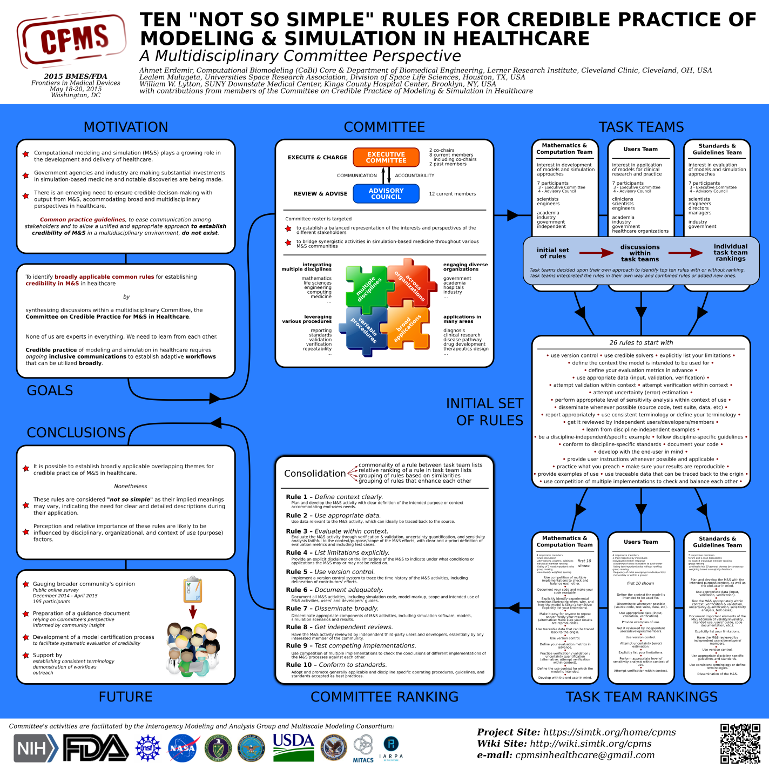
Committee’s Perspective on TSR of Credible Practice
Notes:
This poster summarizes the outcome on the committee’s perspective on the 10 rules of credible practice of M&S. The summary of those rules is at the bottom of the poster. Highlight how the rules aren’t specific to a given topic or application or physics, but very general best practices.

Slide 14
Status of the Ten Simple Rules (TSR) Activity
In an effort to draw out globally well-balanced guidelines across the range of disciplines and application interests, a public survey was launched on August 15th, 2014 to obtain input from the broader M&S stakeholder community.
The survey was closed on April 15, 2015 and the Data Analysis Team has started to analyze the results.
A forum discussion thread has been initiated: https://simtk.org/forums/viewtopic.php?f=848&t=5616&sid=fdcab3f040d5c52b8667a0b0812d2e2b
The raw data is also available at: https://simtk.org/websvn/wsvn/cpms/dat/Survey/Complete%20Survey%20Results_Clean_04242015.xlsx
Notes:
A public survey was then initiated on 8/15/14. The goal being to collect input from stakeholders across the globe. Another goal was to reconcile any difference in the 10 needs as identified by the group against those of the global community.

Slide 15
Publicly Surveyed Proposed Rules
1 | Engage potential end-user base.
2 | Make the M&S results reproducible.
3 | Develop the M&S with the end-user in mind.
4 | Use appropriate data, e.g., for input, validation, verification.
5 | Explicitly identify experimental scenarios that illustrate when, why, and how the M&S is false or not applicable.
6 | Use competition of multiple M&S implementation methods to check and balance each other.
7 | Document the development and use of M&S appropriately.
9 | Use version control, i.e., to track different revisions of the model.
10 | Be a discipline specific example of good practice.
11 | Use data that can be traced back to the origin of source.
12 | Disseminate whenever and whatever is possible, e.g., source code, test suite, data.
13 | Validate the M&S activity within the context of use.
14 | Perform sensitivity analysis within the context of use.
15 | Define the M&S evaluation metrics in advance.
16 | Make your code readable.
17 | Provide user instructions whenever possible and applicable.
18 | Provide examples of use.
19 | Learn from specialized and broadly applicable guidelines for good practice.
20 | Follow discipline-specific guidelines and standards whenever possible.
21 | Perform uncertainty estimation/quantification within context of use.
22 | Perform numerical error estimation/quantification within context of use.
23 | Get the M&S reviewed by independent users, developers, and members of the intended stakeholder community.
24 | Explicitly list limitations of the M&S.
25 | Make it easy for anyone to repeat and/or falsify your results.
26 | Use consistent terminology or define your terminology.
27 | Verify the M&S processes within context of use.
28 | Report appropriately, i.e., to allow reproducibility, to assess reliability, and to establish accountability.
29 | Define the context in which the M&S is intended to be used.
30 | Use credible, e.g. verified, solvers (code, software, applications).
31 | Conform to discipline-specific standards.
32 | Disclose conflict of interests.
33 | Adopt and promote standard operating procedures.
34 | Document your code.
35 | Provide clear descriptions of limitations.
36 | Use simulation software with established reliability.
Notes:
This then are the questions used in the public survey. Note that 6 more rules bubbled up as a result of the internal survey, which grew the number of survey questions from 26 to 32. Also, three additional rules were added to ensure consistency in the responses of each participant (duplicate questions are colored). Lastly, the survey questions were presented to each participant in random order.
(you might notice that the rule numbers goes up to 36, but I only mentioned a total of 35 rules. Rule 8 was deleted/skipped and the list was not renumbered)

Slide 16
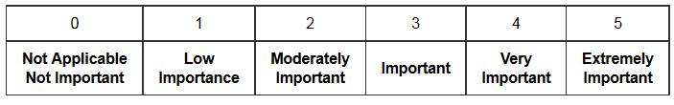
Current Status of Survey Analysis
Total responses: 186
Total valid responses: 148 from
  4 continents, 10 disciplines, various levels of education and experience in M&S
Key Overlaps between Committee’s perspectives & global M&S community
Simple Rule | Description
Define context clearly | Develop and document the subject, purpose, and intended use(s) of the model or simulation
Use appropriate data | Employ relevant and traceable information in the development or operation of a model or simulation.
Evaluate within context | Verification, validation, uncertainty quantification, and sensitivity analysis of the model or simulation are accomplished with respect to the reality of interest and intended use(s) of the model or simulation.
List limitations explicitly | Restrictions, constraints, or qualifications for or on the use of the model or simulation are available for consideration by the users or customers of a model or simulation.
Notes:
We received a total of 186 responses from a diversity of education background (BA, MS, MD, PhD) , occupation background (engineer, clinician, etc.), employer type (industry or academia or government lab) and cultural/national background (Lealem noted that cultural biases can affect how one goes about vetting a model).
Invalid responses were eliminated based on three criteria rules,
failure to answer 2 of the 35 questions
non-consistent ranking of the duplicate questions, where a consistent response is defined as:
total discrepancy of the three pairs of replicated questions must be <=6, and
The individual ranking difference of the three pair rules must be <=3 (e.g. 2 1 3 =6 and consistent response; while 0 1 4=<6 but is considered inconsistent since one of the differences is >3)
Answered more than 15 questions as being extremely important
Of the remaining 148 responses, all 32 rules were ranked based on the total number of Extremely Important (5) or Very Important (4) scores.
Preliminary Outcome: While there were differences in the ranking of the 32 rules by the committee and global community, there was agreement that the 4 rules shown at the bottom of this slide are critical for credible practice of M&S in HC.

Slide 17
Future Work
Publish Committee’s perspective, ‘Ten “Not So” Simple Rules for Credible Practice of Modeling and Simulation in Healthcare: Perspectives from a Multidisciplinary Committee’
Analyze public survey data, and publish results in PLOS Computational Biology in the form of “Ten Simple Rules of Credible Practice of M&S in Healthcare”
Develop and publish the “Guidelines for Credible Practice in Modeling & Simulation in Healthcare” and as well as a “Model Certification Guideline” based off of the above findings
Publish glossary of terms to help unify the use of M&S terminology across a variety of disciplines and stakeholders in the field – Draft: http://tinyurl.com/ze4scnx
Notes:
We are working towards these items:
A glossary of terms, which will eventually be published
Final guidance document and certification guideline are a consolidated summary of the internal and global opinions.
The Guidelines for Credible Practice in Modeling & Simulation in Healthcare is similar to the ASME V&V40 document
The “Model Certification Guideline” will summarize the process of getting a model certified for use. Think of this as receiving a stamp of approval. This might require additional steps, e.g. continual assessment and certification of the model.
Ultimately, would like the guideline and certification process to be published, maybe through the National Library of Medicine (run by the NIH. Documents entered into the NLM must pass a rigorous approval process, which would add credibility to the document(s)).

Slide 18
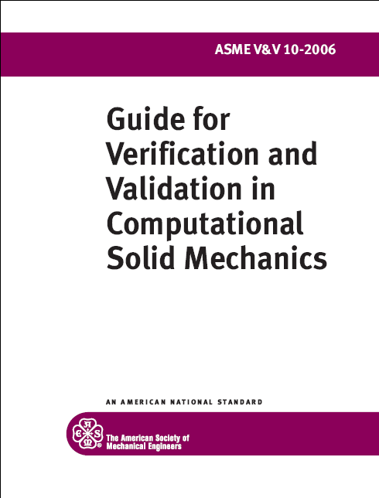
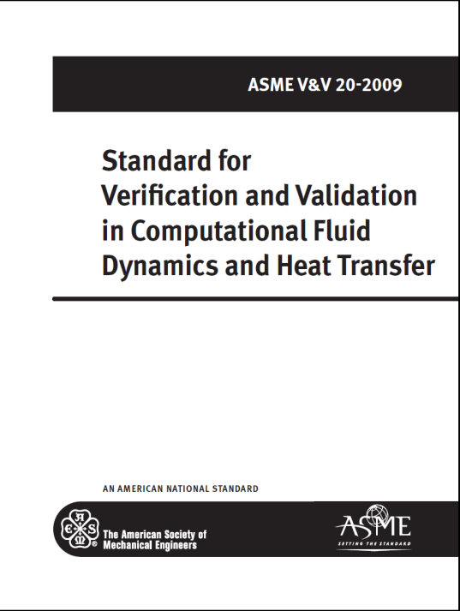
ASME Committee on V&V in Computational Modeling and Simulation
Standards Committee
  Provide procedures for assessing and quantifying the accuracy and credibility of computational modeling and simulation
V&V Standards Committee in Computational Modeling and Simulation
V&V 20 - Verification and Validation in Computational Fluid Dynamics and Heat Transfer
V&V 30 - Verification and Validation in Computational Simulation of Nuclear System Thermal Fluids Behavior
V&V 40 - Verification and Validation in Computational Modeling of Medical Devices
V&V 10 - Verification and Validation in Computational Solid Mechanics
V&V 50 - Verification and Validation of Computational Modeling for Advanced Manufacturing
Notes:
The structure of ASME is such that there is an over-arching standards committee whose goal is to “Coordinate, promote, and foster the development of standards that provide procedures for assessing and quantifying the accuracy and credibility of computational models and simulations.”
There are currently 5 sub-committees. Two of the sub-committees are physics-oriented (FEA and CFD) and three are applications-oriented.

Slide 19
ASME V&V 40
V&V Standards Committee in Computational Modeling and Simulation
V&V 20 - Verification and Validation in Computational Fluid Dynamics and Heat Transfer
V&V 30 - Verification and Validation in Computational Simulation of Nuclear System Thermal Fluids Behavior
V&V 40 - Verification and Validation in Computational Modeling of Medical Devices
V&V 10 - Verification and Validation in Computational Solid Mechanics
V&V 50 - Verification and Validation of Computational Modeling for Advanced Manufacturing
ASME V&V 40 Charter
  Provide procedures to standardize verification and validation for computational modeling of medical devices
  Charter approved in January 2011
Motivating factors
  Regulated industry with limited ability to validate clinically
  Increased emphasis on modeling to support device safety and/or efficacy
  Use of modeling hindered by lack of V&V guidance and expectations within medical device community
Notes:
We have a fairly limited availability to validate models, esp. from the clinical perspective. Also, there was a lack of understanding about FDA’s expectation for V&V in our community in terms of evidence. Addressing these issue would be central to increasing the use of modeling in device submissions.

Slide 20
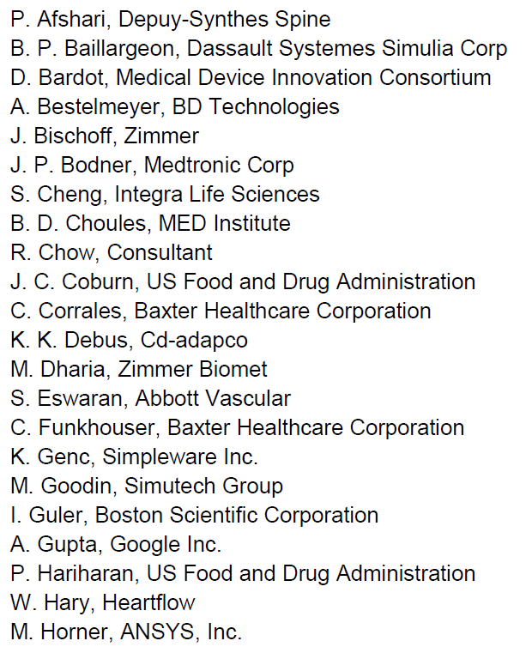
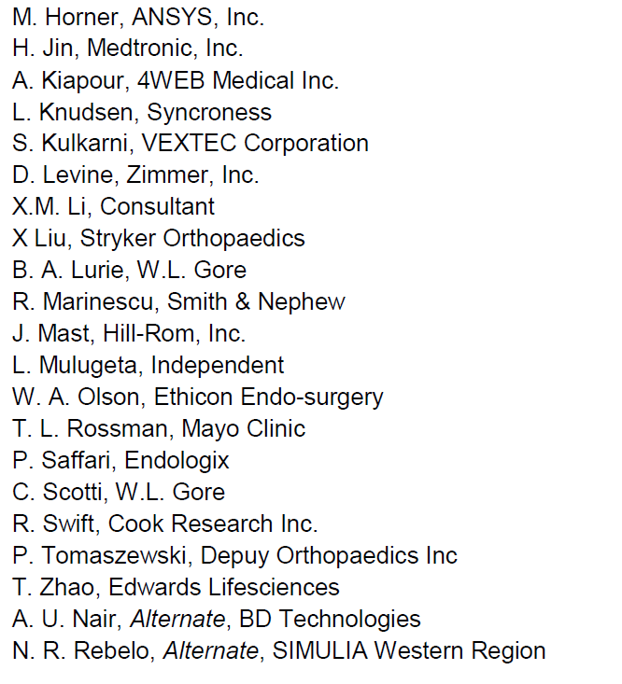
V&V 40 Subcommittee Membership
Carl Popelar, Chair, Southwest Research Institute
Tina Morrison, Vice-Chair*, FDA
Andrew Rau, Vice-Chair, Exponent
Ryan Crane, Secretary, ASME
* Standards Committee representative
*
Notes:
Multidisciplinary committee that well represents medical device community stakeholders. Membership spans device manufacturers, regulatory, consultants and software developers.

Slide 21
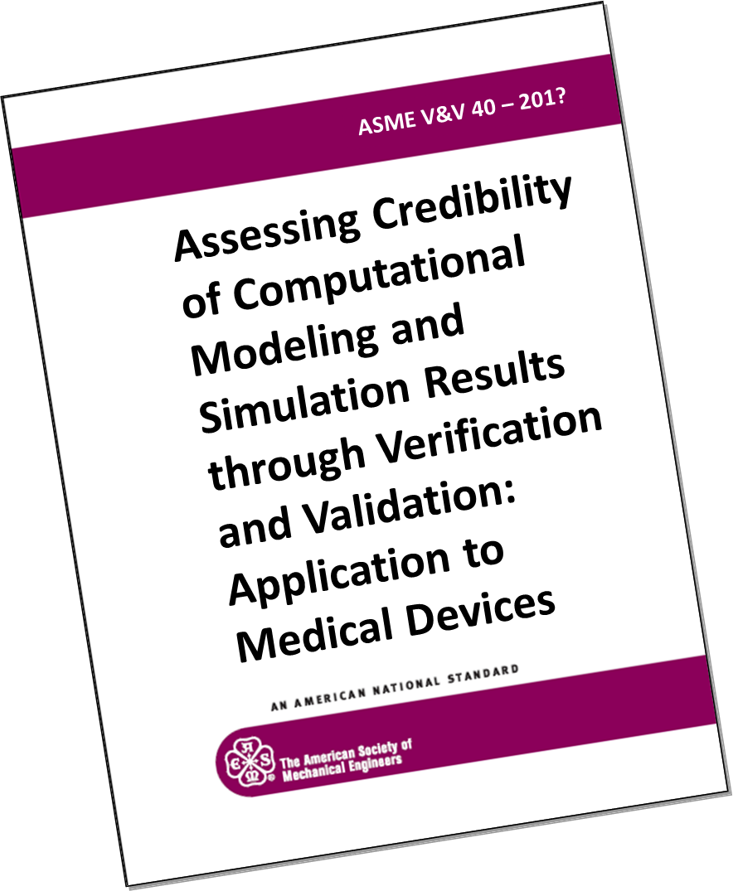
V&V 40 Activities
Current effort focused on completing a standard or guide:
  Document recently completed 2nd round of sub-committee balloting.
  Comments were primarily editorial in nature with a few technical issues to be addressed.
this speaker’s rendition

Slide 22
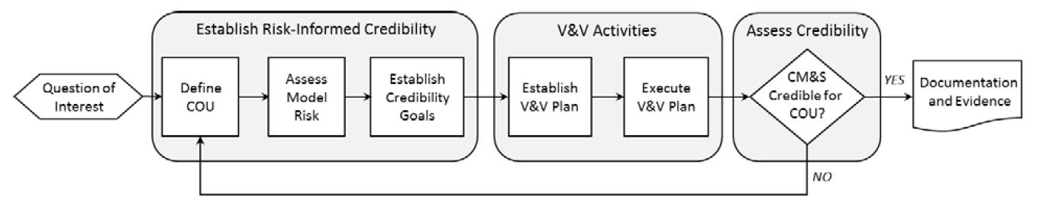
Risk-Informed Credibility Assessment Method
The V&V40 guide outlines a process for making risk-informed determinations as to whether CM&S is credible for decision-making for a specified context of use.
Notes:
The use of computational modeling in assessing the performance of a device or aspect of a device is inherently risky. Thus model credibility becomes paramount. So V&V activities support this, but we are limited in guidance as to what would represent sufficient V&V. So the “main tenet” is that model credibility needs to be established in relation to “model risk”.

Slide 23
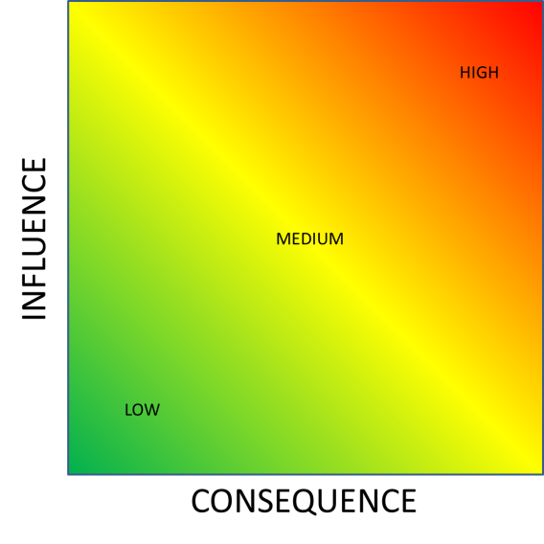
Risk Assessment & Credibility Assessment
Credibility Factors
Verification |  |  |  |  | Validation |  |  |  |  |  |  |  |  | Applicability
Code |  | Solution |  |  | Model |  |  |  | Comparator |  |  | Output Assessment
Software Quality Assurance | Numerical Algorithm Verification | Discretization Error | Use Error | Numerical Solver Error | System Configuration | System Properties | Boundary Conditions | Governing Equations | Sample Characterization | Control Over Test Conditions | Measurement Uncertainty | Equivalency of input and output types | Rigor of Output Comparison | Relevance of the Quantities of Interest | Applicability to the Context of Use

Slide 24
Risk Assessment
CM&S influence is the contribution of the CM&S to the decision relative to other available evidence.
Decision consequence is the significance of an adverse outcome resulting from an incorrect decision.

Slide 25
Credibility Assessment
Model credibility refers to the trust in the predictive capability of the computational model for the COU.
Trust can be established through the collection of V&V evidence and by demonstrating the applicability of the V&V activities to support the use of the CM for the COU.
Credibility Factors
Verification |  |  |  |  | Validation |  |  |  |  |  |  |  |  | Applicability
Code |  | Solution |  |  | Model |  |  |  | Comparator |  |  | Output Assessment
Software Quality Assurance | Numerical Algorithm Verification | Discretization Error | Use Error | Numerical Solver Error | System Configuration | System Properties | Boundary Conditions | Governing Equations | Sample Characterization | Control Over Test Conditions | Measurement Uncertainty | Equivalency of input and output types | Rigor of Output Comparison | Relevance of the Quantities of Interest | Applicability to the Context of Use
Notes:
Model credibility refers to the trust in the predictive capability of the CM for the COU. Trust can be established through the collection of V&V evidence and by demonstrating applicability of the V&V activities to support the use of the CM for the COU.
The credibility factors give us a breakdown of the elements of our V&V study. In this step, we evaluate each of these factors and demonstrate that we will be able to understand these with an appropriate level of rigor such that we will be able to demonstrate credibility of our CM for the COU.

Slide 26
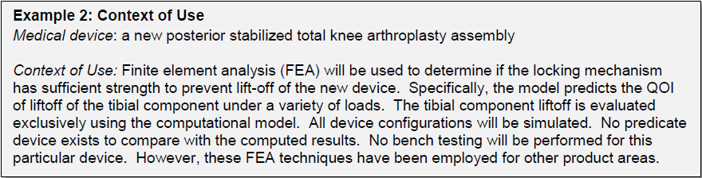
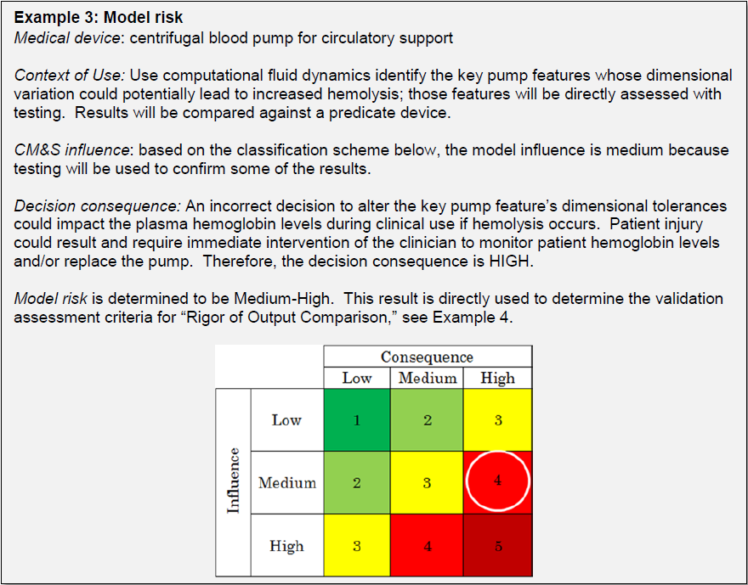
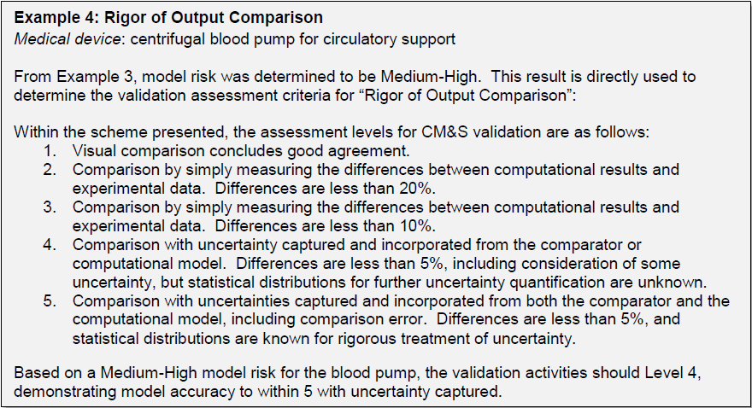
Examples

Slide 27
Comparison Summary
 | CPMS | V&V40
Mission Statement | To establish credible practice guidelines, consistent terminology and proposed model certification process, as well as to demonstrate workflows and identify new areas of research for reliable development and application of M&S in healthcare practice and research. | Provide procedures to standardize verification and validation for computational modeling of medical devices.
Primary stakeholders | Computational M&S in healthcare as a whole – mainly driven by research initiatives under the IMAG Multi-scale Modeling Consortium | Biomedical device industry, industry service providers, and regulatory and standards bodies such as the US Food and Drug Administration (FDA) and ASME
End-product(s) | “Guidelines for Credible Practice of M&S in Healthcare” Proposed model certification process Identify new areas of research to advance I & II | A standard (or guide) for, “Assessing Credibility of Computational Modeling & Simulation Through Verification & Validation: Application to Medical Devices” Series of examples that demonstrate application of one or more components of the standard
Approach to developing end-product(s) | Executive Committee (EC) executes mission Advisory Council provides guidance to the EC Extensive use of crowd-sourcing of the healthcare and M&S community through surveys, wiki contributions and forum discussions | V&V40 sub-committee establishes standard direction through consensus Sub-groups, working groups, and task groups execute tasks related to governing scientific methods, devices, and content writing.
General credibility workflow | Apply the Ten Simple Rules of Credible Practice with appropriate intensity for given context of use (iterative). | Define Context of Use → Assess Model Risk → Establish Credibility Goals → Establish & Execute V&V Plan (iterative) → Assess Credibility → Document

Slide 28
Questions?
https://cstools.asme.org/csconnect/CommitteePages.cfm?Committee=100108782
ASME 2016 V&V Symposium

Slide 29
Definitions
Credible Practice of Modeling & Simulation in Healthcare
dependable with a desired certainty level to guide research or support decision making within a prescribed application domain and intended use; establishing reproducibility & accountability

Slide 30
Definitions
Credible Practice of Modeling & Simulation in Healthcare
any activity involving development, solution, interpretation and application of computational representation of biological, environmental and man-made systems and their interaction thereof

Slide 31
Definitions
Credible Practice of Modeling & Simulation in Healthcare
specifically computational modeling; virtual representation of system(s) of interest in a usable form in order to provide descriptive and predictive metrics for timely and systematic exploration of the system(s)

Slide 32
Definition of Simulation
Credible Practice of Modeling & Simulation in Healthcare
computational solution of models to quantify descriptive and predictive metrics of system(s) of interest; including related post-processing efforts to calculate these metrics from raw analysis results

Slide 33
Definitions
Credible Practice of Modeling & Simulation in Healthcare
any activity involving development, maintenance, advancement, or administration of medical care; including research, diagnosis, risk assessment, prevention, therapy, rehabilitation, surgery, intervention design, and regulation

Slide 34

Upcoming: Ten Simple Rules, Guidelines & Cert.
Community Generated Ten Simple Rules
I
VI
II
VII
III
VIII
IV
IX
V
X
“Guidelines for Credible Practice of M&S in Healthcare”
Proposed model certification process

Slide 35
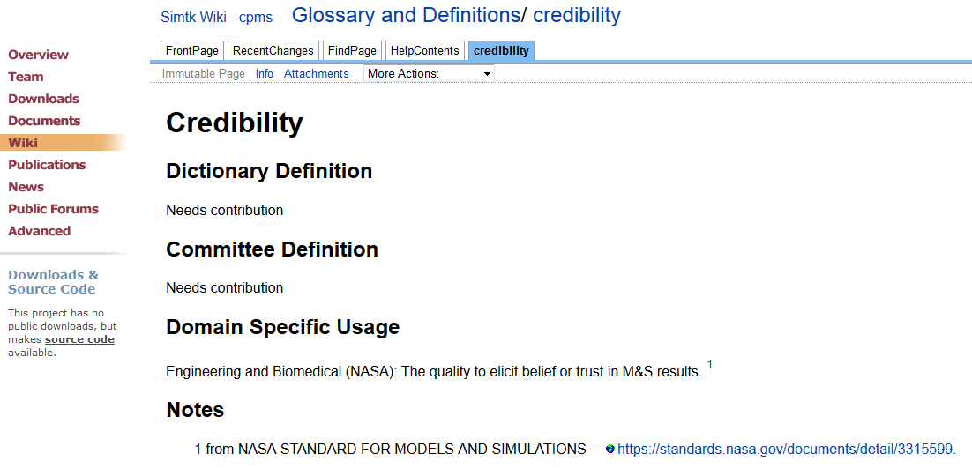
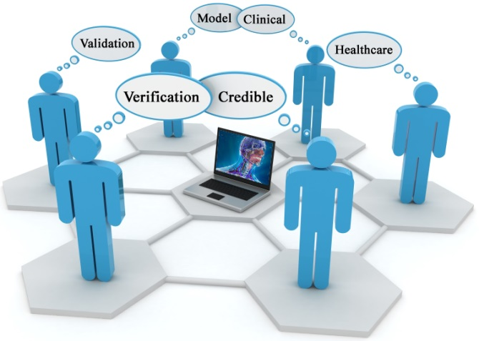
Goal: A Common Language Across Disciplines
Goal Oriented Activity: A glossary of terms is being generated on the Committee’s to help unify the use of M&S vocabulary across a variety of disciplines and stakeholders in the field
We strongly encourages all stakeholders (e.g. SSH community) to help establish these terms and definitions by visiting: http://wiki.simtk.org/cpms/Glossary_and_Definitions
Example

Slide 36
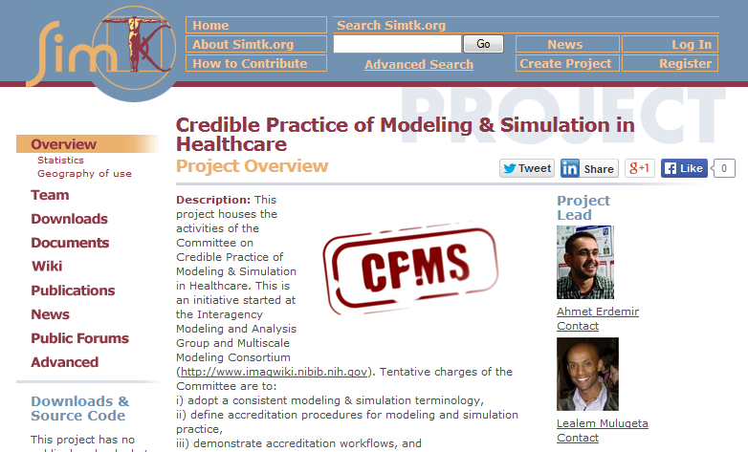
Goal: Adoption of Guidelines by Stakeholders
Goal Oriented Activity: Active engagement of the global stakeholder community to ensure that the guidelines established capture the primary interests of the computational medicine community, and are widely adopted
Open discussions and contribution to activities:
Wiki pages
Discussion forum
Meeting minutes
Subversion repository access of all presentations, abstracts and posters
URL: https://simtk.org/home/cpms

