Slide 1
https://simtk.org/home/cpms
Committee on Credible Practice of Modeling & Simulation: Progress and Forward Work
Lealem Mulugeta^{I and Ahmet ErdemirII,}
Universities Space Research Association, Division of Space Life Sciences
Cleveland Clinic, Computational Biomodeling (CoBi) Core
Presented on Behalf of the Committee
2014 IMAG Multiscale Modeling Consortium Meeting
3-4 September 2014 - Bethesda, MD

Slide 2
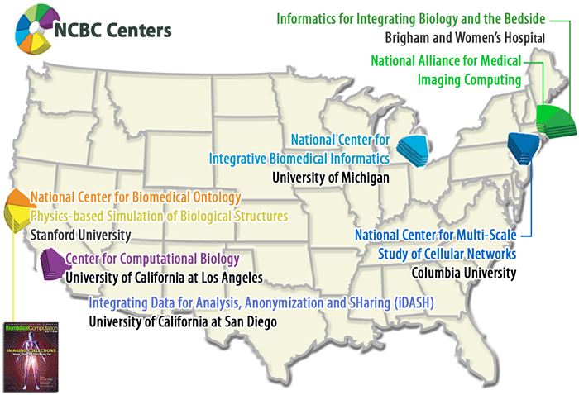
Background
Computational modeling and simulation (M&S) methods have substantial potential to support research, clinical decision and education in healthcare
Government agencies and industry are making substantial investments on R&D activities in simulation-based medicine and notable discoveries are being made
adapted from NCBC website (2014)
<number>

Slide 3

The Challenge
Am I applying credible practice
Common practice guidelines do not exist to ensure that appropriate credibility processes are followed
<number>
Adapted from http://beaver1003.com

Slide 4












Solution Pathway
To bridge this gap, the
Committee on Credible Practice of
Modeling & Simulation in Healthcare
was established under
& Multiscale Modeling (MSM) Consortium
Primary focus: Computational M&S for clinical research and decision making
<number>

Slide 5
Committee’s Charge
Guidelines & Procedures
  Credible practice in computational medicine
  Leveraging readily available techniques
  Define novel translational workflows to enhance credibility practice
Demonstrate Workflows
  Conduct studies to develop novel credibility assessment procedures
  Disseminating examples of credibility assessment
Consistent Terminology
  Unify the use of M&S vocabulary across all stakeholders
Promote Good Practice
  Bridge synergistic activities within the M&S communities
  conduct outreach activities.
End Products
“Guidelines for Credible Practice of M&S in Healthcare”
Proposed model certification process
Identify new areas of research to advance I & II
<number>

Slide 6
What Makes the Committee Unique?
Integration of multiple disciplines
Engaging diverse organizations
Mathematics
Life sciences
Engineering
Computing
Medicine
…
Government
Academia
Hospitals
Industry
…
Multidisciplinary
Cross-organizational
…
Reporting
Standards
Validation
Verification
Repeatability
…
Diagnosis
Clinical research
Disease pathway
Drug development
Therapeutics design
Leverage Existing
Procedures
Wide-ranging
Applications
Inclusive of a variety of procedures
Application across many areas
<number>

Slide 7
Committee Implementation Strategy
None of us are experts in everything.
We need to learn from each other.
Credible practice of modeling and simulation in healthcare requires ongoing inclusive communications to establish adaptive workflows that can be utilized broadly.
<number>

Slide 8
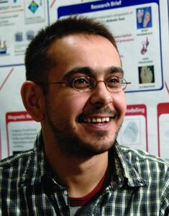
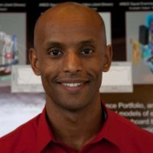

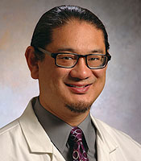
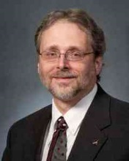
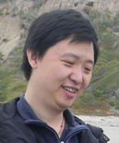
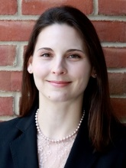
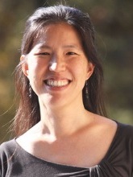
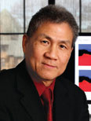
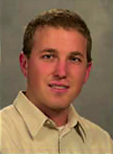
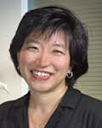
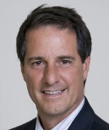
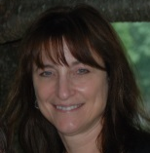
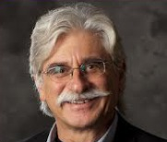
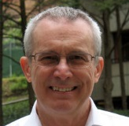
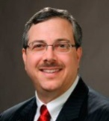
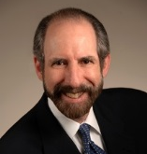
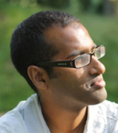
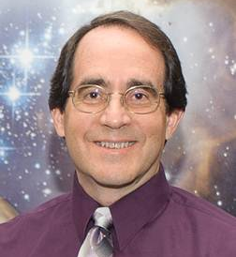
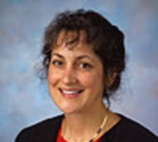
Committee Implementation Strategy
Committee Executive Members (Execute & Charge)
A. Erdemir, Ph.D.
Co-Chair
Cleveland Clinic
L. Mulugeta, M.Sc.
Co-Chair
USRA
W. Lytton, M.D.
Kings County Hosp.
Downstate Med. Cntr
G. An, MD
U. of Chicago
J. Myers, Ph.D.
NASA
L. Tian, Ph.D.
Stanford U.
T. Morrison, Ph.D.
FDA
J. Ku, Ph.D.
Stanford U.
Communication Accountability
Advisory Council (Review & Advise)
W. Kam Liu, Ph.D.
Northwestern U.
J. Bischoff, Ph.D.
Zimmer
G. Peng, Ph.D.
NIH
J. Thomas, M.D.
Cleveland Clinic
D. Lochner
FDA
V. Marmarelis, Ph.D.
U. of Southern California
A. Hunt, Ph.D.
U. of California, SF
D. Eckmann, M.D., Ph.D.
University of Pennsylvania
R. Germain, M.D., Ph.D.
NIH
P. Pathmanathan, Ph.D.
FDA
M. Steele, Ph.D.
NASA
M. Walton, Ph.D.
Wyle
Interagency Modeling and Analysis Group (IMAG) & Multiscale Modeling Consortium (MSM)
For full credentials of the CPMS members: http://wiki.simtk.org/cpms/CPMS_Members
Notes:
Add photos
<number>

Slide 9
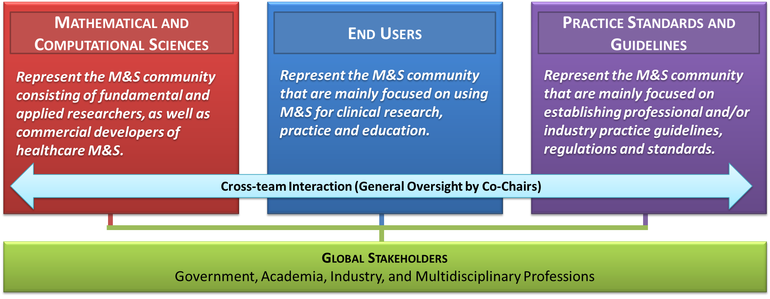
Committee Implementation Strategy
Use team-based structure to:
Establish a balanced representation of the interests and perspectives of the different stakeholders
Bridge synergistic activities in simulation-based medicine throughout the M&S communities
<number>

Slide 10
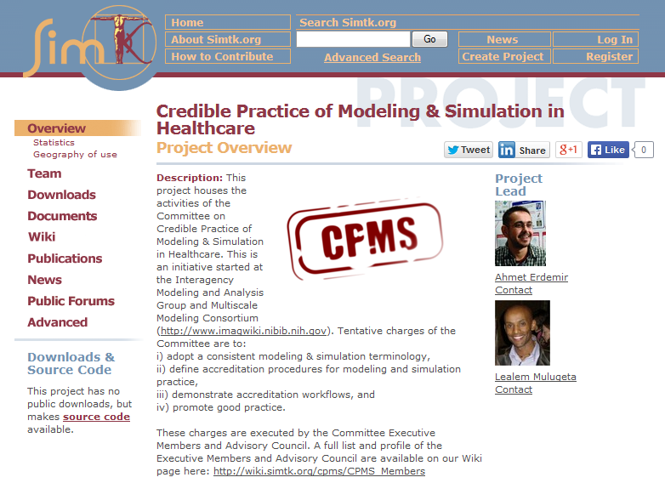
Community Driven Committee
Open discussions and contribution to activities:
Wiki pages
Discussion forum
Meeting minutes
Subversion repository access of all presentations, abstracts and posters
URL: https://simtk.org/home/cpms
<number>

Slide 11
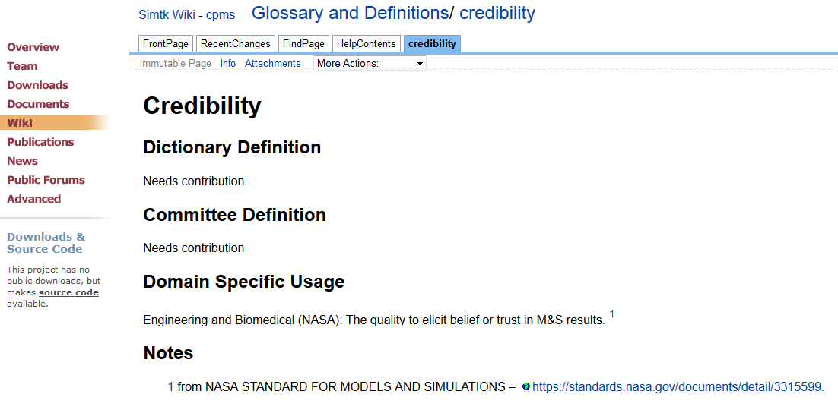

ACTIVITY: A Common Language Across Disciplines - GLOSSARY
Goal Oriented Activity: A glossary of terms is being generated on the Committee’s to help unify the use of M&S vocabulary across a variety of disciplines and stakeholders in the field
We strongly encourages all stakeholders to help establish these terms and definitions by visiting:
http://wiki.simtk.org/cpms/Glossary_and_Definitions
Example
<number>

Slide 12
ACTIVITY: Credible Practice Guidelines – COMMITTEE PERSPECTIVE
Primary deliverable: “Guidelines for Credible Practice of Modeling and Simulation in Healthcare”
Goal Oriented Activity: The CPMS Task Teams were charged to identify ten key elements or simple rules of credible practice in order to establish a foundation upon which the “Guidelines for Credible Practice of Modeling and Simulation in Healthcare” can be developed.
Full details of this activity is available at:
http://wiki.simtk.org/cpms/Ten_Simple_Rules_of_Credible_Practice
<number>
Notes:
Make into bullets
<number>

Slide 13
ACTIVITY: Credible Practice Guidelines – COMMITTEE PERSPECTIVE
To initiate Ten Simple Rules:
26 candidate rules were generated
Candidate rules were surveyed internally among the Committee’s three Task Teams
Results from the three teams were consolidated to arrive at “Ten Simple Rules”
26 Candidate Rules of Credible Practice
Use version control | Follow discipline-specific guidelines | Define the context the model is intended to be used for
Use credible solvers | Attempt verification within context | Perform appropriate level of sensitivity analysis within context of use
Explicitly list your limitations | Attempt uncertainty (error) estimation | Use consistent terminology or define your terminology
Report appropriately | Make sure your results are reproducible | Get it reviewed by independent users/ developers/members
Document your code | Define your evaluation metrics in advance | Provide user instructions whenever possible and applicable
Provide examples of use | Conform to discipline-specific standards | Use traceable data that can be traced back to the origin
Practice what you preach | Be a discipline-independent/ specific example | Disseminate whenever possible (source code, test suite, data, etc)
Develop with the end user in mind | Learn from discipline-independent examples | Use competition of multiple implementations to check and balance each other
Attempt validation within context | Use appropriate data (input, validation, verification)
<number>
Full details are available at:
http://wiki.simtk.org/cpms/Ten_Simple_Rules_of_Credible_Practice/Summary_of_Results
Notes:
<number>

Slide 14
ACTIVITY: Credible Practice Guidelines – COMMITTEE PERSPECTIVE
To consolidate Ten Simple Rules:
Consideration was not given to any rankings established by the three teams
Commonalities and unique aspects of the three sets of rules were evaluated
Identified 13 rules that were partially ranked based on commonality across the team results and possible chronological sequence of the M&S process.
Many of the rules were consolidated or rephrased versions of the commonalities found
Internal Survey Results Consolidated and Rephrased
# | Consolidated & Rephrased Rules | Comment
1 | Plan and develop the M&S with clear definition of the intended purpose or context, and with end-user input | Consolidated
2 | Document the your code and the M&S (domain of validity/invalidity, intended use, user guide, etc), and make your code readable | Rephrased
3 | Use version control
4 | Test the M&S Appropriately within Context (V&V, UQ, sensitivity analysis (SA), test cases) | Consolidated
5 | Use appropriate data | Rephrased
6 | Disseminate whenever and whatever possible
7 | Explicitly list the limitations of the M&S | Rephrased
8 | Adopt and promote standard operating procedures | Consolidated
9 | Use competition of multiple implementations to check and balance each other
10 | Make it easy for anyone to reproduce and/or falsify your results
11 | Use traceable data that can be traced back to the origin
12 | Define your evaluation metrics in advance
13 | Have the M&S reviewed by independent users/developers/members
<number>
More details at: http://wiki.simtk.org/cpms/Ten_Simple_Rules_of_Credible_Practice/Summary_of_Results
Notes:
<number>

Slide 15
ACTIVITY: Credible Practice Guidelines – COMMITTEE PERSPECTIVE
Disciplinary background and perspectives seems to have a strong influence rule definitions and prioritization
The Committee also recognizes that priority for any set of rules or best practices and the intensity of activities to meet them seems to be dependent on:
  intended use of M&S, and
  type of M&S under consideration
This motivated the Committee to survey global stakeholders in order to develop a well-balanced guidelines across the wide-range of disciplinary and application interests
<number>

Slide 16
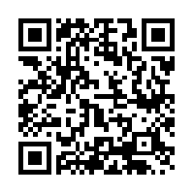
ACTIVITY: Credible Practice Guidelines – COMMUNITY PERSPECTIVE
Global Community Survey: To ensure that we capture the perspectives and interests of the global stakeholder community, we launched a public survey of the new 33 simple rule candidates (combined initial 26 candidate rules with results of internal survey results)
https://stanforduniversity.qualtrics.com/SE/?SID=SV_4MeRluojMgdVR7n
<number>
Notes:
Bullets?
<number>

Slide 17
ACTIVITY: Credible Practice Guidelines – NEXT STEPS
Synthesize Committee discussions and report Committee Perspective
Analyze survey data, and report Community Perspective
Publish, e.g.,
PLOS Computational Biology
“Ten Simple Rules of Credible Practice of M&S in Healthcare”
Estimated timeline: 2015-16
<number>

Slide 18

FOLLOW-UP activitieS: Guidelines & Certification
FROM TEN SIMPLE RULES TO GUIDELINES
I
VI
II
VII
III
VIII
IV
IX
V
X
“Guidelines for Credible Practice of M&S in Healthcare”
Proposed model certification process
<number>

Slide 19
supporting ACTIVITIES
Examples of Success Stories:
To complement the guidance, we are also conducting a review of where M&S have been successfully used in healthcare applications to better understand of the needs and successes of different types and applications of M&S
Outreach for Community Participation:
  Committee has been represented in conferences of various disciplines.
  We strongly encourage participation in the survey, forums, and the wiki site.
  Contribution of M&S examples may help us better understand the needs and successes of different types and application of M&S in healthcare
<number>
Notes:
Bullets?
<number>

Slide 20

WHAT DID WE HOPE? WHAT DID WE DO?
FIRST TERM (2013-2015) GOALS
Form the Committee and the Advisory Council
Establish infrastructure for communications between Committee Co-Chairs and Members, and Advisory Council
Establish a web-based framework for development, community interactions, and dissemination
Develop a guidance document on establishing credible practice of modeling and simulation in healthcare
Draft a proposed model certification process
ACTIVITY
IN PROGRESS
(was due Apr 2014)
ACTIVITY
PENDING
(was due Nov 2014)
<number>

Slide 21
Upcoming Nominations for New Members
2 year terms with possibility of reappointment for both Executive (including Co-chairs) and Advisory Council Membership
Participation through nomination and invitation
Elections take place 6 months prior to end of term for the current members to facilitate seamless handoffs - Next nomination/invitation is in Oct. 2014
Continuing membership subject to commitment to timely completion of tasks and Committee’s mission
If interested or have nominations in mind, please contact Co-chairs:
  mulugeta@dsls.usra.edu (Lealem)
  erdemira@ccf.org (Ahmet)
<number>

Slide 22
Questions?
Please join us in the Satellite Session on September 5, 2014
@ 8 AM & @ 4 PM – Work on various Committee activities
@ 1:15 PM – Presentation on common practice guidelines
https://stanforduniversity.qualtrics.com/SE/?SID=SV_4MeRluojMgdVR7n

Slide 23
Definitions
Credible Practice of Modeling & Simulation in Healthcare
dependable with a desired certainty level to guide research or support decision making within a prescribed application domain and intended use; establishing reproducibility & accountability
<number>

Slide 24
Definitions
Credible Practice of Modeling & Simulation in Healthcare
any activity involving development, solution, interpretation and application of computational representation of biological, environmental and man-made systems and their interaction thereof
<number>

Slide 25
Definitions
Credible Practice of Modeling & Simulation in Healthcare
specifically computational modeling; virtual representation of system(s) of interest in a usable form in order to provide descriptive and predictive metrics for timely and systematic exploration of the system(s)
<number>

Slide 26
Definitions
Credible Practice of Modeling & Simulation in Healthcare
computational solution of models to quantify descriptive and predictive metrics of system(s) of interest; including related post-processing efforts to calculate these metrics from raw analysis results
<number>

Slide 27
Definitions
Credible Practice of Modeling & Simulation in Healthcare
any activity involving development, maintenance, advancement, or administration of medical care; including research, diagnosis, risk assessment, prevention, therapy, rehabilitation, surgery, intervention design, and regulation
<number>

Slide 28
TEN SIMPLE RULES - Mathematical & Comp. Sciences Team
Voting process used by the team:
Each member identified what they deemed were the “top three” rules
Team coordinators ranked the “top ten” rules based on the consolidated results
Some rules were modified/consolidated and new rules were introduced in the process
Vote Results from the Mathematical & Computational Sciences Team
# | Rule | Comment
1 | Define the use context for which the model is intended | Modified
2 | Develop with the end user in mind
3 | Document your code and make your code readable | Mod. / New
4 | Use version control
5 | Practice Verification / Validation / Uncertainty Quantification \ Attempt verification within context | Consolidated
6 | Explicitly identify experimental scenarios illustrating when, why, and how the model is false \ Explicitly list your limitations | New
7 | Use competition of multiple implementations to check and balance each other
8 | Make it easy for anyone to repeat and/or falsify your results \ Make sure your results are reproducible | Mod. / New
9 | Use traceable data that can be traced back to the origin
10 | Define your evaluation metrics in advance
<number>
Notes:
<number>

Slide 29
TEN SIMPLE RULES - End Users Team
Voting process used by the team:
Each member identified what they deemed were the “top ten” rules
Team coordinators consolidated the votes to ranked the “top ten” rules
Some rules were modified and new rules were introduced in the process
Vote Results from the End Users Team
# | Rule | Comment
1 | Define the context | Modified
2 | Engage potential user base | Modified
3 | Document appropriately | Modified
4 | Use version control
5 | Attempt verification | Modified
6 | Attempt validation | Modified
7 | Attempt uncertainty estimation | Modified
8 | Use appropriate data | Modified
9 | Disseminate whenever and whatever possible | Modified
10 | Adopt and promote standard operating procedures | New
<number>
Notes:
<number>

Slide 30
TEN SIMPLE RULES - Practice Standards and Guidelines Team
Vote Results from the End Users Team
# | Rule | Comment
1 | Plan and develop the M&S with the intended purpose/context, as well as end-user in mind | Mod. / Cons.
2 | Document important element of the M&S (domain of validity/invalidity, intended use, user guide, code documentation, etc) | Mod./New
3 | Use version control
4 | Test the M&S Appropriately within Context (V&V, UQ, sensitivity analysis (SA), test cases) | Con./New
5 | Use appropriate data (input, validation, verification)
6 | Dissemination of the M&S | Modified
7 | Explicitly list your limitations
8 | Use appropriate discipline specific guidelines and standards | Consolidated
9 | Use consistent terminology or defining terminologies
10 | Have the M&S reviewed by independent users/developers/members
<number>
Notes:
<number>

