Slide 1
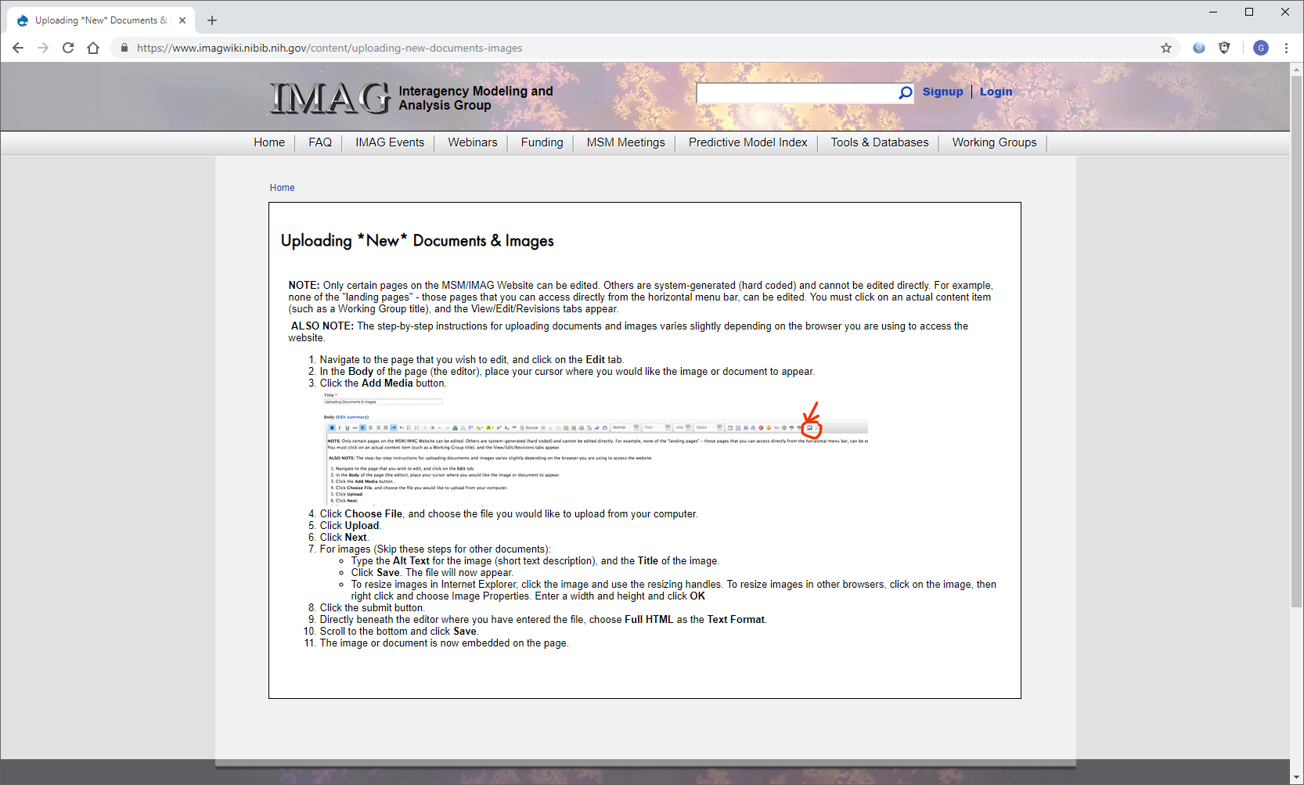
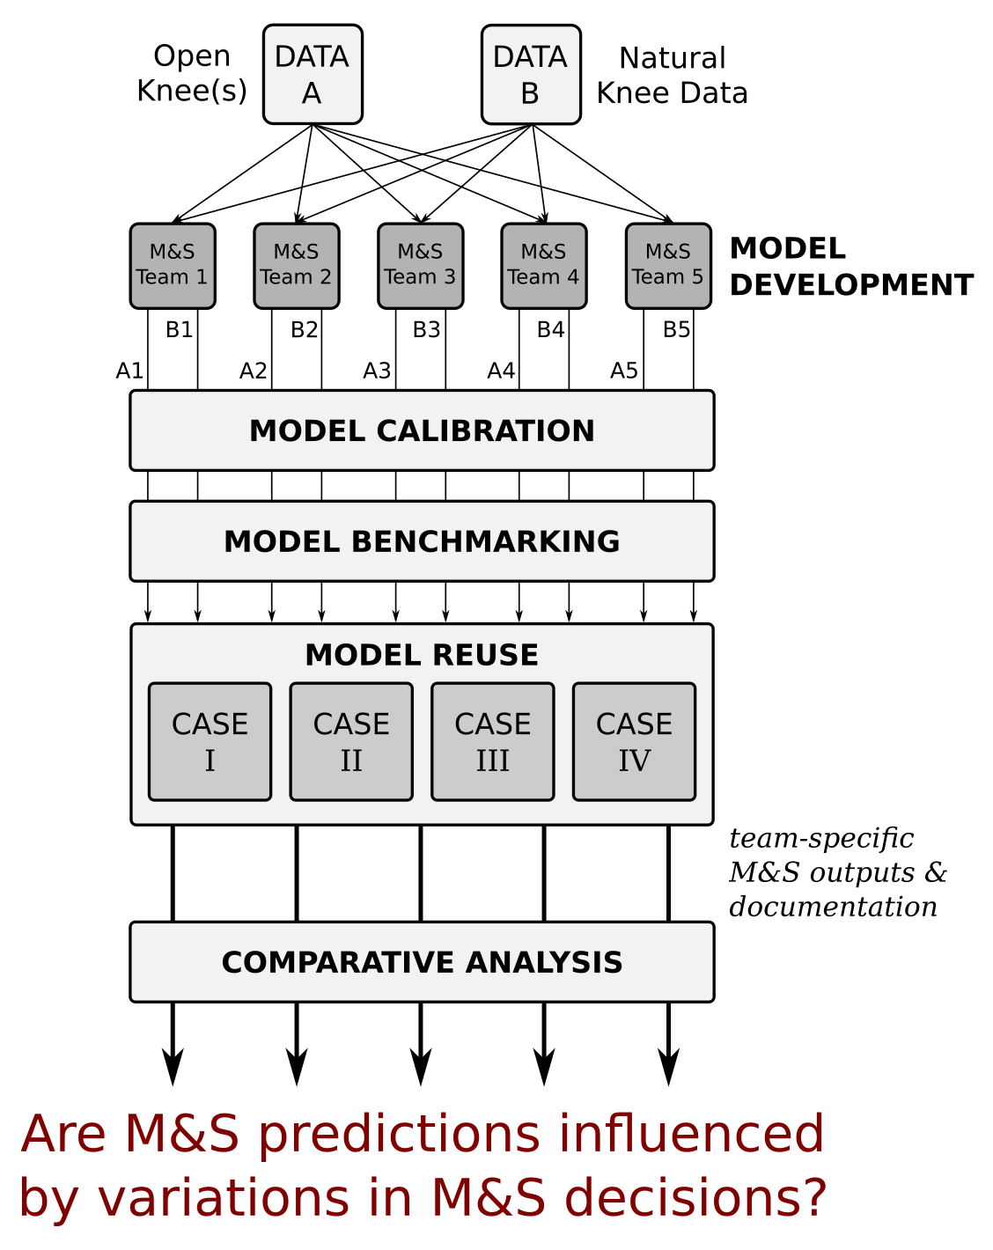
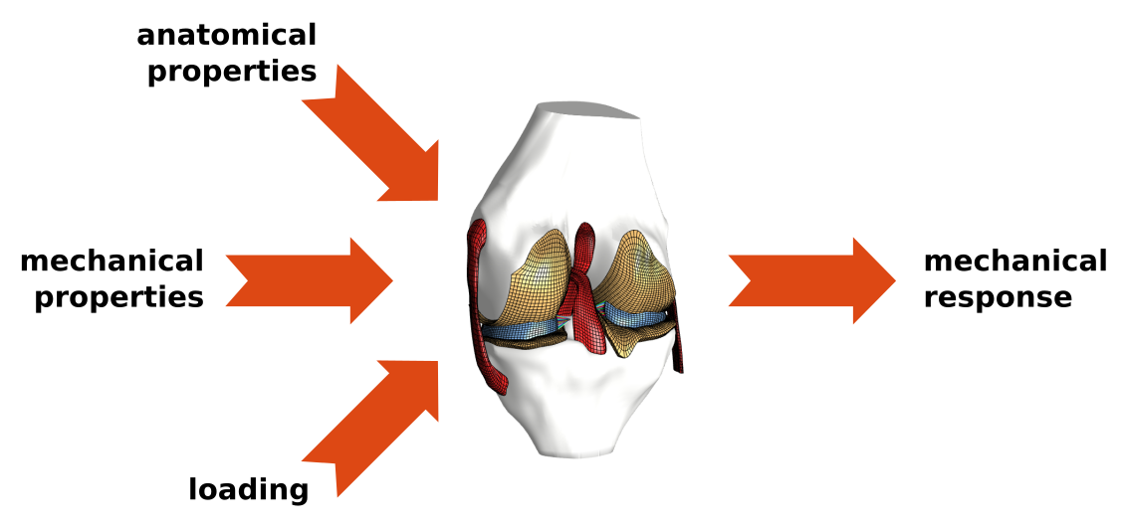

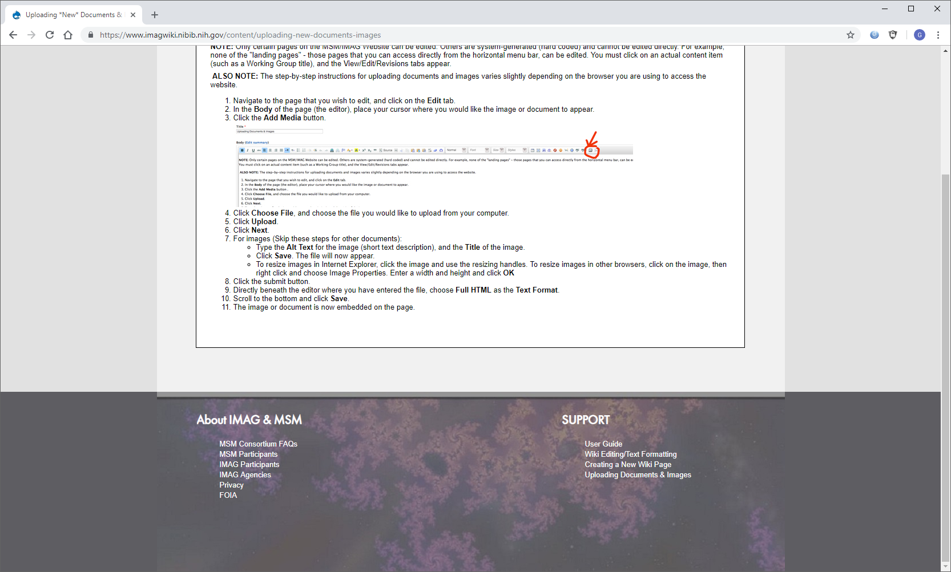




REPRODUCIBILITY & “ART” OF KNEE MODELING
The model
Virtual biomechanical knees
Physics-based (Newton’s laws)
continuum mechanics
rigid body dynamics
What is new inside?
Computational techniques are not new.
Modeler’s interpretation, i.e., their “art”, vary.
What’s new is the overall strategy
to document modeler’s choices, and
to understand their impact on reproducibility.
How will this change current practice?
Emergence of good practices
Demonstration of competing implementations
Documentation and exchange of simulation workflows
Increased credibility in modeling & simulation (M&S)
End users
Knee biomechanists who rely on computational models
Broader biomedical M&S community to adopt demonstrated practices
Decision-makers in M&S regulation and policy making
Same data
Same reuse cases
Different
models?
predictions?
conclusions?
Ahmet Erdemir (CC)
Kevin Shelburne & Peter Laz (DU)
Jason Halloran (CSU)
Carl Imhauser (HSS)
Thor Besier (ABI)
NIBIB - R01EB024573
https://simtk.org/projects/kneehub
Notes:
Project summary:
Recent explorations of knee biomechanics have benefited from computational modeling, specifically leveraging advancements in finite element analysis and rigid body dynamics of joint and tissue mechanics. A large number of models have emerged with different levels of fidelity in anatomical and mechanical representation. Adapted modeling and simulation processes vary widely, based on justifiable choices in relation to anticipated use of the model. However, there are situations where modelers’ decisions seem to be subjective, arbitrary, and difficult to rationalize. Regardless of the basis, these decisions form the “art” of modeling, which impact the conclusions of simulation-based studies on knee function. These decisions may also hinder the reproducibility of models and simulations, impeding their broader use in areas such as clinical decision making and personalized medicine. This project aims to capture the modeling and simulation workflow in its entirety - operation procedures, deviations, models, by-products of modeling, simulation results, and comparative evaluations of case studies and applications. The ultimate goal is to delineate the “art” of a cohort of knee modeling teams through a publicly accessible, transparent approach and begin to unravel the complex array of factors that may lead to a lack of reproducibility. The outcomes have potential implications on reproducibility, on science, engineering, and training of modeling and simulation, on modeling standards, and on regulatory affairs.
For details, see a recent manuscript submission that is currently in review:
https://simtk.org/svn/kneehub/doc/JBME-2019ASI/JBME-Perspective.pdf
PI name, email: Ahmet Erdemir, erdemira@ccf.org
Project website: https://www.simtk.org/projects/kneehub
<number>

