Slide 1
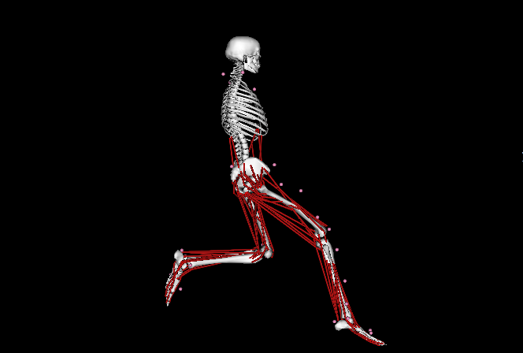
Single Footed Hopping Rebound:
Simulation of a reverse of direction maneuver
Matt DeMers ME485 Sprint 2008

Slide 2
Motivation

Slide 3
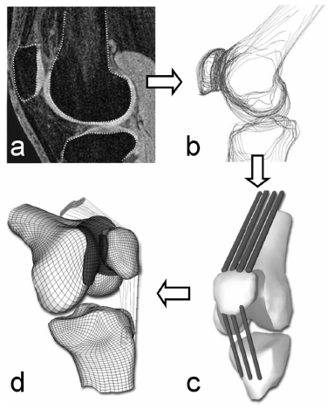
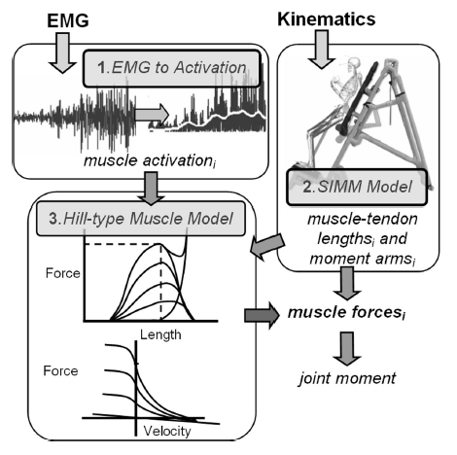
Motivation
Motivation
Quantification of joint loads: cartilage stress
1: Besier et al, MEDICINE & SCIENCE IN SPORTS & EXERCISE, 2006

Slide 4
Overview
Collected motion capture and EMG at HPL
  Thanks Thor, Jason, Emel
Inverse Kinematics
Residual Reduction Algorithm
Computed Muscle Control
  Compared excitations with EMG

Slide 5
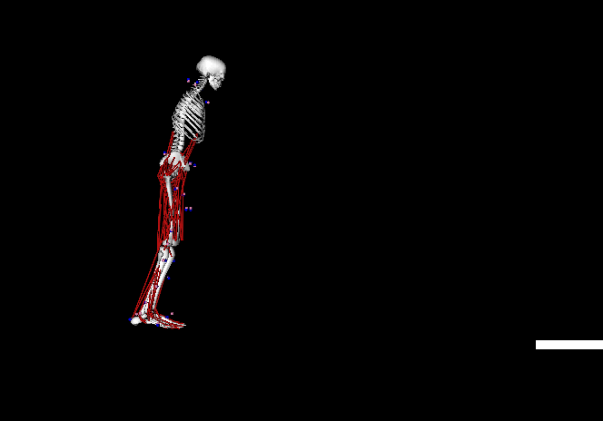
IK: Why so difficult?

Slide 6
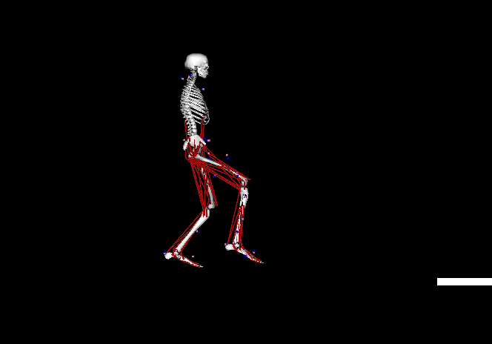
IK: Why do difficult?

Slide 7
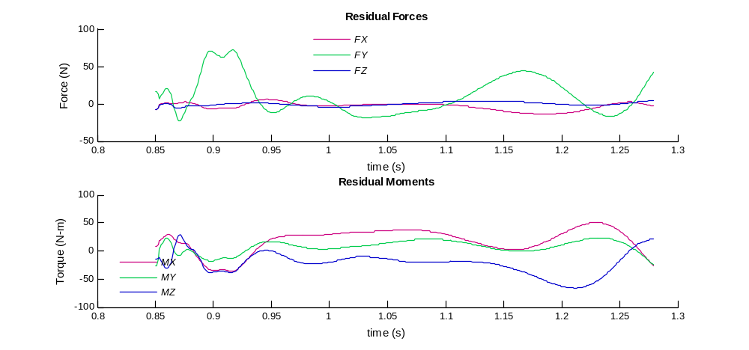
RRA
- Max force: 80 N
- Max moment: 65 N-m
- Mass inaccuracy

Slide 8
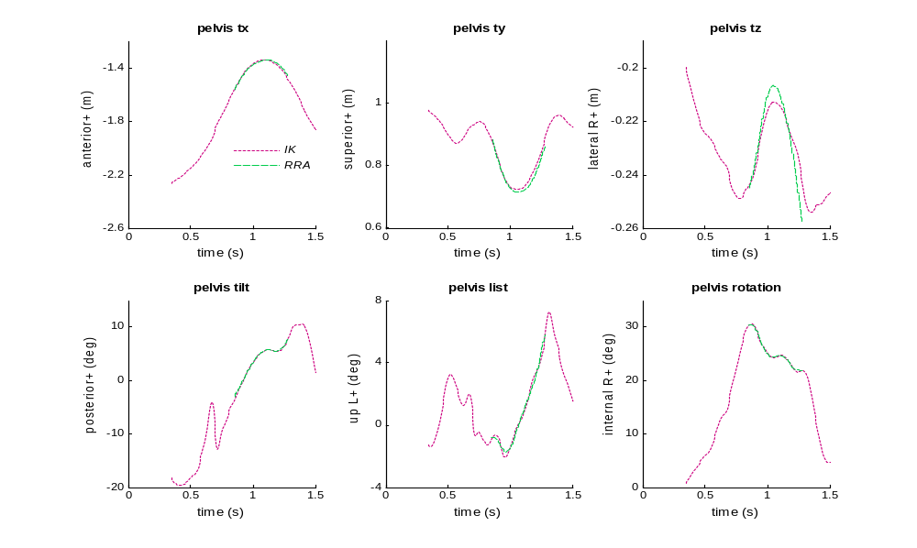
RRA tracking

Slide 9
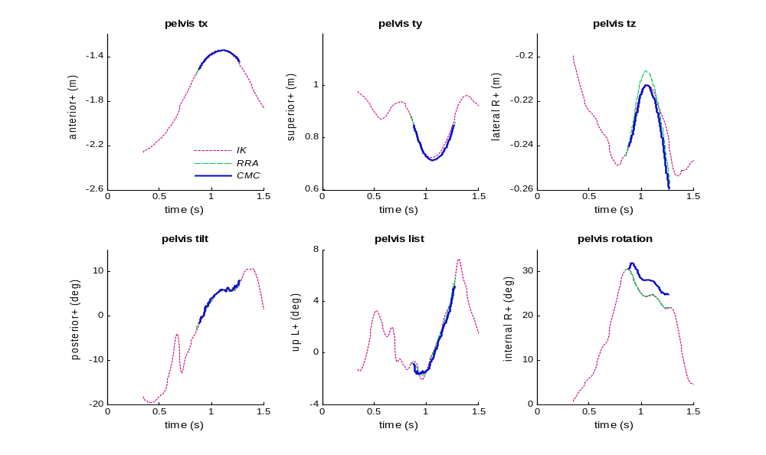
CMC Tracking

Slide 10
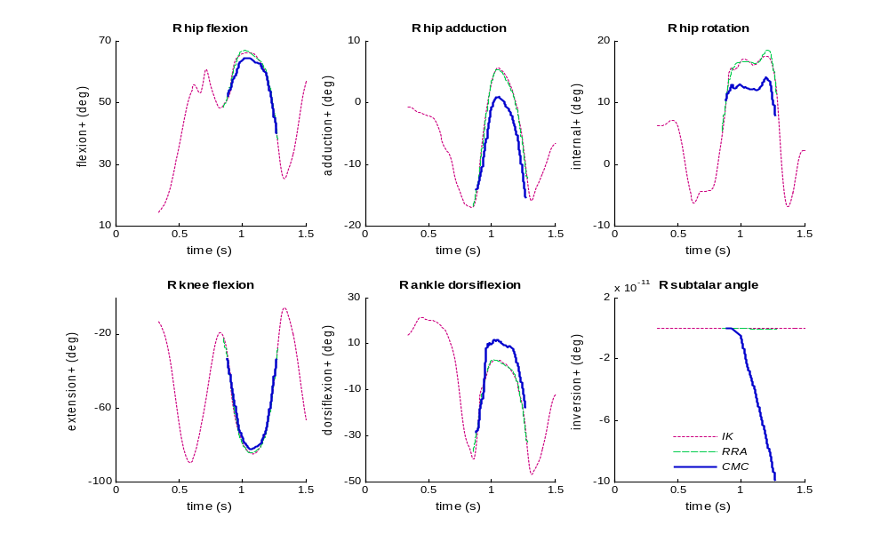
CMC Tracking

Slide 11
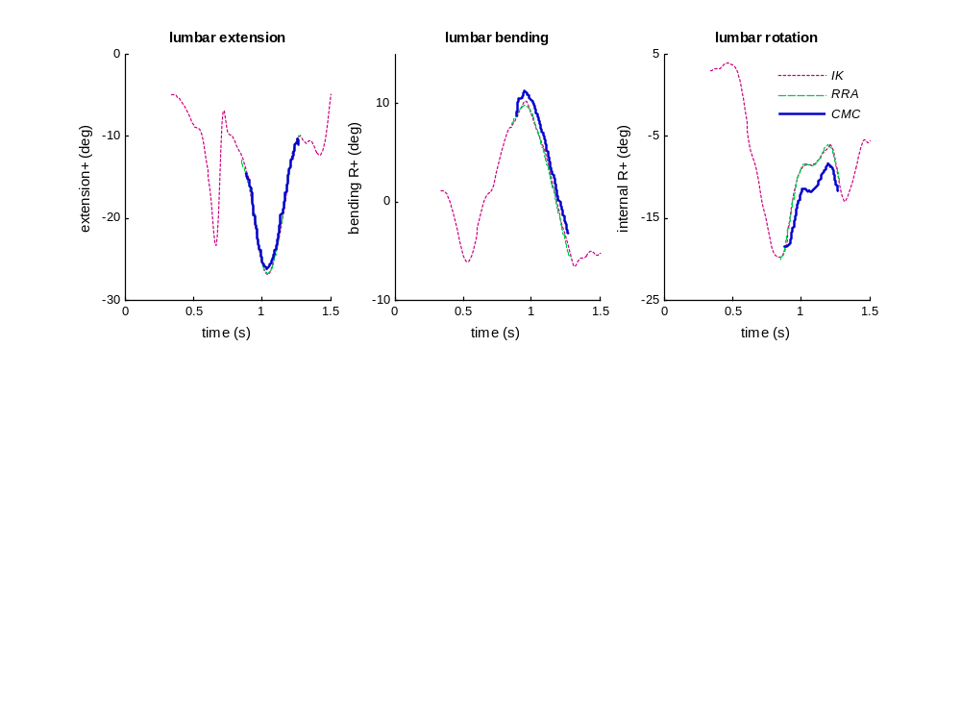
CMC Tracking
Iterations of:
  Increasing/Decreasing Coordinate weights
  Strengthening muscles (max optimal force)
  Decreased CMC time window

Slide 12
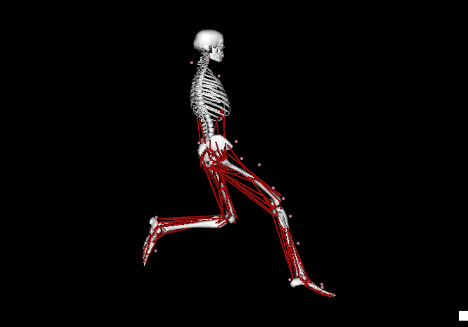
CMC

Slide 13
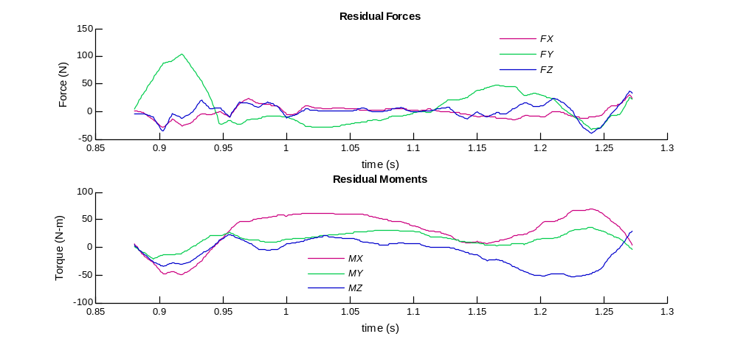
Best CMC

Slide 14
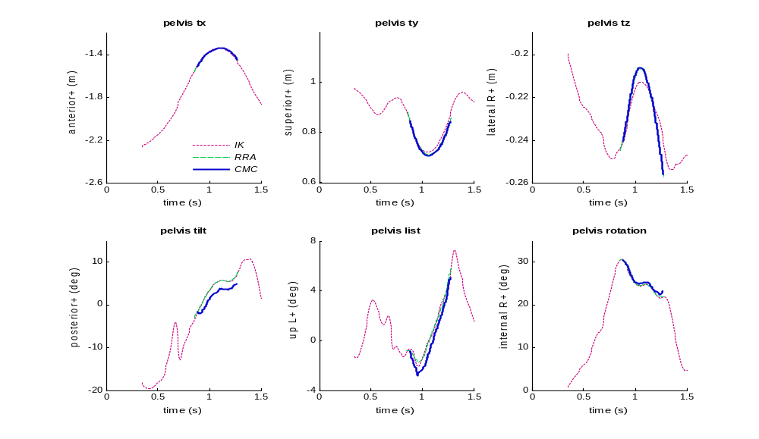
CMC

Slide 15
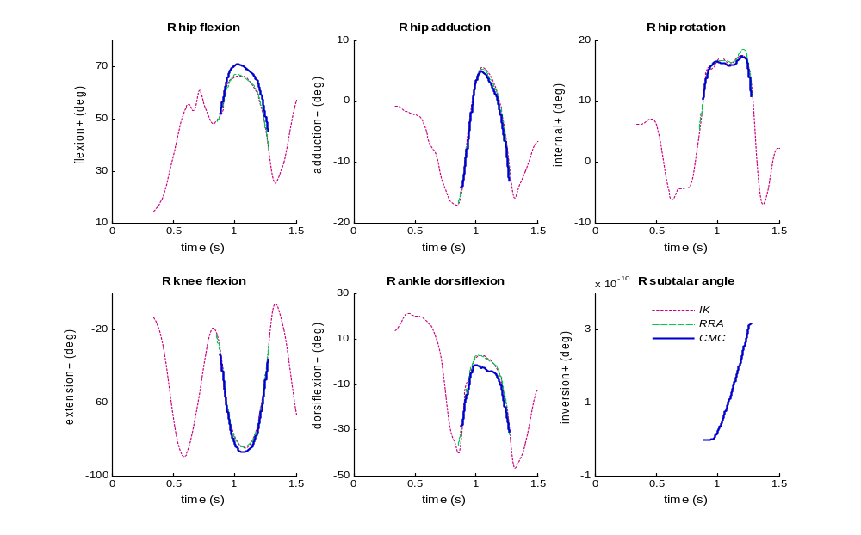
CMC

Slide 16
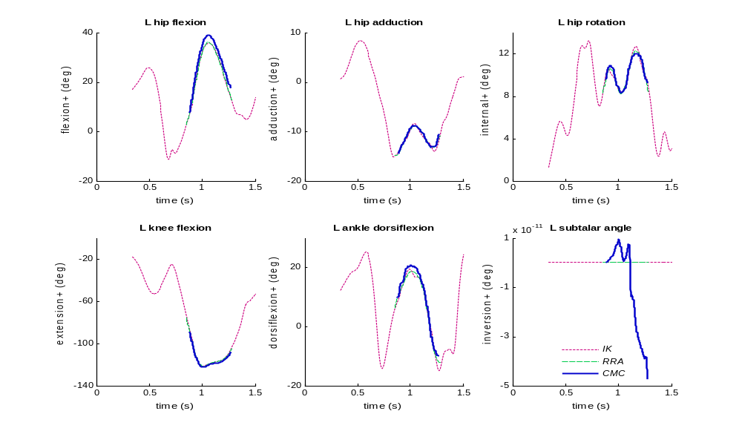
CMC

Slide 17
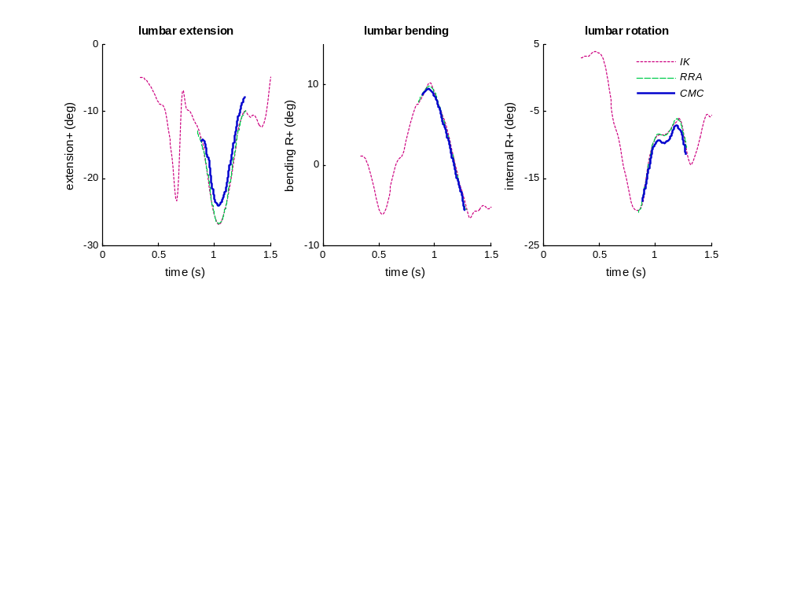
CMC

Slide 18
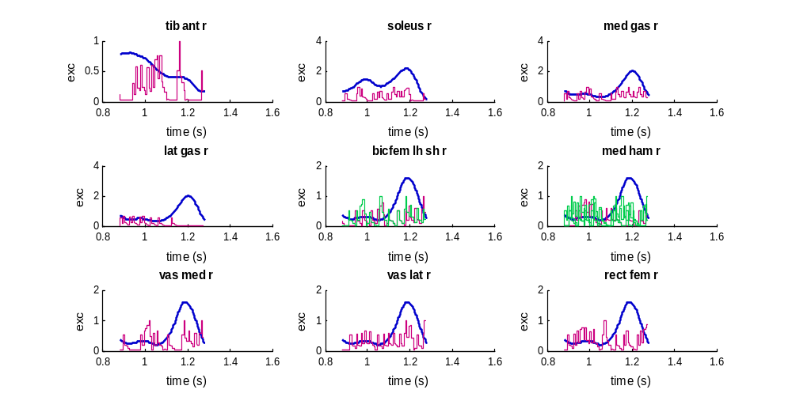
CMC Excitations and EMG

Slide 19
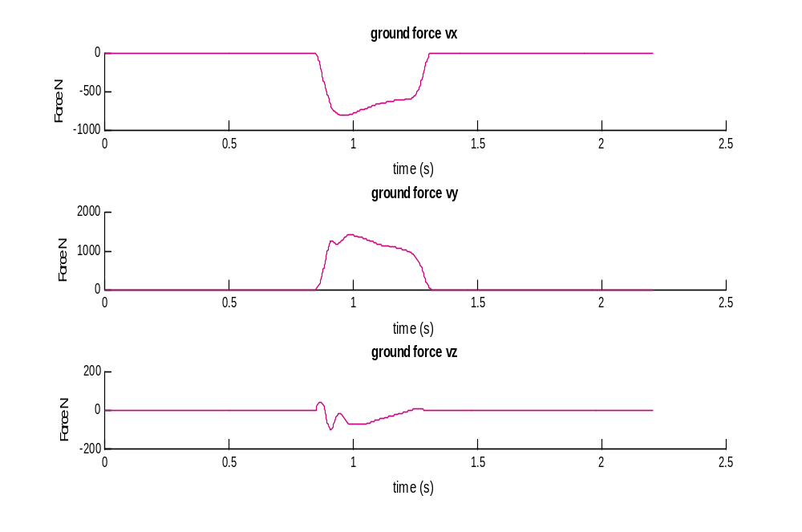
Learning
Data!!!
  Filtering
  Missing information
Process:
  Give it super powers, then take them away
Compromise
Stronger muscles can hurt as well as help
Dynamics faster than muscle
  Motion planning

Slide 20
Challenges
Co-contraction: Drives reserves up
Redundancy: chosing single or biarticular muscles
  Hip flexion: glutes vs hamstrings
  Ankle dorsiflexion: gastroc vs soleus
Coupling of fast dynamics and lack of “planning” the simulation

Slide 21
Future Directions
Explore other trials
Simulate a slower trial
Alter raw data filtering
Change of approach
  Forward dynamics
  Control excitation: excitation editor
Human Element

Slide 22
Thanks!
Questions

Slide 23
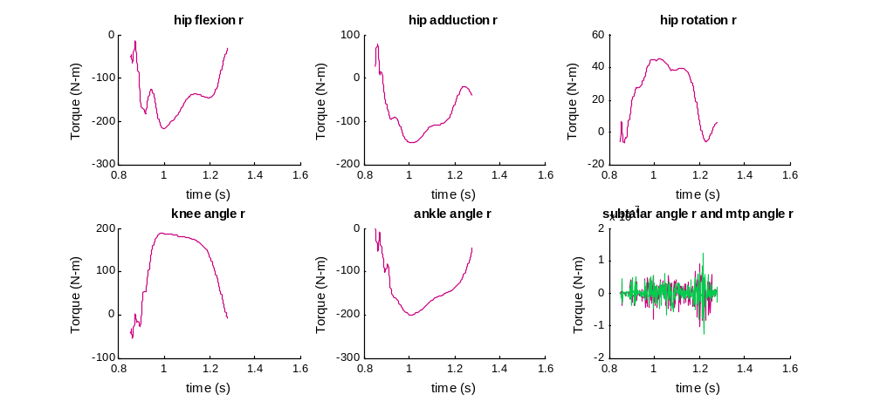
RRA actuators

Slide 24
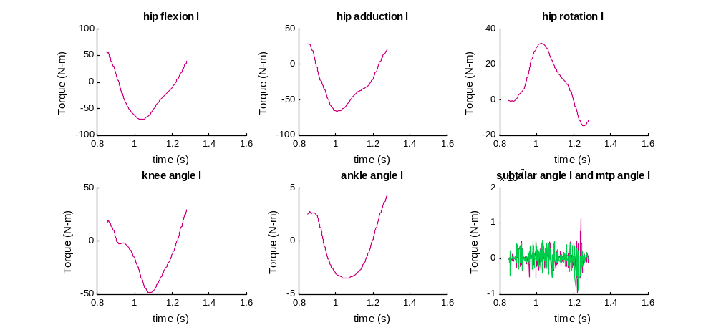
RRA actuators

Slide 25
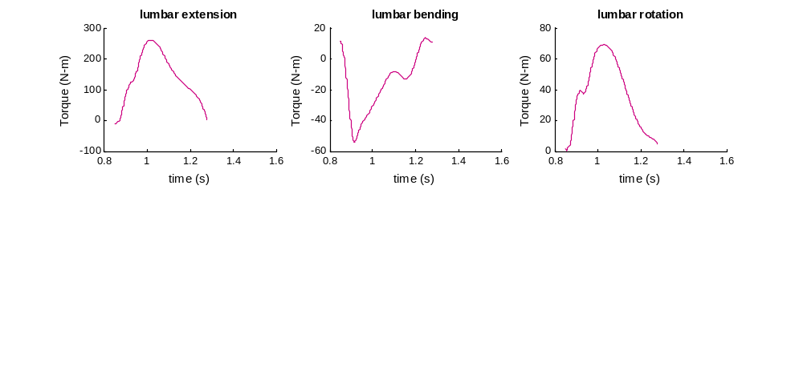
RRA actuators

Slide 26
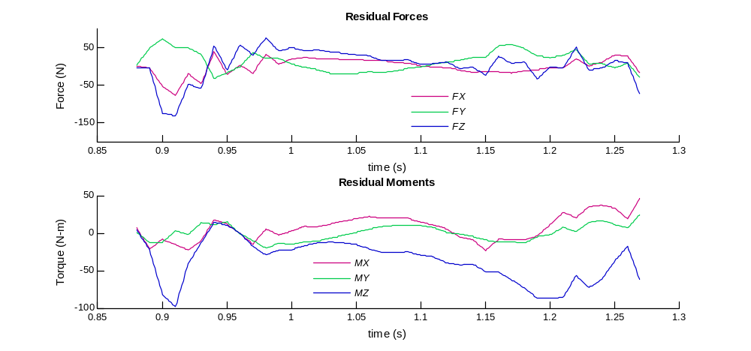
CMC1 Residuals

Slide 27
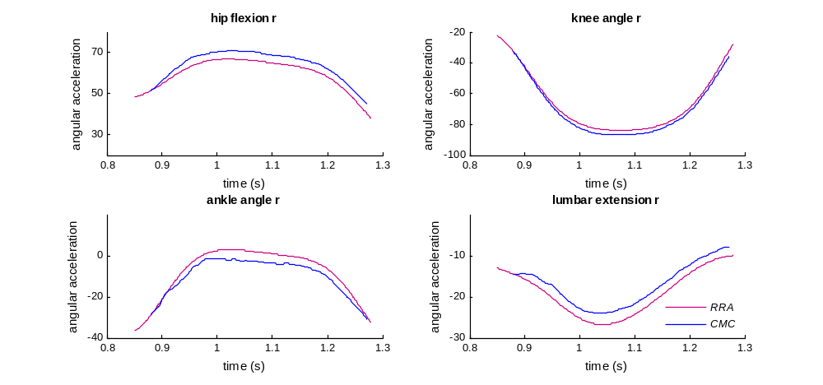
CMC accelerations

Slide 28
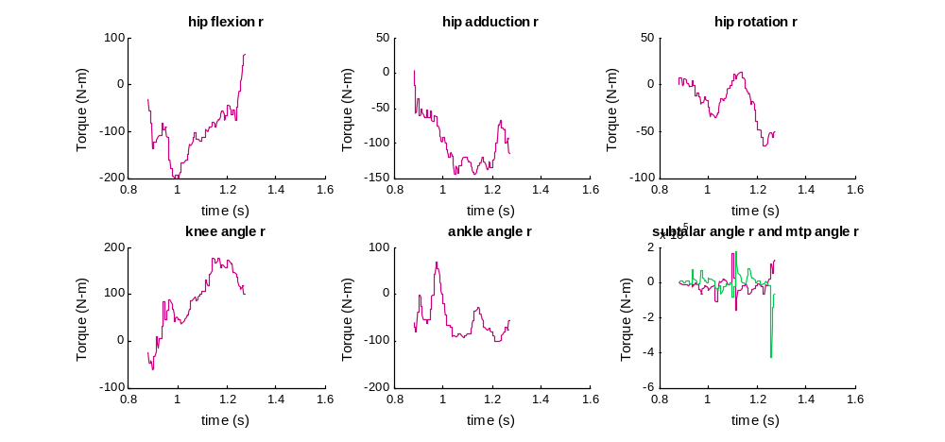
CMC Reserves

Slide 29
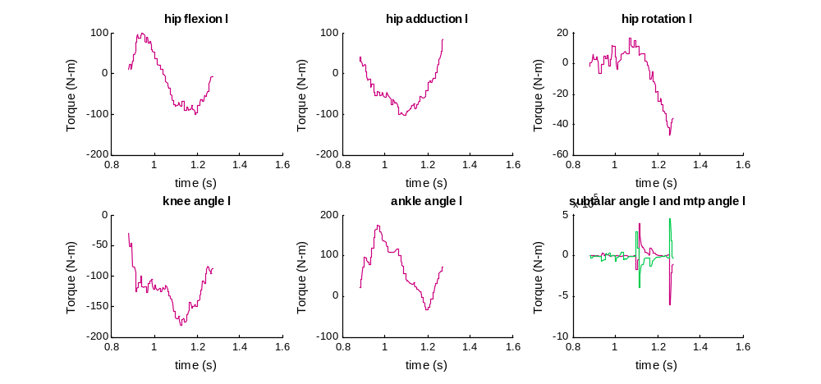
CMC reserves

Slide 30
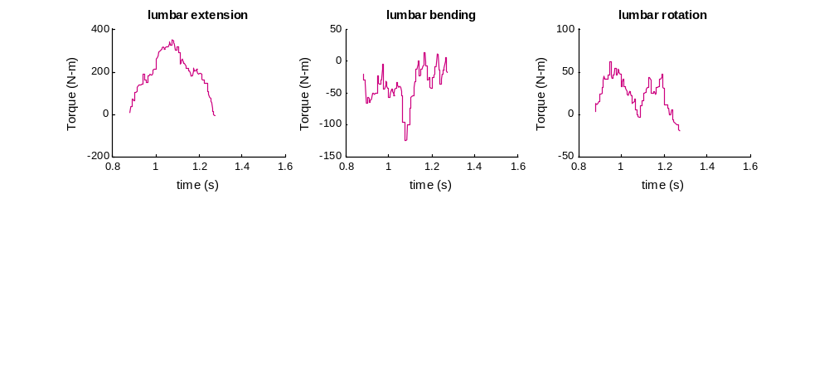
CMC reserves

Slide 31
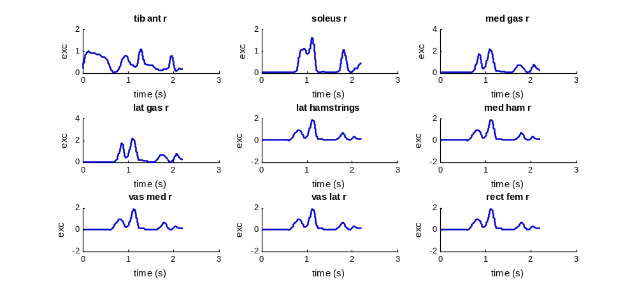
Quickhop5 EMG

Slide 32
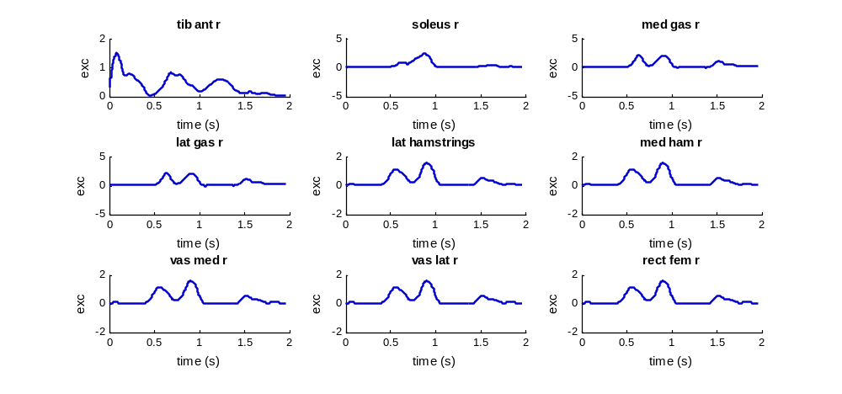
Quickhop4 EMG

