Slide 1
Simulations of Two Regimes of High Knee Loading Tasks
Matt DeMers

Slide 2
Goals
Develop simulations of two high load maneuvers:
  Reverse of direction (high Ant-Post force)
  Weighted squat (low Ant-Post force)
Obtain a measure of joint loading using inter-segmental and muscle forces

Slide 3
Motivation
OA prevention and preservation of cartilage health
  Loading known to mediate cartilage health¹
    Hydrostatic → chondro-preservation
    Shear → osteogenesis
  Lack of quantitative guidelines:
    Exercise mode
    Frequency
    Intensity
    Duration
1: Carter & Beaupre, 2001

Slide 4
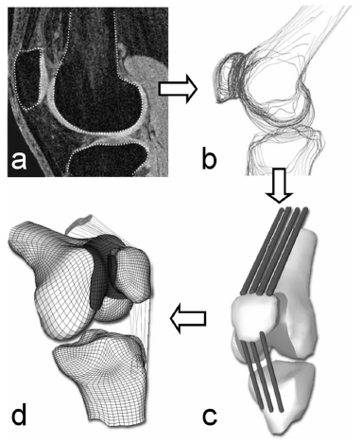
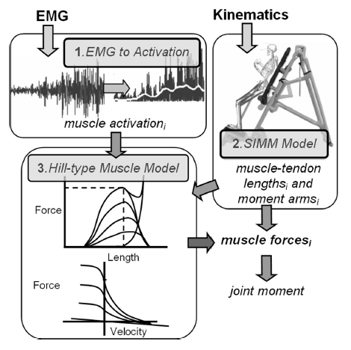
Motivation
Quantification of joint loads: cartilage stress
Need physiological muscle and joint forces
2: Besier et al, MEDICINE & SCIENCE IN SPORTS & EXERCISE, 2006

Slide 5
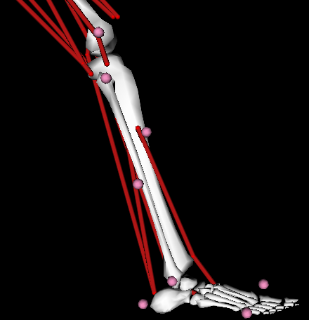
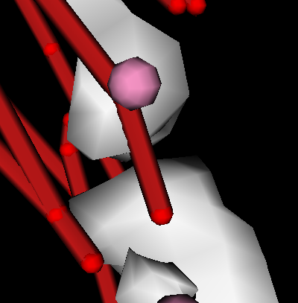
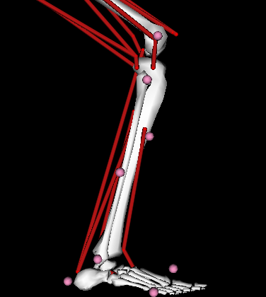
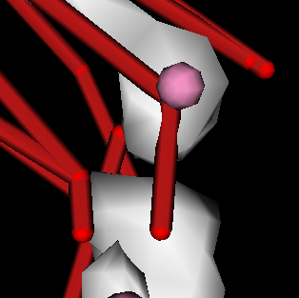
Methods
2 muscle driven (CMC) simulations
  Reverse of direction
  Weighted squat

Slide 6
Methods
Model development:
  Reverse of direction
    Strengthen model: stability, convergence
    Footfall
  Weighted squats
    Strengthen model
    Issues with added mass
      Model scaling protocol
      Assign to torso or make new segment
      Residuals
  EMG driven or EMG matching/tracking?

Slide 7
Resources Required
Mot Cap data (marker, GRF) on two actions:
  Reverse direction: single foot hop on-off with one force plate
  Squat: two feet on independent force plates
Simultaneous EMG data
Possibly dynamometer calibration measurements³ (if EMG driven model applied)
3: Lloyd et al, Journal of Biomechanics 2003

Slide 8
Timeline
Item | 1-May | 6-May | 8-May | 13-May | 15-May | 20-May | 22-May | 27-May | 29-May | 3-Jun
MotCap & EMG
Model Marker Plcmt
Segmenting/Scaling
Inverse Kinematics
RRA
CMC
Sim Validation
Interpret segment/ muscle forces

