Slide 1

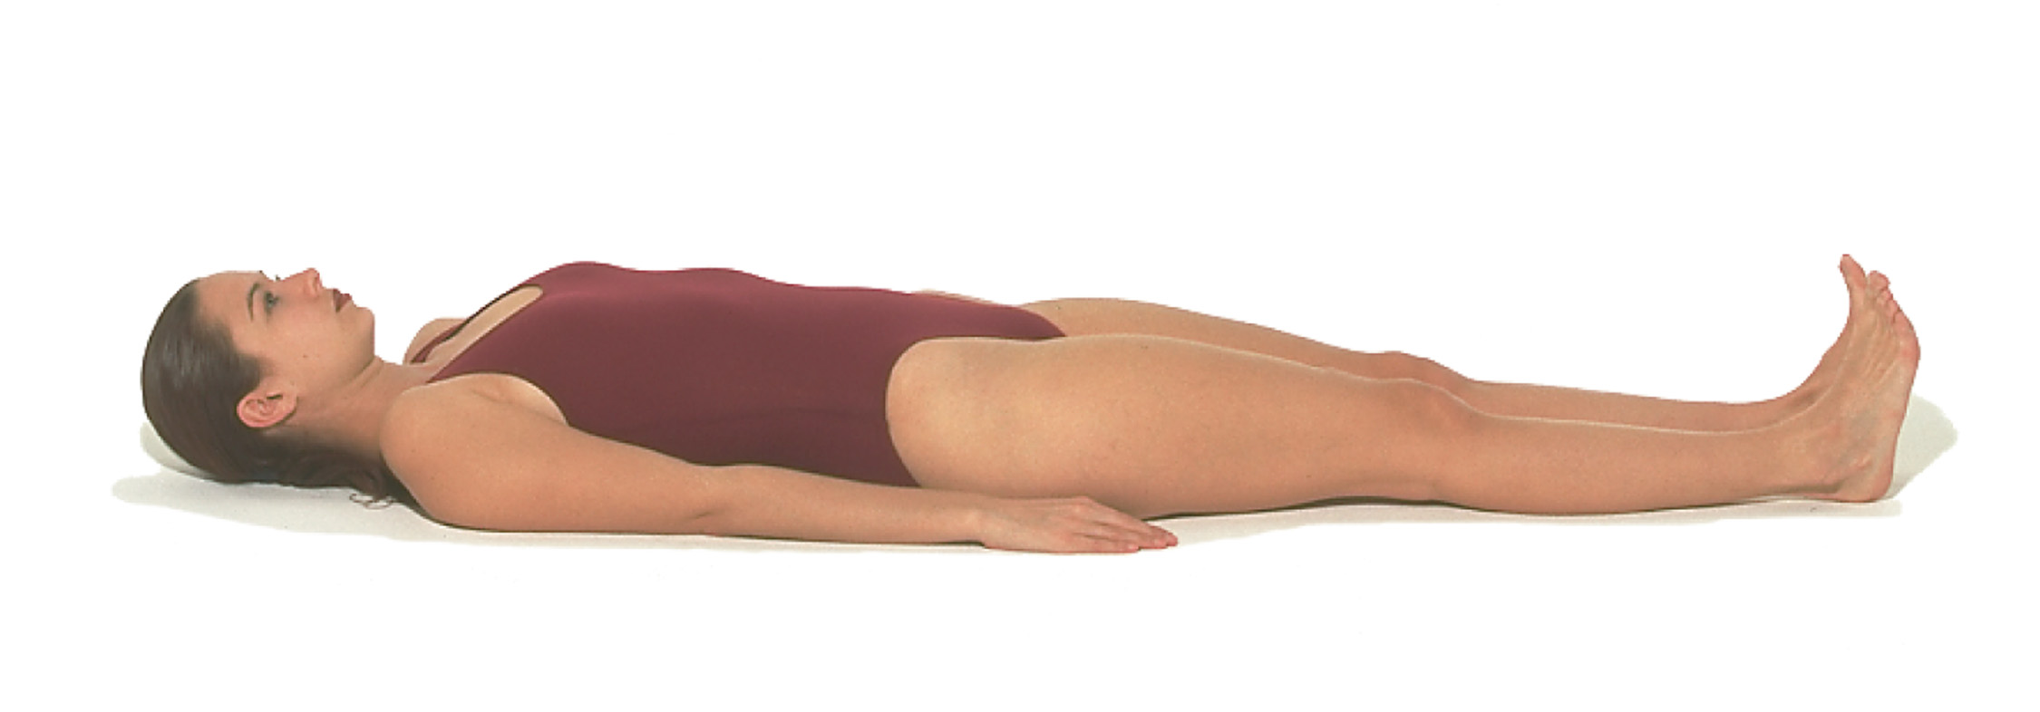
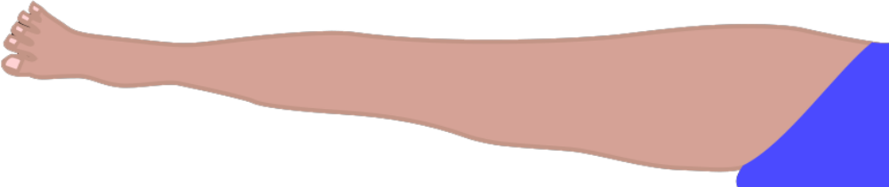
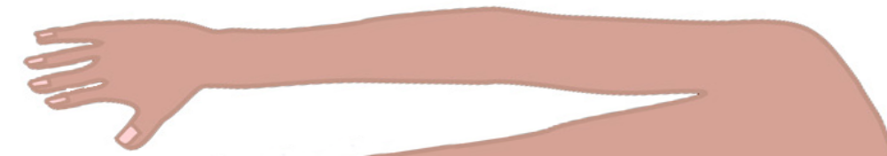

A DATABASE FOR MUSCULOSKELETAL SEGMENT LENGTH AND
CIRCUMFERENCES FOR INDIVIDUALIZED ANTHROPOMETRIC REPRESENTATION
¹Tammy M. Owings, ¹Erica E. Morrill, ¹Tyler Schimmoeller, ¹Tara F. Bonner, ¹Robb W. Colbrunn, ¹Benjamin Landis, ²John E. Jelovsek, and ¹Ahmet Erdemir
Departments of ¹Biomedical Engineering and ²Obstetrics and Gynecology
MOTIVATION
RESULTS
Anthropometry data provides useful information:
for health status, disease risk, and body composition [1]
for development/refinement of anatomical representation in computer models for biomechanics
for development of multi-layer tissue models based on data from the same subject
14
Age (years) | 42.3 (16.1)
Height (cm) | 175.1 (7.2)
Body mass (kg) | 83.0 (16.4)
BMI (kg/m²) | 27.0 (4.8)
Demographics
14
Age (years) | 39.2 (16.9)
Height (cm) | 163.9 (6.5)
Body mass (kg) | 73.1 (18.7)
BMI (kg/m²) | 27.2 (6.5)
12
Race
12
10
White/Caucasian
Black/African American
American Indian/Alaska Native
Asian
Native Hawaiian/Pacific Islander
10
8
8
Male (n)
6
Female (n)
PURPOSE
4
Ethnicity
6
2
Hispanic/Latino
Not Hispanic/Latino
4
To acquire comprehensive anthropometric measurements (length and circumference) of the arms and legs to support the acquisition of tissue thickness data [2; see Poster 406B]
0
2
18-25
>80
0
26-30
31-35
36-40
41-45
46-50
51-55
56-60
61-65
66-70
71-75
76-80
18-25
26-30
31-35
36-40
41-45
46-50
51-55
56-60
61-65
66-70
71-75
76-80
Age range
Age range
>80
Limb Length (cm)
METHODS
Male (n=50) |  |  | Female (n=50)
Mean (SD) | Range (min-max) | Segment | Mean (SD) | Range (min-max)
31.9 (2.2) | 24.4-37.1 | Upper Arm | 29.9 (1.9) | 25.9-34.0
25.9 (1.5) | 22.4-28.6 | Lower Arm | 24.1 (1.5) | 20.6-27.6
39.4 (3.1) | 34.1-47.3 | Upper Leg | 38.3 (3.4) | 31.7-52.4
43.6 (2.9) | 37.6-49.5 | Lower Leg | 40.5 (2.3) | 34.5-47.4
Length and circumference measurements were made on 100 subjects, following approval of the study protocol by the Cleveland Clinic IRB and Human Research Protection Office of the U.S. Army.
humeral lateral epicondyle
greater trochanter
Limb Circumference (cm)
lateral acromion
ulnar styloid process
lateral tibial plateau
lateral malleolus
90
50
80
Male
Female
45
Male
Female
upper arm
lower arm
upper leg
lower leg
70
40
Landmarks for length measurements
60
35
Circumference (cm)
Circumference (cm)
30
distal shaft
of humerus
distal shaft
of ulna-radius
distal shaft
of femur
distal shaft
of tibia
50
distal axillary
proximal shaft
of ulna-radius
top of
inner thigh
distal tibial
tuberosity
40
25
30
20
20
15
upper arm
midpoint
lower arm
midpoint
upper leg
midpoint
lower leg
midpoint
Locations for circumference measurements
DISCUSSION AND CONCLUSION
REFERENCES
Circumference values change along the length of the extremity, which increase the detail in shape descriptors and improve the fidelity of anatomical and inertial representation in musculoskeletal models [3].
The geometry of external volume of segments, with support from individual tissue thicknesses [2], allow for detailed volumetric representation of tissue composition, i.e., that of skin, fat, and muscle.
Anthropometric data from a variety of demographic populations are publically available at https://multisbeta.stanford.edu
[1] Fryar CD, et al. Nat Health Stat Reports 3(39), 1-39, 2016.
[2] Morrill EE, et al. Abstract for 41st Annual ASB meeting, 2017.
[3] Erdemir, A, et al. Clin Biomech 22(2), 131-54, 2007.
Poster #314B
41st Annual Meeting of the American Society of Biomechanics
Boulder, CO, USA, August 8th-11th, 2017
Project Title: Reference Models for Multi-Layer Tissue Structures
Project Funding: USAMRMC, DoD (W81XWH-15-1-0232; PI: Erdemir)
Project Website: https://simtk.org/projects/multis
Contact: Ahmet Erdemir, erdemir@ccf.org
Contributors: Tara Bonner, Robb Colbrunn, Scott Delp, Ahmet Erdemir, John Eric Jelovsek, Joy Ku, Ben Landis, Erica Morrill, Tammy Owings, Tyler Schimmoeller, Mike Wong

