Slide 1


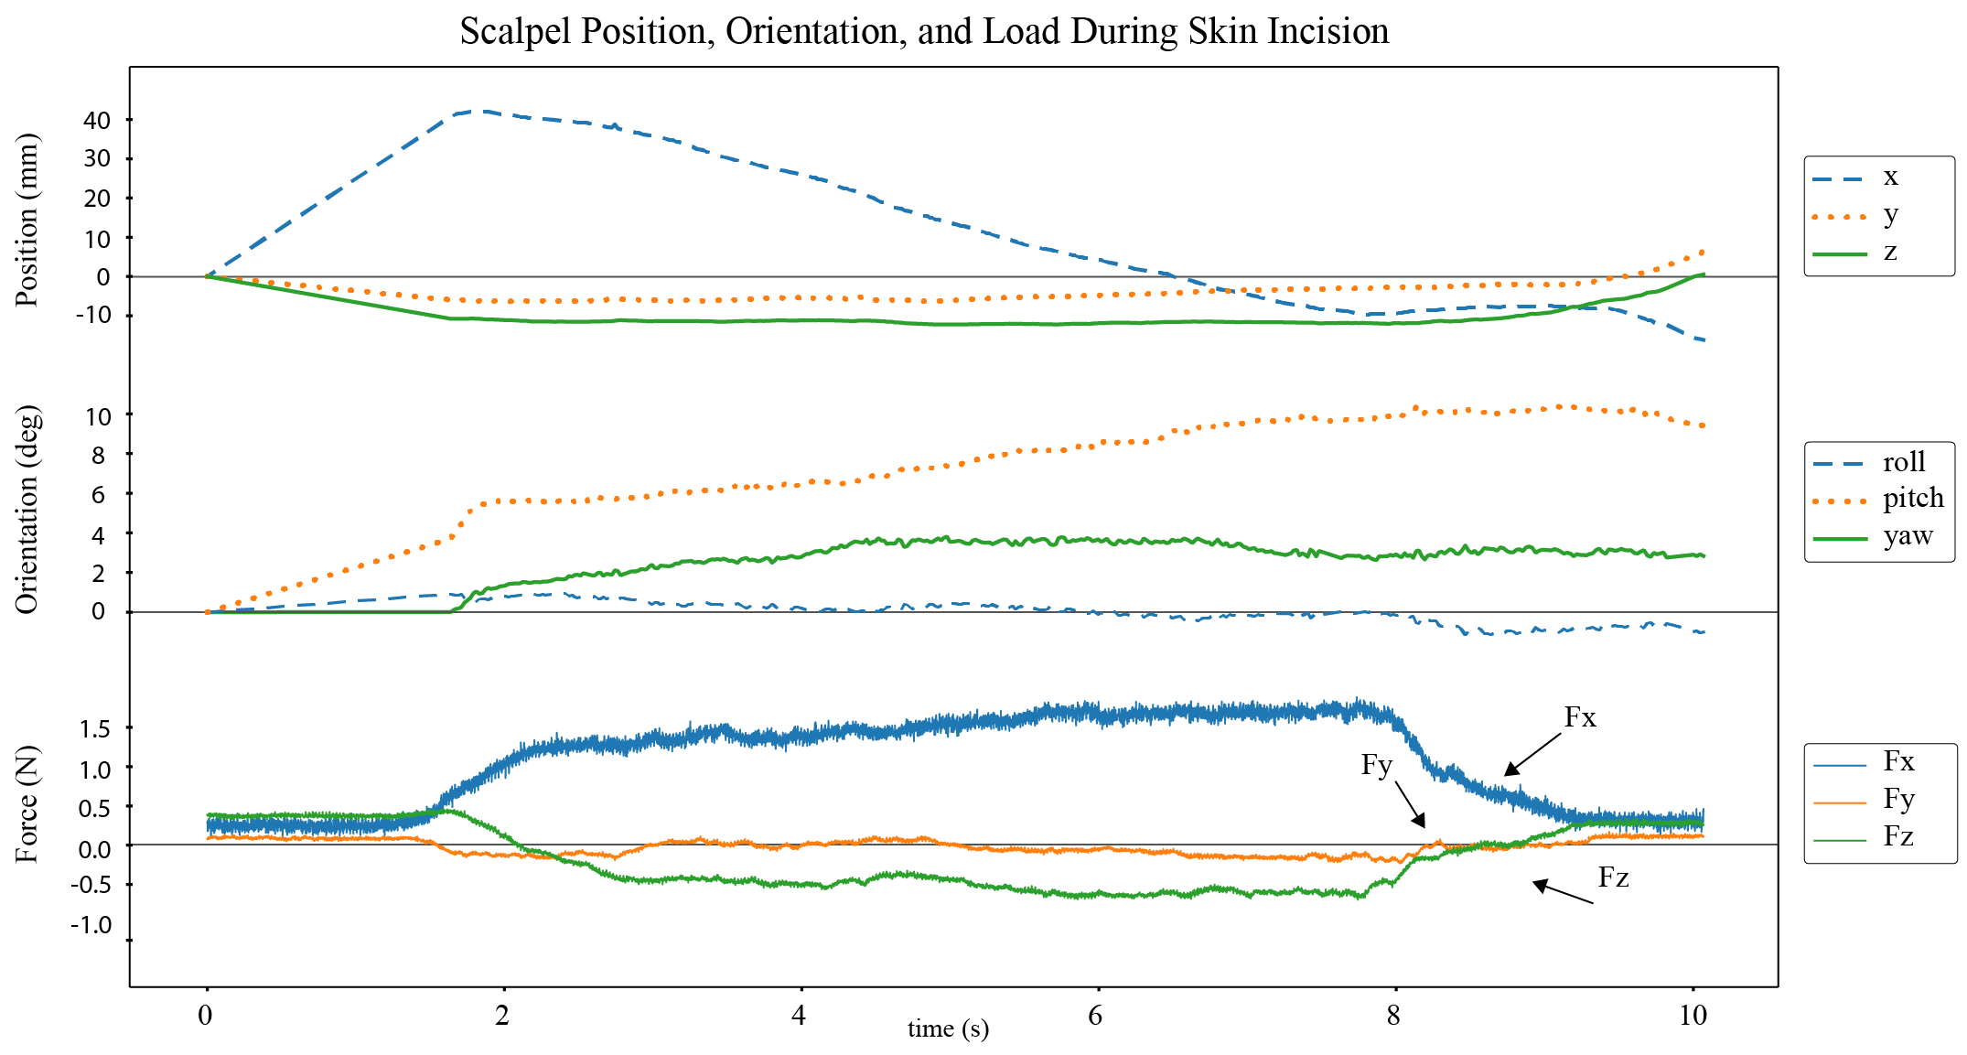
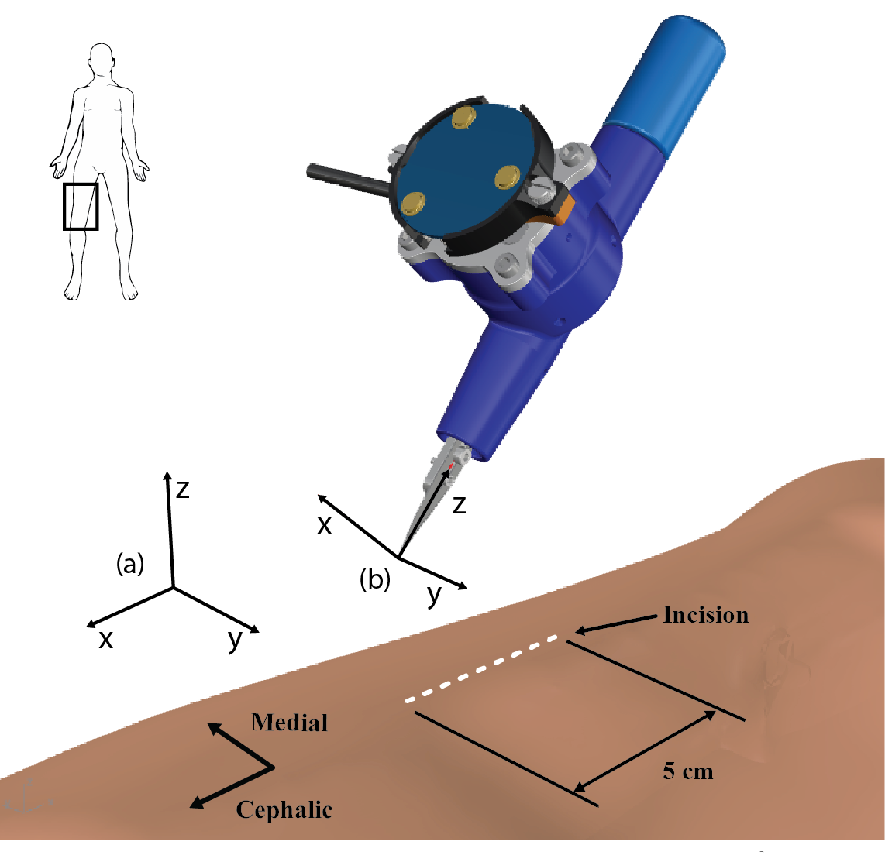
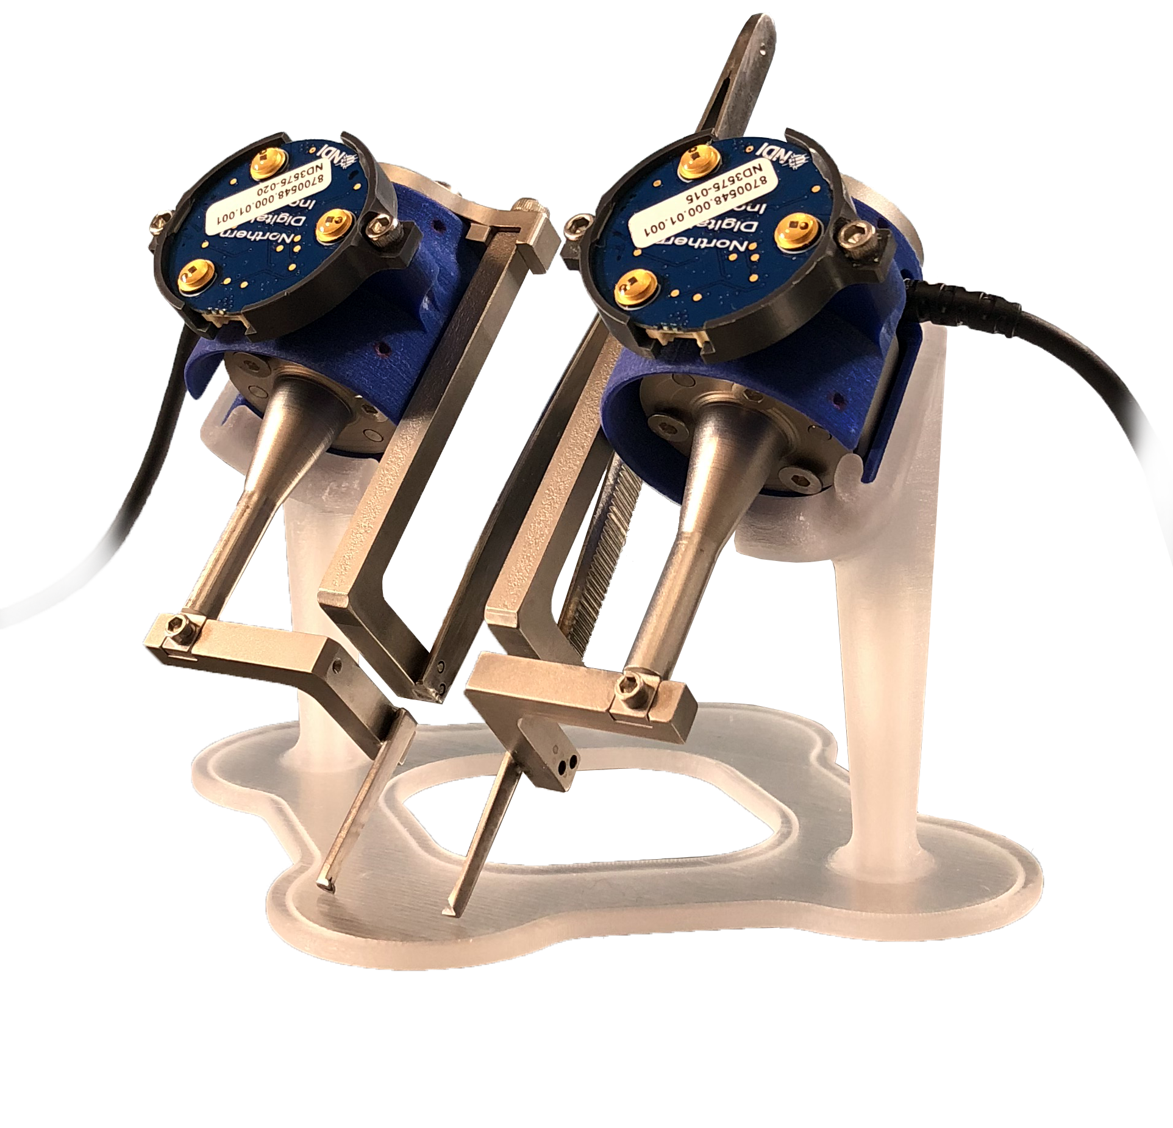
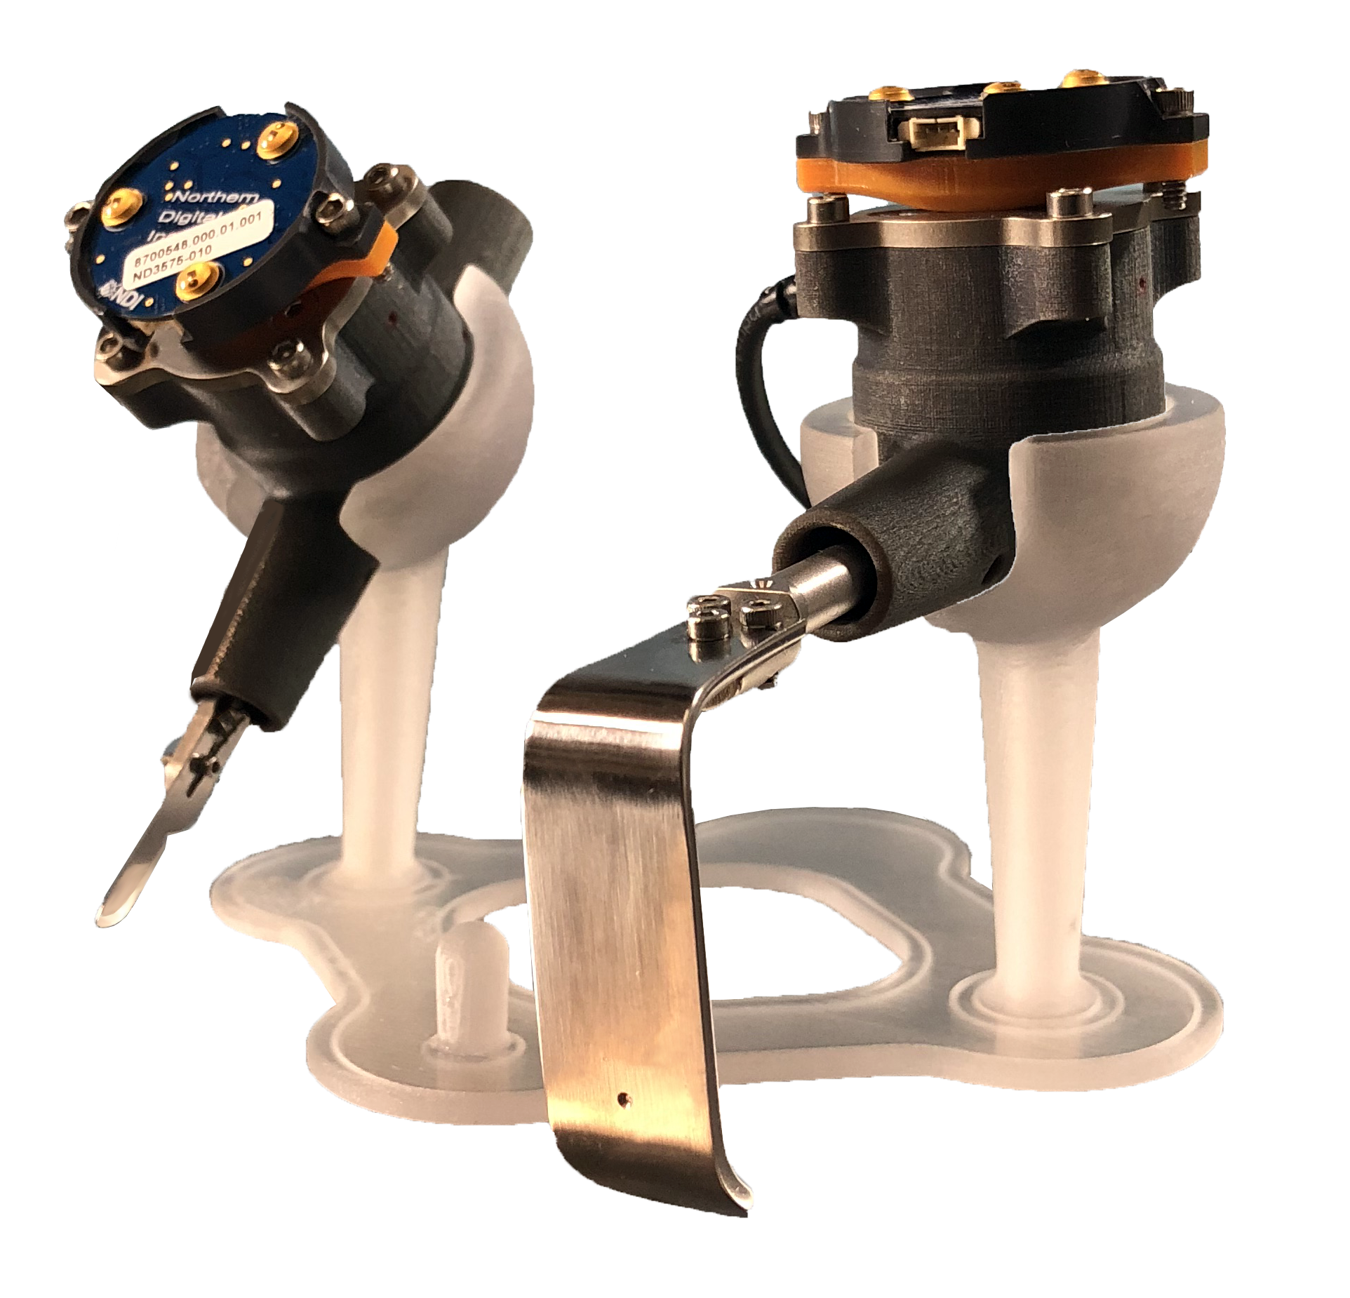
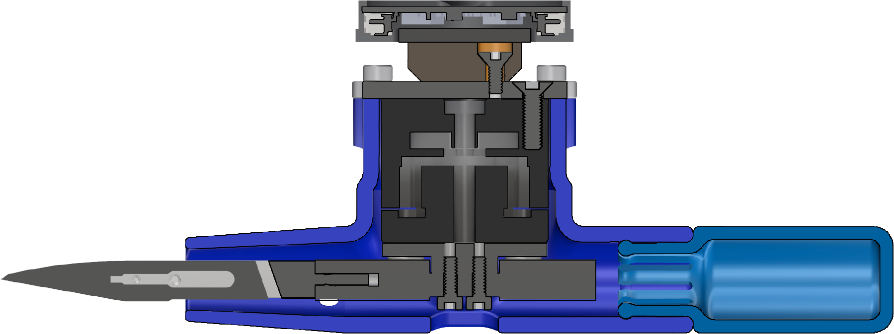
INSTRUMENTATION OF SURGICAL TOOLS TO MEASURE LOAD AND POSITION DURING INCISION, TISSUE RETRACTION, AND SUTURING
Tyler Schimmoeller, Ki-Hyun Cho, Robb Colbrunn, Tara Nagle, Erica Neumann, Ahmet Erdemir
Problem
Missing foundational data for accurate haptic feedback during virtual reality surgical training
Results
Methods
Modular instrumentation system for surgical tools
Scalpel
Forceps
Retractor
Conclusions
The tool / tissue interaction during surgical procedures was characterized and can be implemented to provide accurate haptic feedback during surgical training.
Methods can be used to easily instrument other tools where force characterization is desired
motion sensor
load
cell
Poster 913

