Slide 1
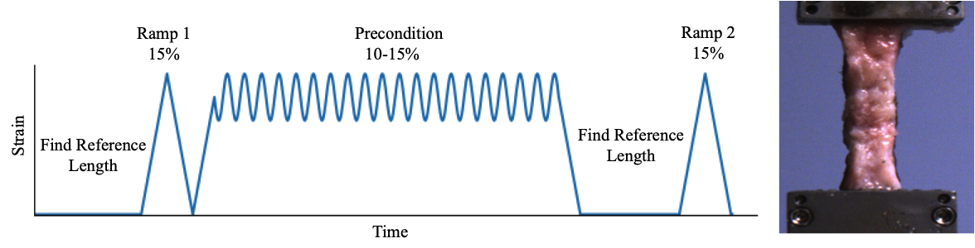

Slide 2
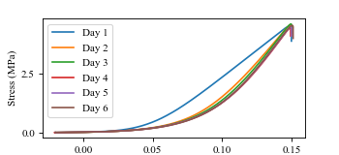
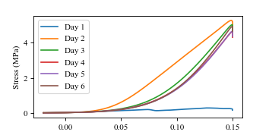

Slide 3
Table 1: Modulus values and percent differences
Frozen Sample
Trial Day | 1 | 2 | 3 | 4 | 5 | 6
Modulus (MPa) | 45.38 | 62.86 | 66.20 | 65.19 | 65.73 | 66.25
Percent Difference* |  | 32.29 % | 5.17% | 1.54% | 0.84% | 0.77%
Refrigerated Sample
Trial Day | 1 | 2 | 3 | 4 | 5 | 6
Modulus | 3.65 | 49.56 | 68.08 | 66.51 | 66.25 | 72.52
Percent Difference* |  | 172.55% | 31.49% | 2.33% | 0.38% | 9.03%
*The percent difference was calculated based on the previous day’s test.

