Slide 1




OPEN KNEE(S): COMPREHENSIVE PATELLOFEMORAL JOINT TESTING FOR SPECIMEN SPECIFIC NEXT GENERATION KNEE MODELS
August 6th, 2015
Robb Colbrunn, Tara Bonner, Snehal Chokhandre,
Craig Bennetts, Jason Halloran and Ahmet Erdemir

Slide 2
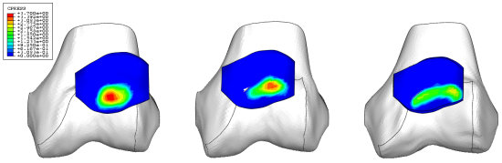
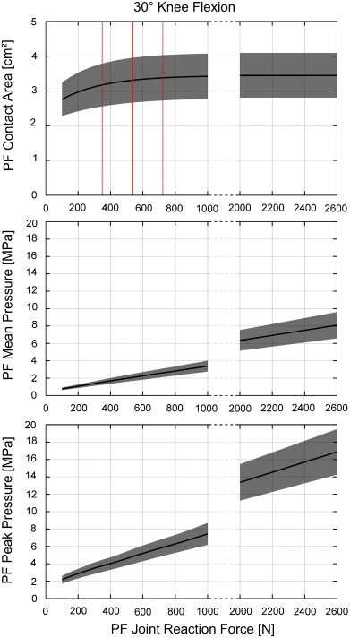
So you want to model the patellofemoral joint?
Need reference data for modeling purposes
  Anatomy?
  Material Properties?
  Validation Data Set?
Goudakos et al. Journal of Biomechanics, 2010-12-01, Volume 43, Issue 16, Pages 3237-3239

Slide 3
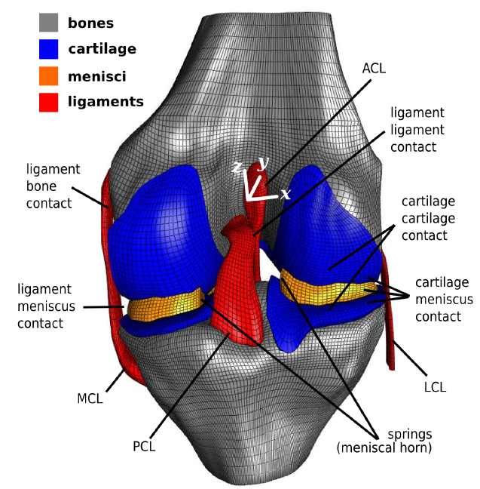
What is Open Knee?
Problem:
Fully specimen-specific computational models (anatomy and mechanical properties) of diverse populations do not exist
Open Knee Solution:
Platform for community driven modeling & simulation
General purpose models of healthy and diseased knees
  gender
  age
  grades of osteoarthritis

Slide 4
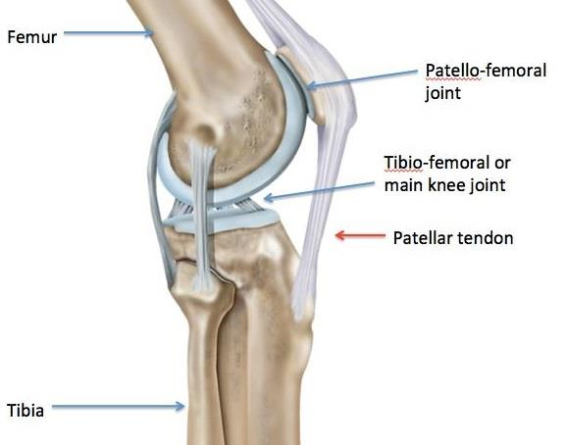
Open Knee: Patellofemoral Joint
Goal:
Develop virtual models of healthy and diseased knees for clinical and scientific simulations of the patellofemoral joint
Requires comprehensive testing to create specimen-specific models
  Individualized anatomy
  Tibiofemoral joint mechanics
  Patellofemoral contact mechanics
  Tissue mechanical properties
  Presentation Focus:
  Details and preliminary results of the patellofemoral testing within the framework of the Open Knee(s) project
Notes:
BOLD AREA OF PTFJ WHEN SHOWING LAST SECTION

Slide 5
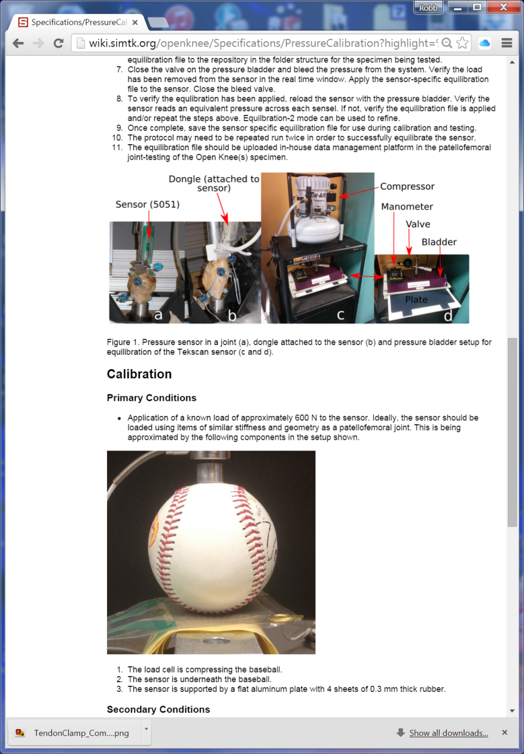
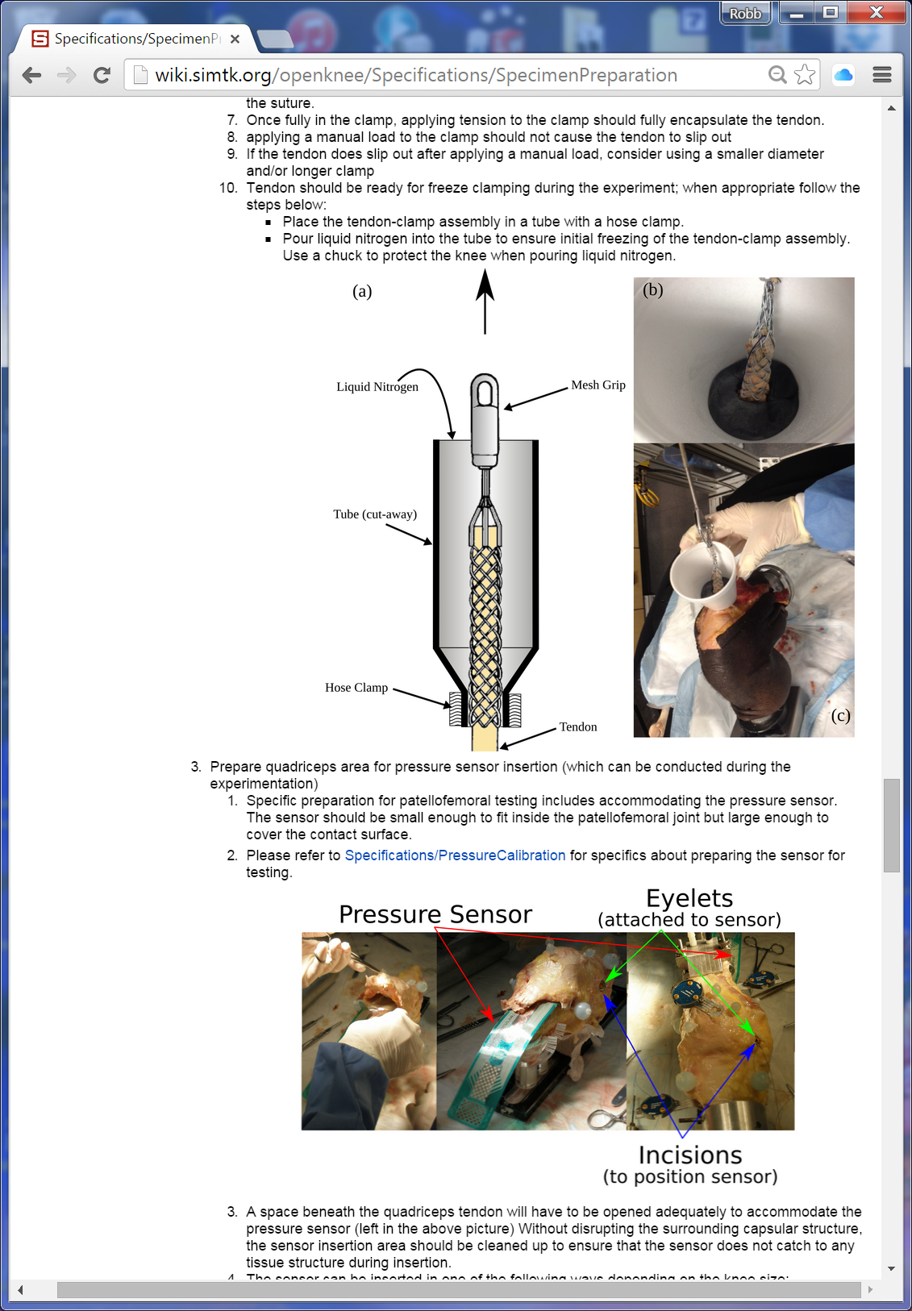
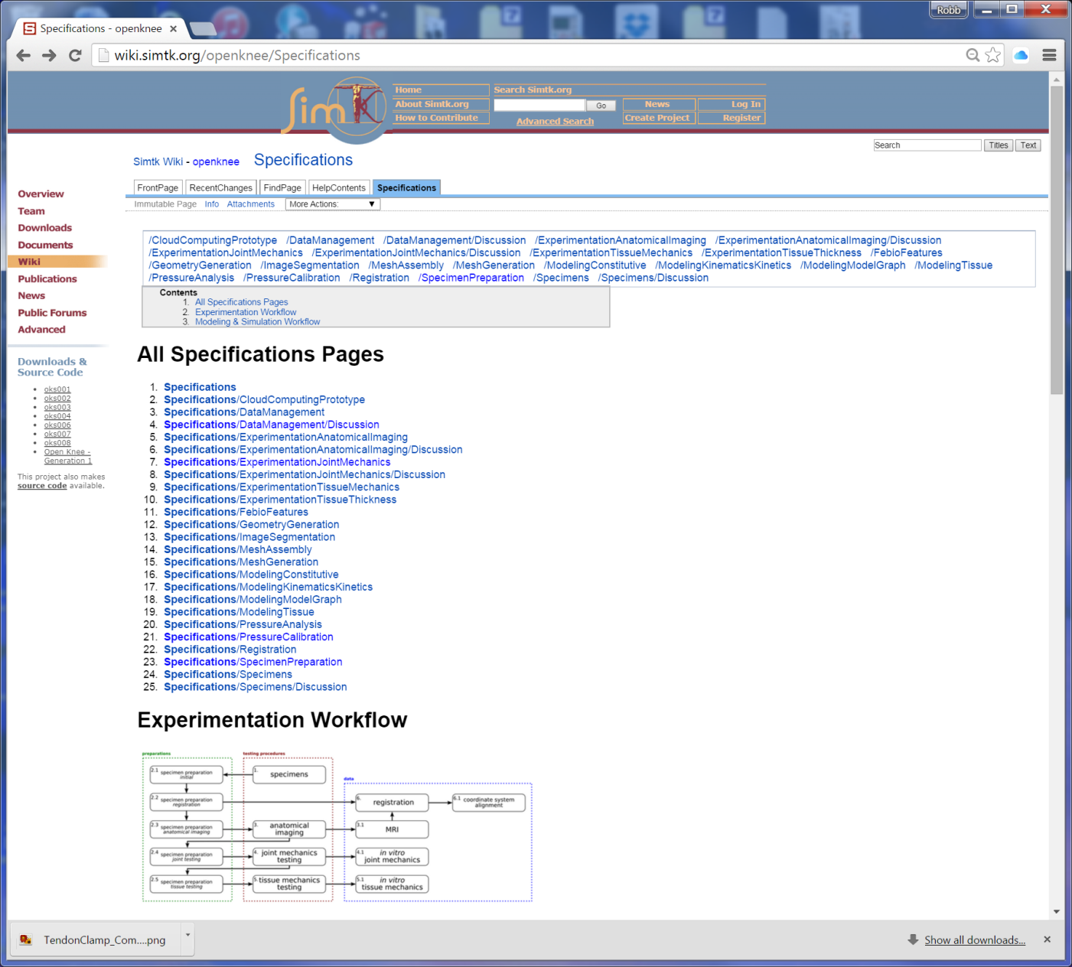
Methods

Slide 6
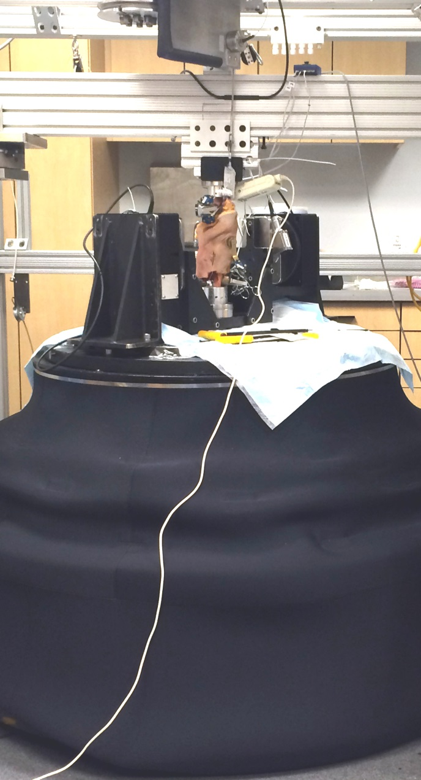
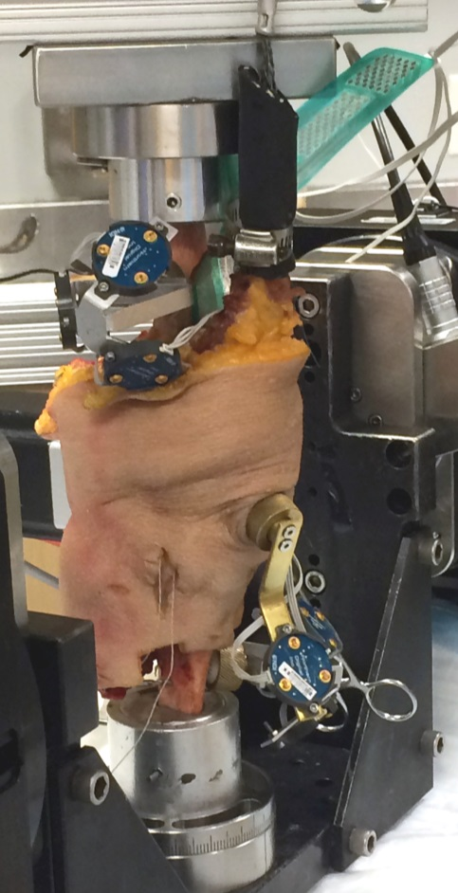
Methods
Data from 6 of 10 Specimens
  2 male, 4 female
  Ages 25 to 71
6 DOF Robot
  simVITRO software
  Real-time force feedback control
  0°, 15°, 30°, 45°, and 60° Flexion
Quadriceps Load Actuator
  20, 100, 200, 300, 400, 500, & 600 N
Motion Tracking
  Patellofemoral and Tibiofemoral joint
Contact Mechanics
  Tekscan 5051
Specimen # | Gender | Age | Height | Weight | BMI
oks001 | Male | 71 | 1.83 m | 77.1 kg | 23.1 kg/m²
oks002 | Female | 67 | 1.55 m | 45.3 kg | 18.9 kg/m²
oks003 | Female | 25 | 1.73 m | 68.0 kg | 22.8 kg/m²
oks004 | Female | 46 | 1.58 m | 54.4 kg | 21.9 kg/m²
oks006 | Female | 71 | 1.52 m | 49.4 kg | 21.3 kg/m²
oks007 | Male | 71 | 1.7 m | 65.8 kg | 22.7 kg/m²
Notes:
Add lines to point to object

Slide 7
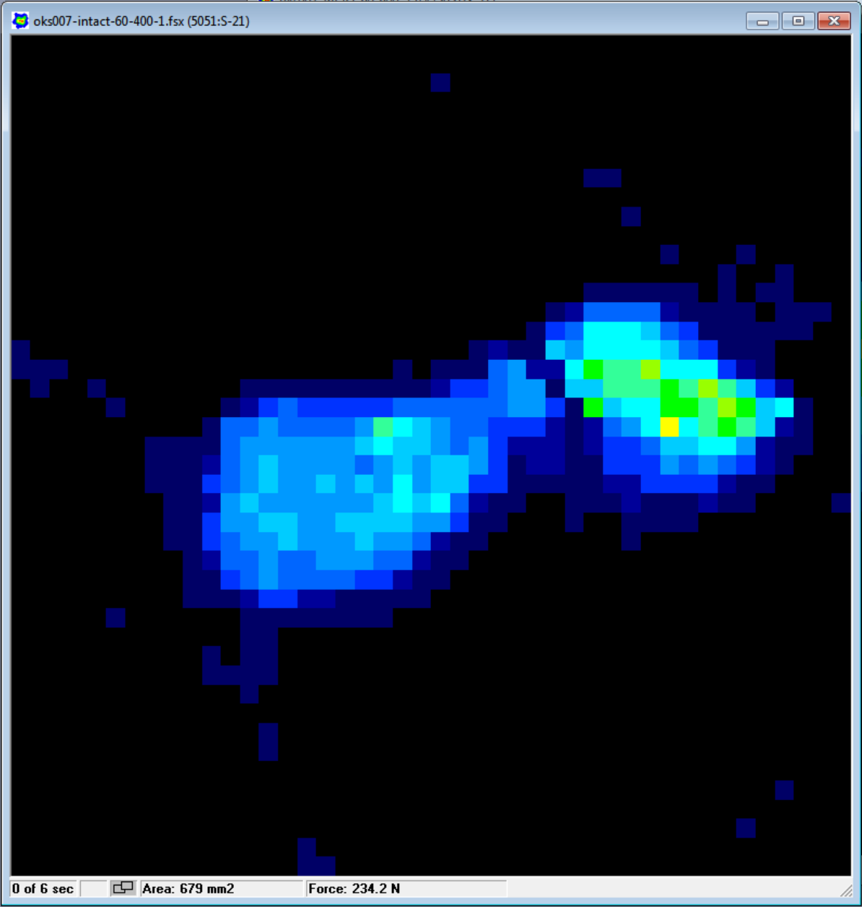
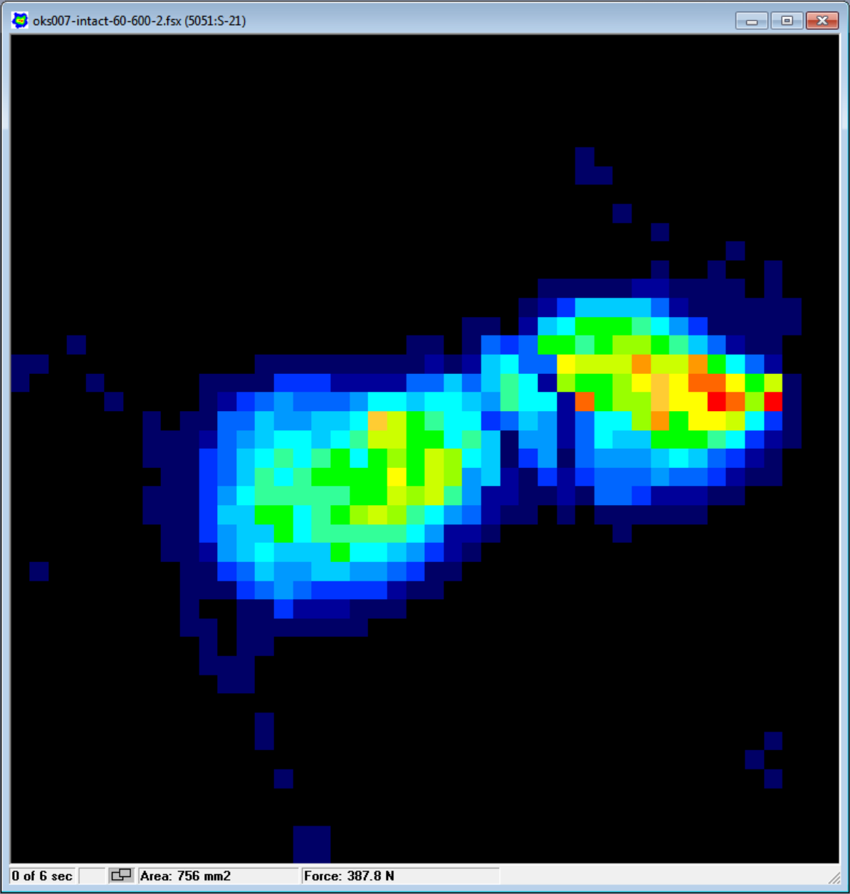
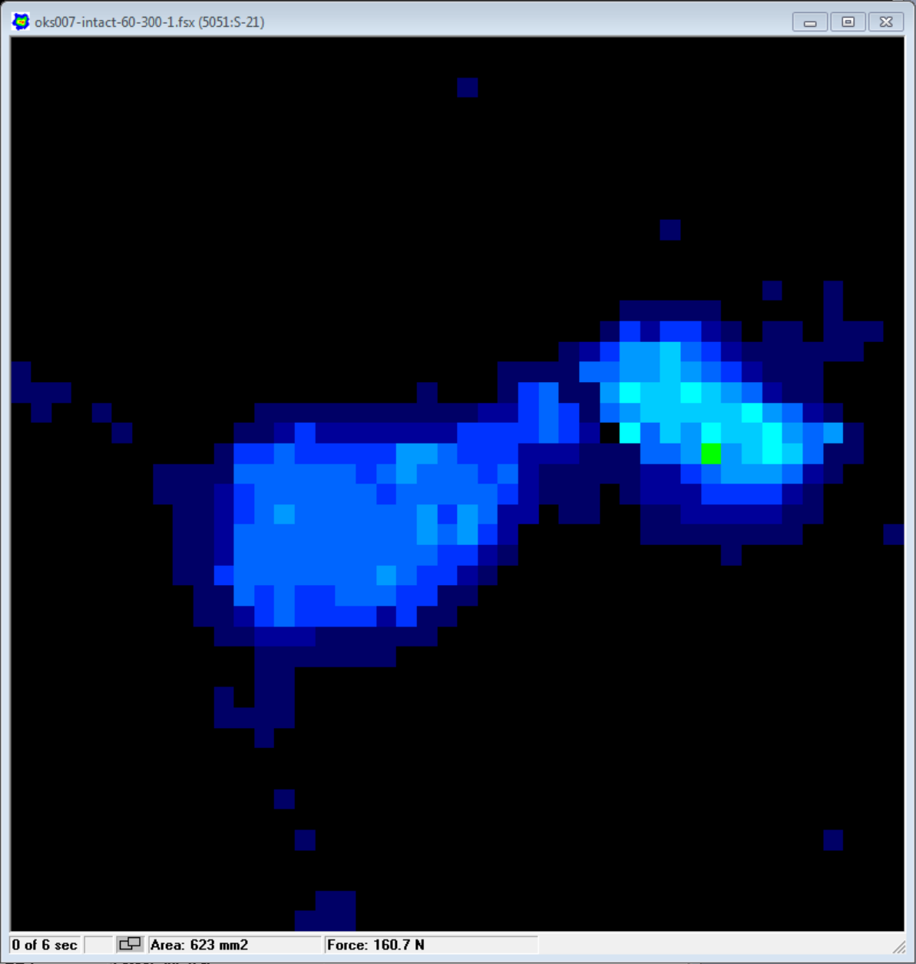
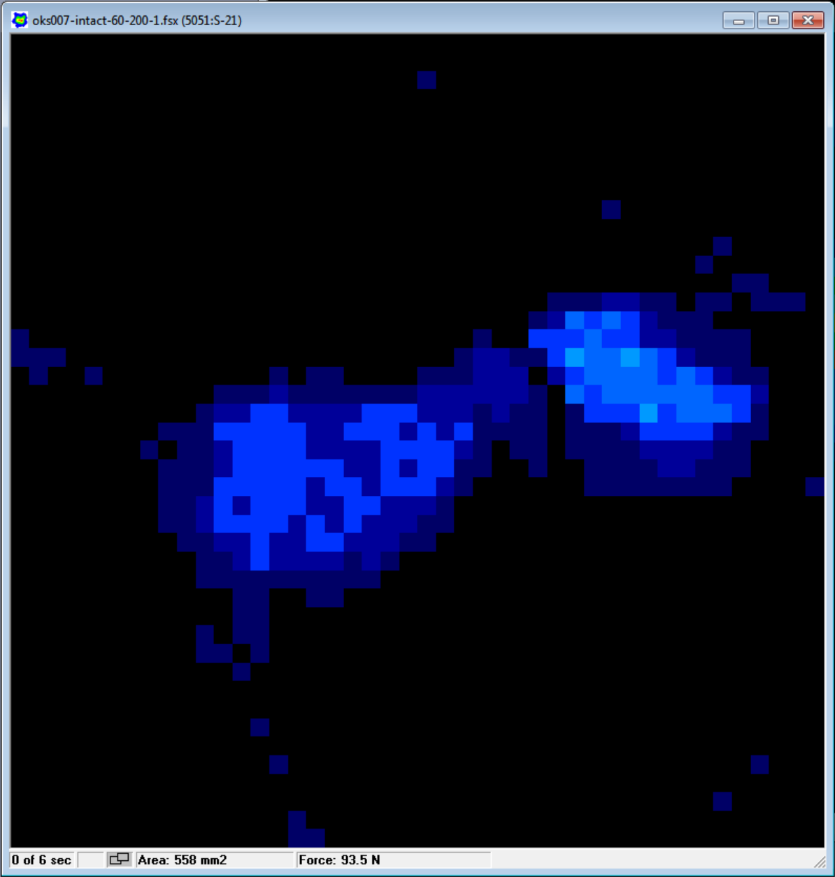
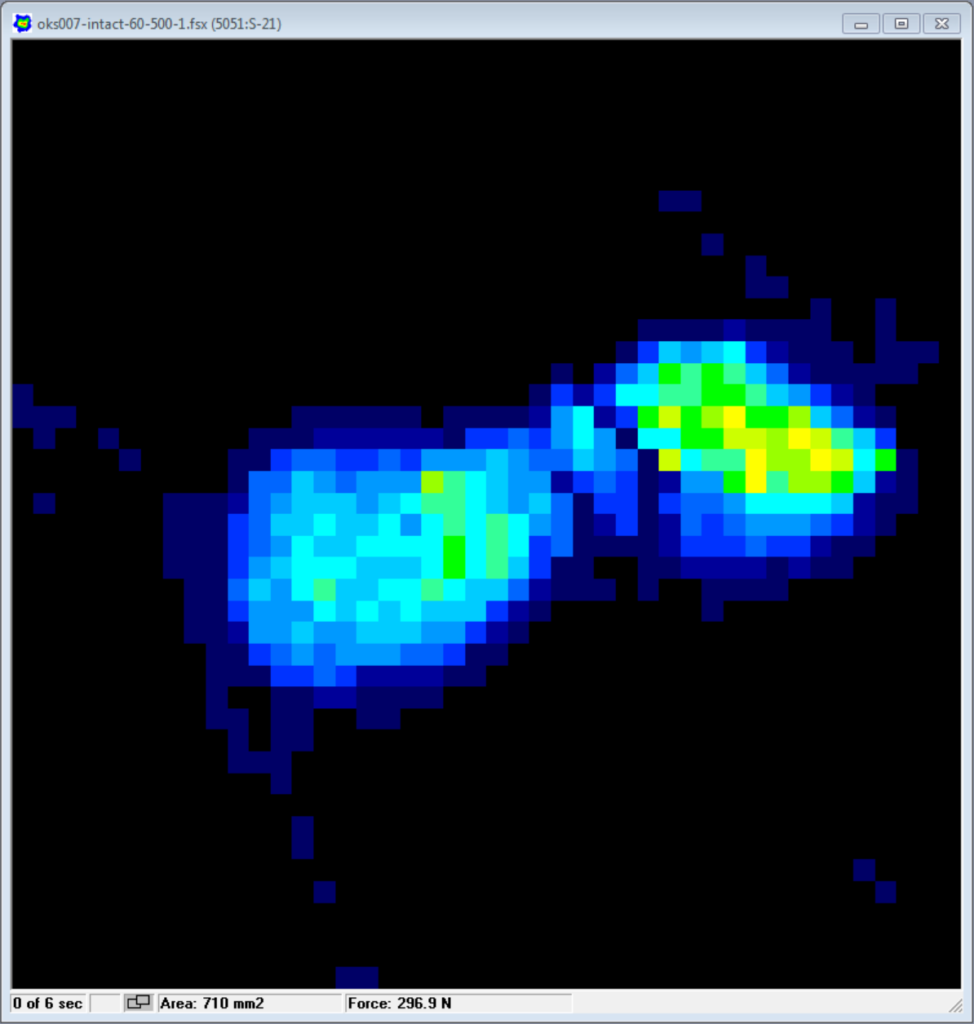
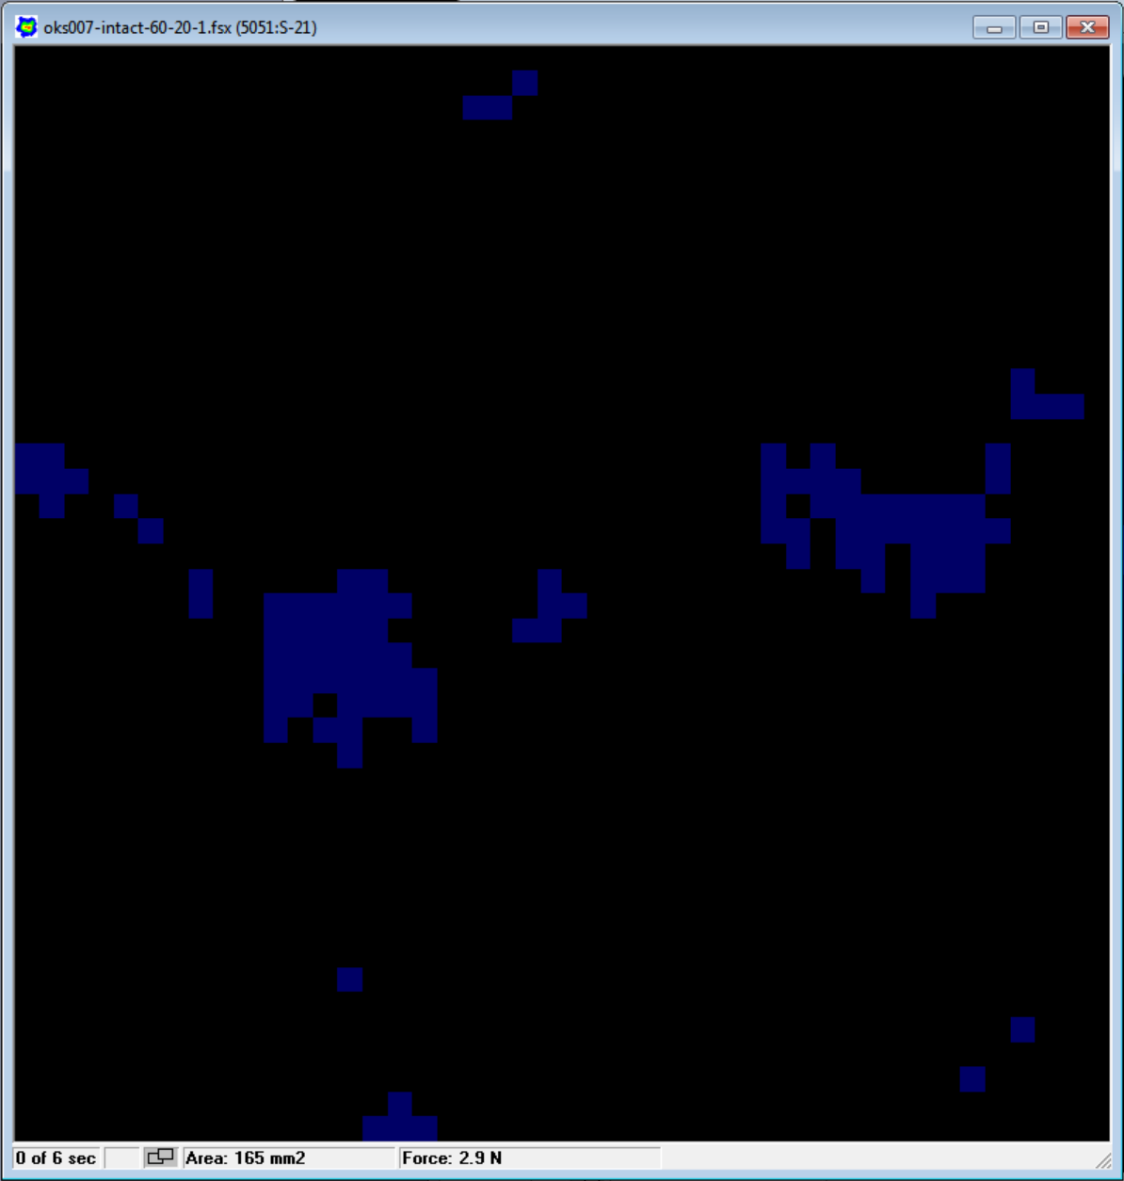
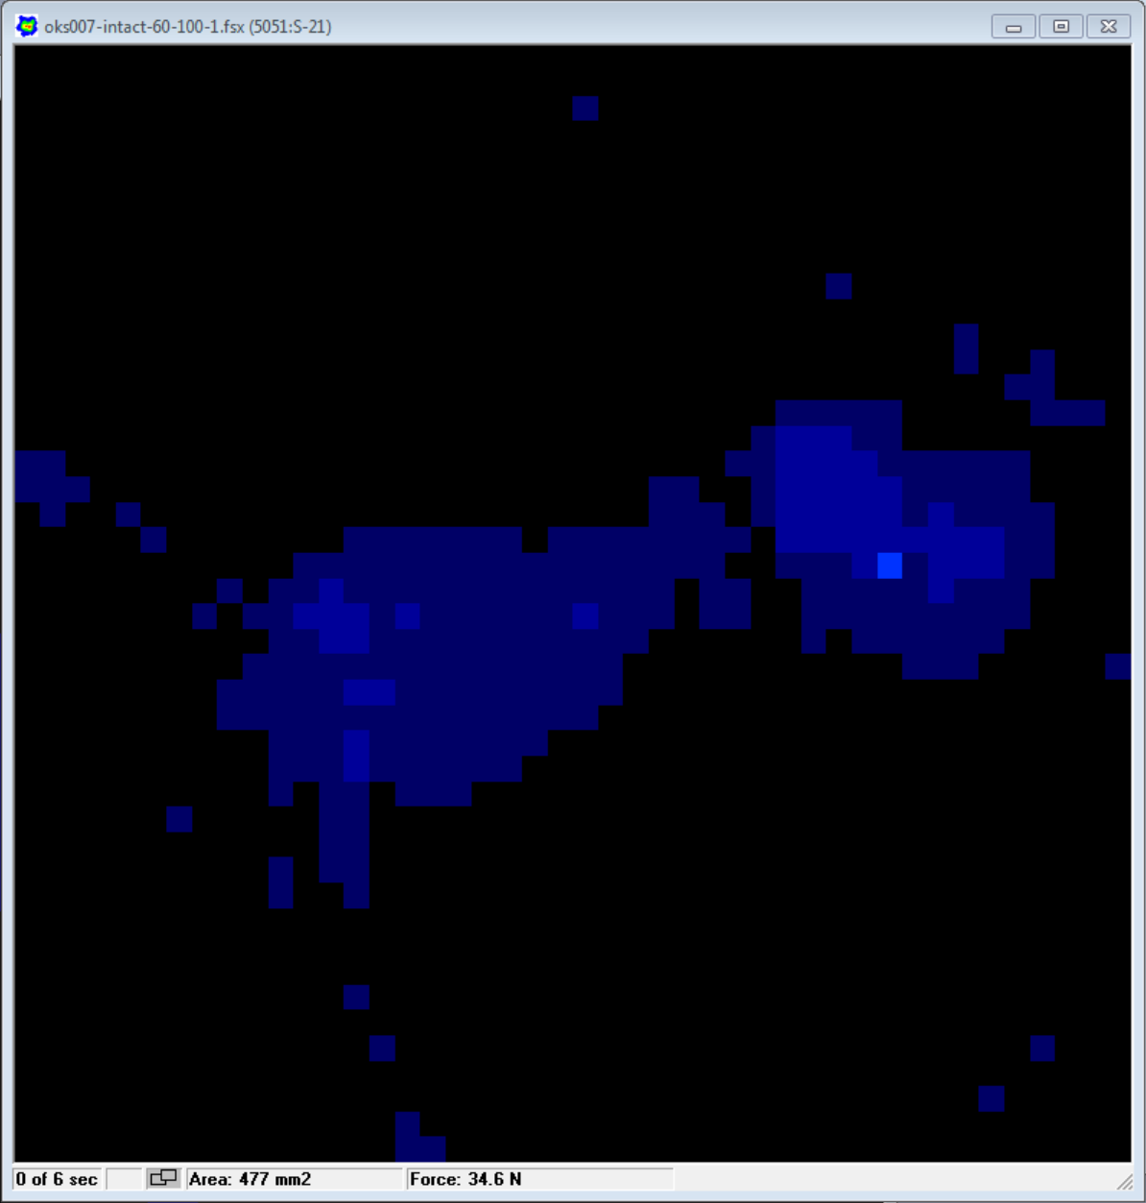
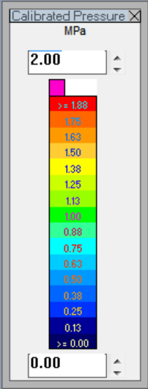
Contact Mechanics (oks007)

Slide 8
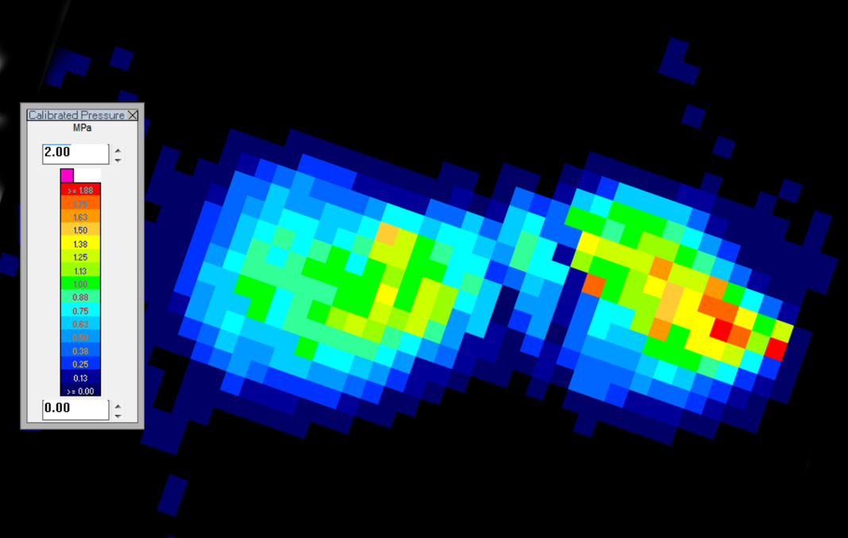
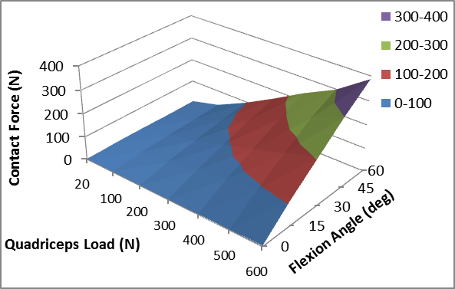
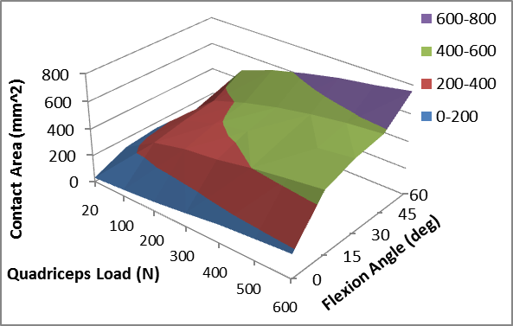
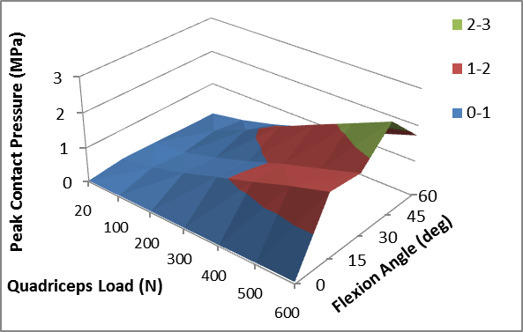
Results (oks007)

Slide 9
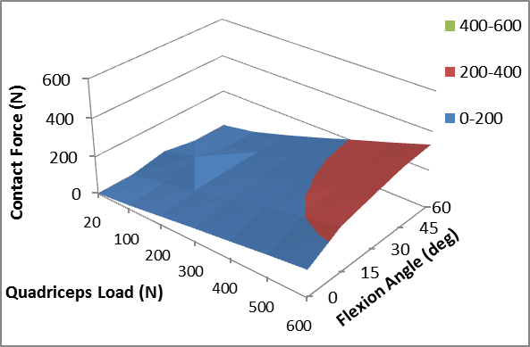
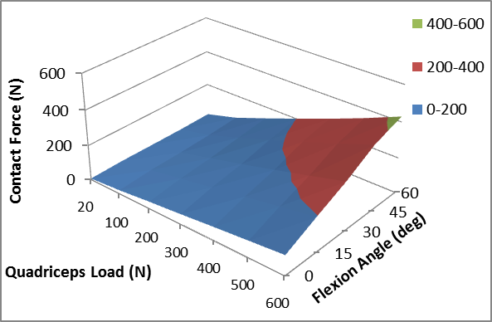
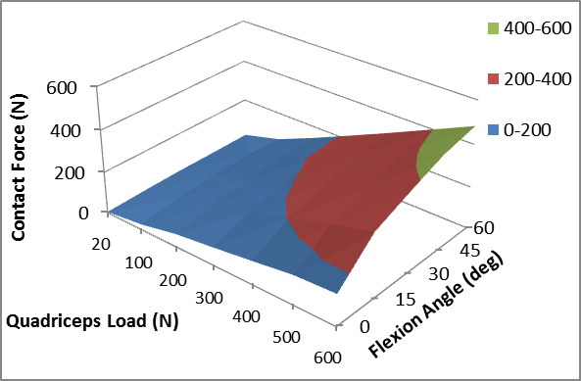
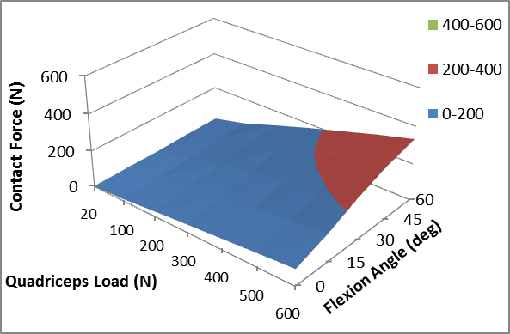
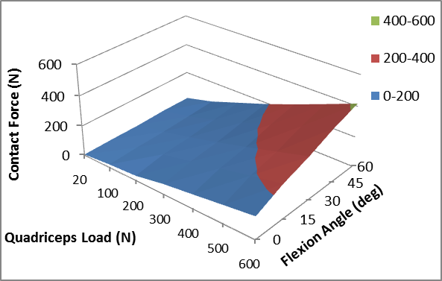
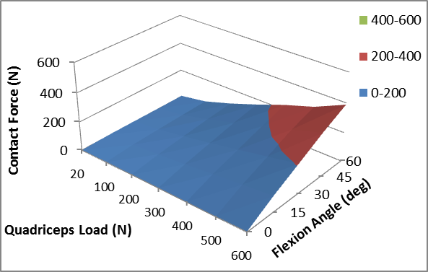
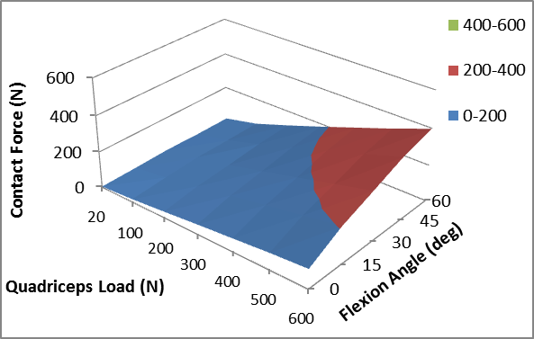
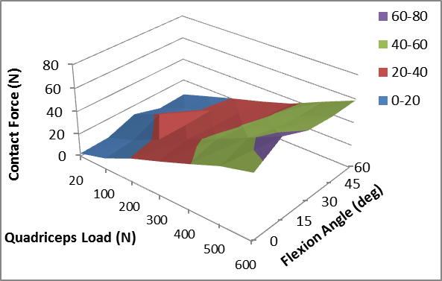
Contact Force Results
oks001
oks002
oks003
oks004
oks006
oks007
Mean
Standard Deviation

Slide 10
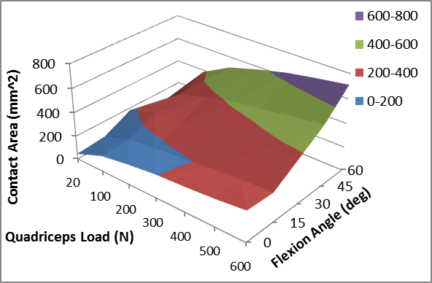
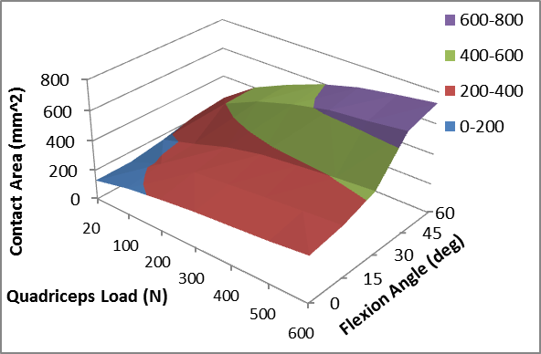
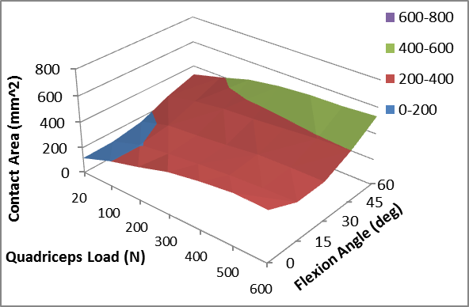
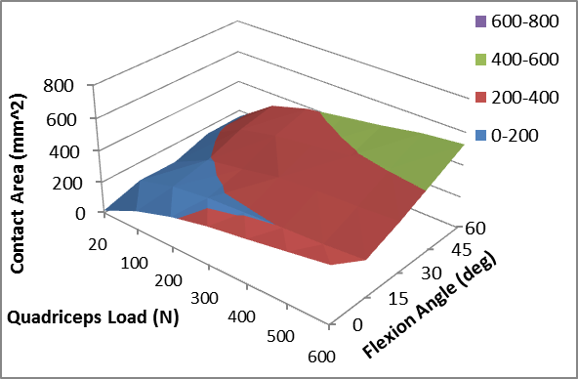
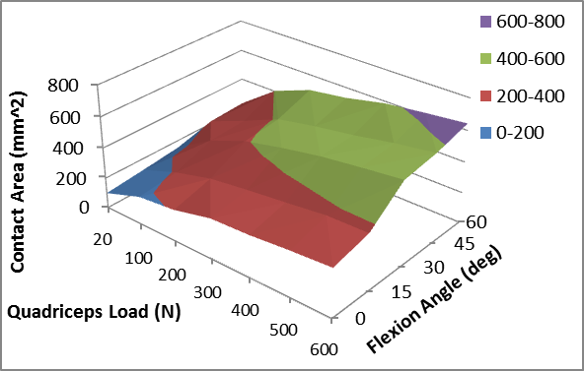

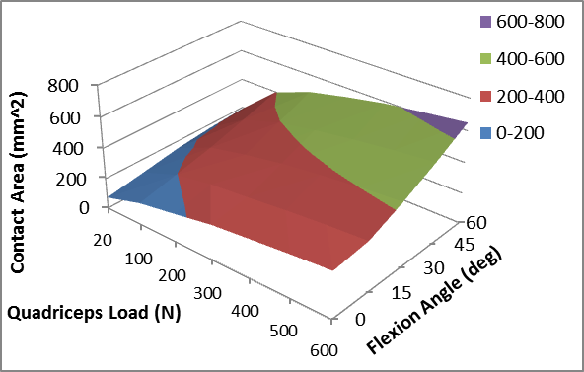
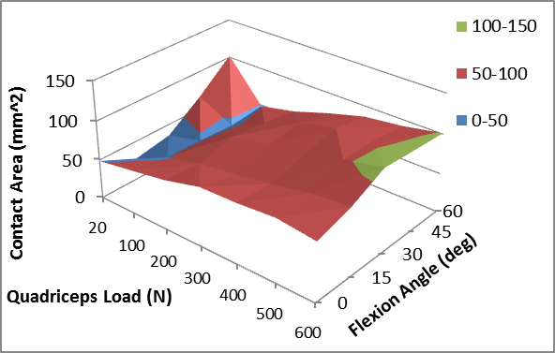
Contact Area Results
oks001
oks002
oks003
oks004
oks006
oks007
Mean
Standard Deviation

Slide 11
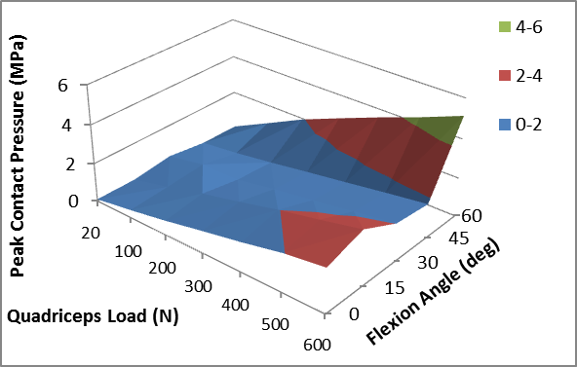
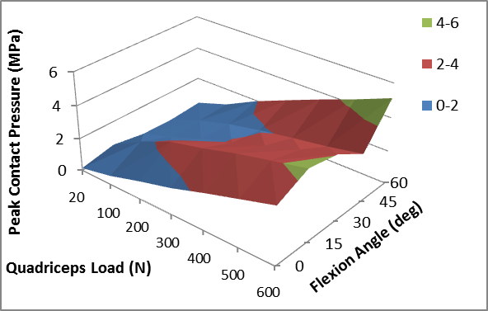
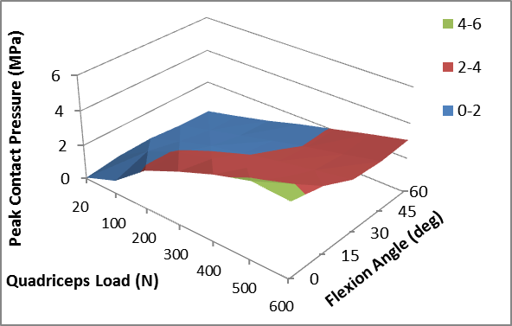
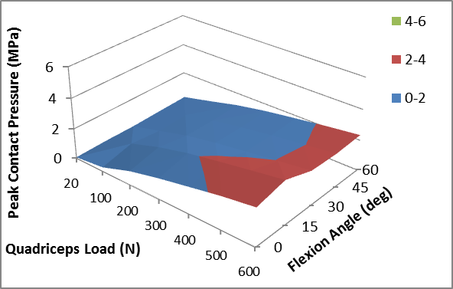
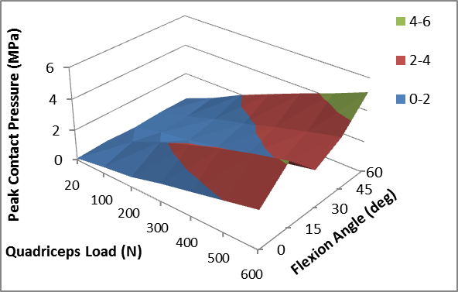
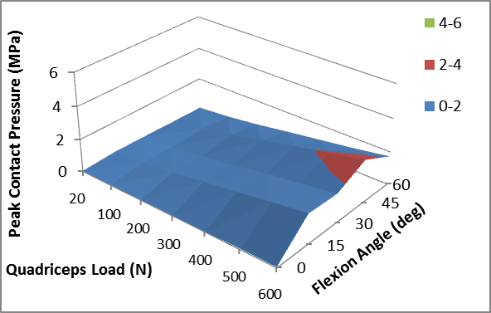
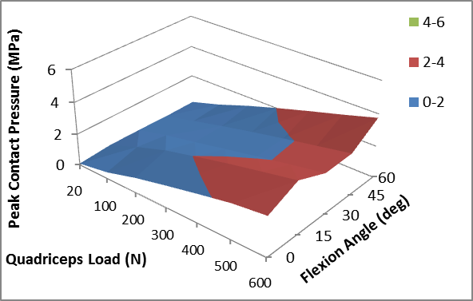
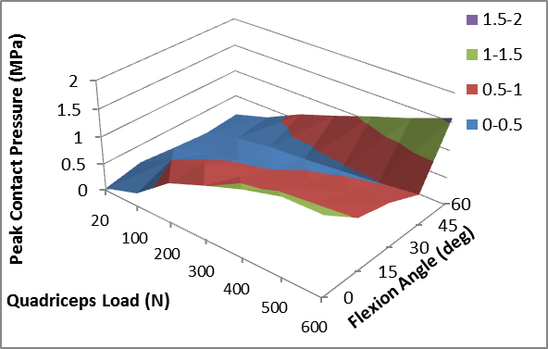
Peak Contact Pressure Results
oks001
oks002
oks003
oks004
oks006
oks007
Mean
Standard Deviation

Slide 12
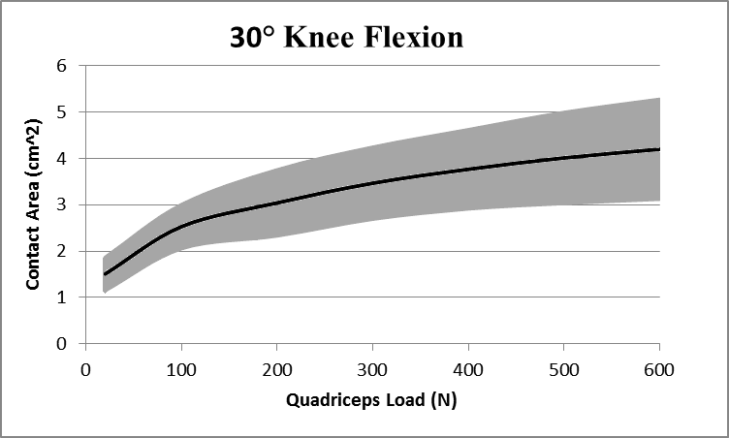
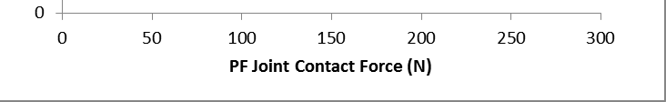
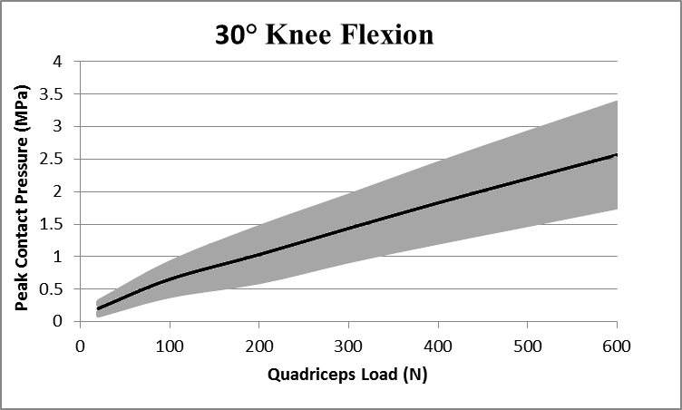
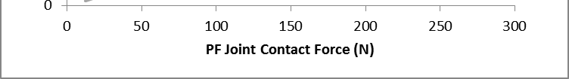
Similar to literature
Goudakos et al. Journal of Biomechanics, 2010-12-01, Volume 43, Issue 16, Pages 3237-3239

Slide 13
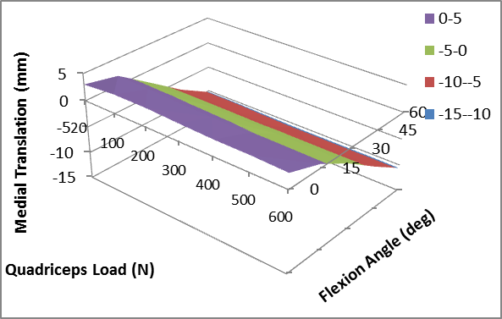
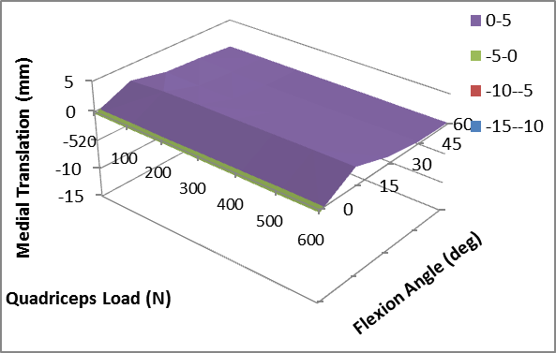






Preliminary Kinematic Results - Medial
oks001
oks002
oks003
oks004
oks006
oks007
Mean
Standard Deviation

Slide 14
Conclusions
0 flexion differences
  May be anatomical in nature, or experimental (line of action)
Models require confirmation (validation)
  Virtual knee models with accurate specimen-specific joint mechanics, require model predicted joint kinematics-kinetics and contact mechanics be similar to the experimental measurements for the corresponding specimen
Mean (literature) values have limitations
  Contact mechanics vary between specimens and using mean or literature based values for models may suffer from uncertainties associated with anatomical and mechanical variations
Notes:
. (anterior drawer vs. compression)

Slide 15

Next Steps
Analyze all kinematics
Test remaining specimens
  Dissemination of data
Model building and validation
  Dissemination of data
Get Involved…
  https://simtk.org/home/openknee
Notes:
. (anterior drawer vs. compression)

Slide 16
Acknowledgments
Study was funded by NIGMS, NIH (R01GM104139, PI: Erdemir).
Assistance from Katie Stemmer, Dylan Beckler, Amelia Chantler, Sam Doerle and Erin Merico is appreciated.
Open Knee(s) is an open development modeling project; specifications, models, and data can be accessed at:
https://simtk.org/home/openknee

Slide 17
Questions…
Robb Colbrunn
colbrur@ccf.org
216-385-5914

Slide 18
Methods
6 of 10 Specimens:
Specimen # | Gender | Age | Height | Weight | BMI
oks001 | Male | 71 | 1.83 m | 77.1 kg | 23.1 kg/m²
oks002 | Female | 67 | 1.55 m | 45.3 kg | 18.9 kg/m²
oks003 | Female | 25 | 1.73 m | 68.0 kg | 22.8 kg/m²
oks004 | Female | 46 | 1.58 m | 54.4 kg | 21.9 kg/m²
oks006 | Female | 71 | 1.52 m | 49.4 kg | 21.3 kg/m²
oks007 | Male | 71 | 1.7 m | 65.8 kg | 22.7 kg/m²

Slide 19
Methods
7 of 10 Specimens Tested:
Specimen # | Gender | Age | Height | Weight | BMI
oks001 | Male | 71 | 1.83 m | 77.1 kg | 23.1 kg/m²
oks002 | Female | 67 | 1.55 m | 45.3 kg | 18.9 kg/m²
oks003 | Female | 25 | 1.73 m | 68.0 kg | 22.8 kg/m²
oks004 | Female | 46 | 1.58 m | 54.4 kg | 21.9 kg/m²
oks006 | Female | 71 | 1.52 m | 49.4 kg | 21.3 kg/m²
oks007 | Male | 71 | 1.7 m | 65.8 kg | 22.7 kg/m²
oks008 | Male | 40 | 1.78 m | 63.5 kg | 20.1 kg/m²

Slide 20


Tendon Gripping

